Slide 1
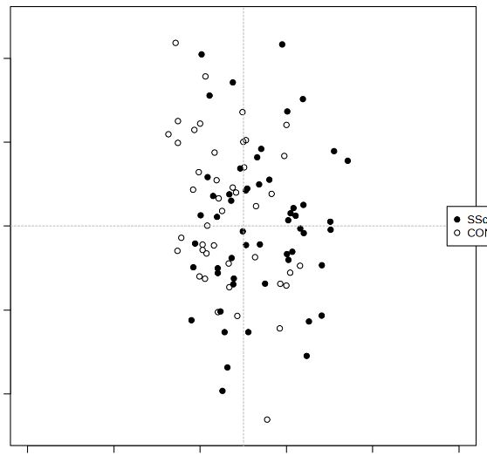
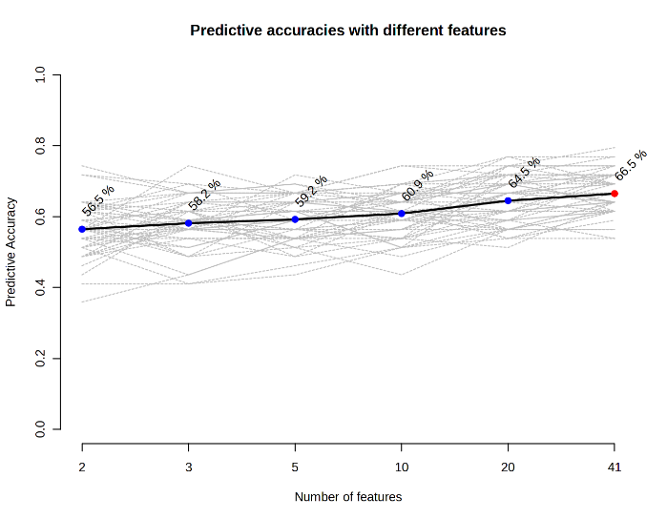
a
b
2
1.0
1
0.8
58.2%
59.2%
60.9%
64.5%
66.5%
0.6
56.5%
0
SSc
Predictive Accuracy
Samples
HC
0.4
-1
-2
0.2
0.0
0.2
0.4
0.6
0.8
1.0
0.0
2
3
5
10
20
41
Predicted Class Probabilities
Number of features

