Slide 1

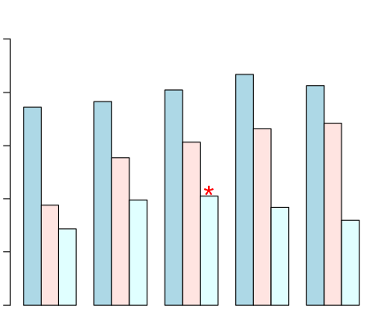
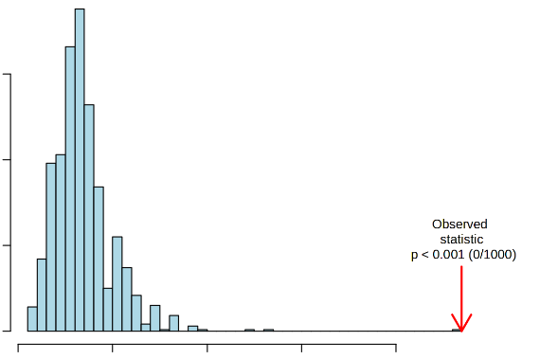
a
Accuracy
b
1.0
R2
Q2
0.8
150
0.6
100
Performance
Frequency
0.4
0.2
50
Observed statistic
p < 0.001 (0/1000)
0.0
1
2
3
4
5
0
0
1
2
Number of components
Permutation test statistics

