Slide 1
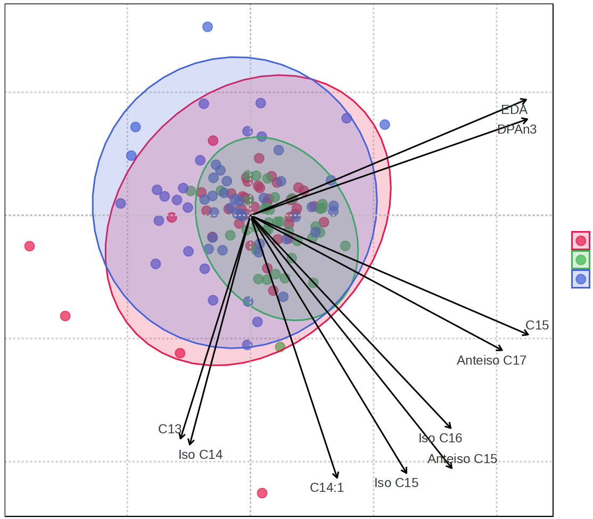


Biplot
0.2
EDA
DPAn3
0.0
PC 2 (11.8%)
Control
RA
SSc
-0.2
C15
Anteiso C17
C13
Iso C16
-0.4
Iso C14
Anteiso C15
C14:1
Iso C15
-0.2
0.0
0.2
0.4
PC 1 (23.1%)

