Slide 1
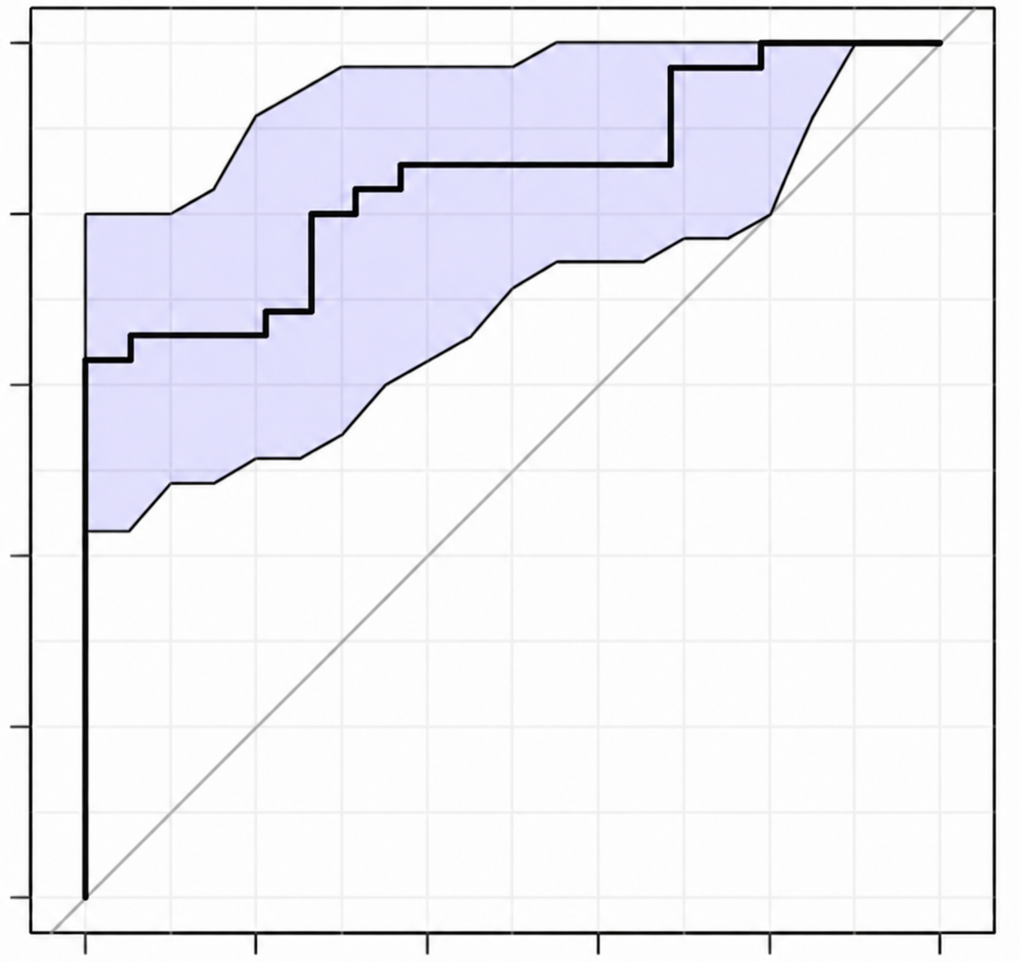
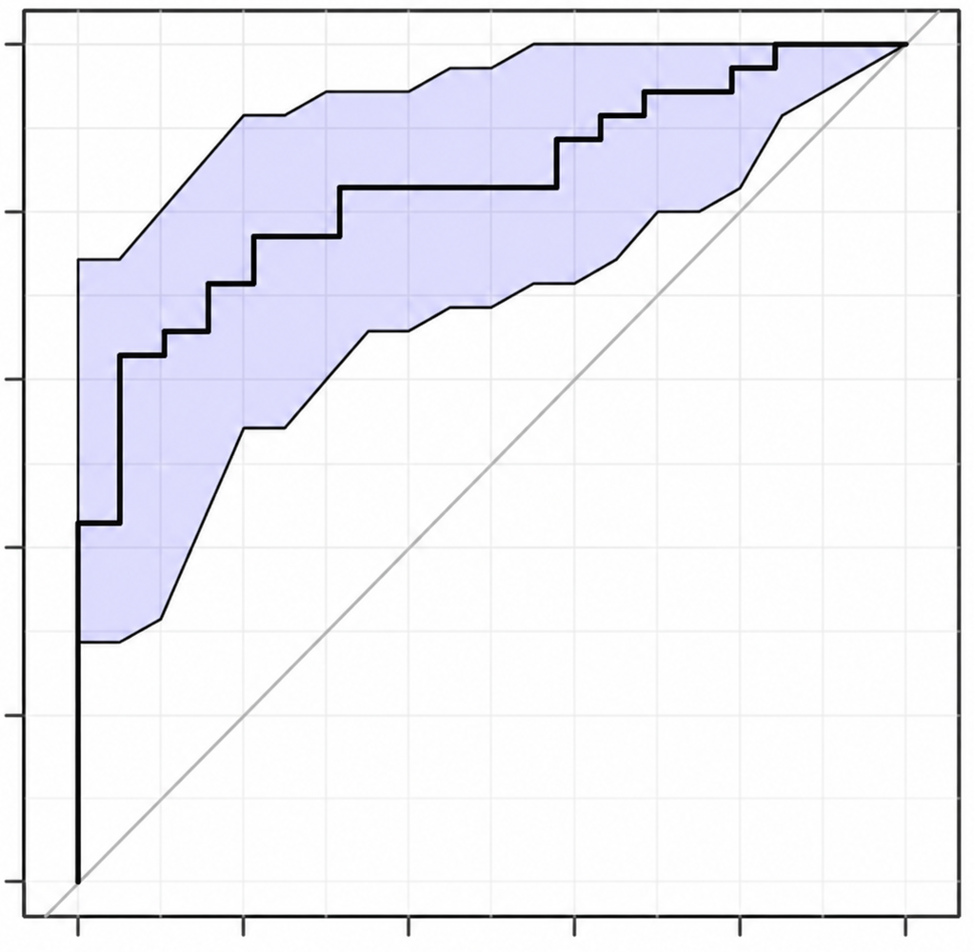
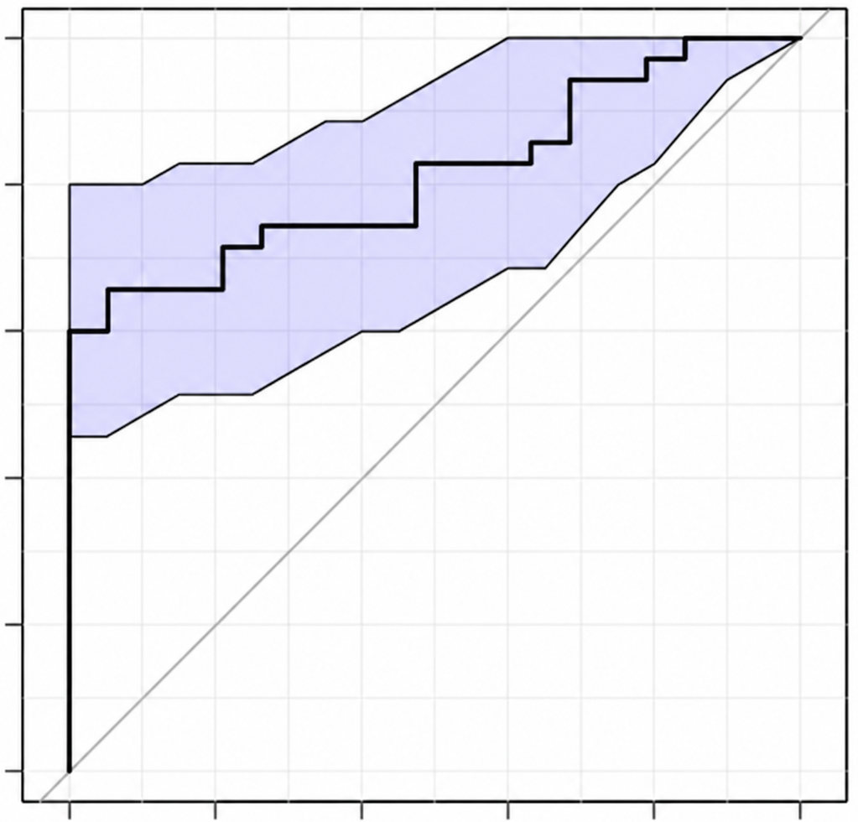
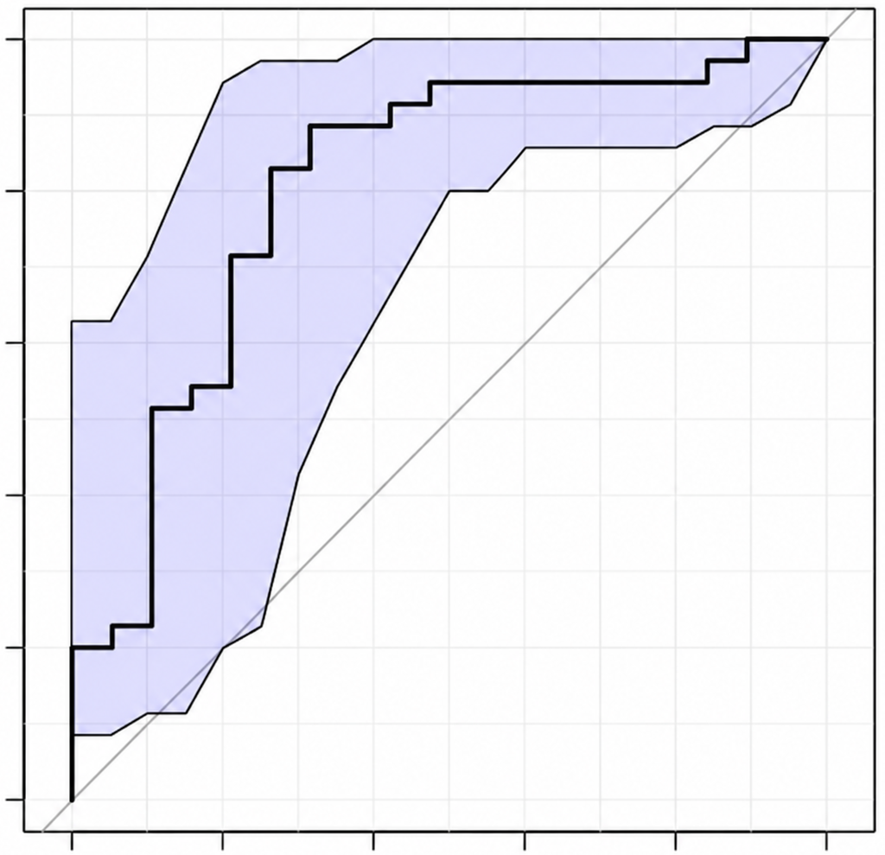
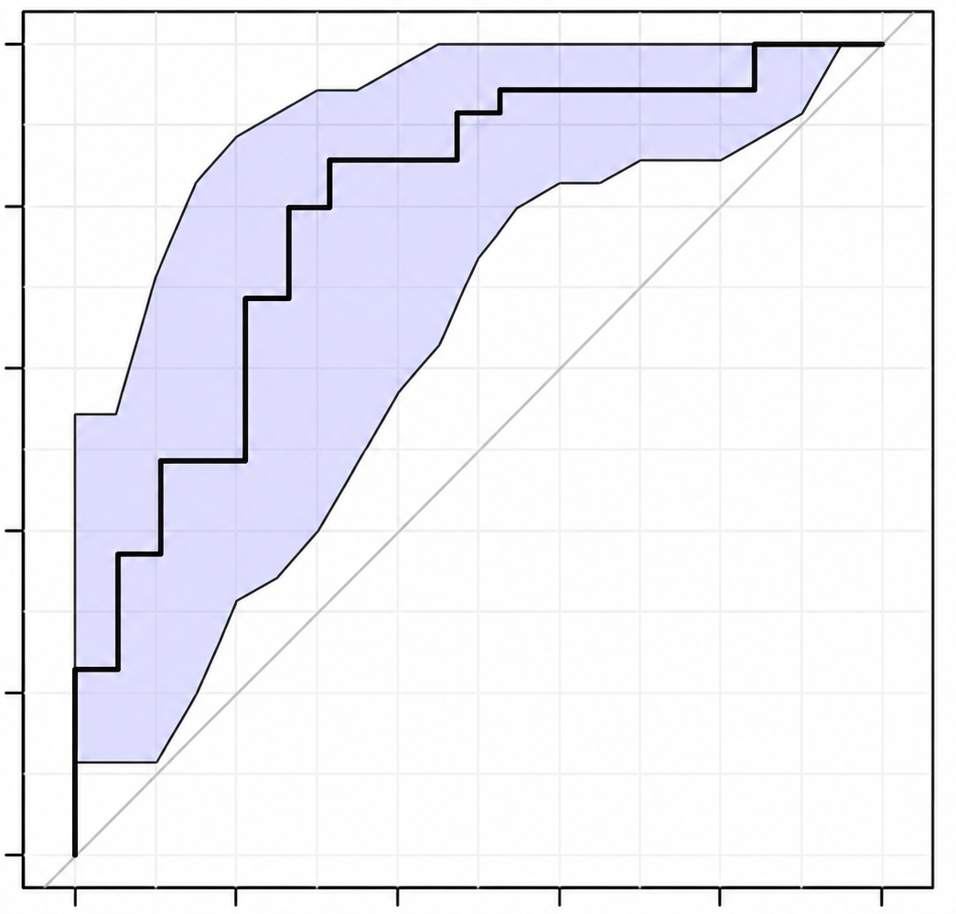
Iso C17
Iso BCFA
1.0
1.0
0.8
0.8
0.6
0.6
True positive rate
True positive rate
0.4
0.4
0.2
AUC: 0.848
(0.741-0.942)
0.2
AUC: 0.833
(0.729-0.929)
0.0
0.0
0.0
0.2
0.4
0.6
0.8
1.0
0.0
0.2
0.4
0.6
0.8
1.0
False positive rate
False positive rate
total BCFA
total PUFA
1.0
1.0
0.8
0.8
0.6
0.6
True positive rate
True positive rate
0.4
0.4
0.2
AUC: 0.816
(0.7-0.915)
0.2
AUC: 0.809
(0.653-0.923)
0.0
1.0
0.0
0.0
0.2
0.4
0.6
0.8
1.0
0.0
0.2
0.4
0.6
0.8
False positive rate
False positive rate
n6 PUFA
1.0
0.8
0.6
True positive rate
0.4
0.2
AUC: 0.801
(0.666-0.917)
0.0
0.0
0.2
0.4
0.6
0.8
1.0
False positive rate

