Slide 1
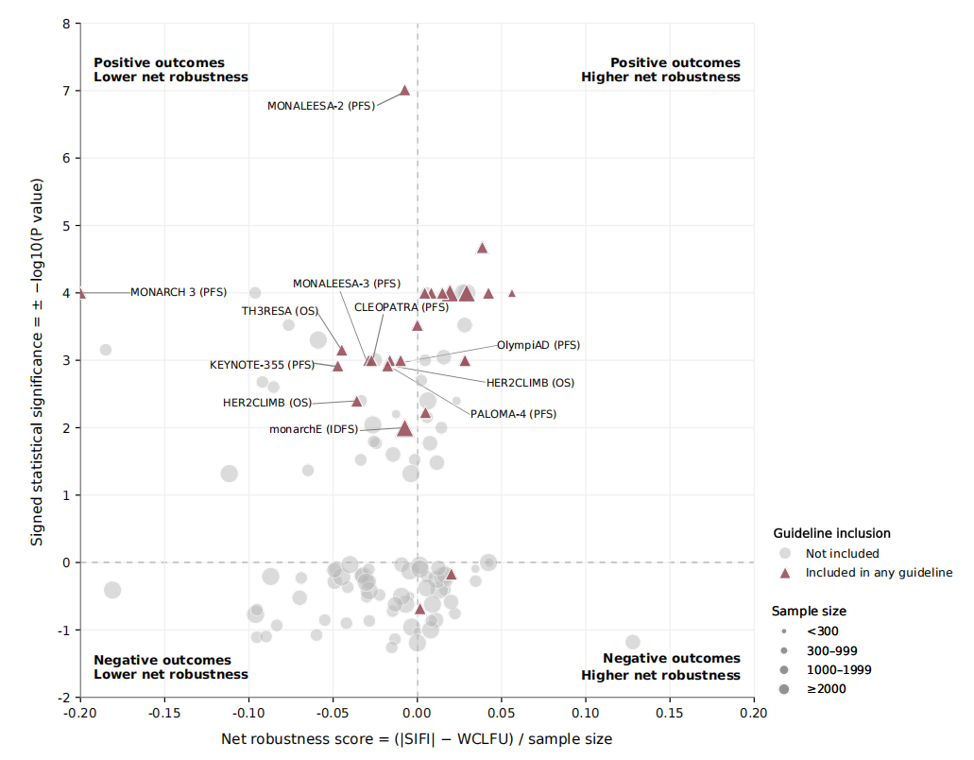
Supplementary Figure 1. Statistical robustness of outcomes by guideline inclusion status.
Note. Net robustness was calculated as (∣SIFI∣−WCLFU)/samplesize, with values below 0 indicating WCLFU ≥ |SIFI|. The y-axis shows signed statistical significance.

