Slide 1








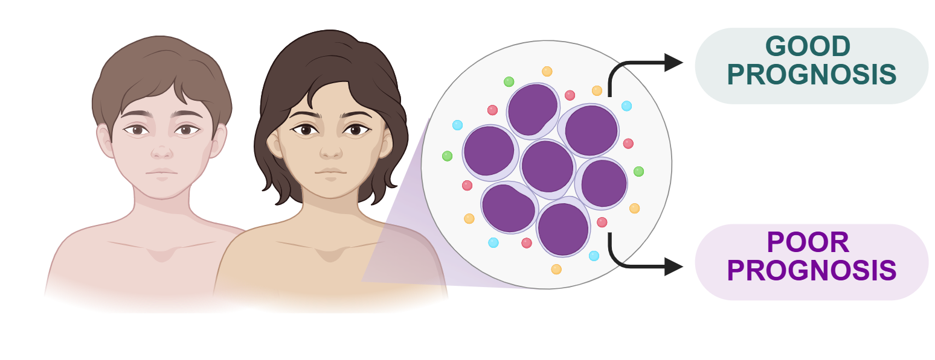

















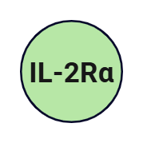







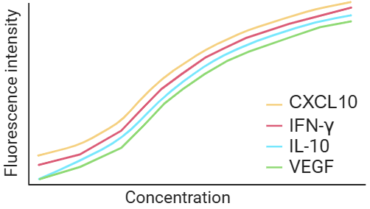


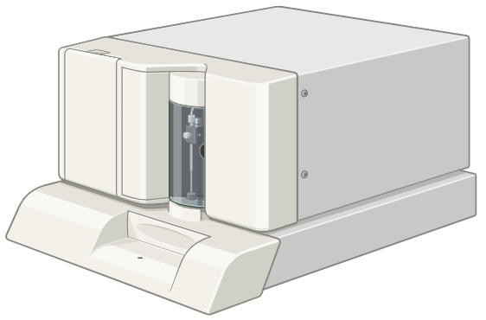














A | Background
C | Sample Collection Timeline
E | Mainly Finds
Production
B-ALL
DG
CG
Production
RG
Whole blood collected in EDTA tubes
at four consecutive time points
C
P
R
GF
C
P
R
GF
D0
D35
Peripheral blood decision tree panel:
Bone marrow decision tree panel:
Diagnosis baseline
End of induction therapy
How does the immune landscape evolve during remission chemotherapy, and can immune signatures improve risk stratification in pediatric B-ALL?
D15
D84
  Distinct baseline immune signatures were associated with clinical outcome
  Candidate panels predict mortality with high accuracy within this cohort
  Immune dysregulation persists after chemotherapy
Day 15 of induction therapy
Day 84 of consolidation therapy
B | Study Population
D | Measurement of Immune Mediators
F | Clinical Impact
Control Group - CG (n=25)
Peripheral Blood
B-ALL patients (n=36)
Peripheral Blood and Bone Marrow
B-ALL Remission Group - RG (n=25)
48-Plex cytokine assay (Bio-Rad)
Chemokines - C
Pro-inflammatory cytokines - P
Regulatory cytokines - R
Growth factors - GF
Candidate immune signatures support future precision risk stratification strategies
B-ALL Deceased Group - DG (n=11)

Slide 2
Get the BioRender Add-in for PowerPoint
Our integration allows you to unlock the power of BioRender, right inside PowerPoint:
  Export your BioRender presentation as an editable .PPTX file.
  Edit BioRender figures without leaving your PowerPoint slides.
  Sync updates from BioRender with just one click.
  Effortlessly manage sharing and permissions with your team.
  Access your entire BioRender library at your fingertips.
  Need a transparent background? Toggle it on or off, anytime.
BioRender for PowerPoint is hosted safely and securely in the Microsoft AppSource.
This presentation was created in BioRender
To access the original source of this presentation, visit:
https://app.biorender.com/illustrations/689cbf6d24516e6c305957fd
Sign up for your own BioRender account at www.biorender.com
Get the add-in now:
https://appsource.microsoft.com/en-us/product/office/wa200006038?src=product&mktcmpid=pptx_export

