Slide 1
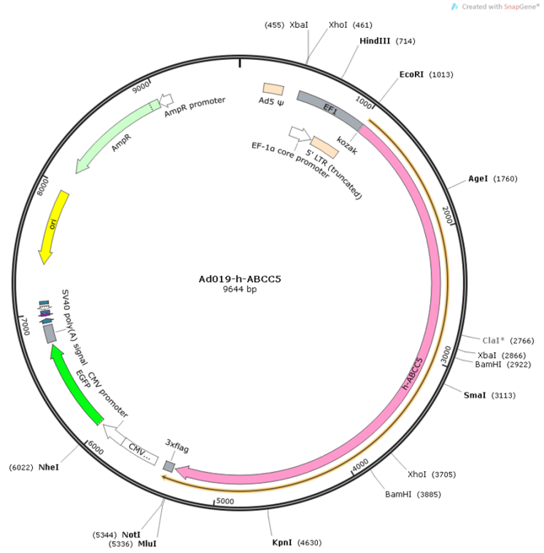
Supplement Fig.1 ABCC5 adenovirus map

Slide 2
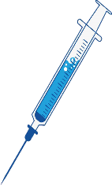
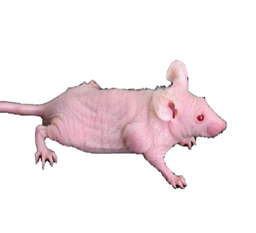
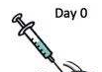


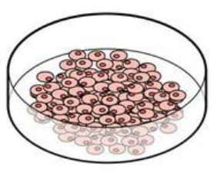



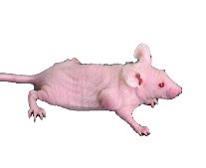
Supplement Fig.2 Animal studies design
Day 30
Tumor volume greater than 100mm³
Day 0
MCF-7
+ABCC5
Over expression
Digest
centrifuge
Resuspend
count
Injection of adenovirus containing ABCC5 gene, divided into two times, each injection of virus amount 5 × 10⁹PFU
MCF-7 cells
5-week-old female Balc/b nude mice were injected with about 1×10⁷ MCF-7 cells.
MCF-7
control
Day 35~46
The tumor volume is about 150mm³
Injection of control
adenovirus
MCF-7
+ABCC5
Over expression
×6
20mg/kg normal saline (NS)
×6
20mg/kg MTA
Cervical dislocation method to kill nude mice
Taking tumor, measuring, sending inspection
Tumor volume and weight
were measured
MCF-7
control
×6
20mg/kg normal saline (NS)
×6
20mg/kg MTA
Notes:
Animal studies design

Slide 3
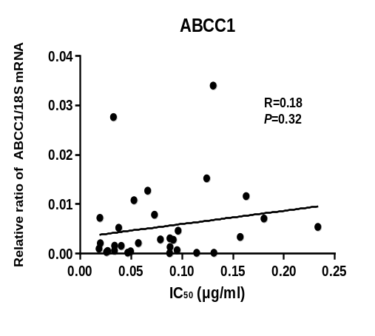
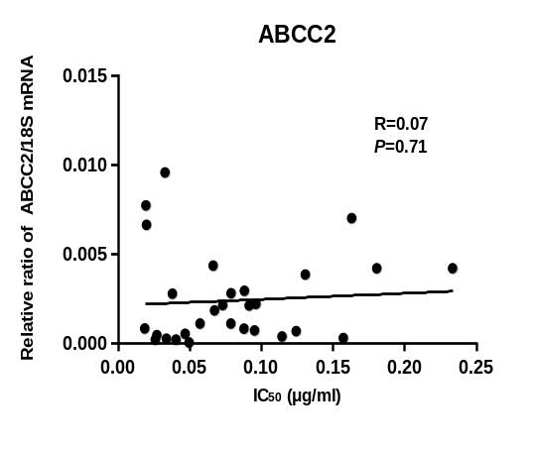
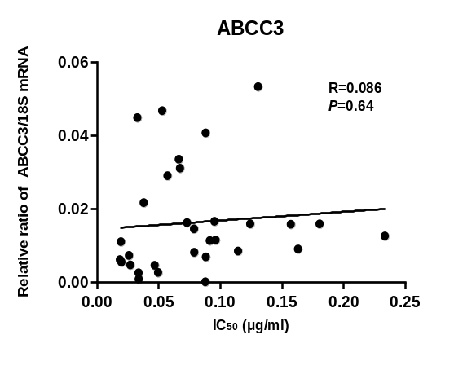
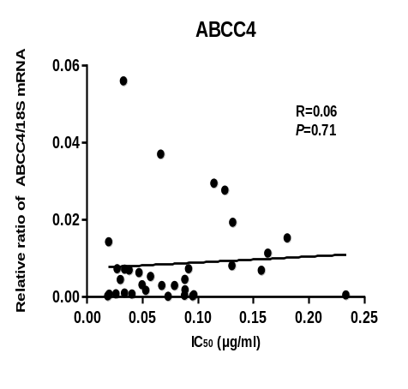
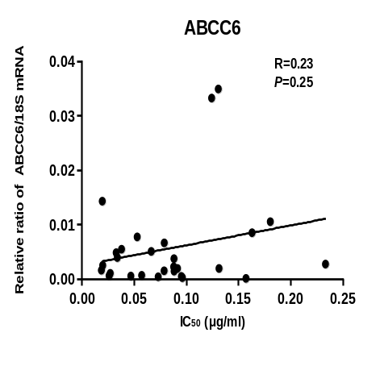
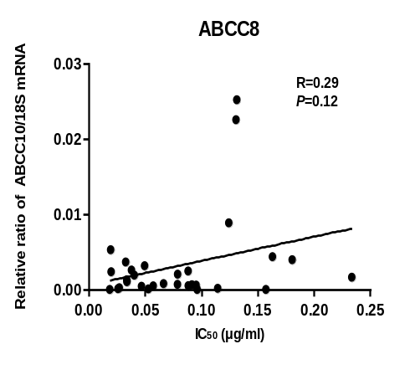
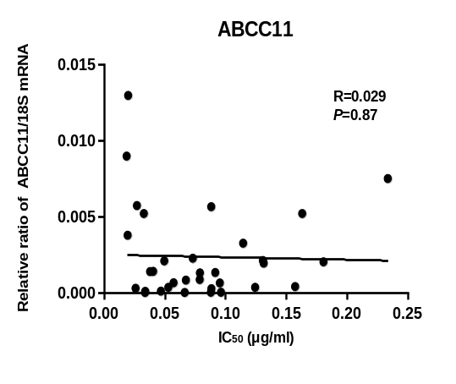
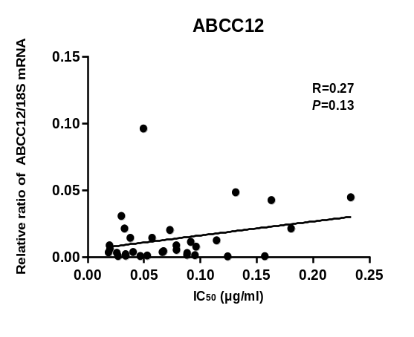
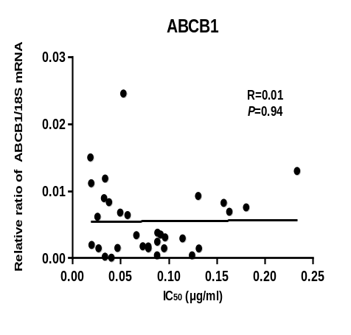
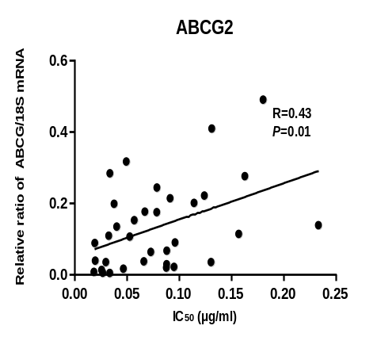
Supplement Fig.3 Correlation of IC₅₀ values of MTA and mRNA expression of
ABCC transporters in primary cell lines from patients

