Slide 1
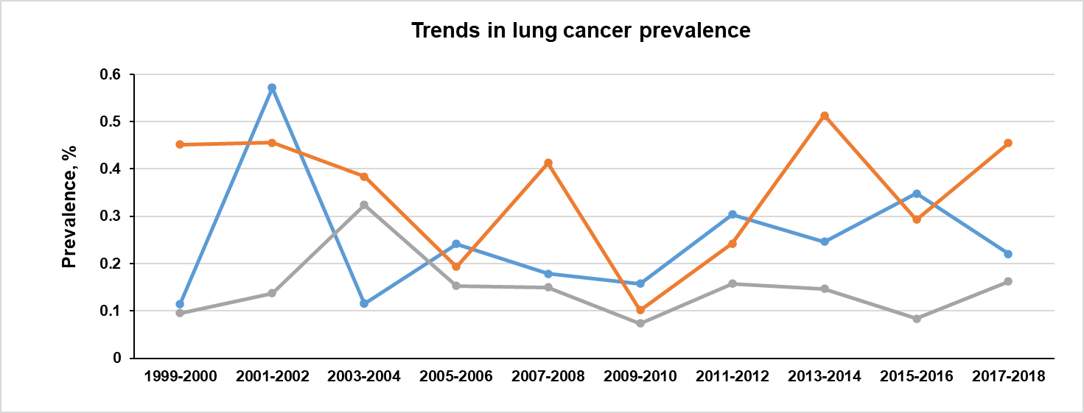
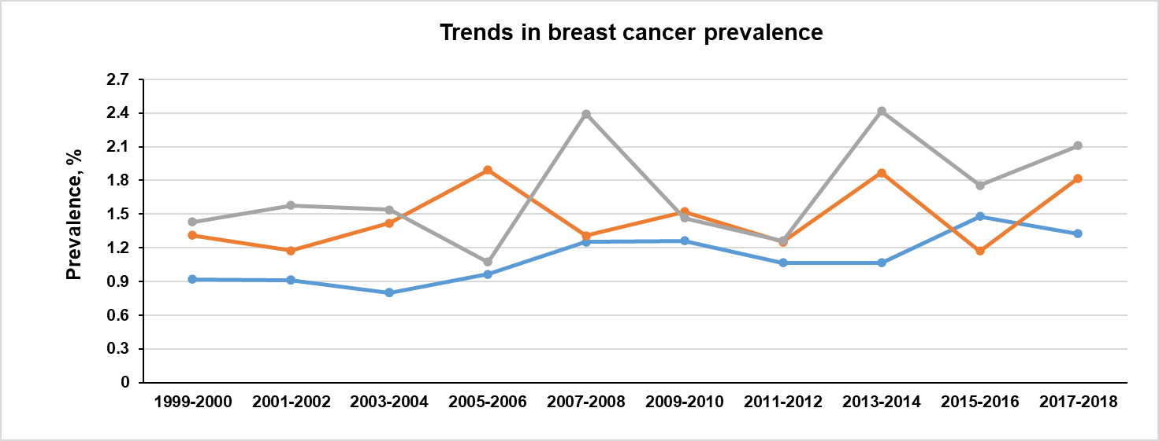
(A)
Low-income
Middle-income
High-income
Survey year
(B)
Survey year
Supplemental Figure 1. Trends in Prevalence of Cancer Disease Outcomes Among Participants 20 Years or Older Stratified by Income Group, 1999-2018.

Slide 2
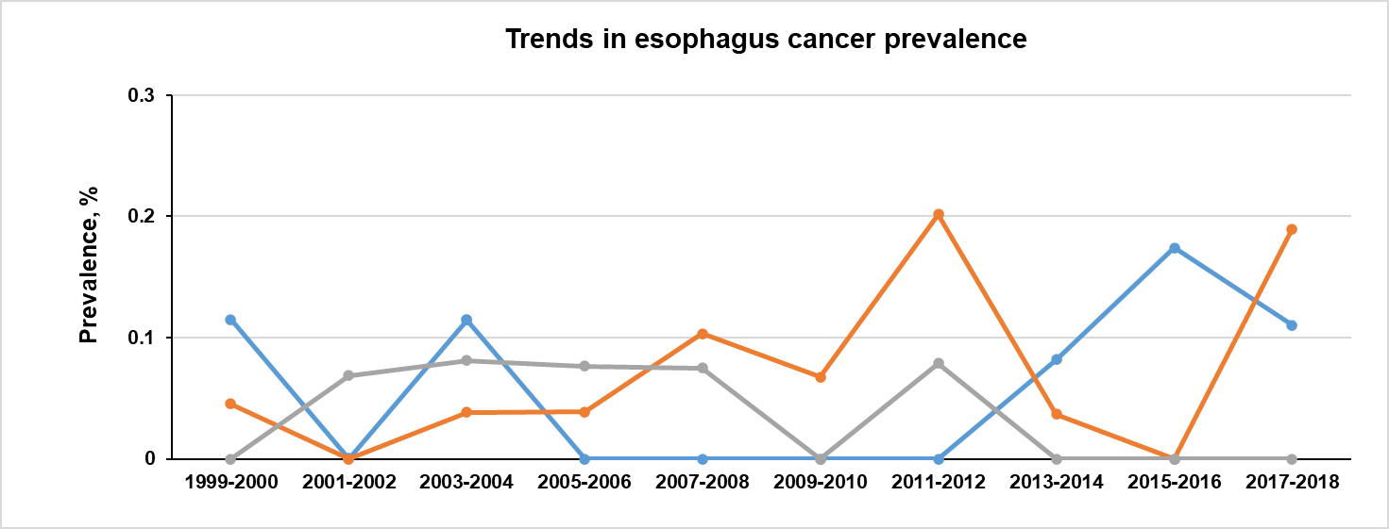
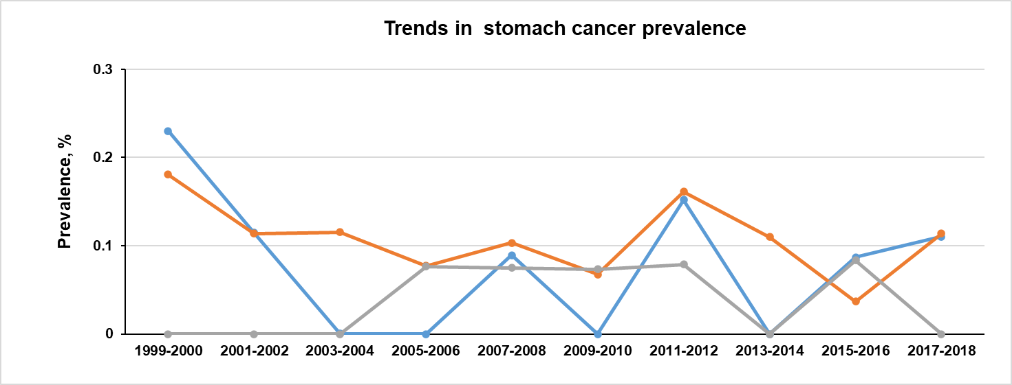
(C)
Survey year
(D)
Survey year

Slide 3
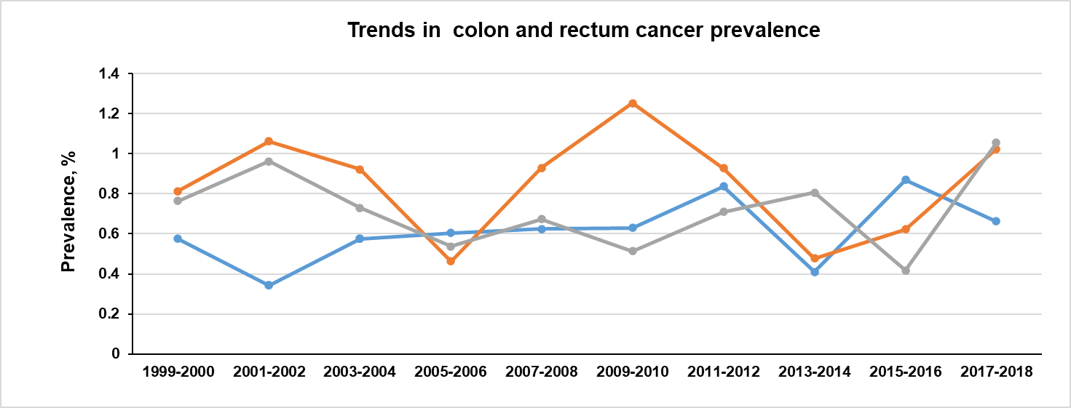
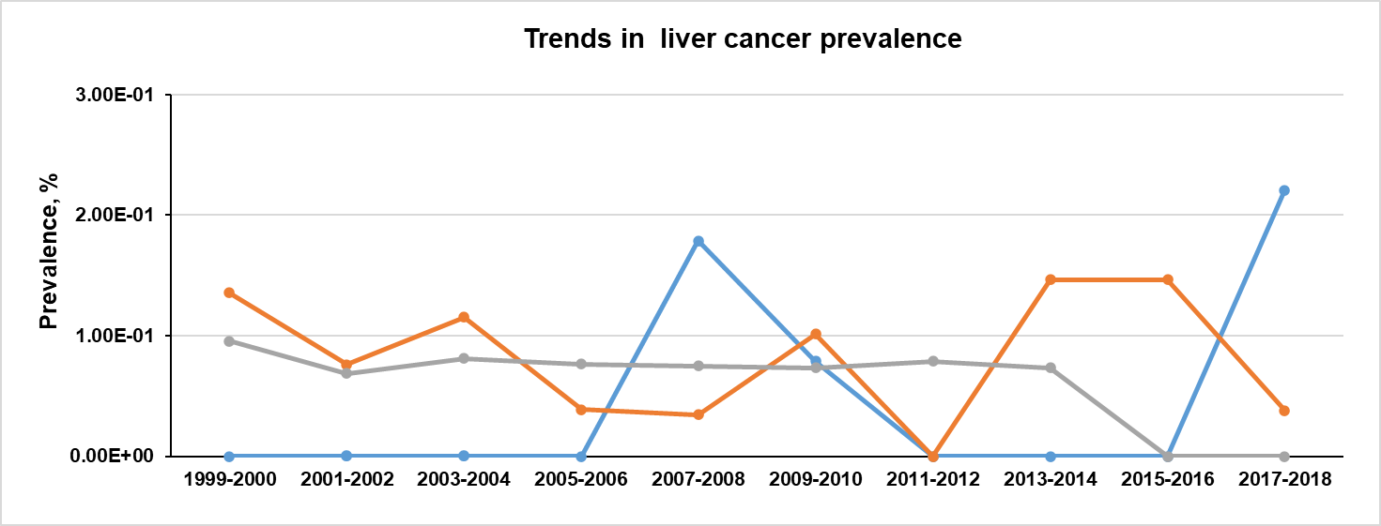
(E)
Survey year
(F)
Survey year

