Slide 1
Contents
Fig. S1. Uncropped blots corresponding to Fig. 1E
Fig. S2. Uncropped blots corresponding to Fig. 2S
Fig. S3. Uncropped blots corresponding to Fig. 3C
Fig. S4. Uncropped blots corresponding to Fig. 4B
Fig. S5. Uncropped blots corresponding to Fig. 4B
Fig. S6. Uncropped blots corresponding to Fig. 5A
Fig. S7. Uncropped blots corresponding to Fig. 5K
Fig. S8. Uncropped blots corresponding to Fig. 7B,E

Slide 2
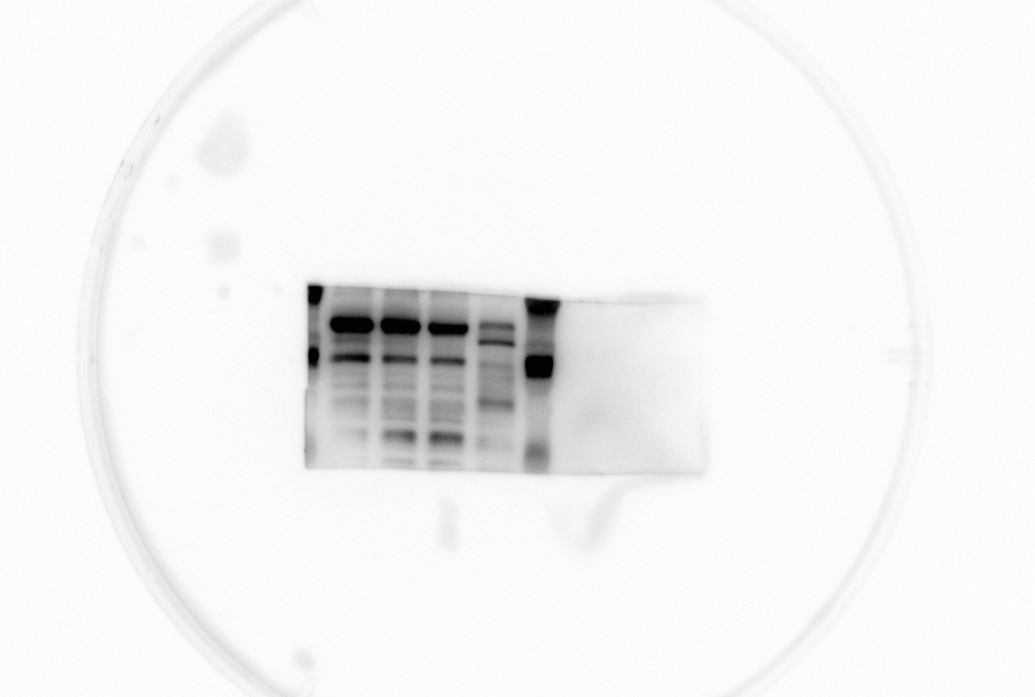
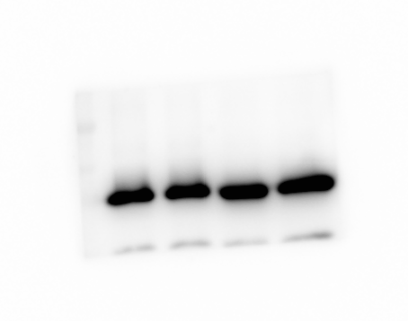
Figure S1
GFRAL
GAPDH
si-GFRAL 608
Control
si-GFRAL 124
si-NC
70kDa
50kDa
40kDa
35kDa
40kDa
35kDa

Slide 3
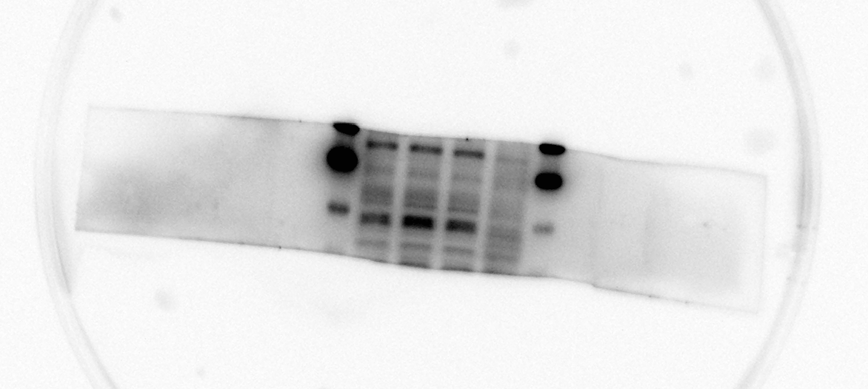
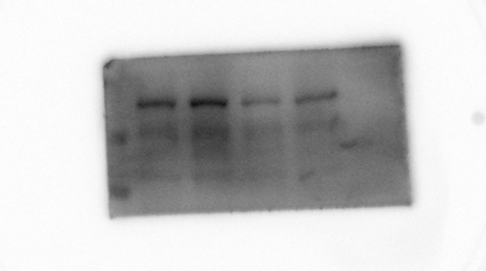
Figure S2
GFRAL
p-RET(Y905)
Control
GDF15
Control
GDF15
GDF15
Control
Control
GDF15
72kDa
150kDa
45kDa
100kDa
70kDa

Slide 4
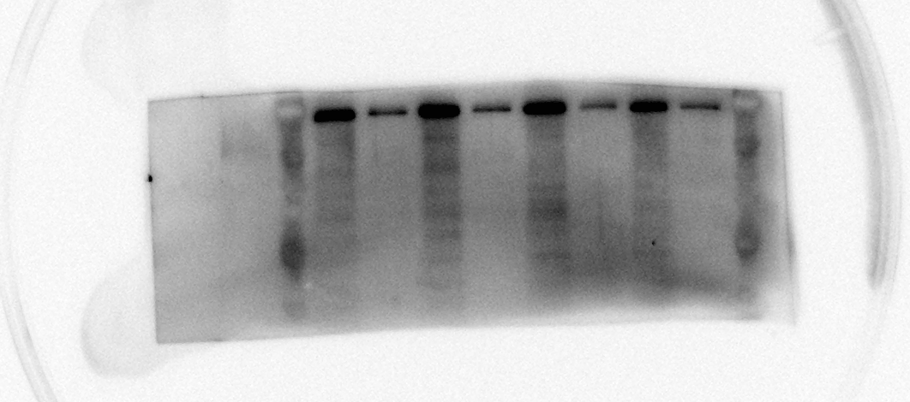

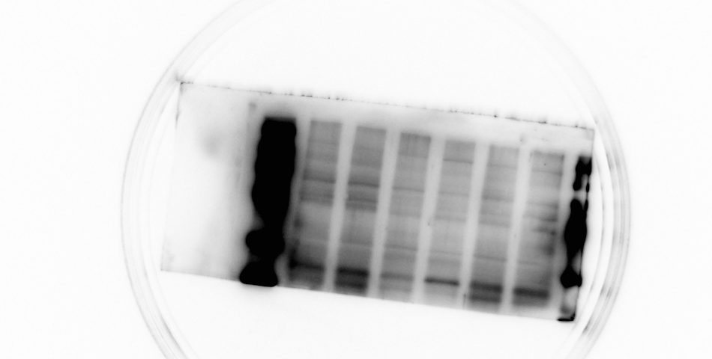
Figure S3
p-RET(Y905)
anti-GFRAL+GDF15
anti-GFRAL+GDF15
anti-GFRAL
p-AKT
anti-GFRAL
GDF15
Control
Control
GDF15
150kDa
anti-GFRAL+GDF15
100kDa
anti-GFRAL+GDF15
Control
anti-GFRAL
Control
70kDa
GDF15
72kDa
50kDa
40kDa
p-PI3K
anti-GFRAL+GDF15
Control
anti-GFRAL
anti-GFRAL+GDF15
Control
GDF15
72kDa
45kDa

Slide 5
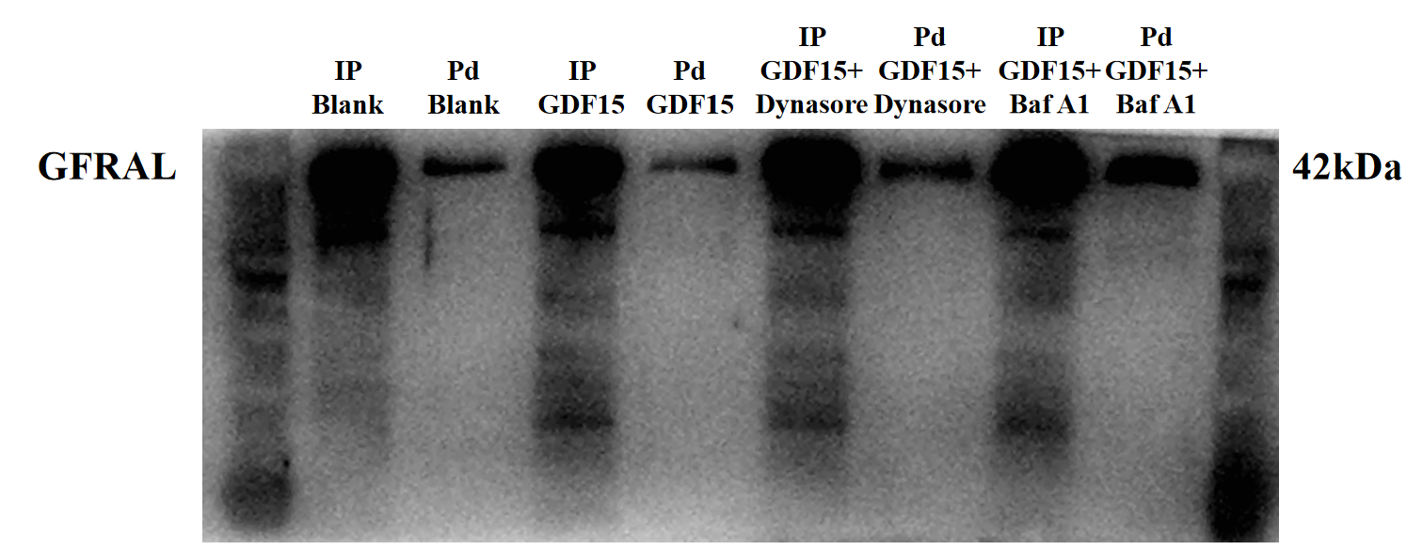
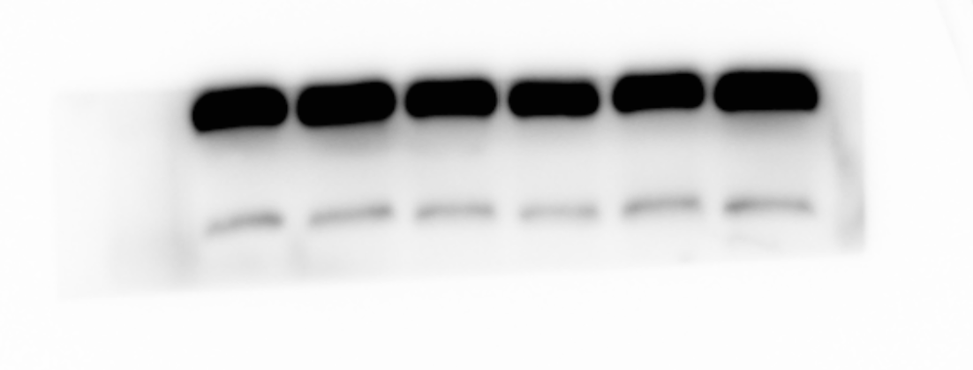
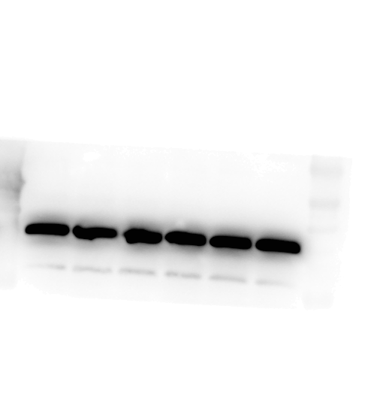
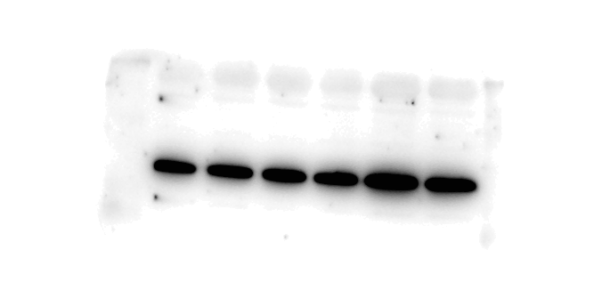
Figure S4
0 h
GDF15+Dynasore pd
GDF15+Dynasore Ip
GDF15 Ip
GDF15+Baf A1 Ip
GDF15 pd
GDF15+Baf A1 pd
pull down GFRAL
Input GFRAL
GDF15+Dynasore
GDF15
GDF15+Baf A1
GDF15
GDF15
0.5 h
GDF15+Dynasore
GDF15
GDF15
GDF15
GDF15+Baf A1
GDF15
GDF15

Slide 6
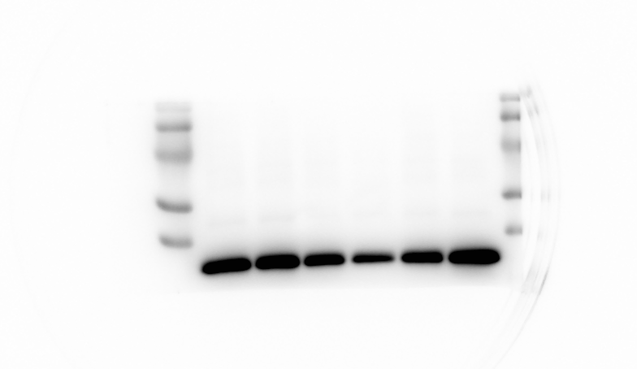
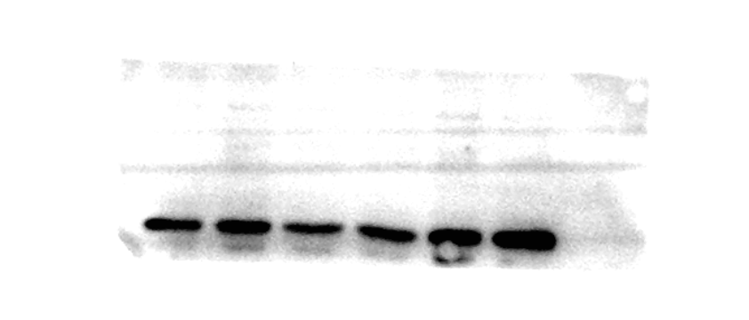

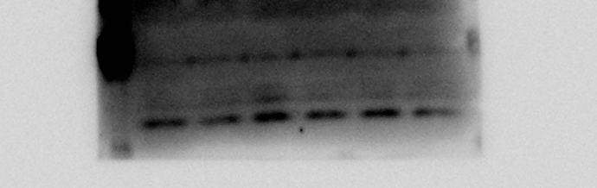
Figure S5
pull down GFRAL
Input GFRAL
2 h
GDF15+Baf A1
GDF15+Dynasore
GDF15+Dynasore
GDF15+Baf A1
GDF15
GDF15
GDF15+Baf A1
GDF15+Dynasore
GDF15
GDF15
GDF15
72kDa
GDF15
45kDa
25kDa
GDF15+Baf A1
GDF15+Baf A1
24 h
GDF15+Dynasore
GDF15+Baf A1
GDF15
GDF15+Baf A1
GDF15
GDF15+Dynasore
GDF15+Baf A1
GDF15
GDF15
GDF15+Baf A1
45kDa
45kDa
25kDa
25kDa

Slide 7
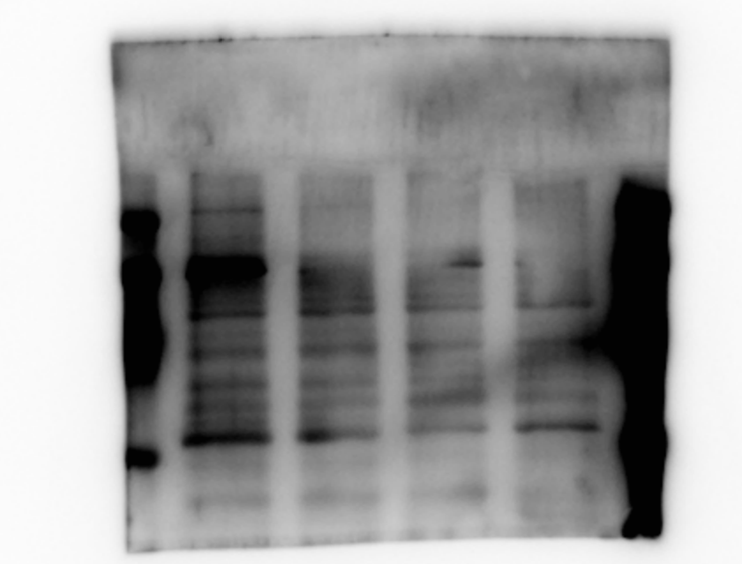
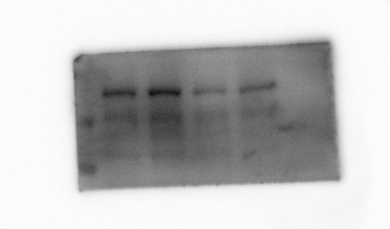
Figure S6
p-AKT
p-PI3K
Control
GDF15
GDF15
Control
72kDa
Control
GDF15
GDF15
Control
45kDa
72kDa
45kDa

Slide 8
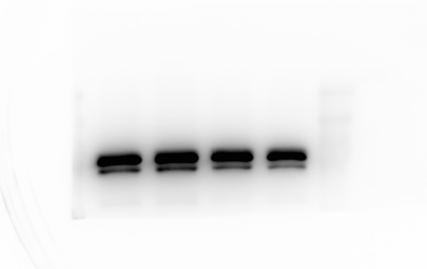
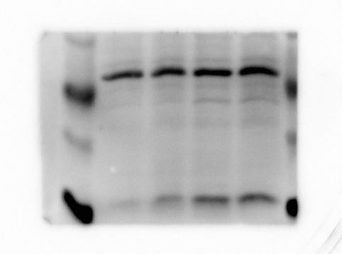
Figure S7
GRP78
CHOP
35kDa
GDF15+LY294002
Control
GDF15+740Y-P
GDF15
Control
GDF15+LY294002
GDF15
GDF15+740Y-P
25kDa
20kDa
15kDa

Slide 9
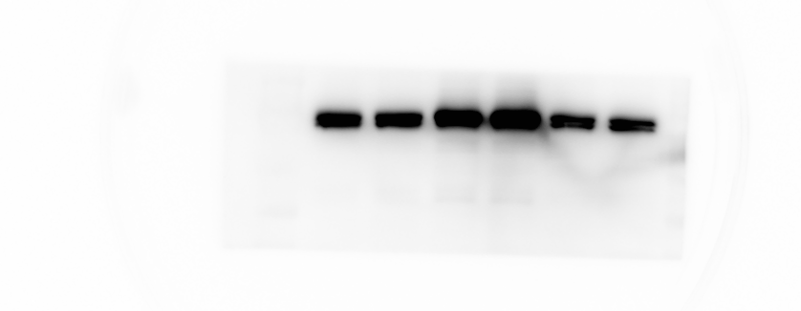
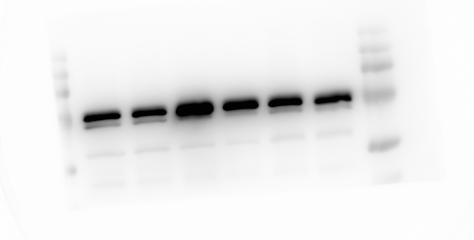
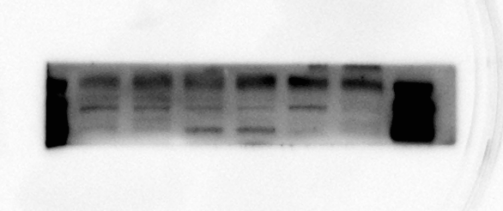
Figure S8
GRP78
CHOP
Thapsigargin+GDF15
Control
Thapsigargin
4-PBA+GDF15
Control
Thapsigargin+GDF15
GDF15
GDF15
4-PBA
Thapsigargin
4-PBA+GDF15
4-PBA
40kDa
30kDa
25kDa
Cleaved Caspase-3
20kDa

