Slide 1
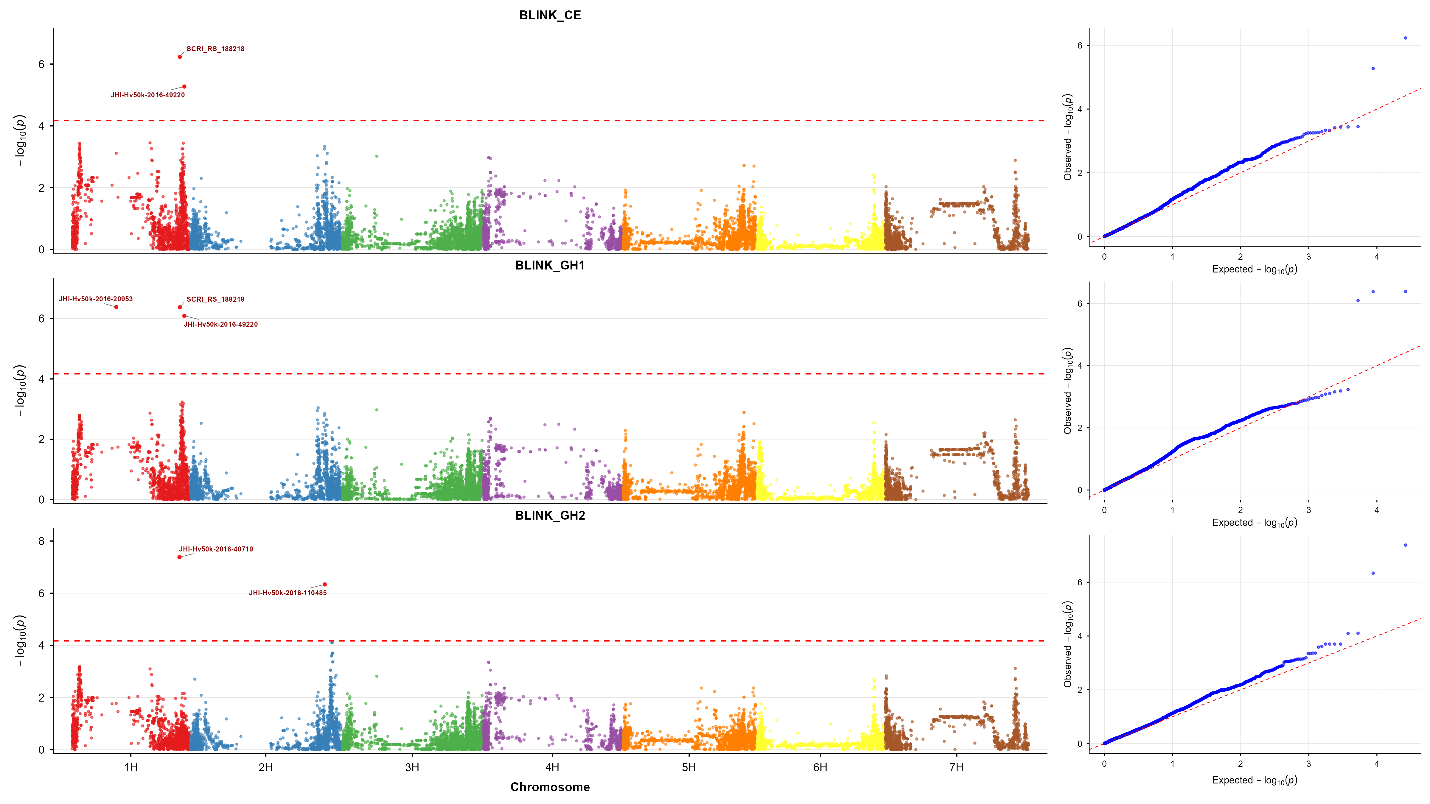
Manhattan and QQ plots of BLINK model across three environments

Slide 2
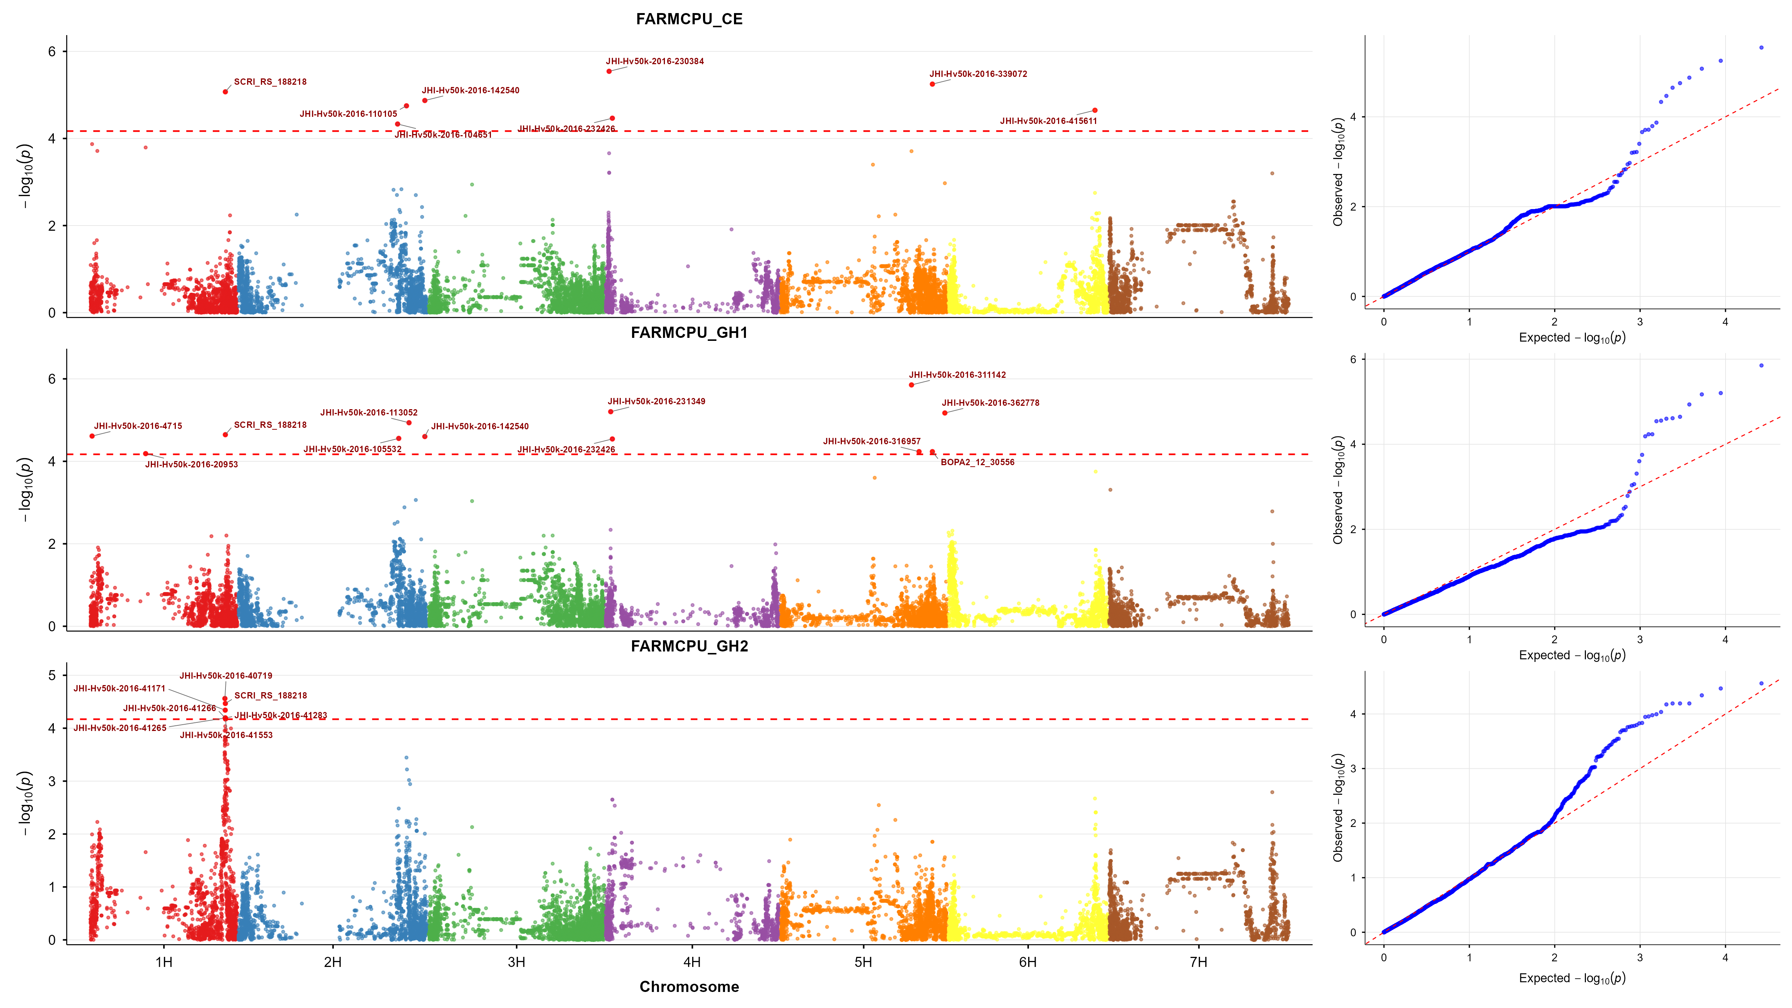
Manhattan and QQ plots of FarmCPU model across three environments

Slide 3
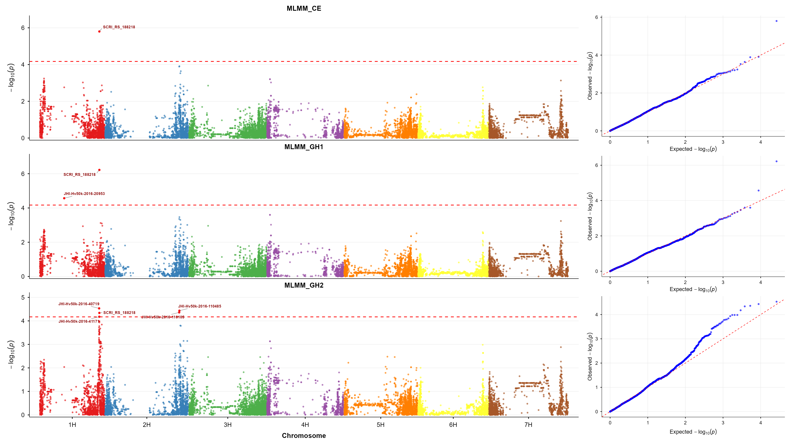
Manhattan and QQ plots of MLMM model across three environments

Slide 4
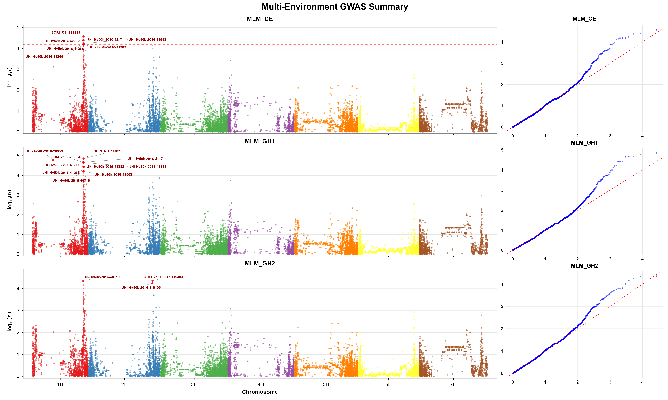
Manhattan and QQ plots of MLM model across three environments

