Slide 1
α-Synuclein Activates Ras–PI3K/AKT/mTOR Signaling to Drive Pathology in
Parkinson’s Disease
Original western blot images
Suaad Abd Elhadi, Jenna Congdon-Loeffler, Eva Harrosch, Dima Khatib, Lama Naamneh, Meir Schechter, ,Alexandra Eliassaf , Ori Shalev, Ronit Sharon

Slide 2
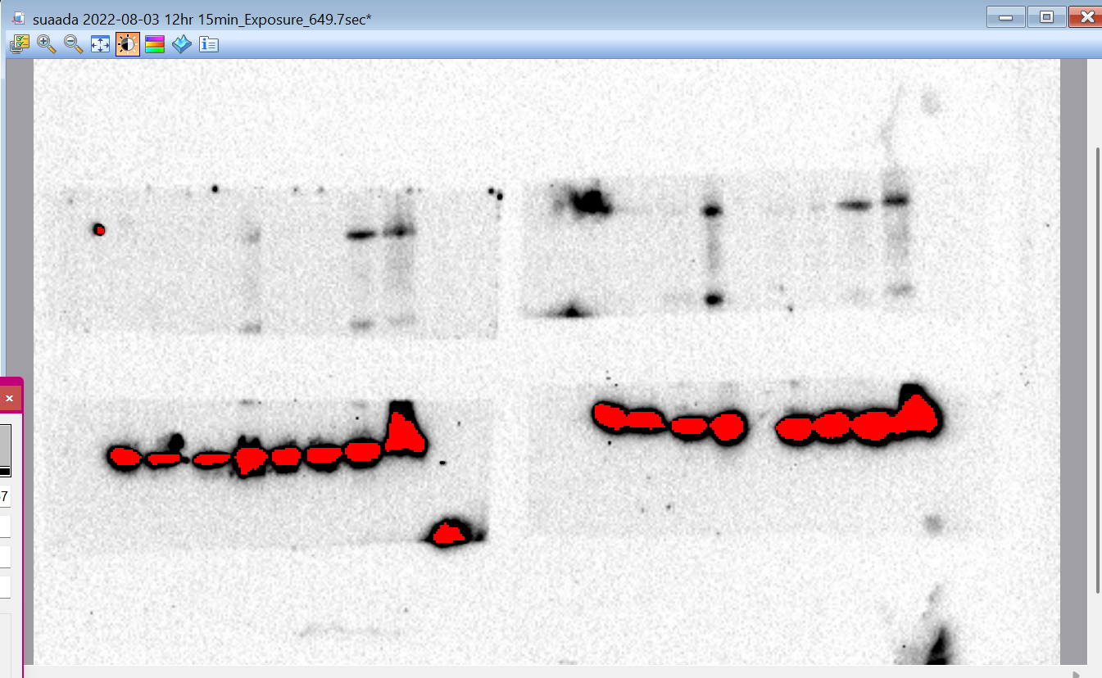
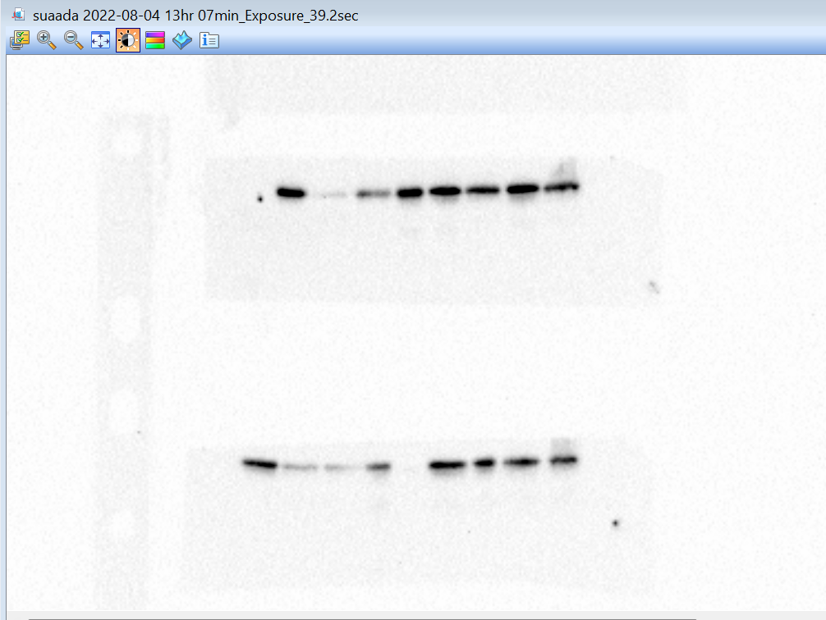
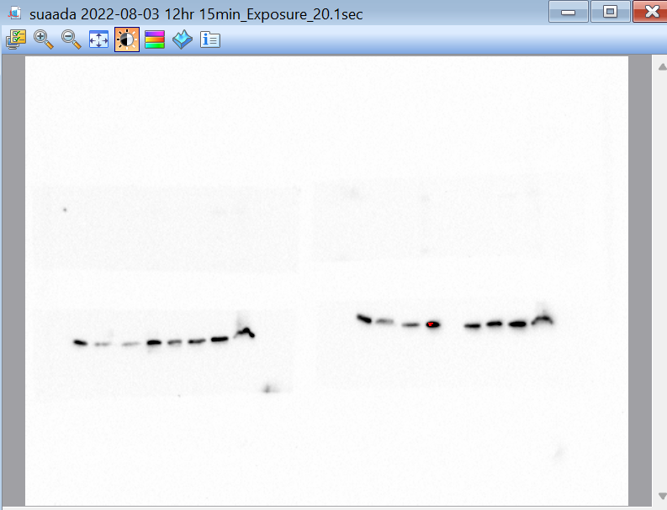
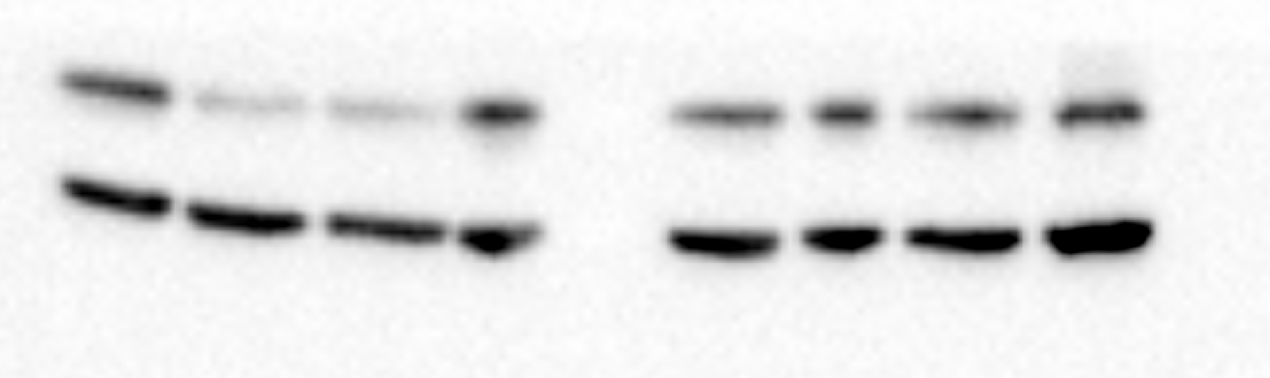
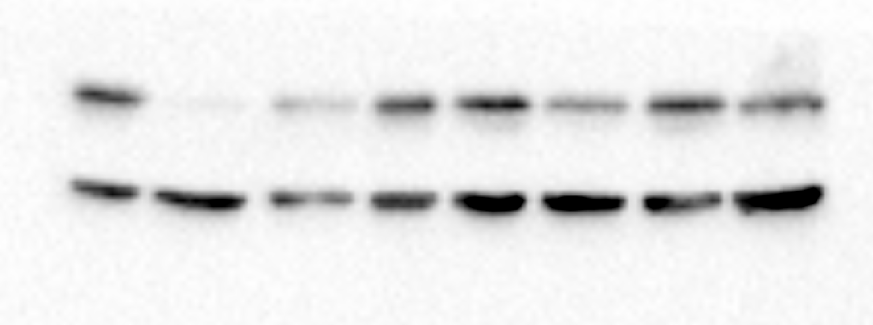
1A
thr308
ser473
pAKT
Akt total
asyn
AKT total
actin

Slide 3
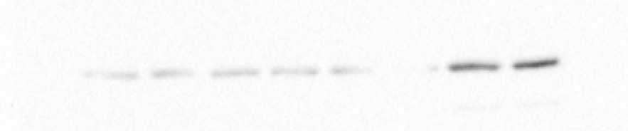
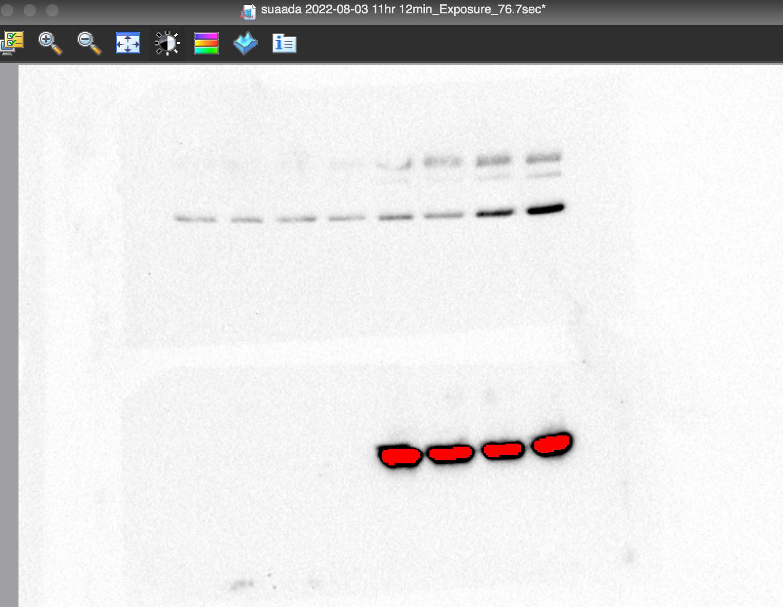
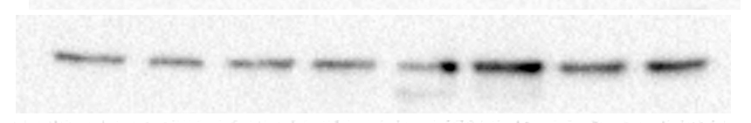
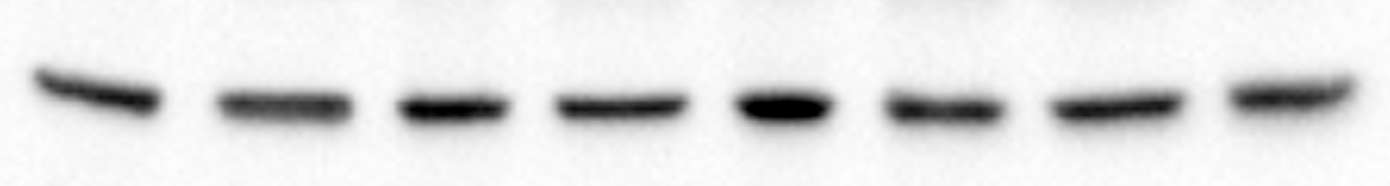

1C

Slide 4
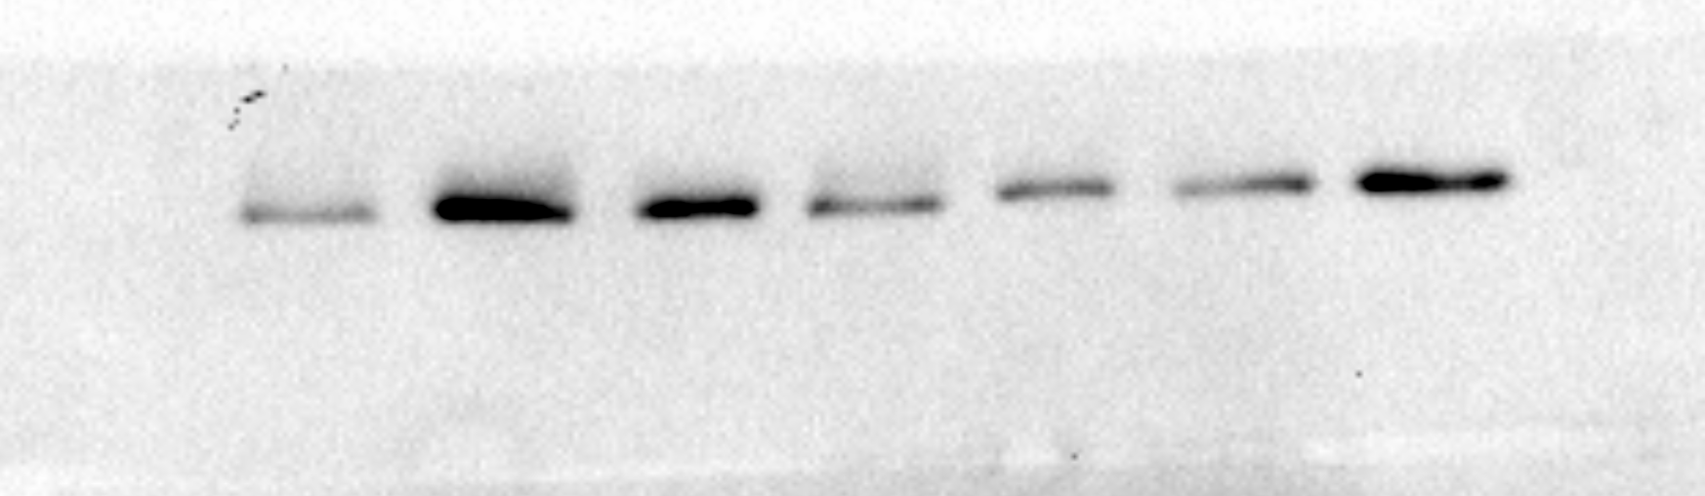
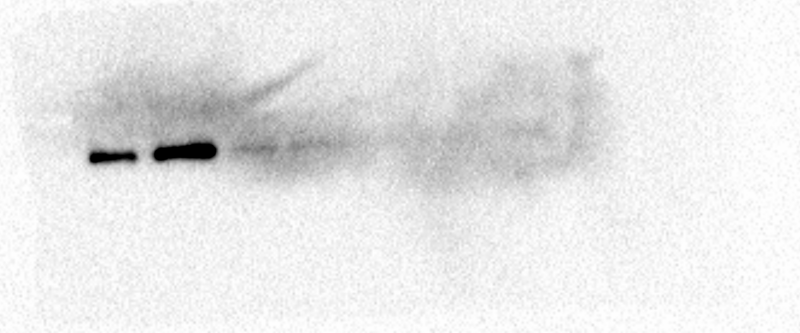
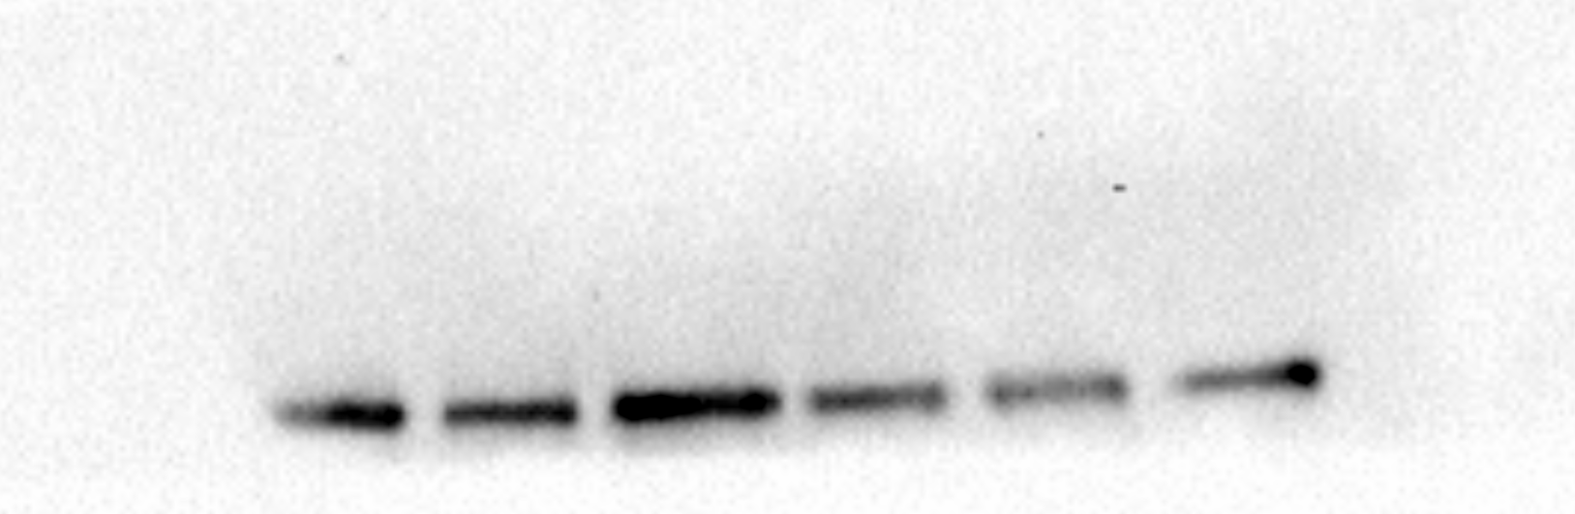
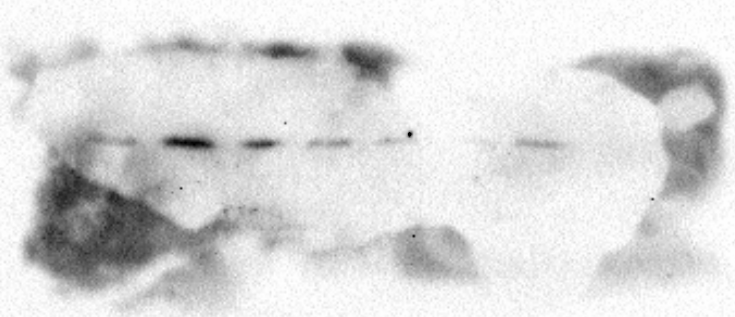
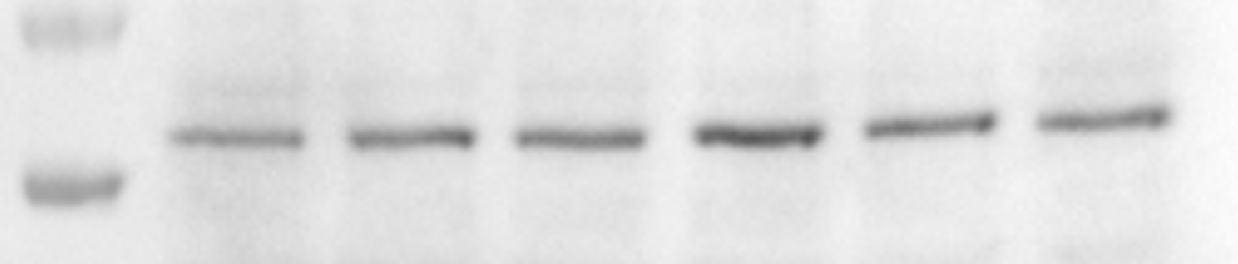
Fig 1 E.
Thr308
Ser473
α-Syn
T-AKT
tubulin

Slide 5



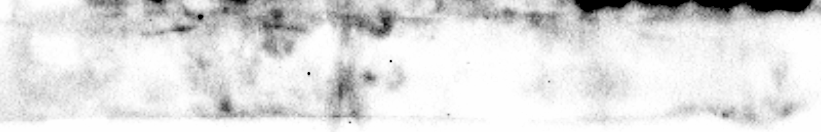
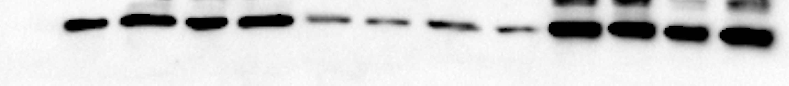
Fig 1 G.
Thr 308
Ser 473
Total AKT
α-Syn
actin

Slide 6
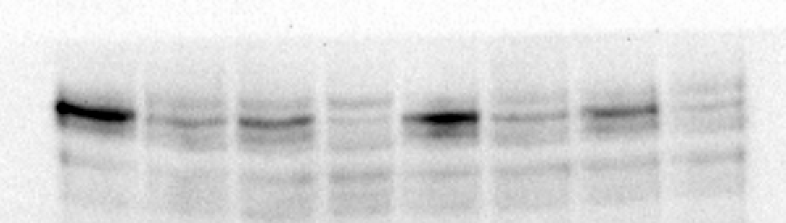
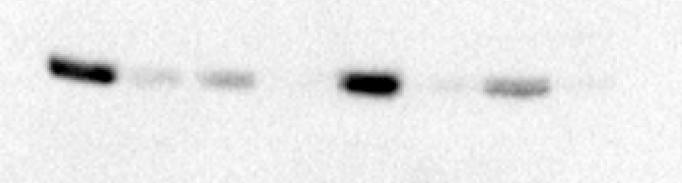
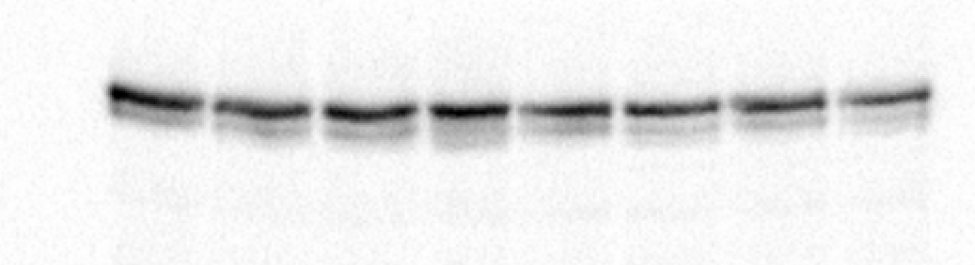
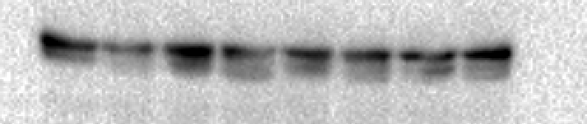
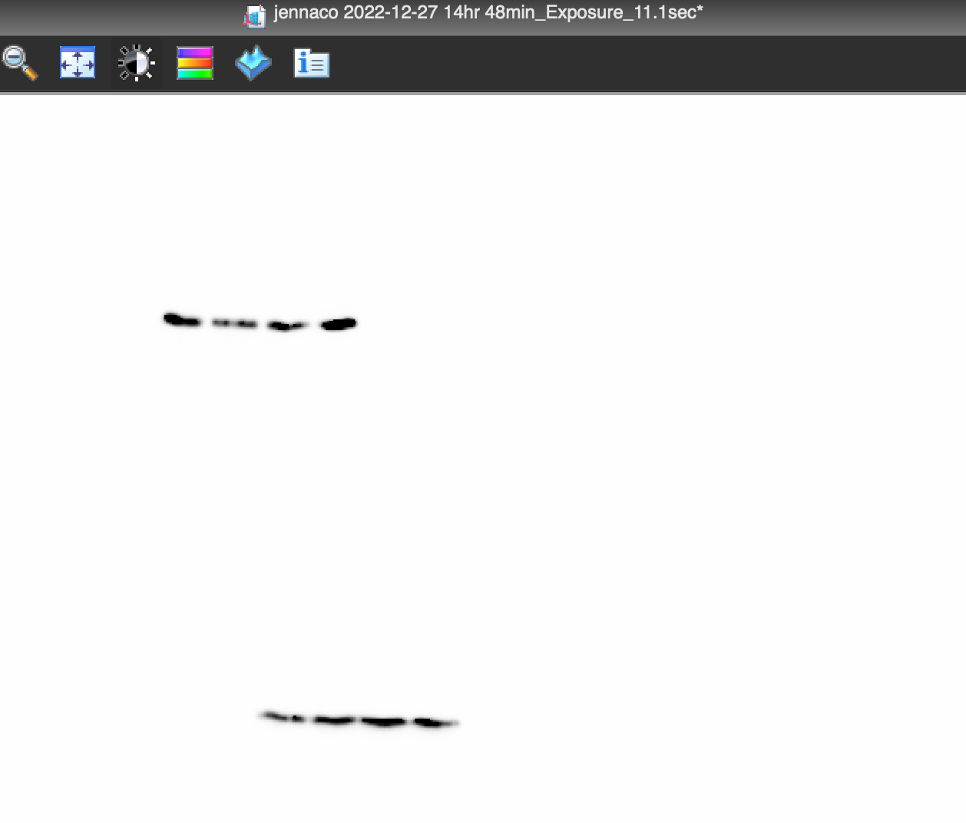
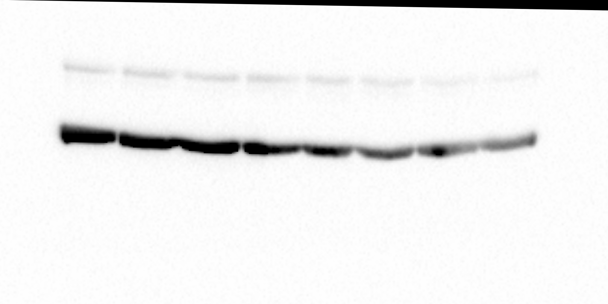

2A
Ser
Thr
P-AKT
Akt total
asyn
actin

Slide 7
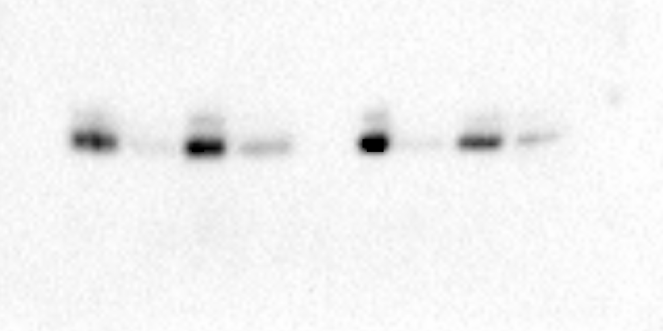
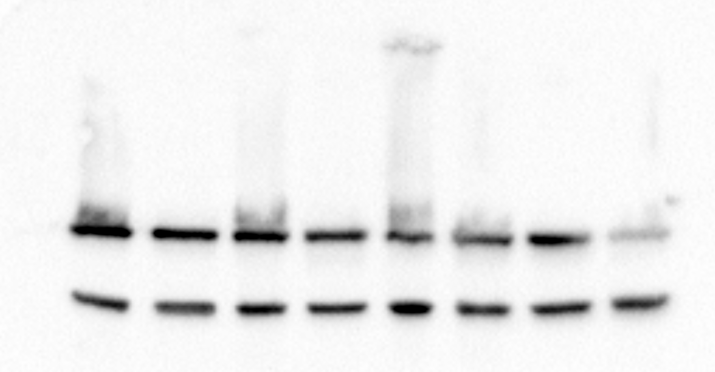
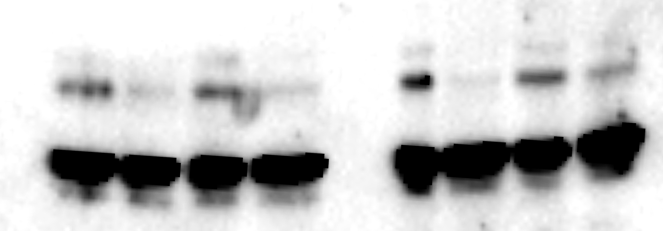
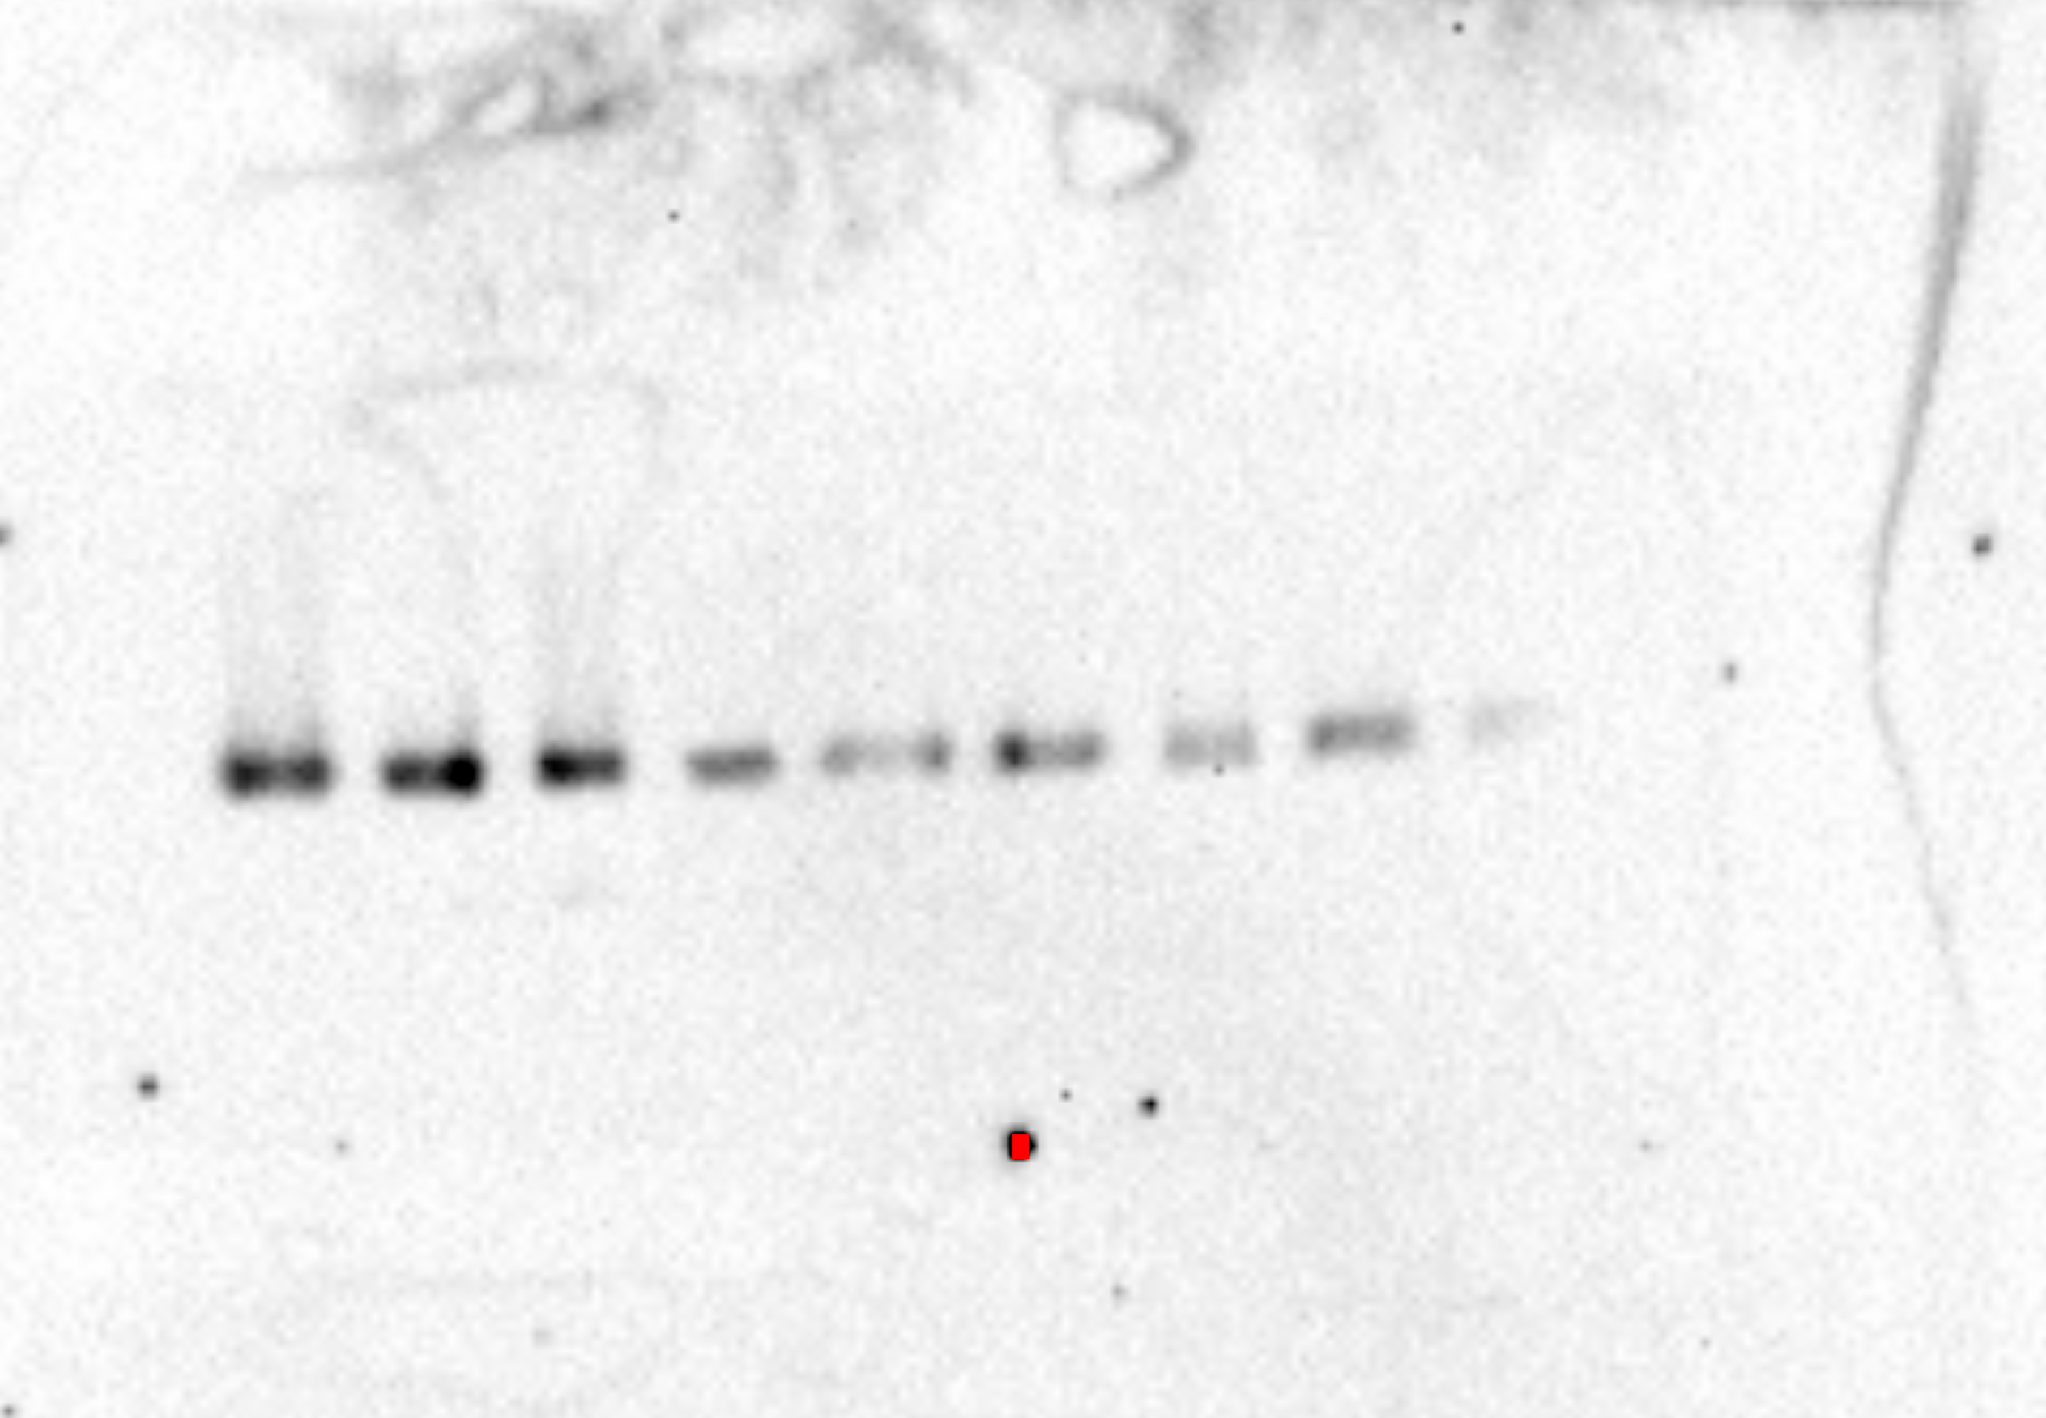
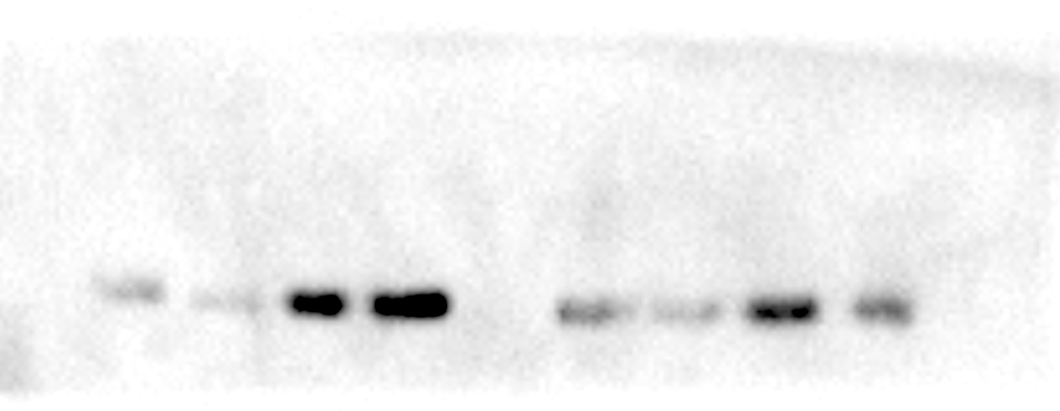
Fig 2C
PIK3CA
Total AKT
Thr 308
actin
actin
α-Syn
Serin 473

Slide 8
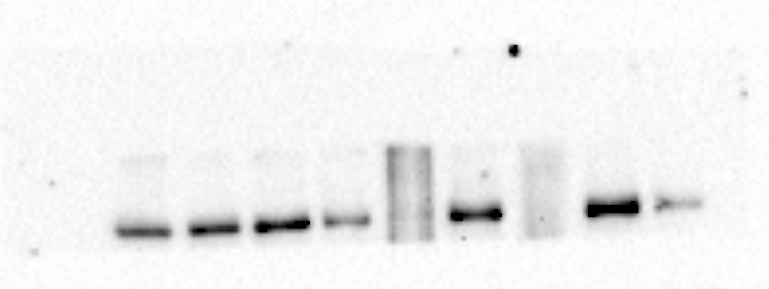
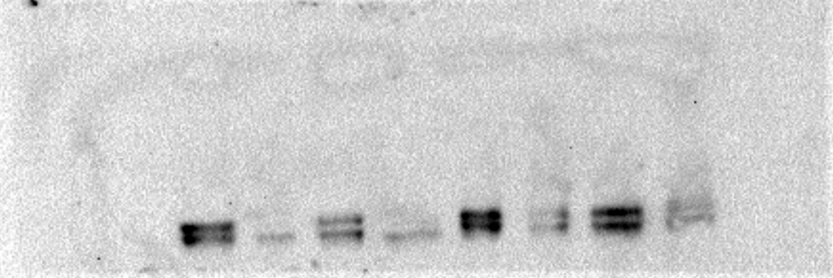
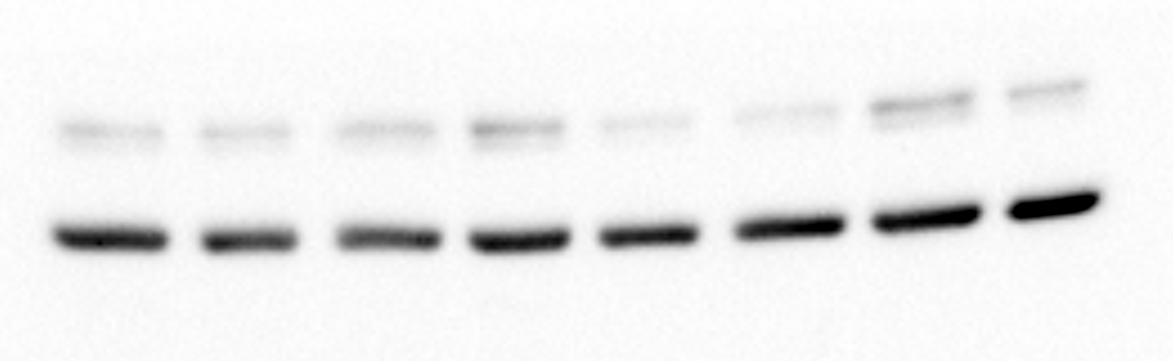
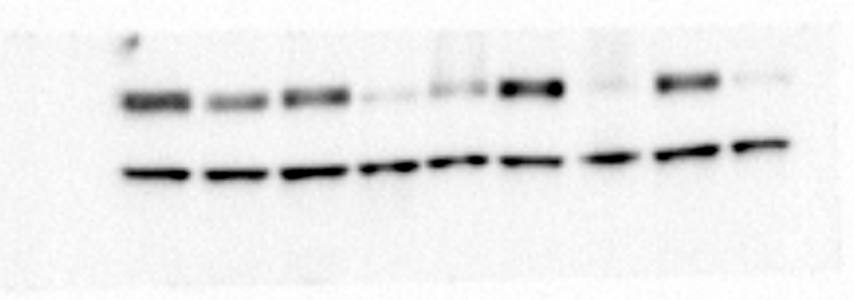

Fig 2C
PIK3CB
Thr308
Total AKT
Ser 473
α-Syn
actin

Slide 9
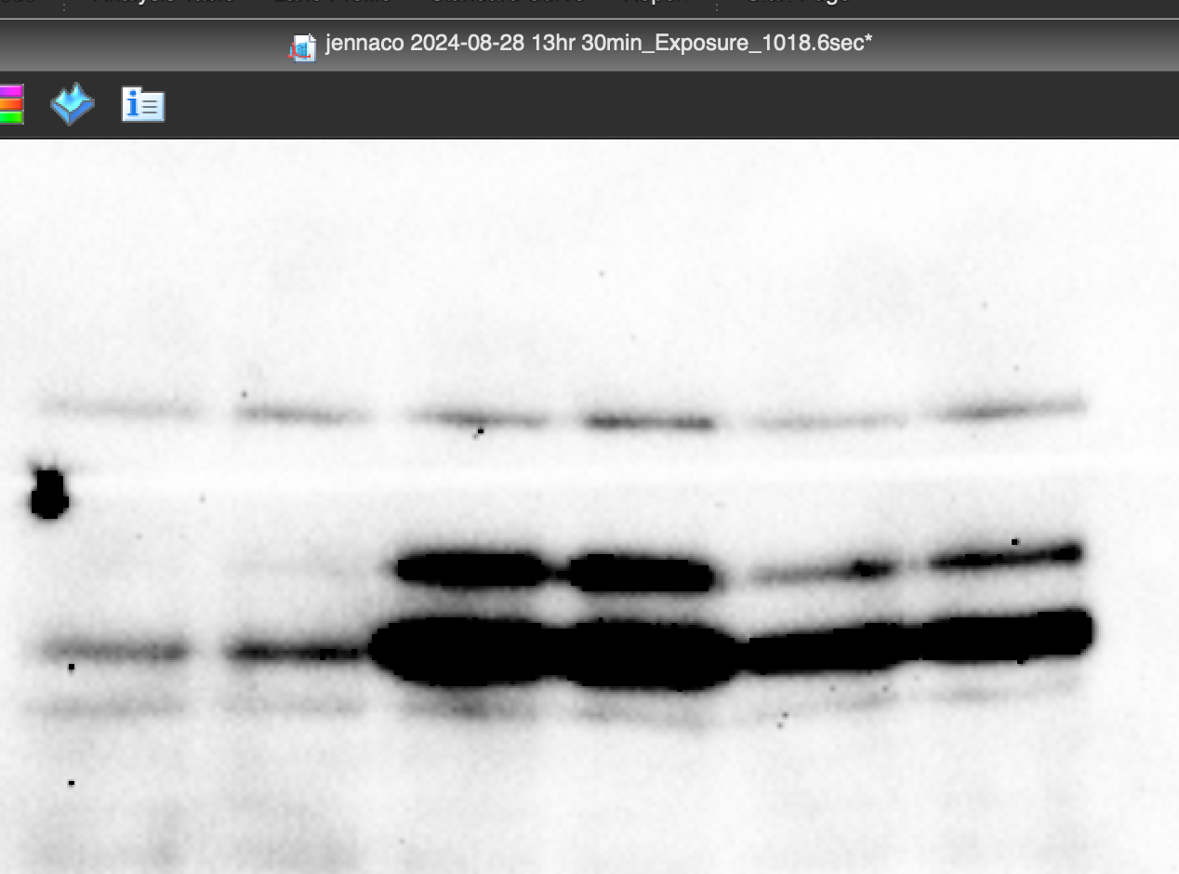
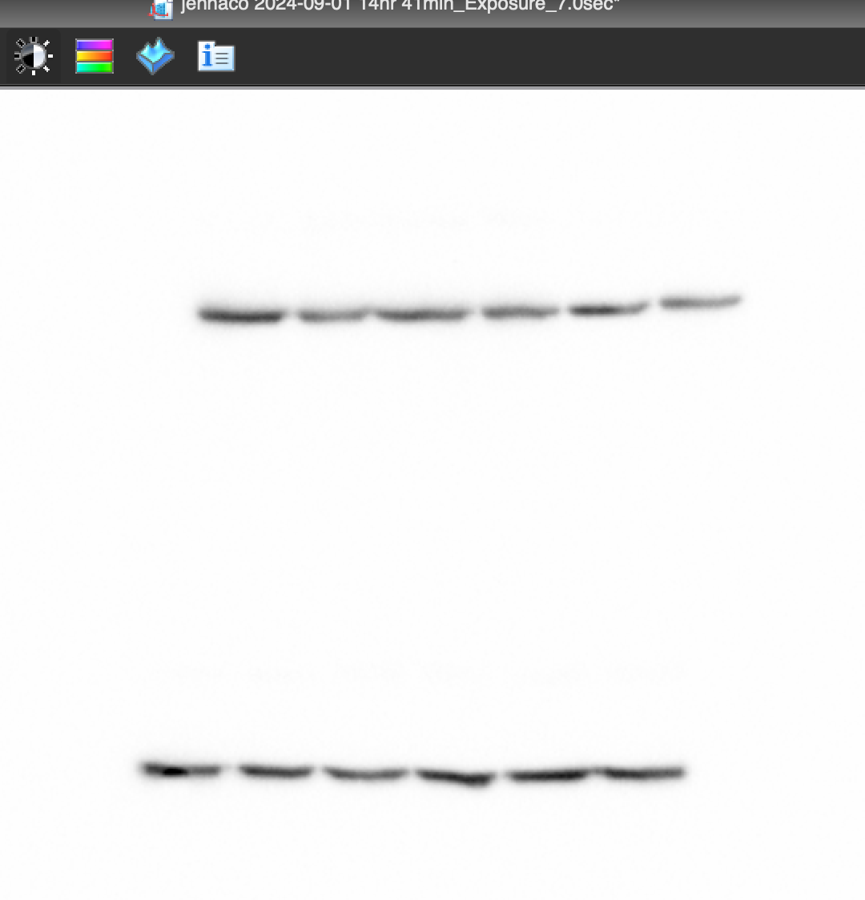
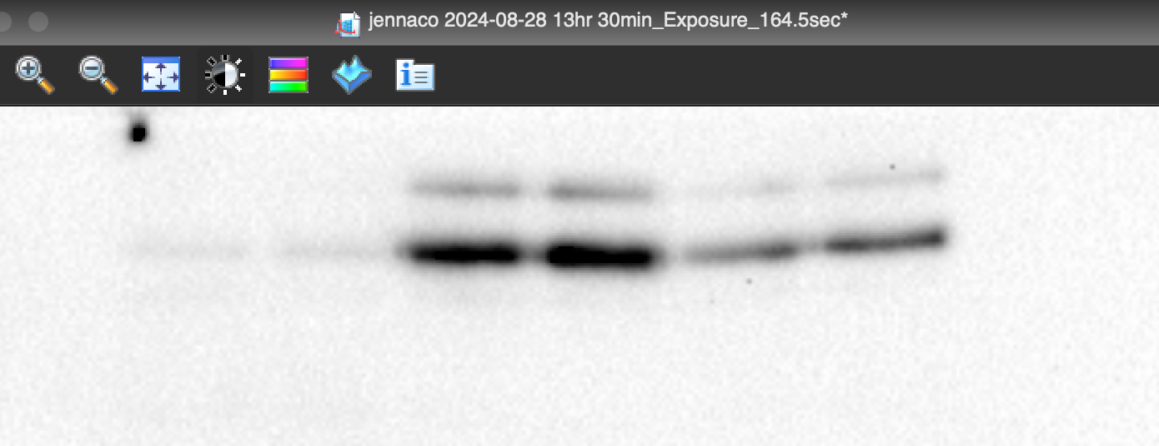
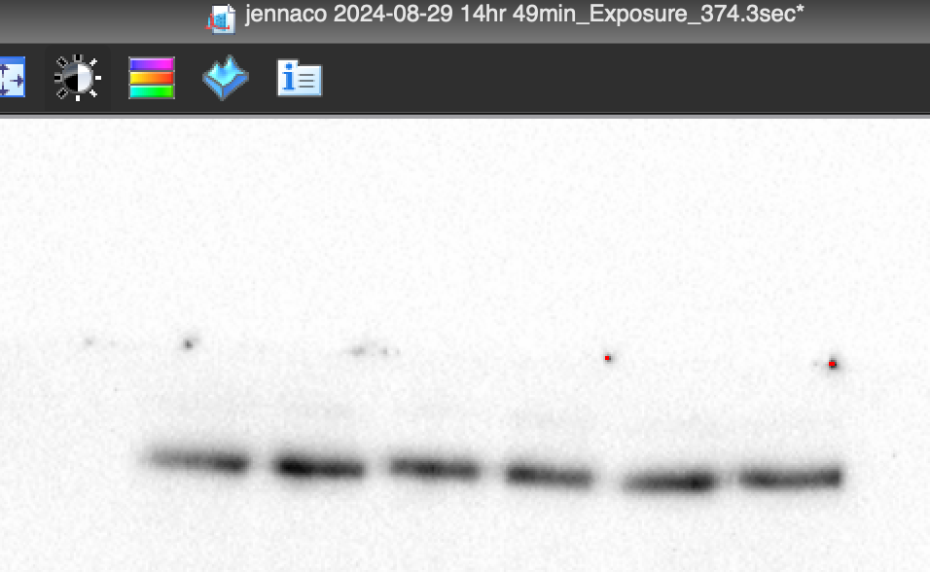
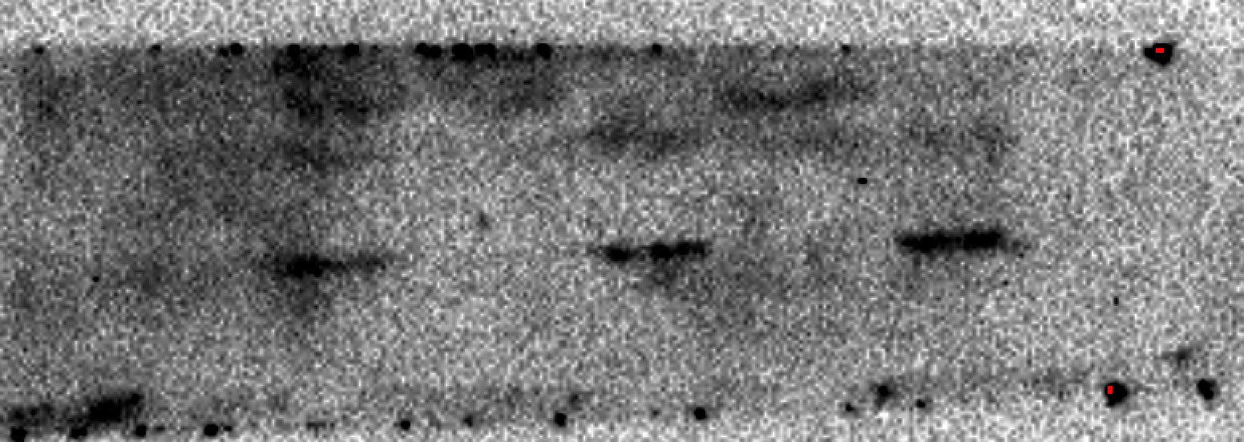
Fig 2E
p-ACLY
Total-ACLY
p-S6P
S6P
ACTIN
asyn

Slide 10
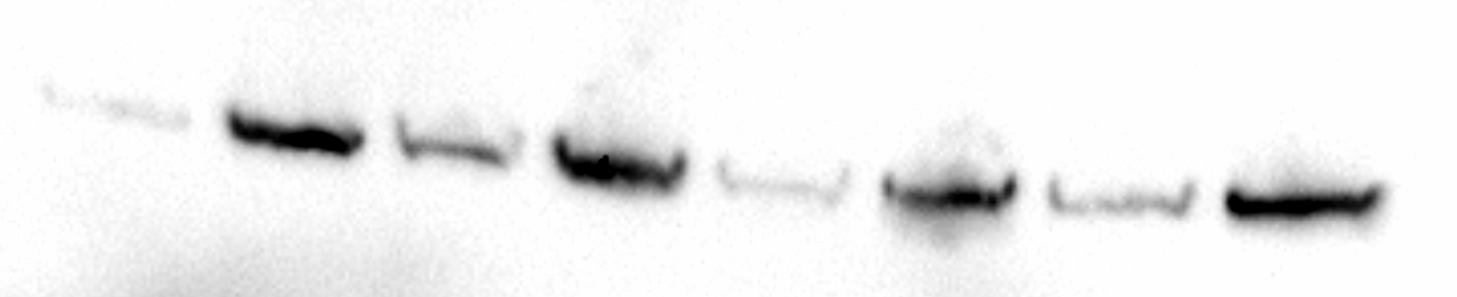
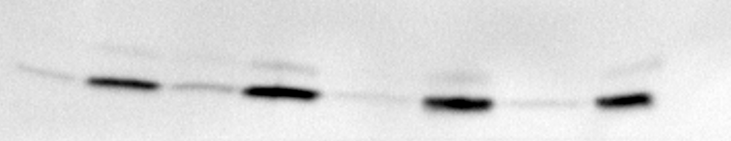
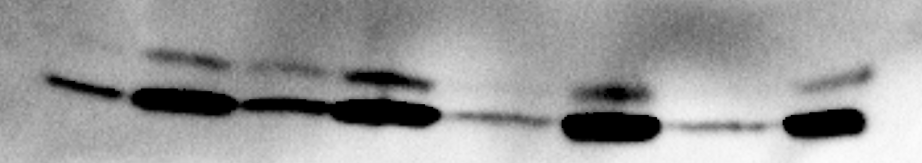

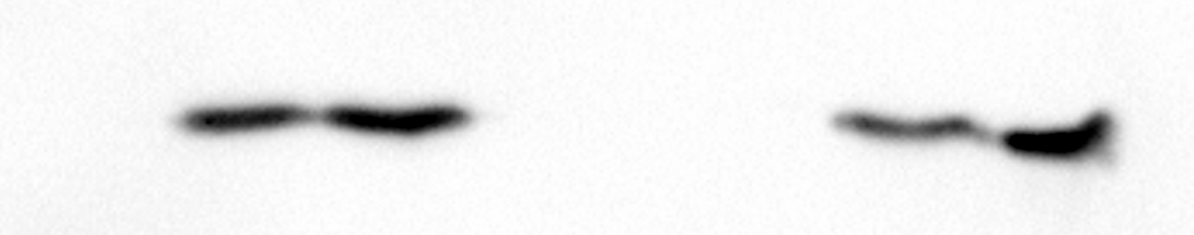
Fig. 2G

Slide 11
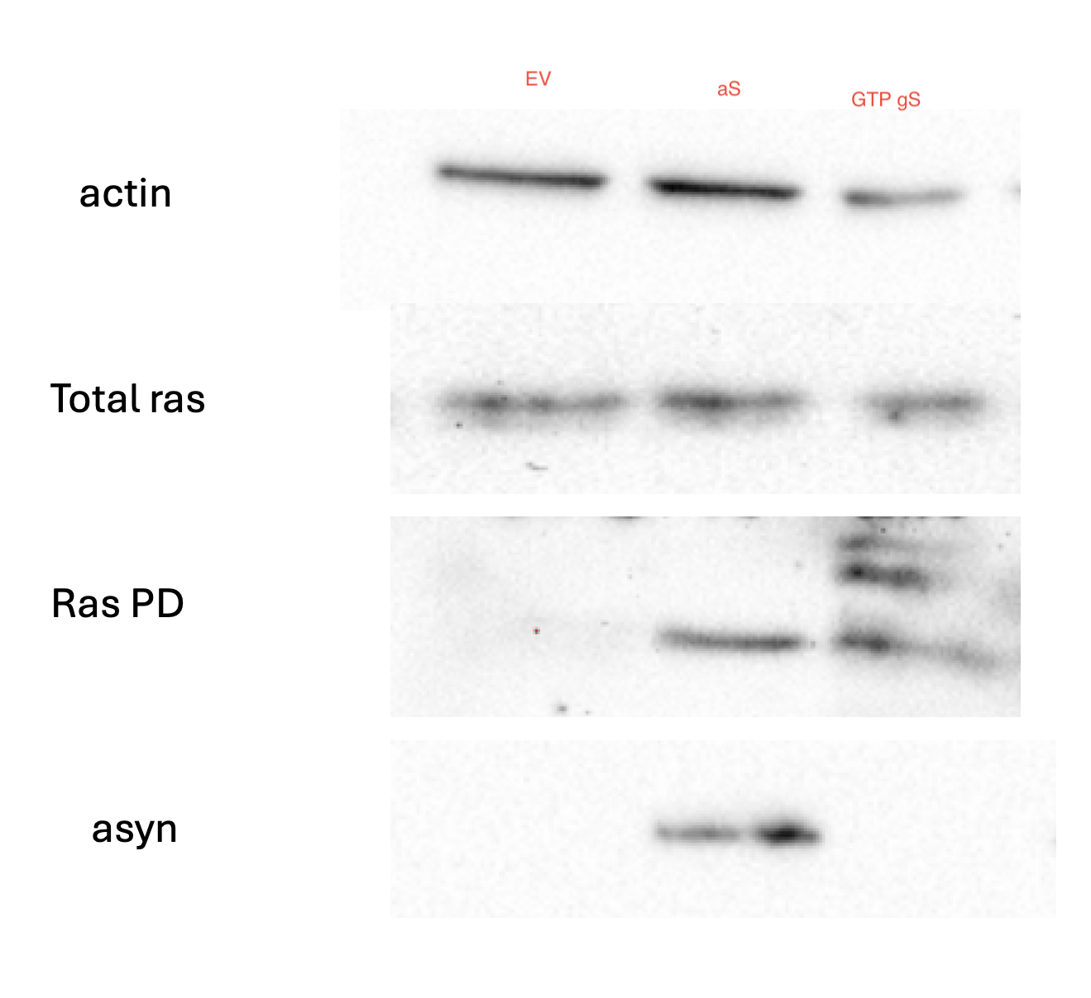
Fig. 3A

Slide 12
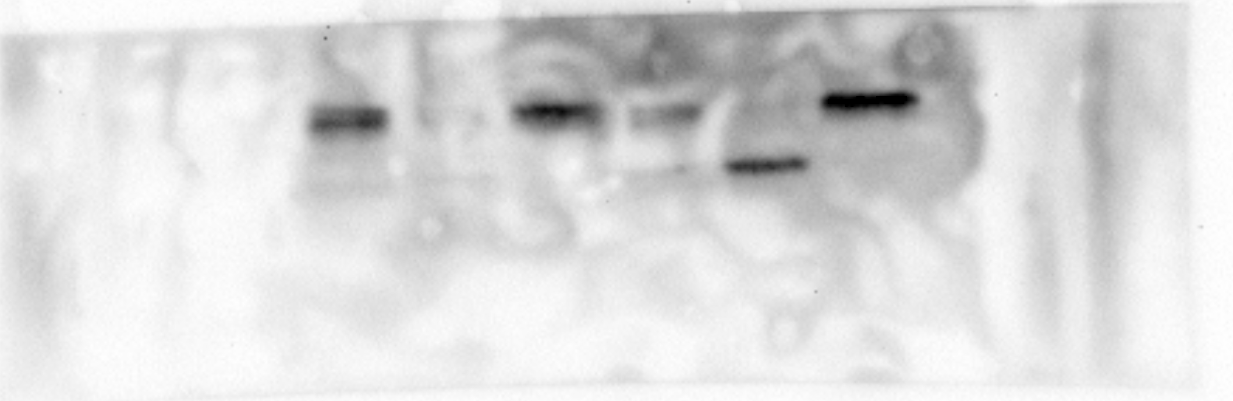
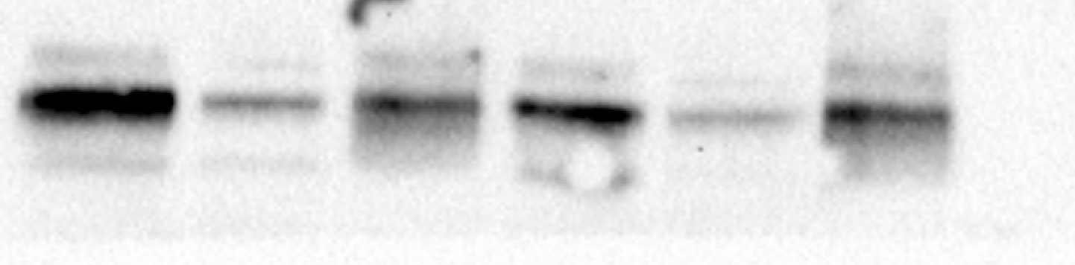
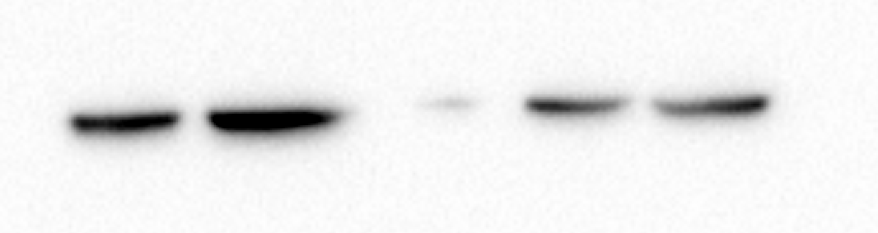
Fig 3D
ras
asyn
NaKATPase
actin

Slide 13
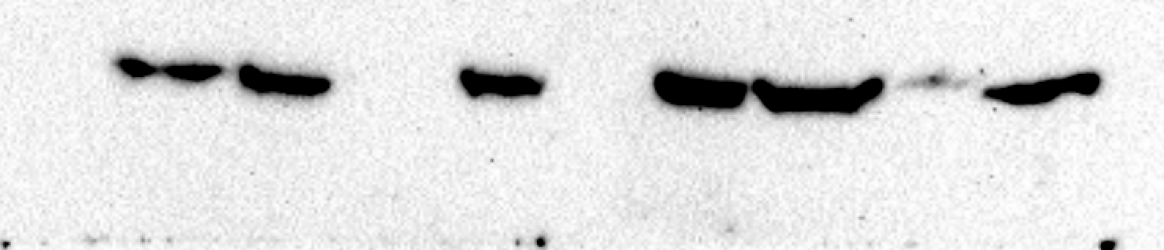
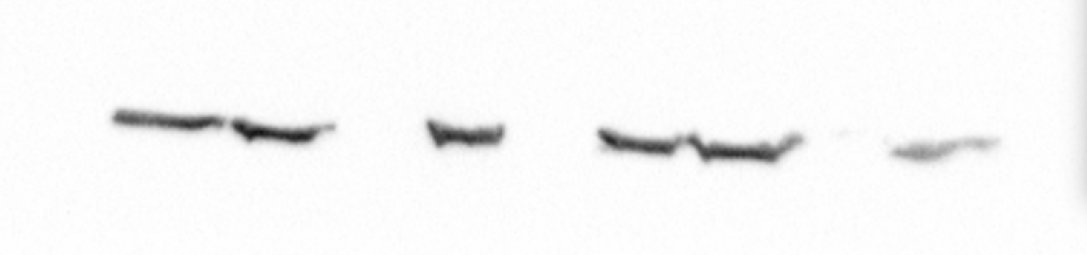
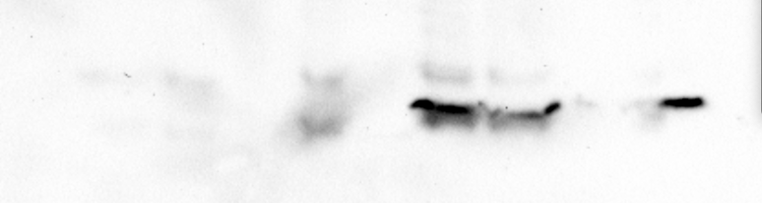
Fig 3F
ras
actin
asyn

Slide 14
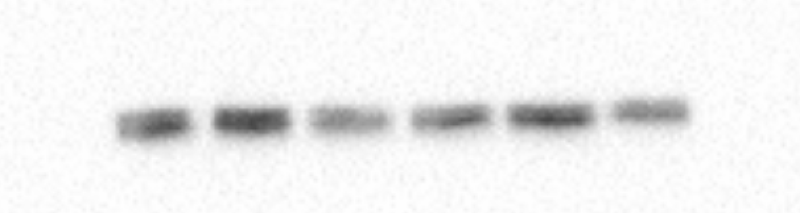
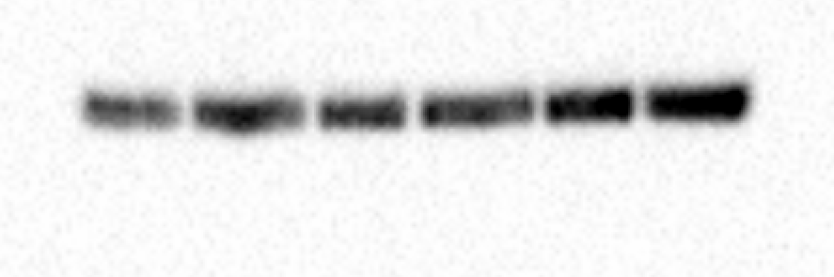
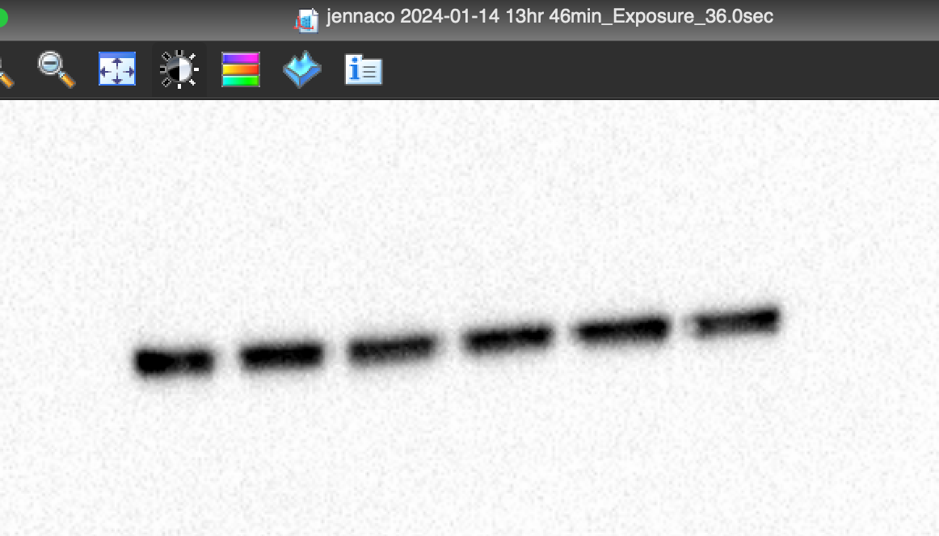



Fig 3H
thr308
ser473
Akt total
asyn
PI3KCA
actin

Slide 15
Fig. 3L
Total
ERK
α-Syn

Slide 16


Fig 3J
308
AKT total
actin

Slide 17







Fig 5A
Fig 3B
308
473
P-AKT
Akt total
asyn
actin

Slide 18




Fig 6B
308
473
Akt total
asyn

Slide 19

Fig. 6D

Slide 20


Fig 6H
asyn
actin

Slide 21





Fig S2
asyn

Slide 22




Fig. S3
Akt total
308
473

Slide 23


Fig. S6
ACLY
actin

