Slide 1
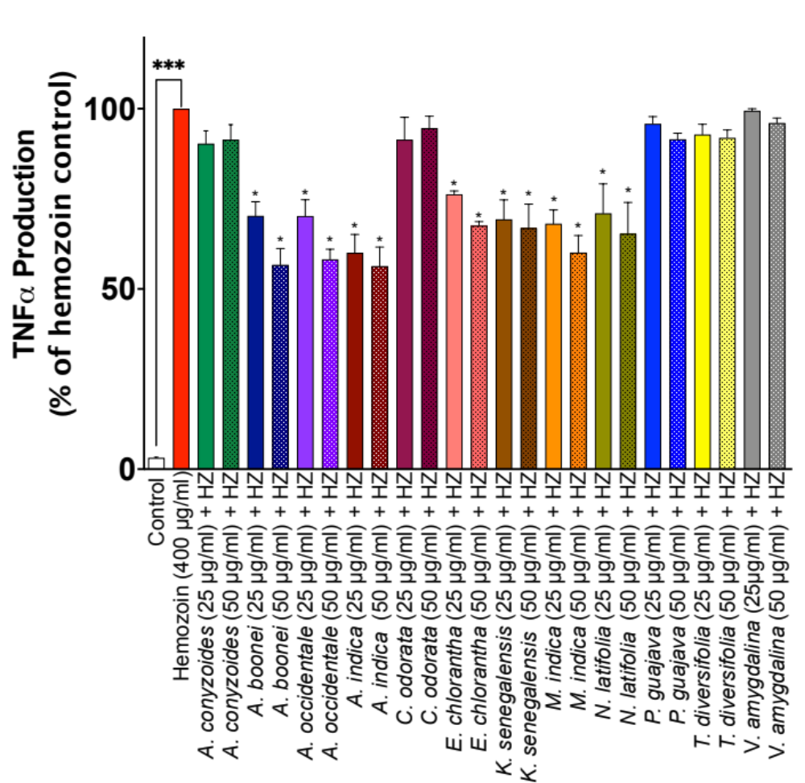
Supplementary Data 1
Effects of freeze-dried infusions of plants with FL>50% on increased production of TNFα in HZ-stimulated BV-2 microglia. Cells were treated with 25 and 50 µg/mL of freeze-dried infusions prior to stimulation with HZ (400 µg/mL) for 24 h. Levels of cytokines were detected using mouse ELISA kits. Values are mean ± SEM for at least 3 independent experiments (### p<0.001 unstimulated control versus HZ stimulation. *p<0.05, treatments versus HZ stimulation; one-way ANOVA with post-hoc Dunnett’s multiple comparison test).

Slide 2
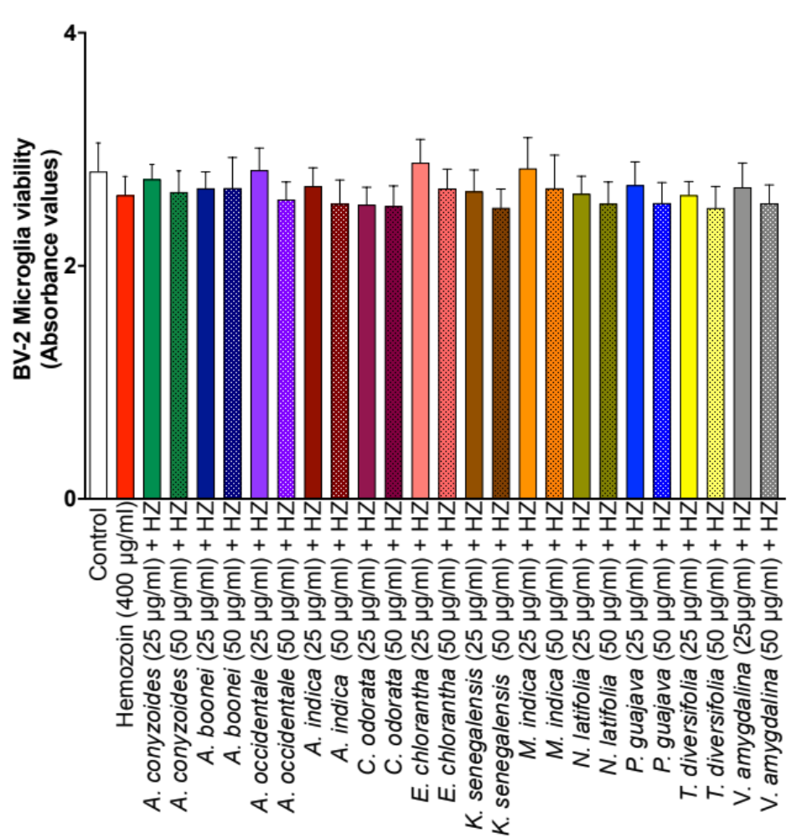
Supplementary Data 2
Effects of freeze-dried infusions of plants with FL>50% on the viability of HZ-stimulated BV-2 microglia. Cells were treated with 25 and 50 µg/mL of freeze-dried infusions prior to stimulation with HZ (400 µg/mL) for 24 h. Cell viability was determined with MTT assay. Values are mean ± SEM for at least 3 independent experiments.

