Slide 1
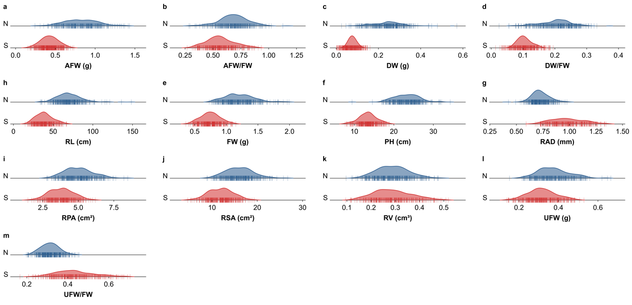
Figure S1. Frequency distribution of 13 seedling traits in the maize association panel under normal (N) and salt (S) conditions. a–m represent the 13 traits in the following order: (a) AFW, (b) AFW/FW, (c) DW, (d) DW/FW, (e) FW, (f) PH, (g) RAD, (h) RL, (i) RPA, (j) RSA, (k) RV, (l) UFW, and (m) UFW/FW (abbreviations and units defined in Table S2). For each trait, the upper and lower density curves represent the distributions under normal (N) and salt (S) conditions, respectively. The x-axis indicates trait values; the y-axis indicates probability density. Red vertical tick marks indicate the trait value of each inbred line.

