Slide 1
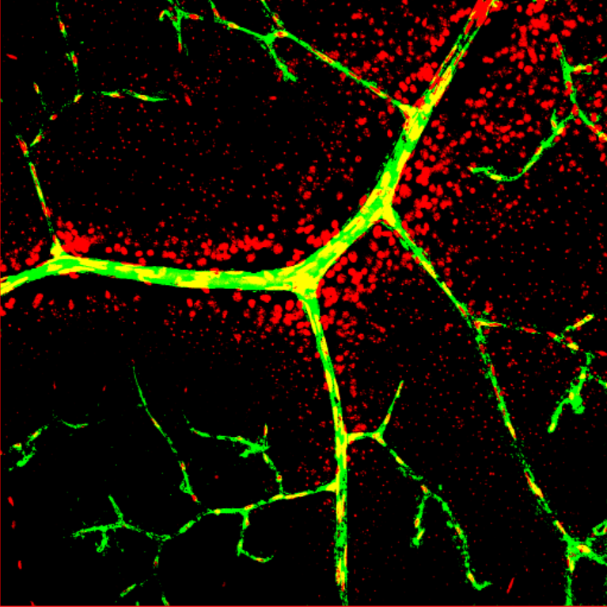
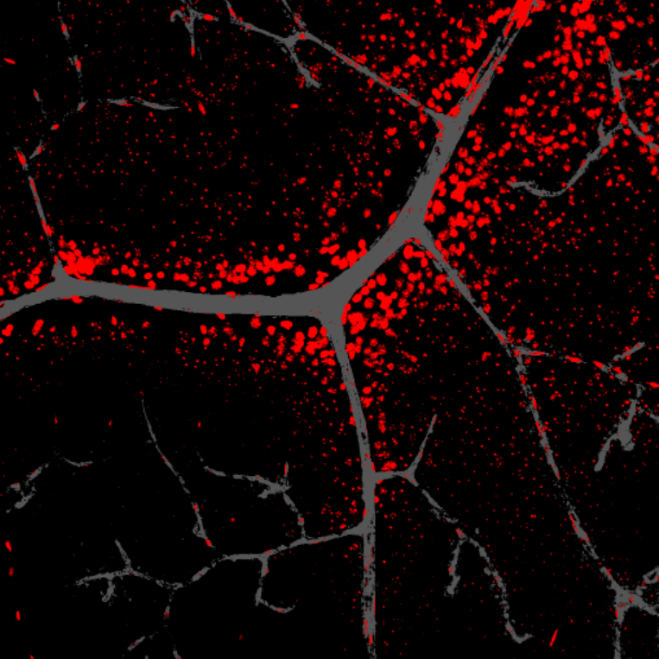
A
Original image for FITC-dextran
FITC-dextran-positive total vessel region
Supplemental Figure 2
Dextran
Dextran
B
FITC-dextran-positive total vessel region
Total Hoechst-positive region
Combined image
Dextran
Hoechst
Dextran
+ Hoechst
C
FITC-dextran-positive total vessel region
Extravascular Hoechst-positive region
Combined image
Dextran
+ Hoechst
Dextran
Hoechst

