Slide 1
Extended data Figure 1a: Study flow – PRiDE-UK
Early pregnancy consent visit (<16 weeks)
Recruitment: 4751
Not included in the study: 5
Severe anaemia: 3
On B12 injections: 2
Eligible for OGTT: 4746
Excluded: 419 (8.8%)
Miscarried: 118 (termination 3)
Did not attend OGTT: 165 (3.8%)
Declined OGTT: 4; Not booked: 8
Unwell during OGTT: 4
Withdrew consent: 55; Moved out of area: 56
Not eligible: 9 (Reasons unknown: 3; B12 injections: 2;
Developed other diseases: 4)
Extreme preterm: 7
OGTT done: 4320^{a, b}
GDM: 633 (14.65%); NGT: 3687
At least one outcome data available: 4447
At least one outcome data available: 4250
Study flow charts for (a) PRiDE-UK, (b) STRiDE-India and (c) STRiDE-Kenya
ª n=3885 women with complete OGTT and HbA1c data; ^{b}17 GDM diagnosed by other means, without OGTT

Slide 2
Extended data Figure 1b: Study flow – STRiDE-India
Early pregnancy consent visit (<16 weeks)
Recruitment: 3070
Not included in the study: 167
Withdrew consent when contacted blood sample: 84; Miscarriage: 58; Medical termination of pregnancy: 13; Unable to contact: 12
Early pregnancy GDM: 566 Overt diabetes: 8
Eligible for OGTT: 2329
Not completed OGTT: 214
Did not continue the pregnancy: 67; Unable to attend OGTT at 24-28weeks as they shifted antenatal care or were out of station: 47
OGTT done: 2115
GDM: 407 (19.2%) NGT: 1708
eGDM: FPG ≥5.1 mmol/l (92mg/dl)
Overt diabetes: FPG ≥7.0 mmol/l (126mg/dl)
GDM at OGTT (cGDM):
FPG: ≥5.1mmol/l (92mg/dl) or
1-hr PG: ≥10.0mmol/l (180mg/dl) or
2-hr PG: ≥8.5mmol/l (153mg/dl)
At least one outcome data available: 2575
At least one outcome data available: 1789

Slide 3
Extended data Figure 1c: Study flow – STRiDE-Kenya
Early pregnancy consent visit (<16 weeks)
Recruitment: 4104
Not included in the study: 716
Withdrew consent: 681; miscarriage: 2; >16 weeks on USS: 3; missing data: 25; not pregnant by USS: 2; unknown: 3
Early pregnancy GDM: 12; overt diabetes: 1
Eligible for OGTT: 3375
Not completed OGTT: 1233
Not eligible:109 (not pregnant: 36 or >20 weeks on USS: 73); vomited: 21; miscarriage: 51; ectopic: 2; intrauterine death: 2; missing dcf: 20; not willing to travel: 2; consent withdrawn: 7; DNA and not eligible by the time of re-engagement: 1003; sample related issues: 9; unknown: 7)
OGTT done : 2142
cGDM: 65 (3.03%); NGT: 2077
At least one outcome data available: 3224
At least one outcome data available: 1846

Slide 4
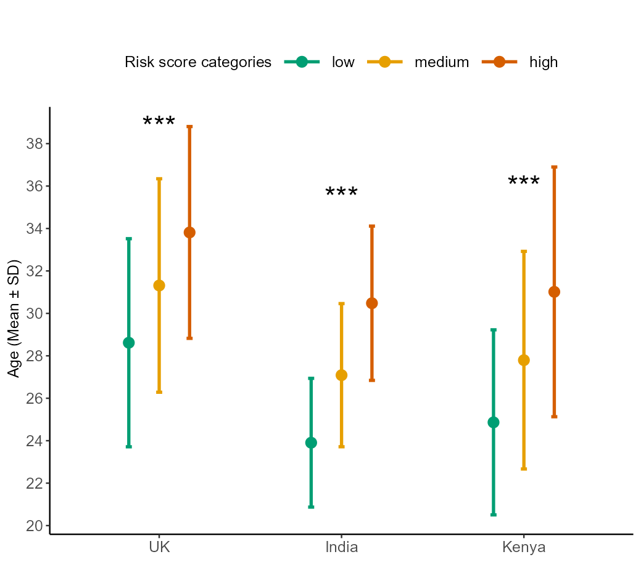
Extended data Figure 2a: Maternal age across risk categories
Mean maternal age (± SD) for participants in PRiDE UK, STRiDE Kenya and STRiDE India across risk score categories. Asterisks indicate statistically significant group differences (***: p < 0.001).

Slide 5
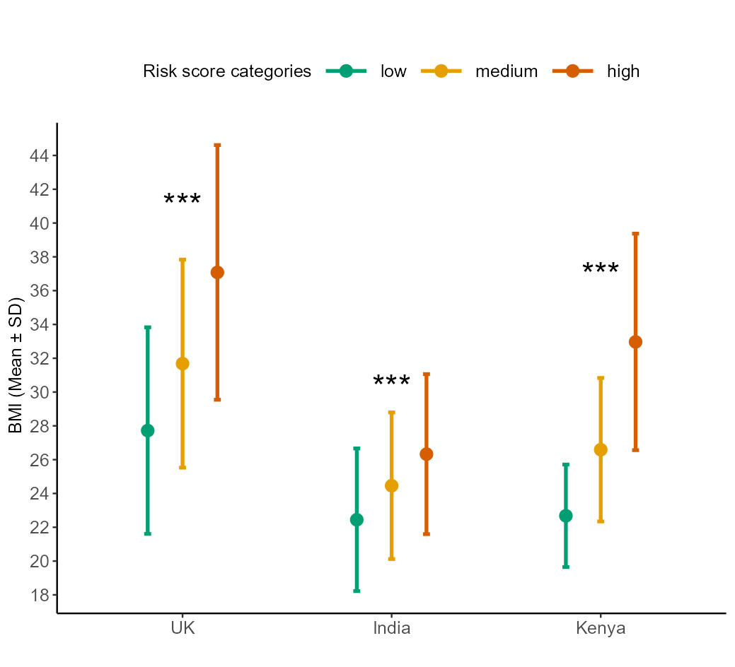
Extended data Figure 2b: Maternal BMI across risk categories
Mean BMI (± SD) for participants in PRiDE UK, STRiDE Kenya and STRiDE India across risk score categories. Asterisks indicate statistically significant group differences (***: p < 0.001).

Slide 6
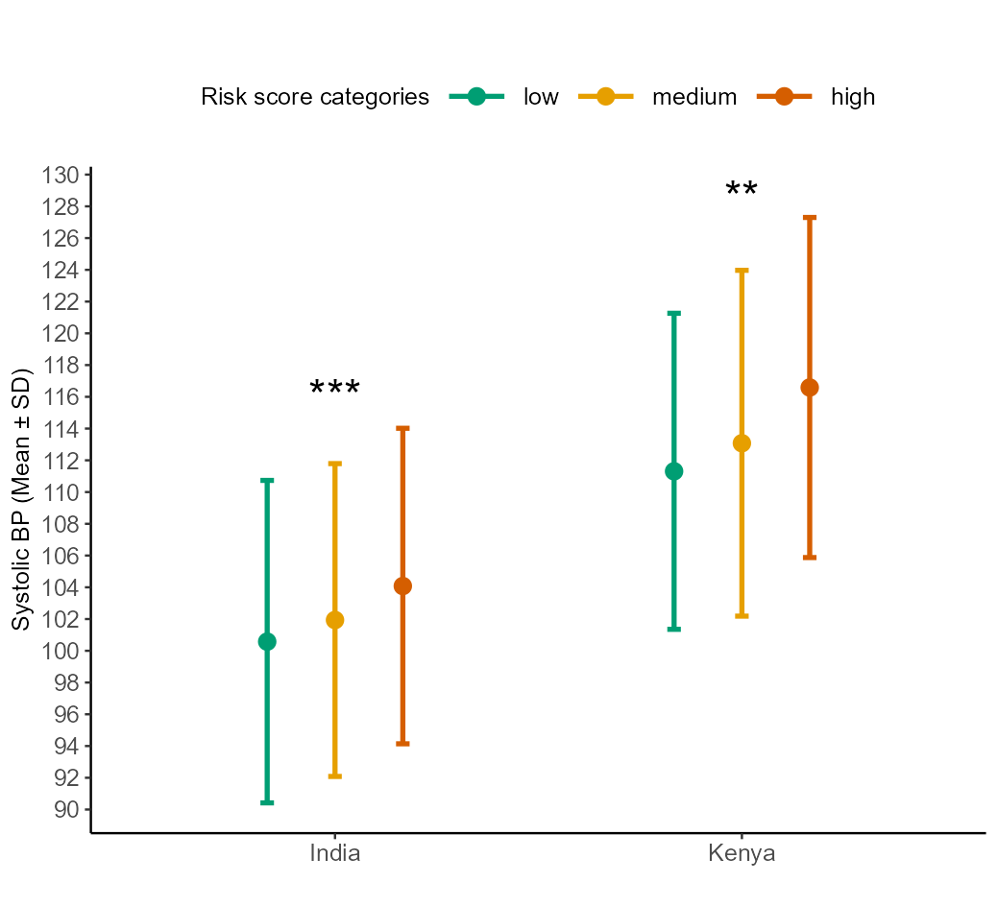
Extended data Figure 2c: Maternal systolic blood pressure across risk categories
Mean systolic blood pressure (± SD) for participants in STRiDE India and STRiDE Kenya across risk score categories. Asterisks indicate statistically significant group differences (***: p < 0.001, **: P < 0.01).

Slide 7
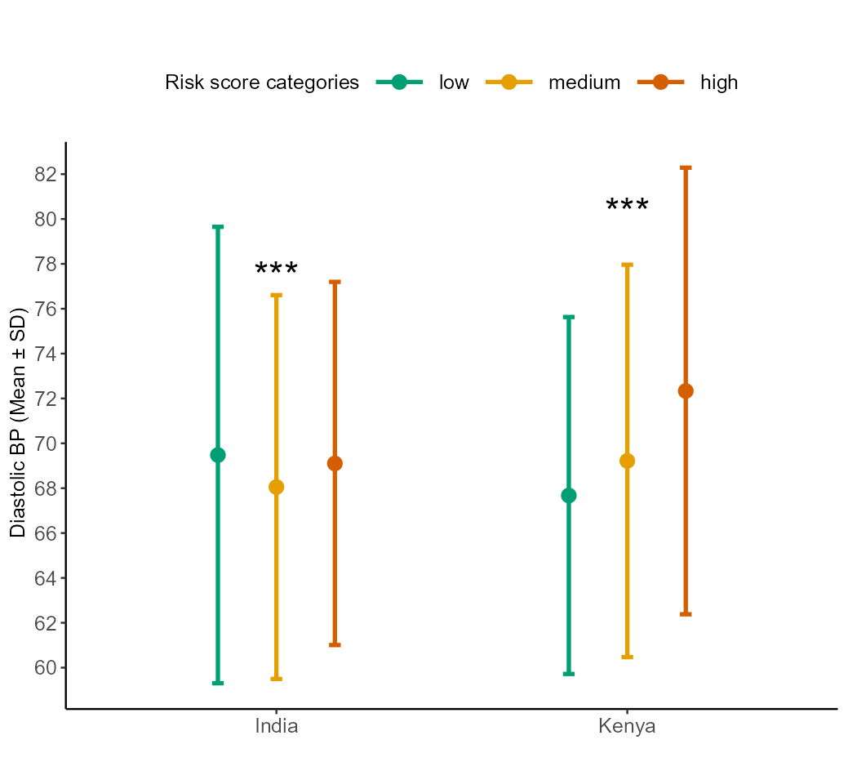
Extended data Figure 2d: Maternal diastolic blood pressure across risk categories
Mean diastolic blood pressure (± SD) for participants in STRiDE India and STRiDE Kenya across risk score categories. Asterisks indicate statistically significant group differences (***: p < 0.001).

Slide 8
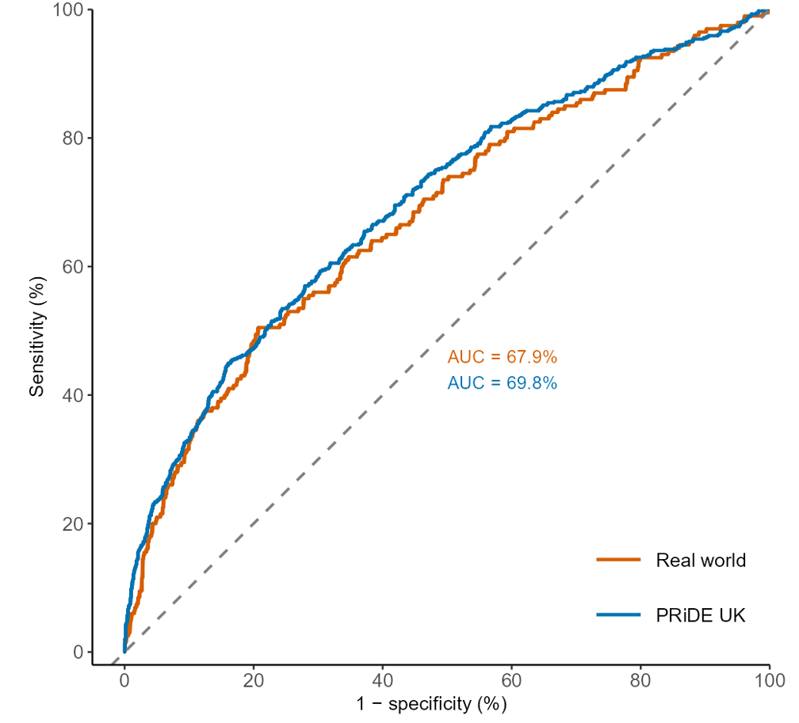
Extended data Figure 3a: ROC-AUC of UK real-world data and PRiDE
ROC curves and corresponding AUC values for the composite prediction model in the real-world and PRiDE UK datasets.

Slide 9
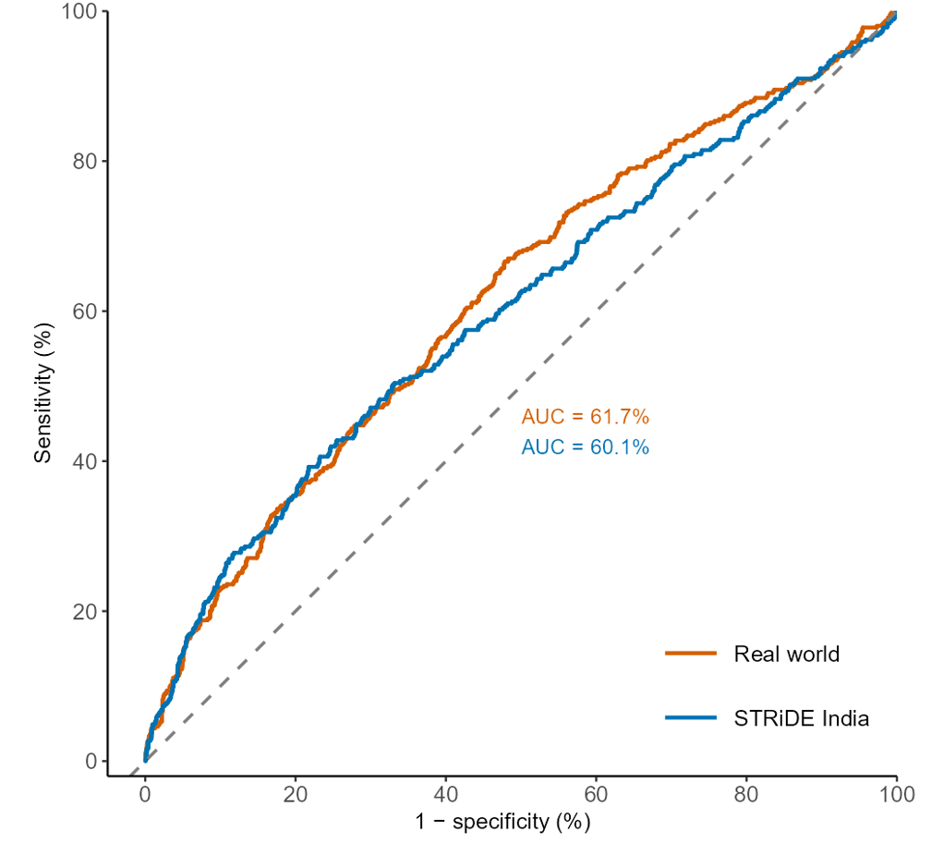
Extended data Figure 3b: ROC-AUC of India real-world data and STRiDE-India
ROC curves and corresponding AUC values for the composite prediction model in the real-world and STRiDE India datasets.

