Slide 1
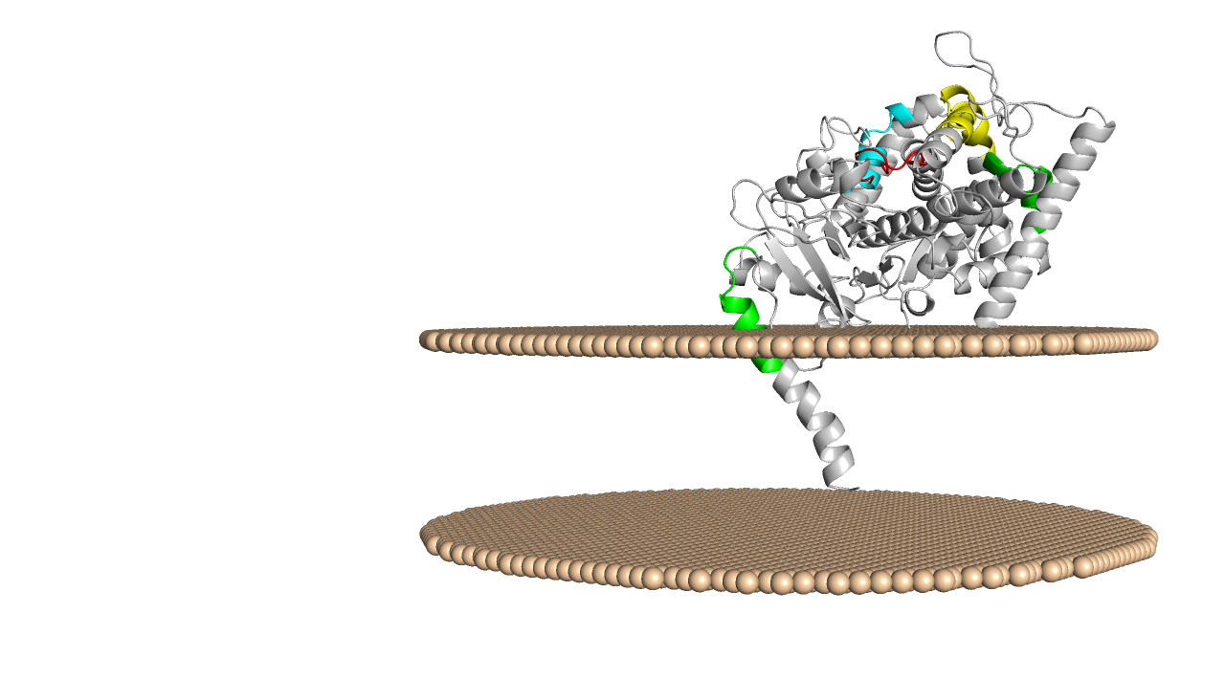
CRAC3/CARC4
CARC2
CARC3
Heme
group
CRAC2
CRAC1
Figure S2: Localization of potentially relevant CRAC and CARC motifs in the predicted 3D structure of tomato C22DES. The position of the heme group in the catalytic site is also shown.
Notes:
1

