Slide 1
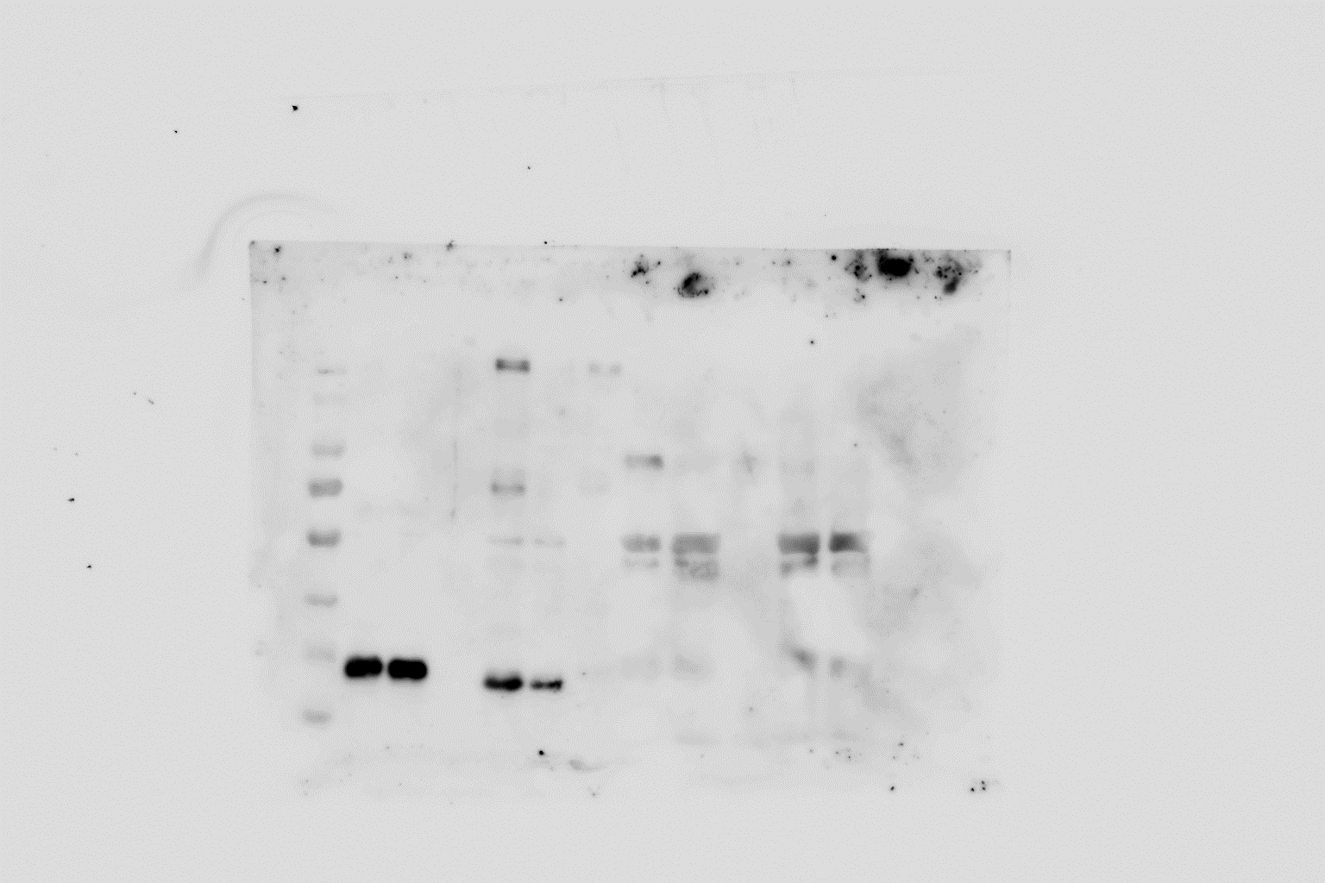
KDa
MW marker
T
GFP
BRL3-GFP
S
M
T
S
M
180
130
95
72
55
42
34
26
17
Figure S3. Full length image of the western blots shown in Fig. 6C. Immunoblot analysis of total (T), soluble (S), and membrane (M) cell fractions from N. benthamiana leaves expressing BRL3-GFP (≈153 KDa) and GFP (≈26.85 KDa) used as membrane-bound and soluble control proteins, respectively.

