Slide 1

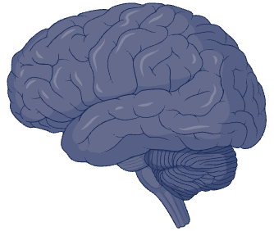
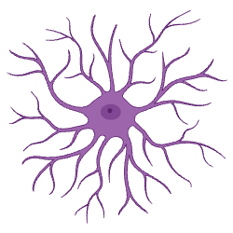
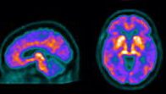
A. Among amyloid negative
B. Among amyloid positive
NIE: -.028 (-.152 – 0.095): p=0.651
NIE: .037 (-.33 – 0.40): p=0.841
NDE: .301 (-.299 – 0.903): p=0.325
TE: .273 (-.307 – 0.853): p=0.356
Visual memory:
Benson complex figure delayed
NDE: -2.89 (-4.93 – -0.86): p=0.005
adj.p=0.007
TE: -2.86 (-4.70 – -1.01): p=0.002
adj.p=0.006
Astrogliosis
GFAP
Astrogliosis
GFAP
Visual memory:
Benson complex figure delayed
NIE: -.011 (-.057 – 0.033): p=0.612
NIE: .137 (-.386 – 0.662): p=0.606
Astrogliosis
18F-SMBT-1
(cuneus)
NDE: .033 (-.101 – 0.168): p=0.628
TE: .021 (-.088 – 0.132): p=0.702
Astrogliosis
18F-SMBT-1
(cuneus)
NDE: -.897 (-1.83 – 0.043): p=0.062
adj.p=0.093
TE: -.759 (-1.33 – -.185): p=0.010
adj.p=0.030
Visual memory:
Benson complex figure delayed
Visual memory:
Benson complex figure delayed
Notes: * Adjusting for age and education.
Abbreviations: NIE: natural indirect effect; NDE: Natural direct effect, TE: total effect: GFAP: Glial fibrillary acidic protein. Adjusted p-values for multiple comparisons w/ Benjamini-Hochberg method.
Notes: * Adjusting for age, sex, education.
Abbreviations: NIE: natural indirect effect; NDE: Natural direct effect, TE: total effect: GFAP: Glial fibrillary acidic protein.

