Slide 1
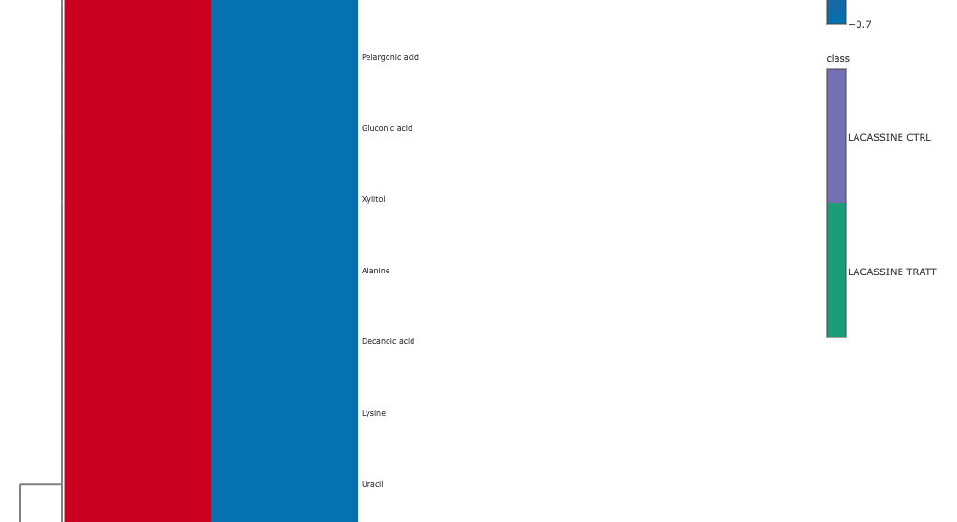
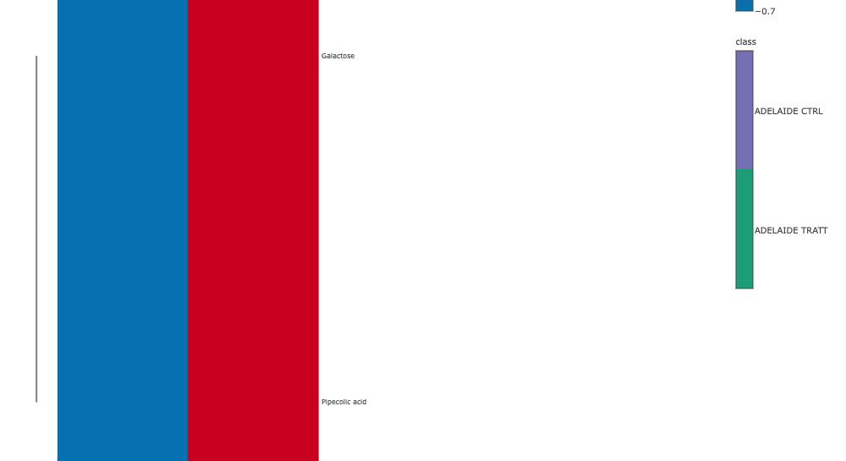

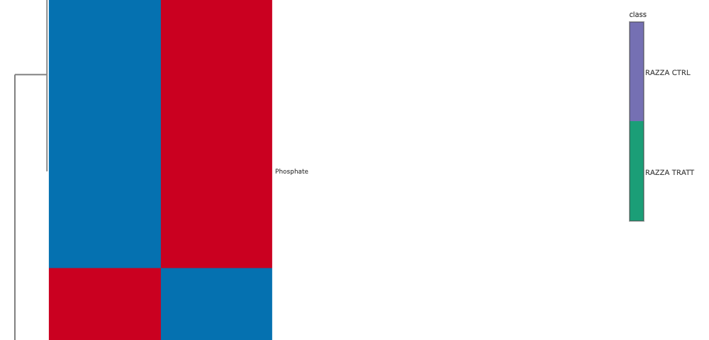
Online Resource 7
Article title Effects of PGPB Colonization on Ancient and Recent Rice Varieties
Journal Plant biosystems
Authors Giorgia Siviero1, Francesca Juretich1, Francesca Grolla1, Cristina Teruzzi2, Ignacio Ezquer3, Fabrizio Araniti2, Giampiero Valè1, Erica Mica1
Affiliations 1 University of Piemonte Orientale “Amedeo Avogadro”, Department for Sustainable Development and Ecological Transition (DiSSTE), Vercelli 13100 (VC), Italy
Affiliations 2 University of Milan, Department of Agricultural and Environmental Sciences – Production, Landscape, Agroenergy, Milan 20133 (Mi), Italy
Affiliations 3 University of Milan, Department of Biosciences, Milan 20133 (MI), Italy
Correspondance erica.mica@uniupo.it

