Slide 1
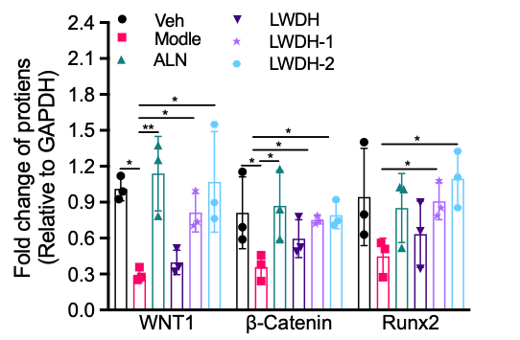








Modle
ALN
LWDH
LWDH-1
LWDH-2
Veh
WNT1
β-Catennin
Runx2
GAPDH
LWDH-1
LWDH-1
LWDH-2
Modle
LWDH
LWDH-2
Modle
LWDH
Veh
ALN
Veh
ALN
WNT1
WNT1
β-Catennin
β-Catennin
Runx2
Runx2
GAPDH
GAPDH

Slide 2
40KDa
WNT1
35KDa
25KDa
100KDa
β-Catennin
70KDa
70KDa
Runx2
55KDa
GAPDH
40KDa

Slide 3
40KDa
35KDa
WNT1
100KDa
70KDa
β-Catennin
70KDa
55KDa
Runx2
40KDa
35KDa
GAPDH

Slide 4
55KDa
WNT1
40KDa
100KDa
70KDa
β-Catennin
Runx2
70KDa
55KDa
GAPDH
40KDa
35KDa

Slide 5
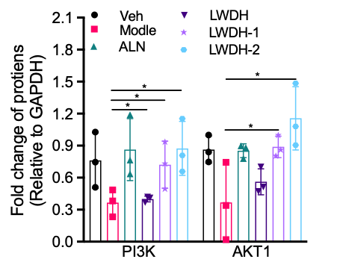








SHAM
ModeL
LWDH
GGL
GGH
ALN
PI3K
115KD
AKT1
55KD
GAPDH
38KD
Modle
LWDH
LWDH-1
LWDH-2
Modle
LWDH
LWDH-1
LWDH-2
Veh
ALN
Veh
ALN
PI3K
PI3K
AKT1
AKT1
GAPDH
GAPDH

Slide 6
140KDa
100KDa
PI3K
70KDa
55KDa
AKT1
40KDa
GAPDH

Slide 7
140KDa
100KDa
PI3K
70KDa
AKT1
55KDa
40KDa
GAPDH

Slide 8
PI3K
140KDa
100KDa
AKT1
70KDa
55KDa
GAPDH
40KDa

