Slide 1
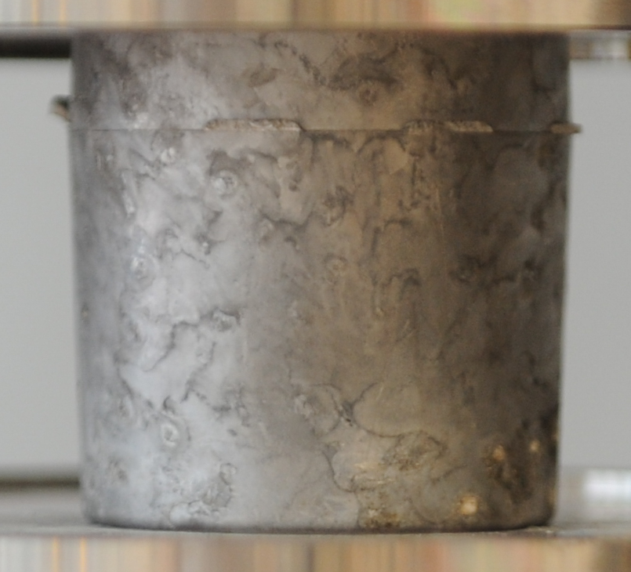
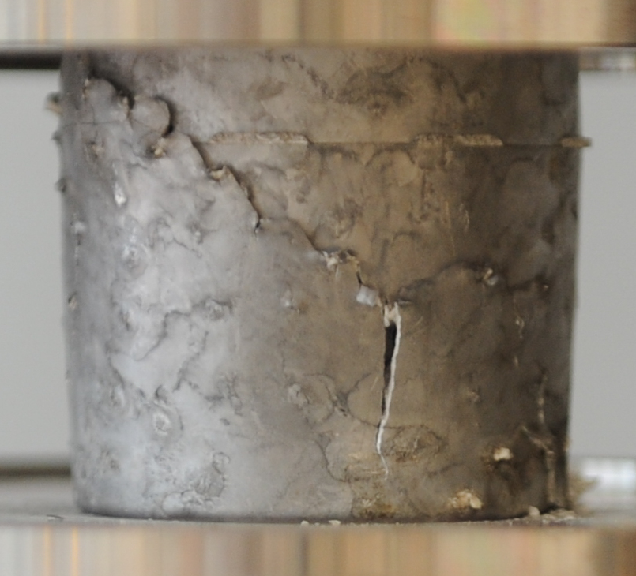
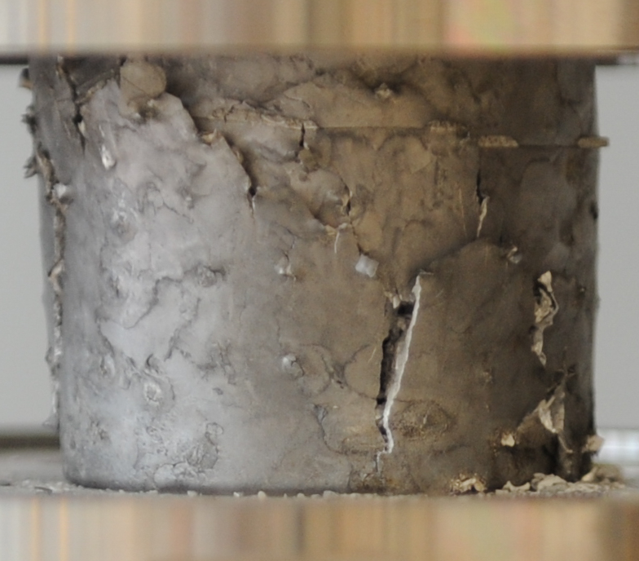
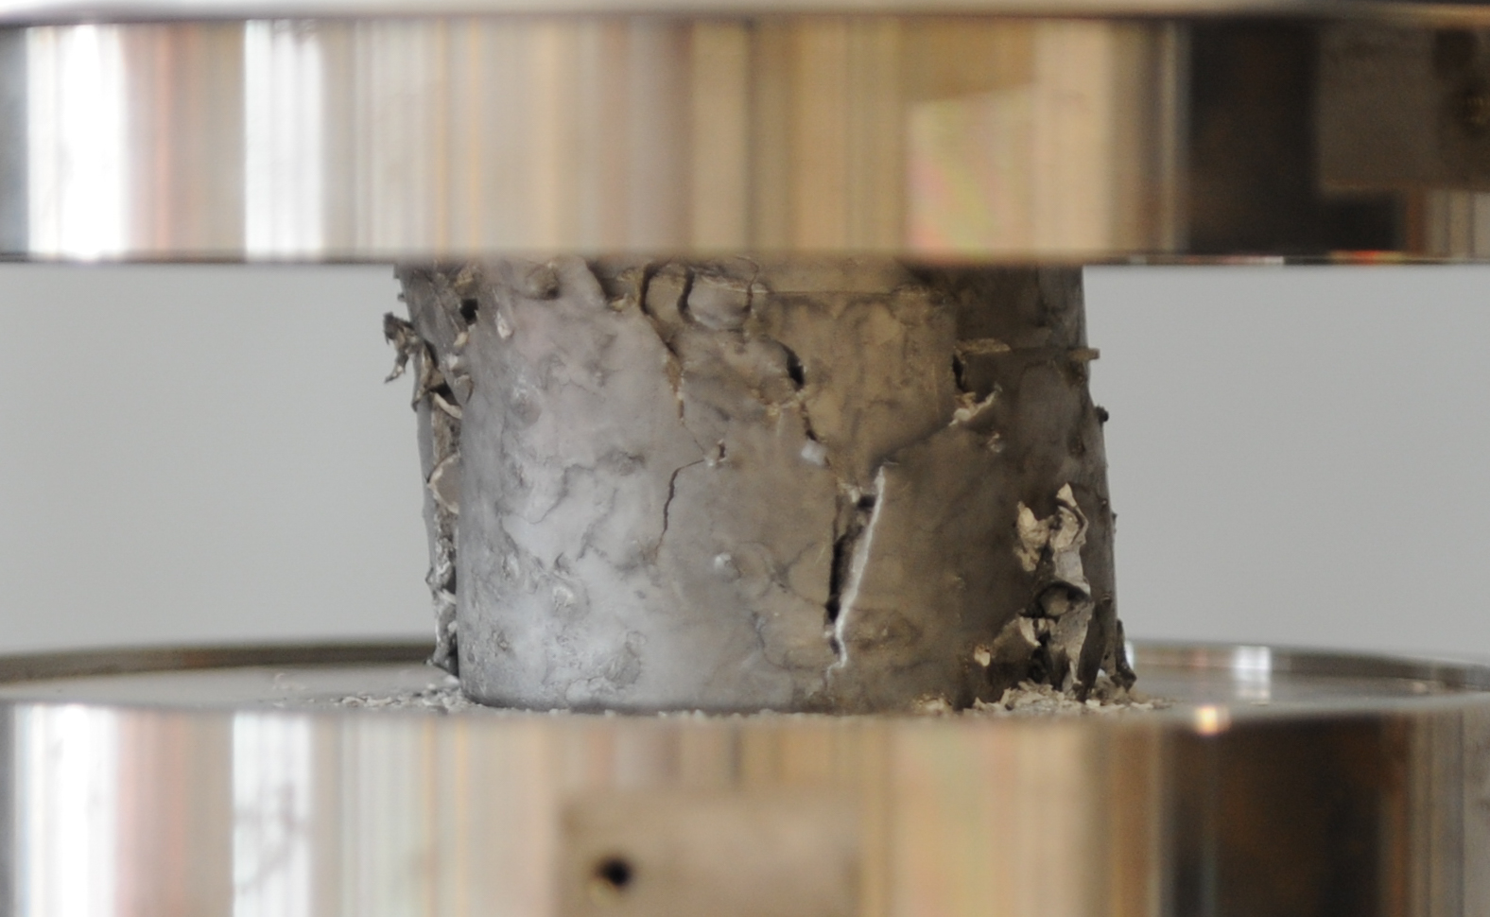
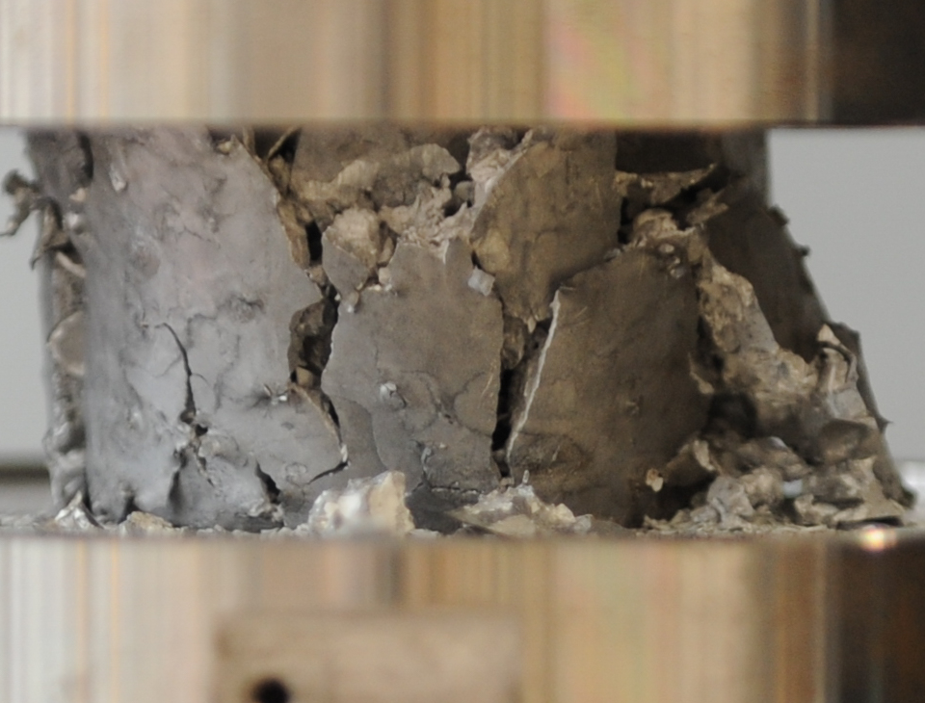
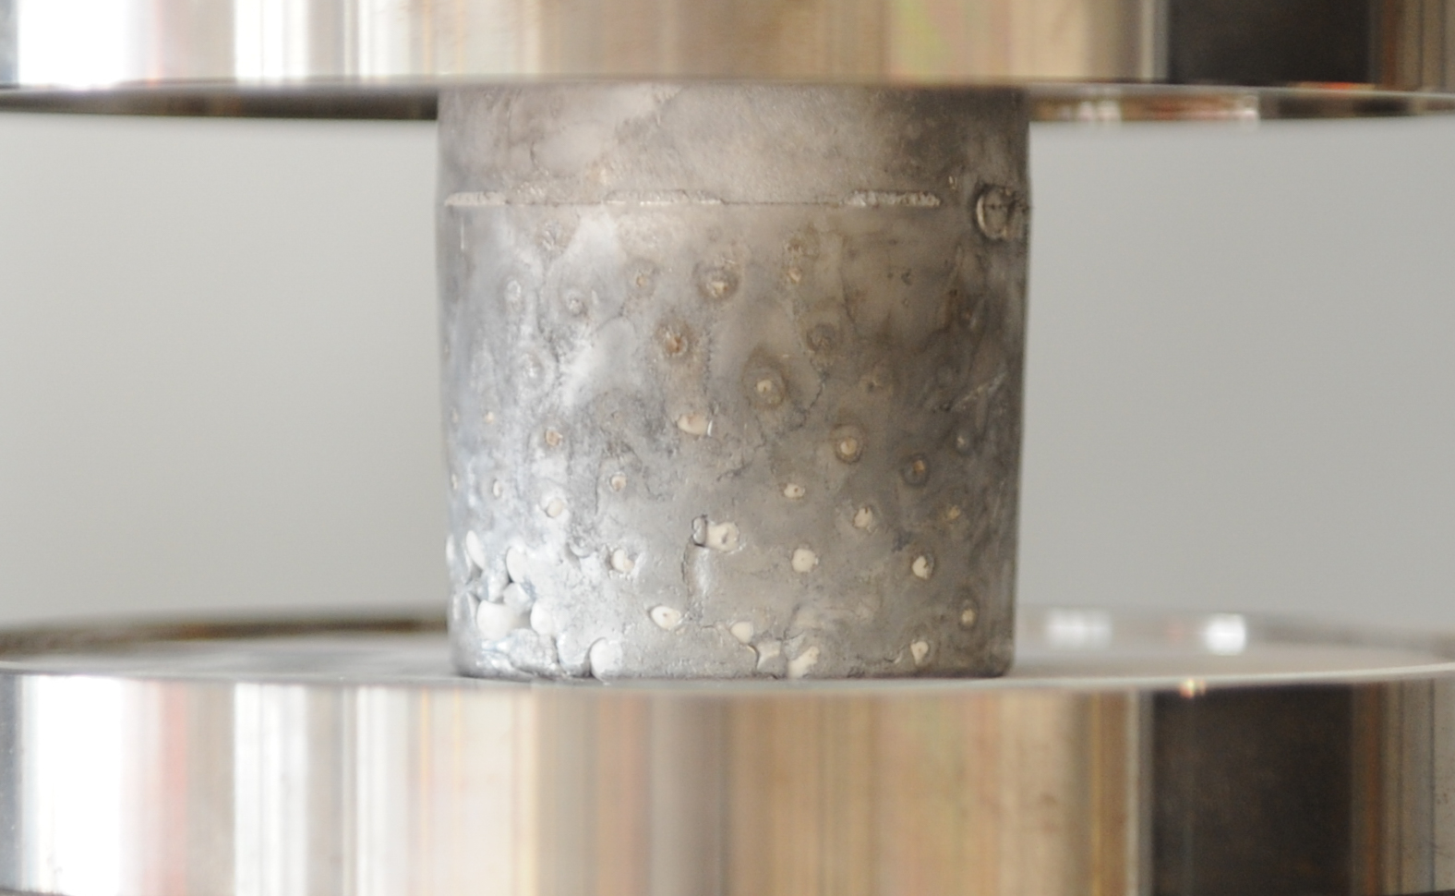
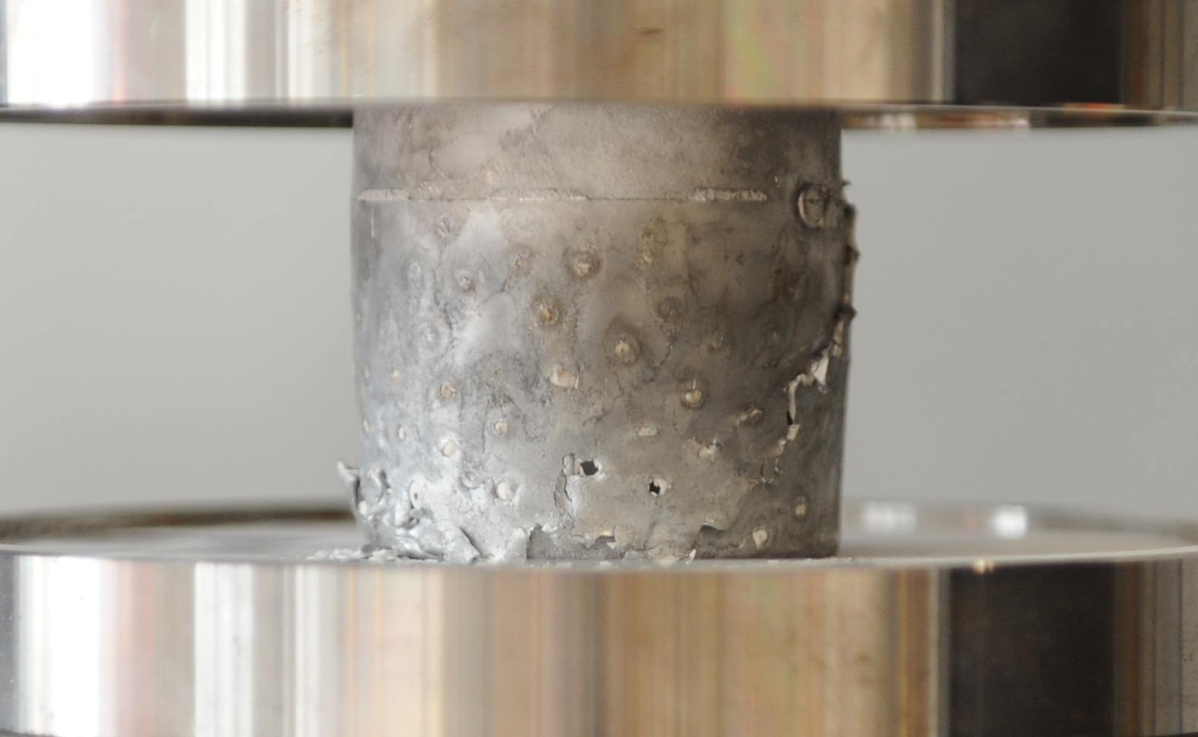
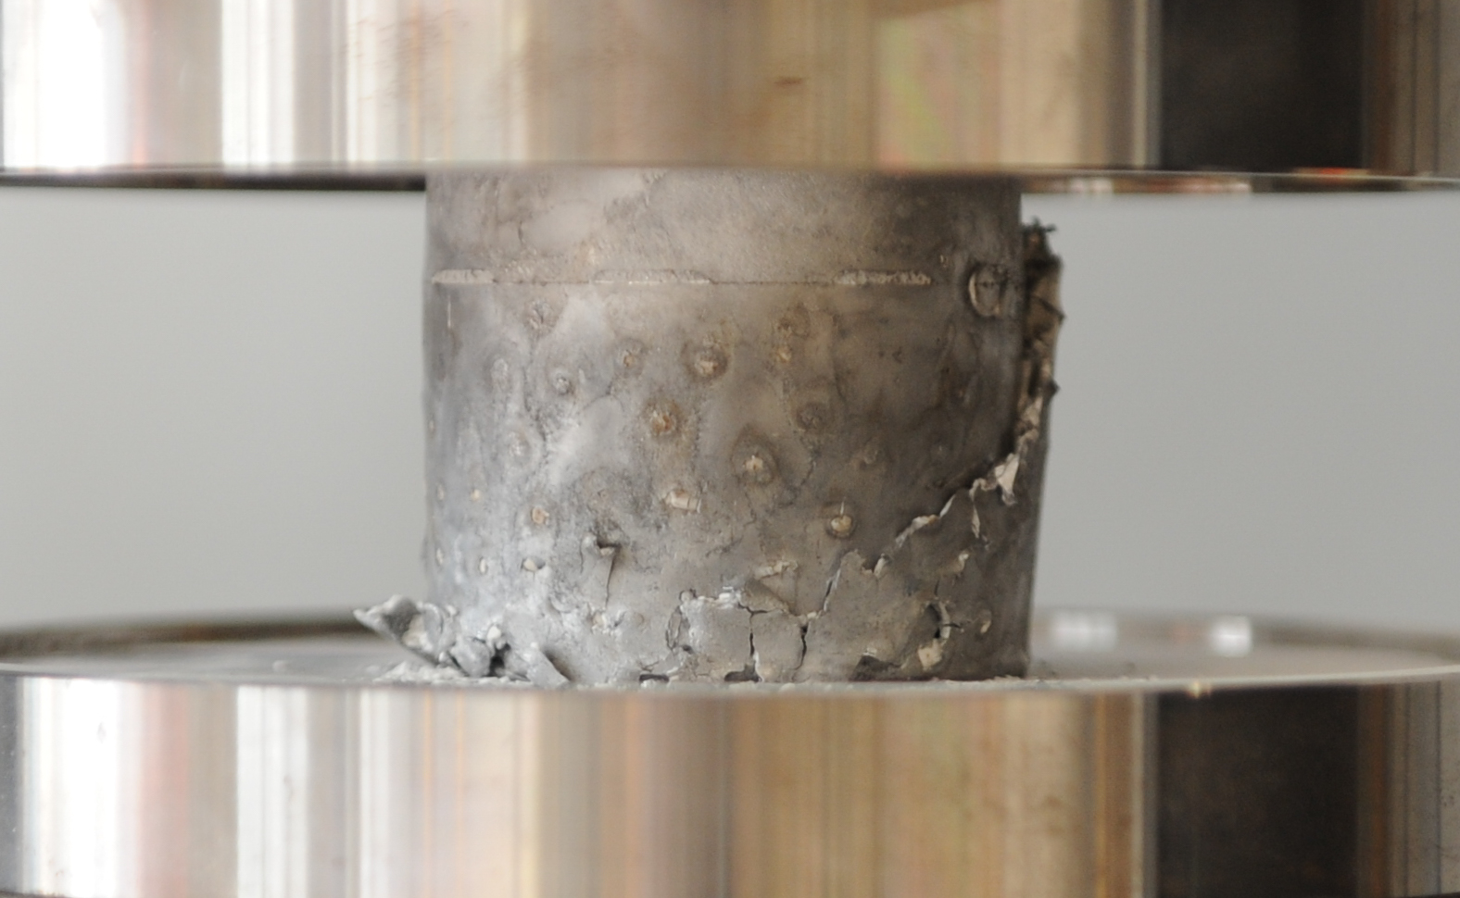
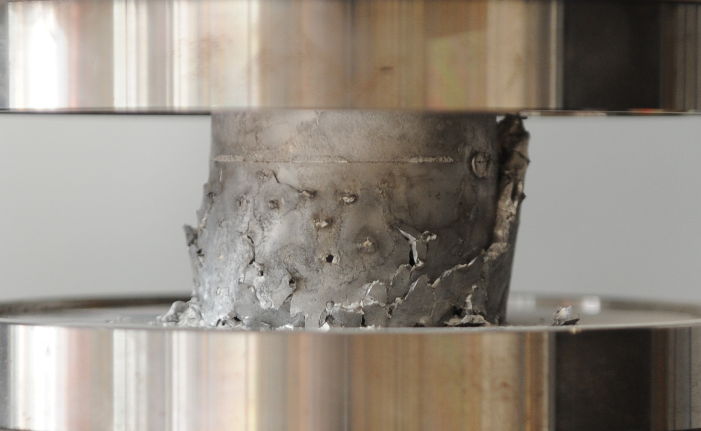
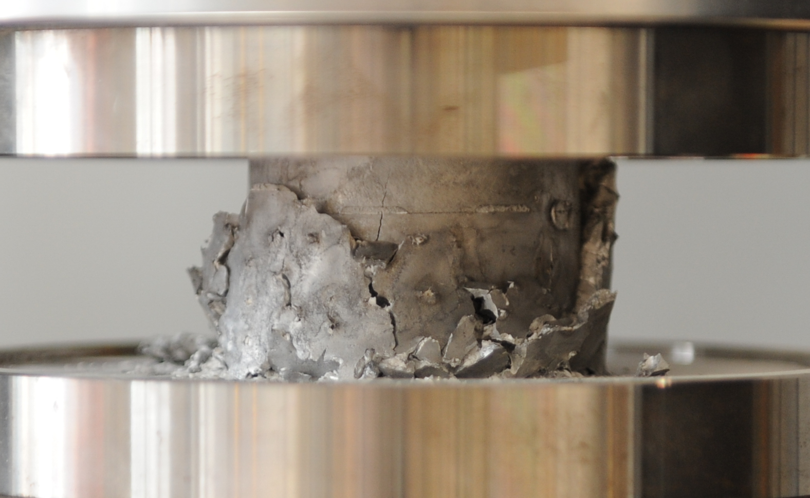
0_0
Supporting material
a)
0 MPa (0 bar)
b)
c)
d)
e)
~45°
ε=0
20 mm
ε=0.12
20 mm
ε=0.24
20 mm
ε=0.36
20 mm
ε=0.5
20 mm
A_140
a)
14 MPa (140 bar)
b)
c)
d)
e)
~45°
ε=0
20 mm
ε=0.12
20 mm
ε=0.24
20 mm
ε=0.36
20 mm
ε=0.5
20 mm

Slide 2
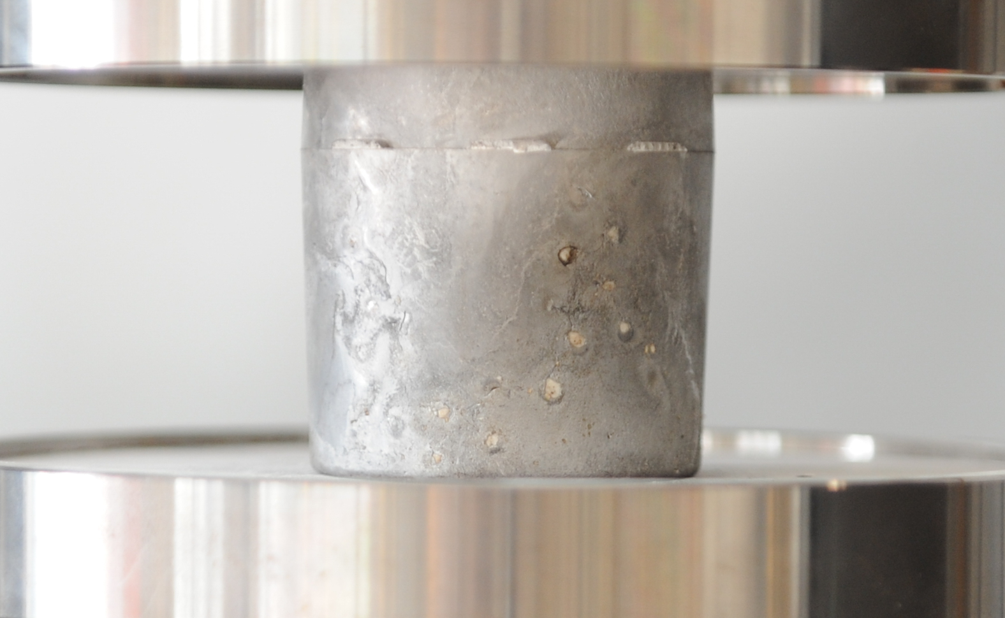
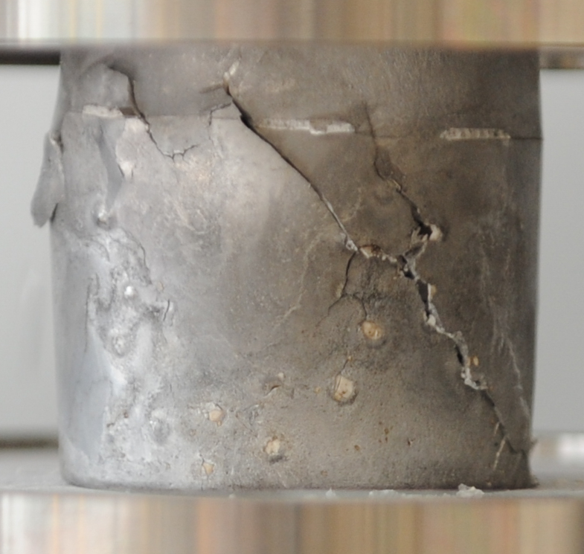
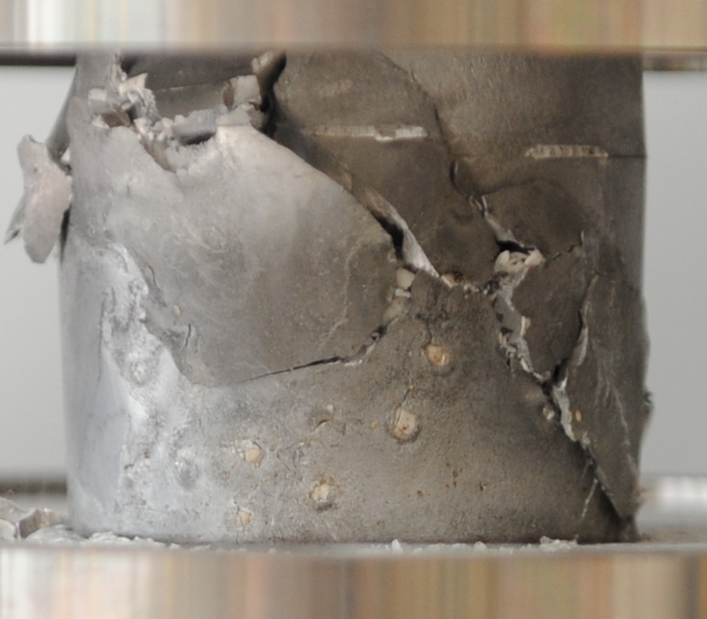
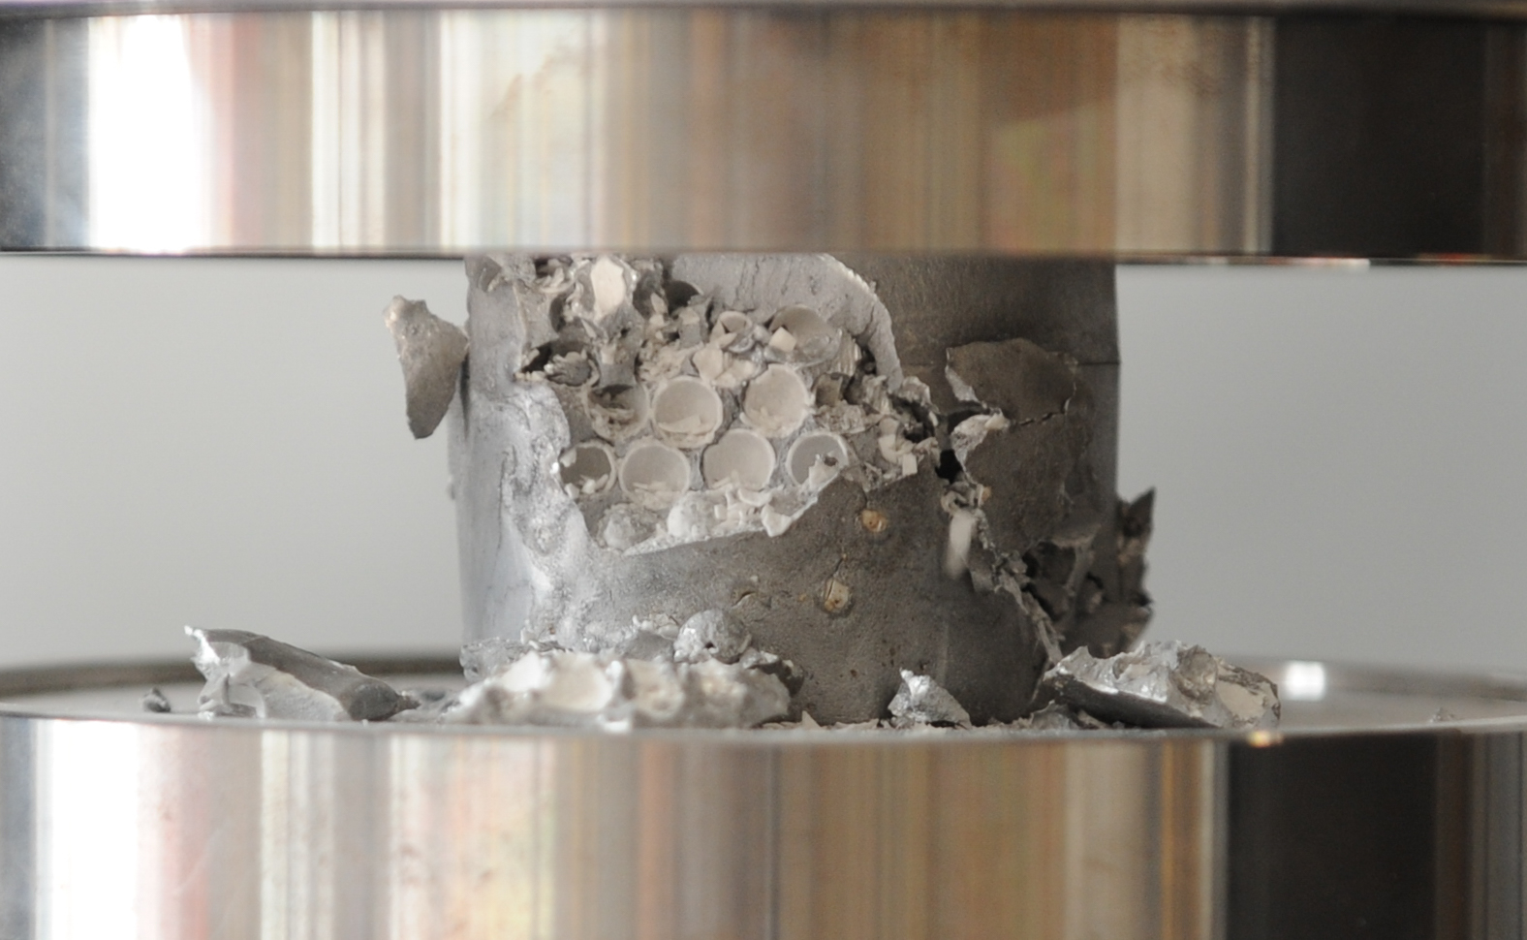
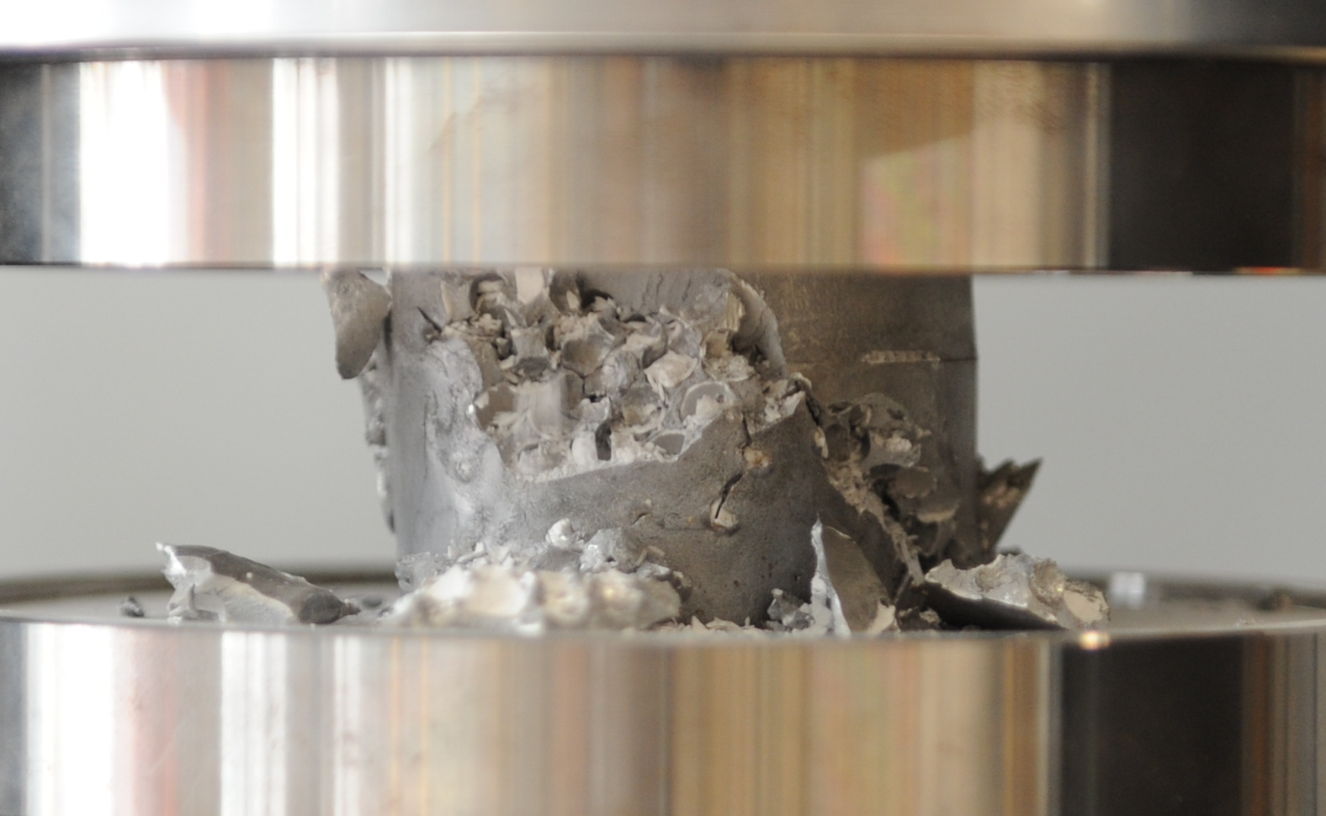
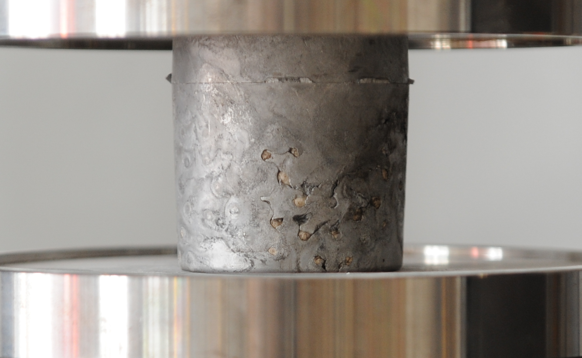
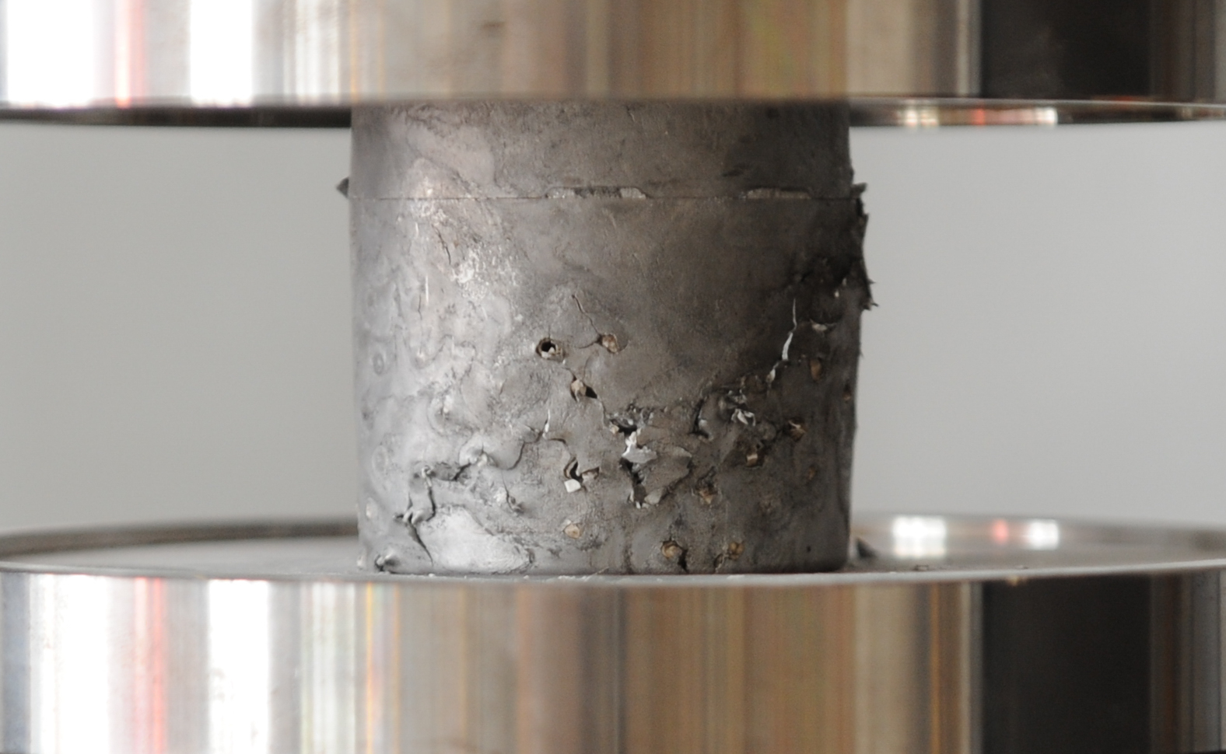
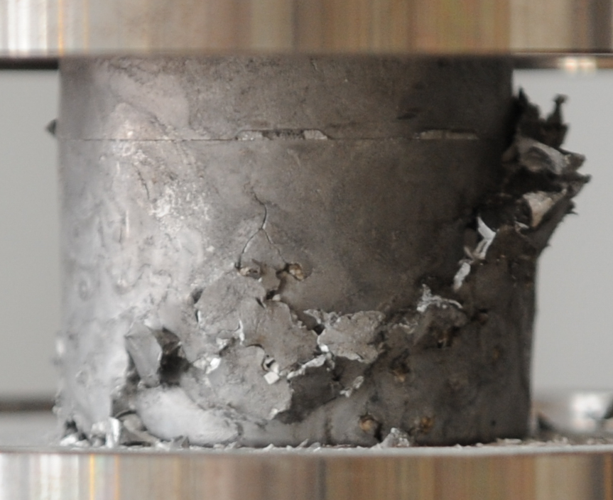
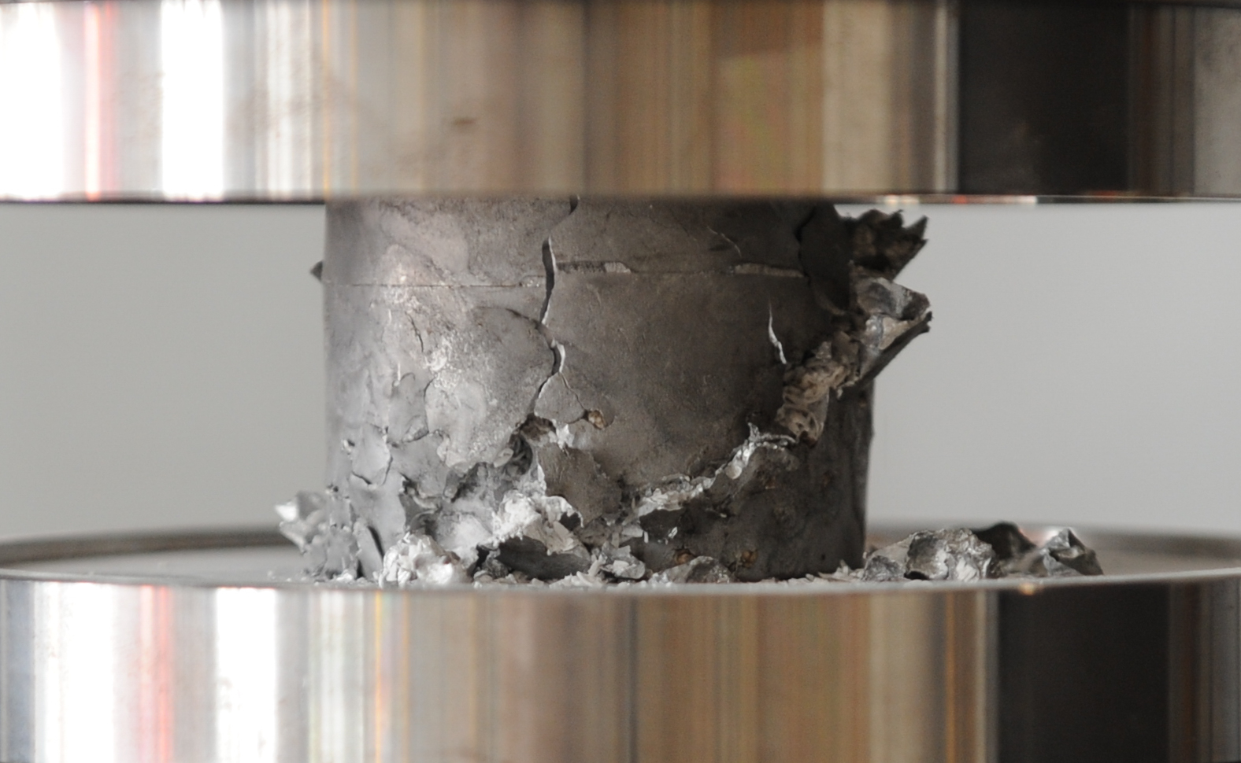
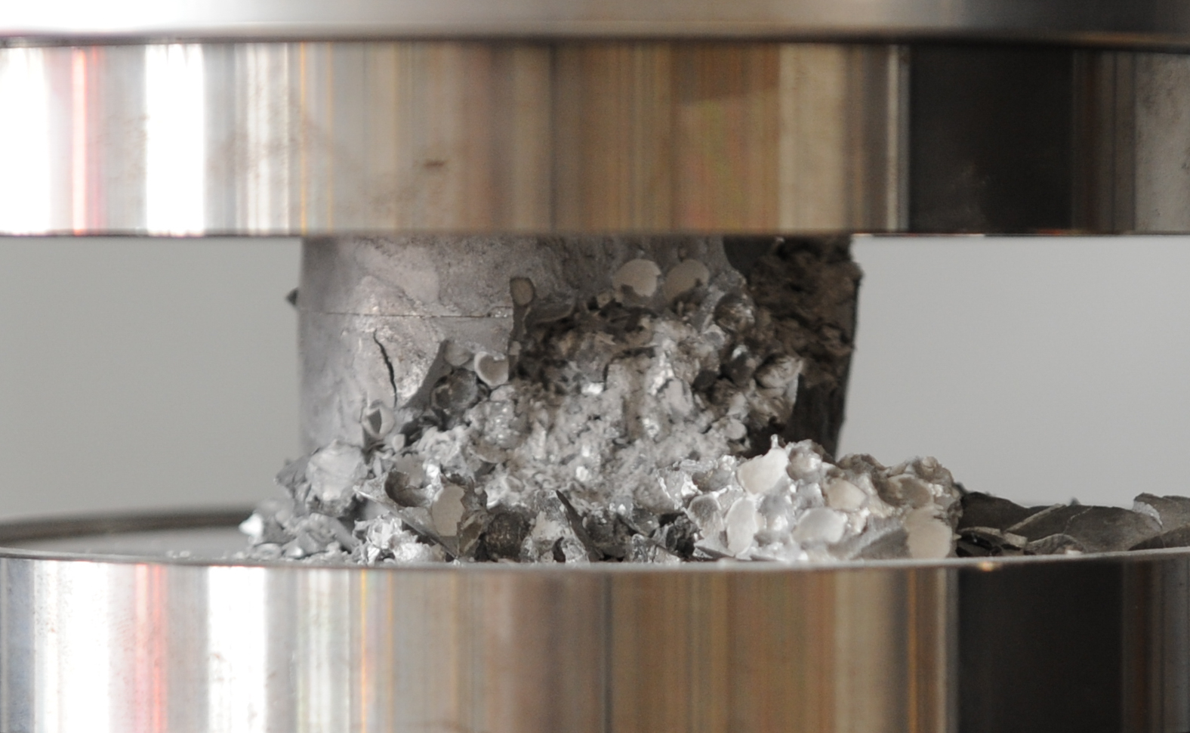
B_180
a)
18 MPa (180 bar)
b)
c)
d)
e)
~45°
ε=0
20 mm
ε=0.12
20 mm
ε=0.24
20 mm
ε=0.36
20 mm
ε=0.5
20 mm
C_(MF)_200
a)
20 MPa (200 bar)
b)
c)
d)
e)
~45°
ε=0
20 mm
ε=0.12
20 mm
ε=0.24
20 mm
ε=0.36
20 mm
ε=0.5
20 mm

Slide 3
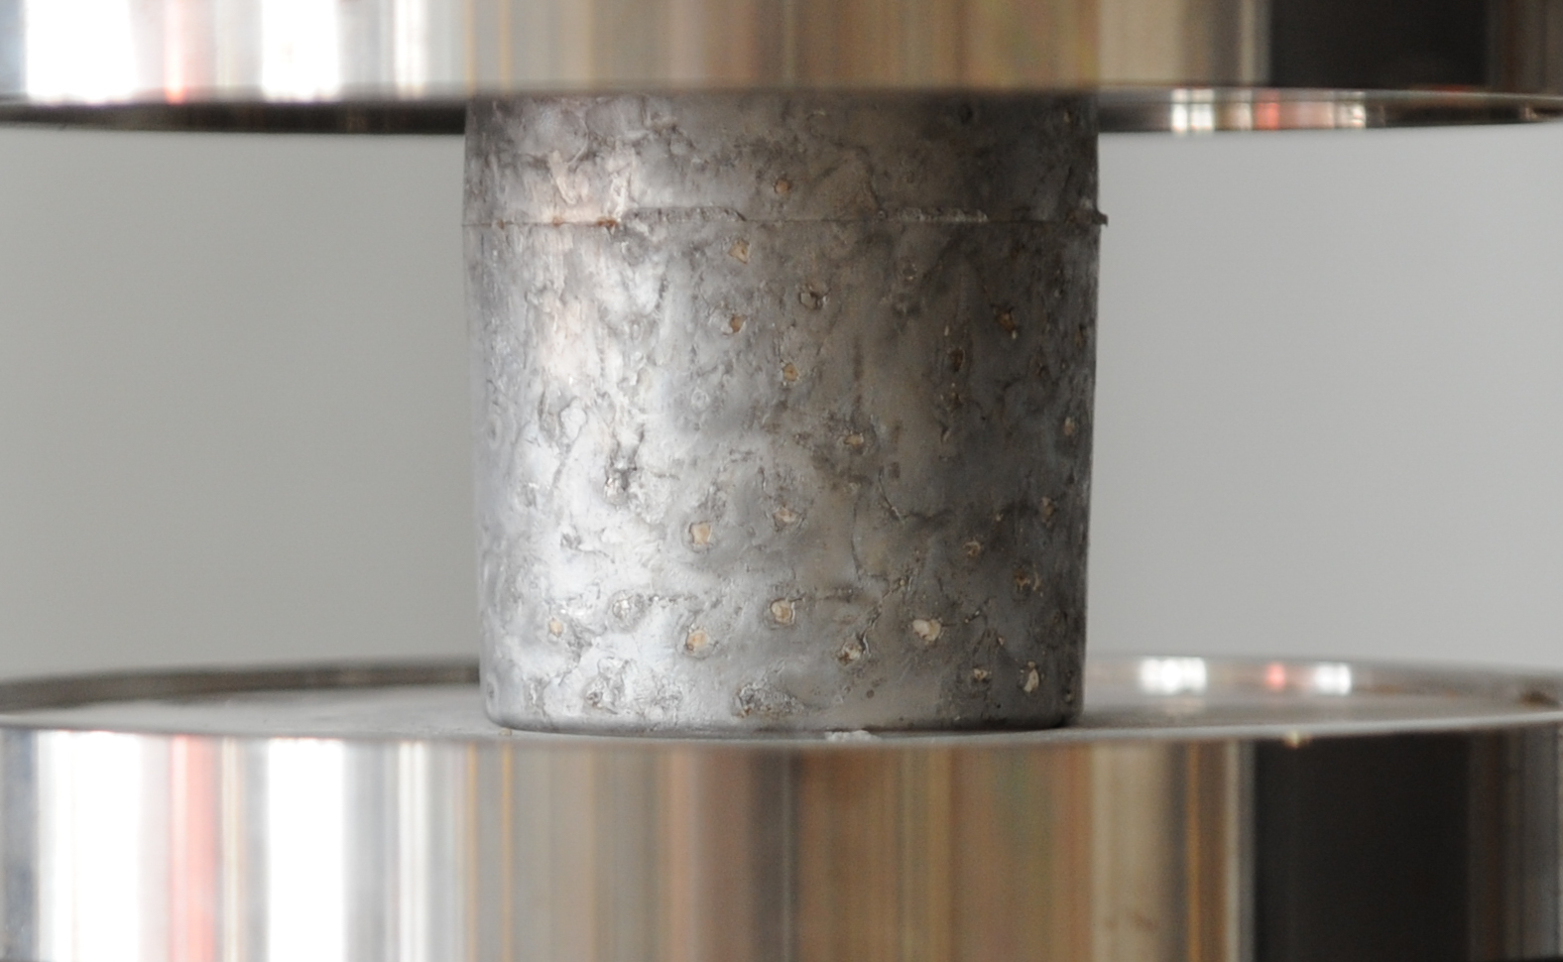
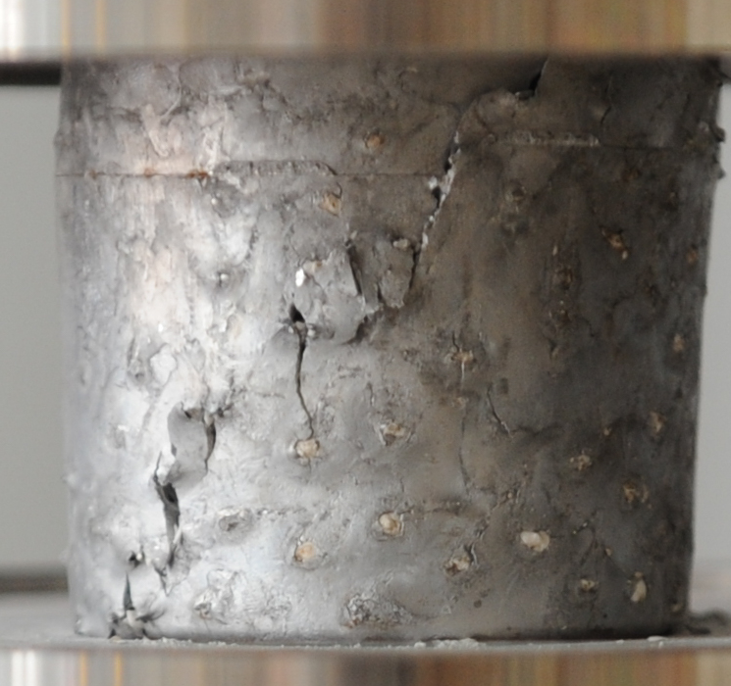
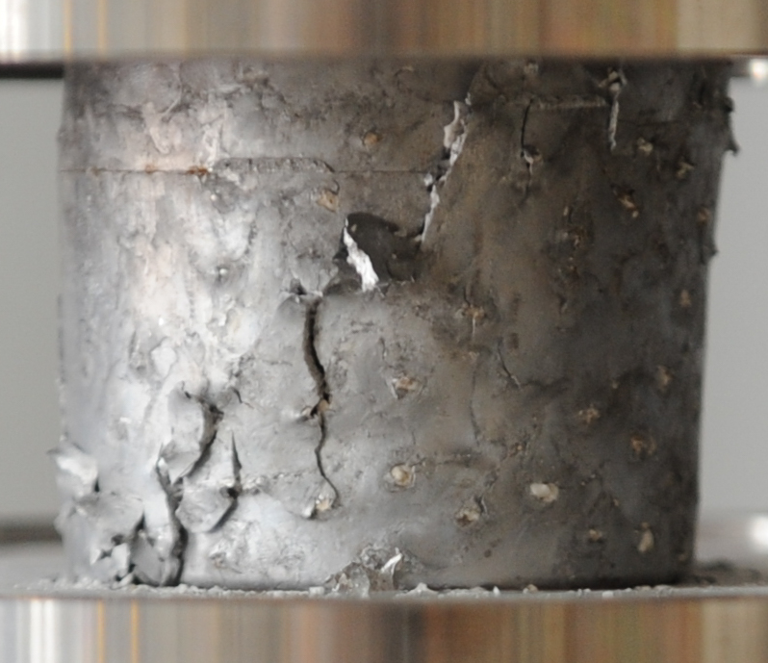
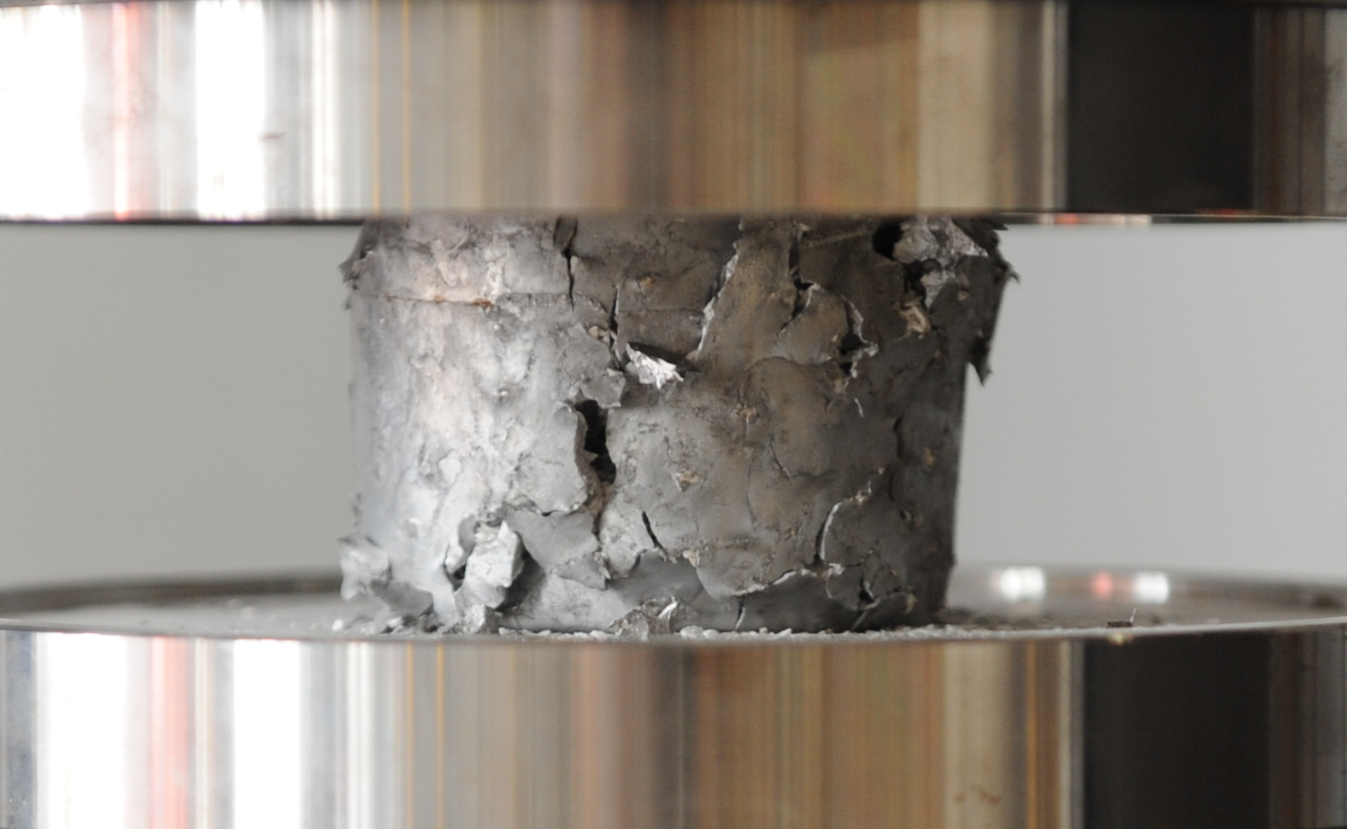
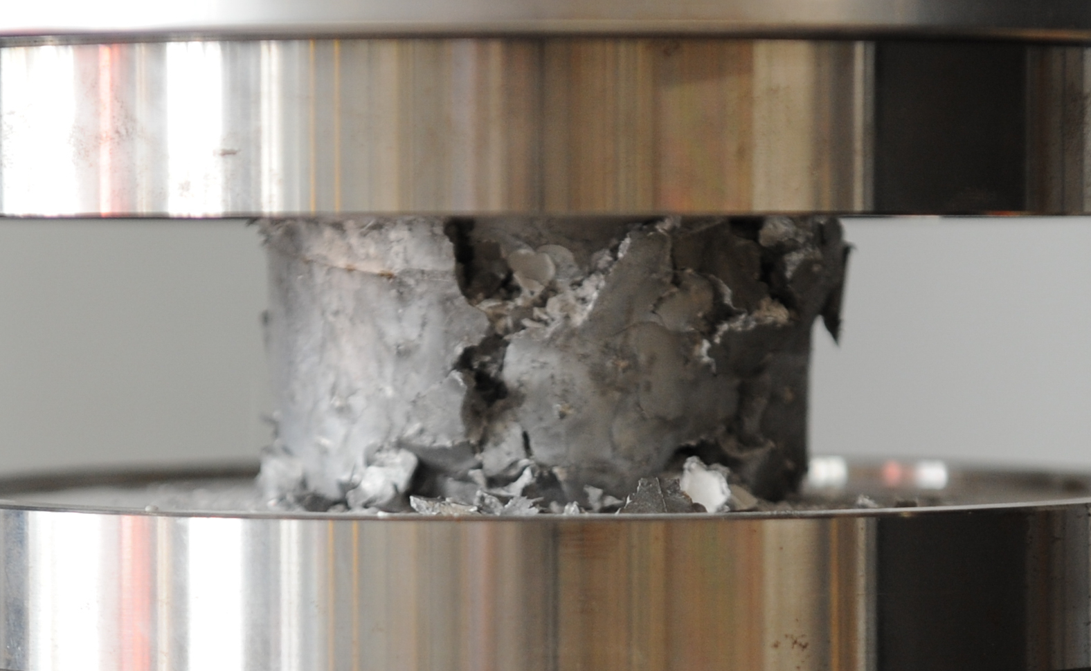
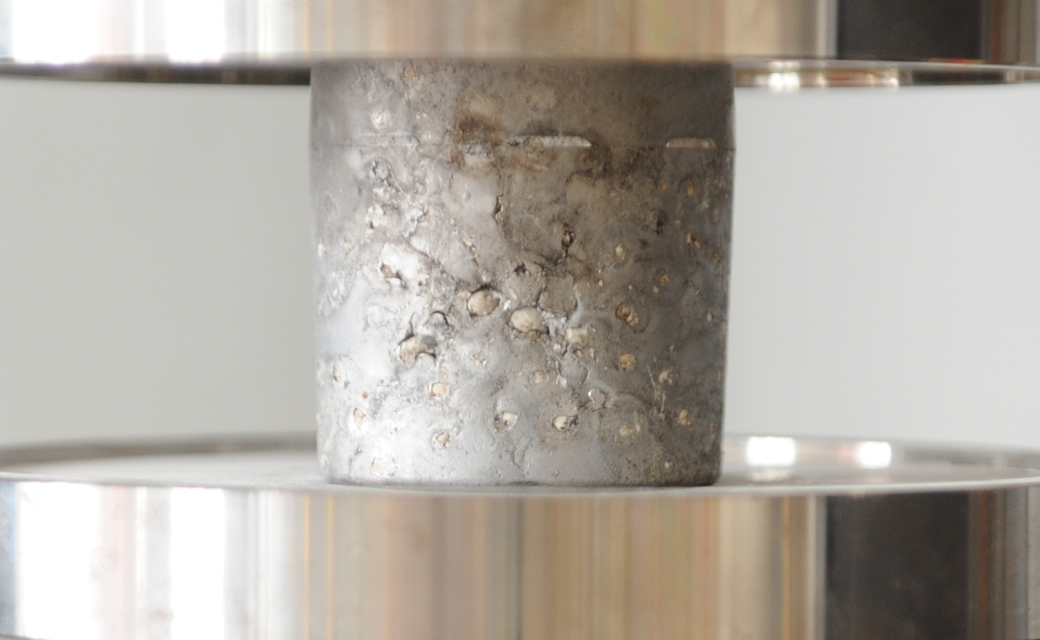
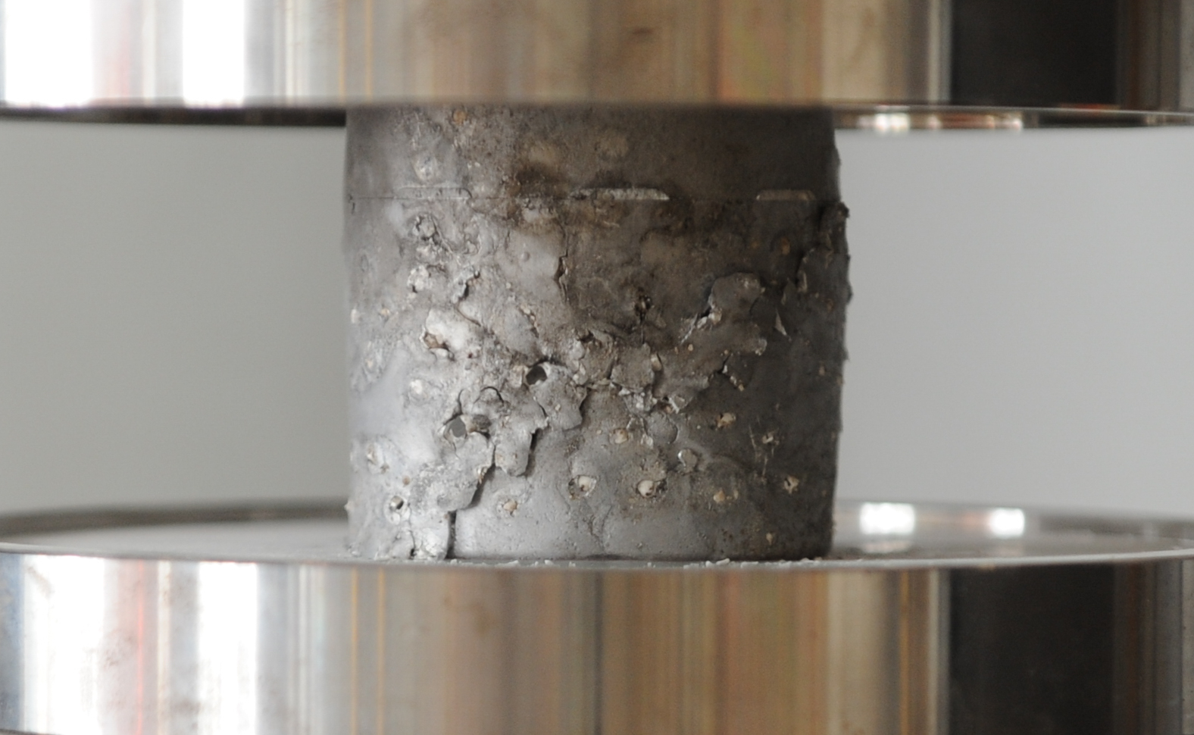
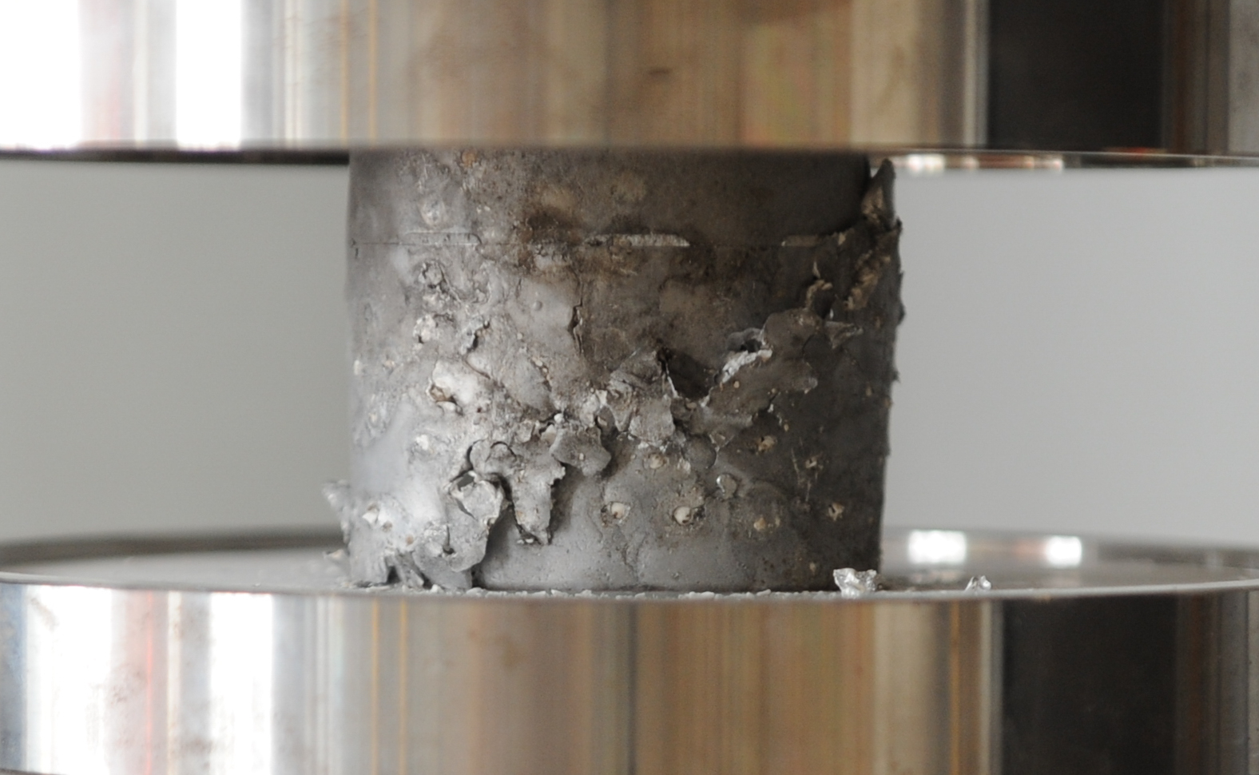
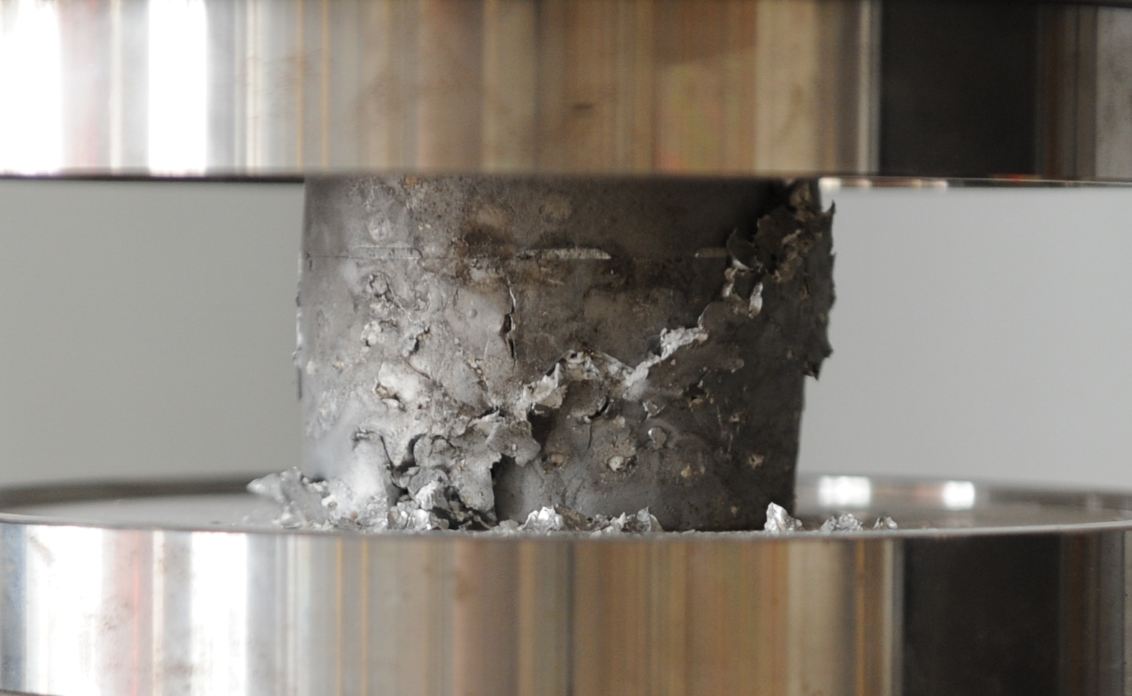
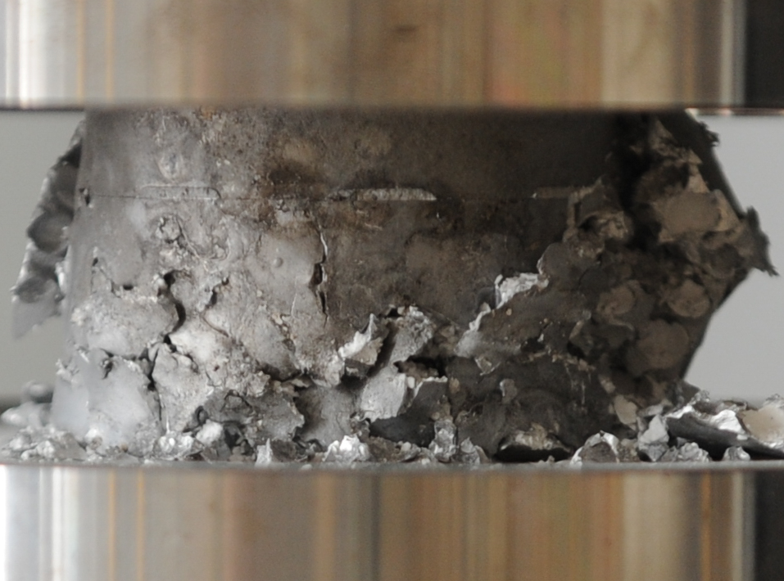
D_220
a)
22 MPa (220 bar)
b)
c)
d)
e)
~45°
ε=0
20 mm
ε=0.12
20 mm
ε=0.24
20 mm
ε=0.36
20 mm
ε=0.5
20 mm
E_(MF)_240
a)
24 MPa (240 bar)
b)
c)
d)
e)
~45°
ε=0
20 mm
ε=0.12
20 mm
ε=0.24
20 mm
ε=0.36
20 mm
ε=0.5
20 mm

Slide 4
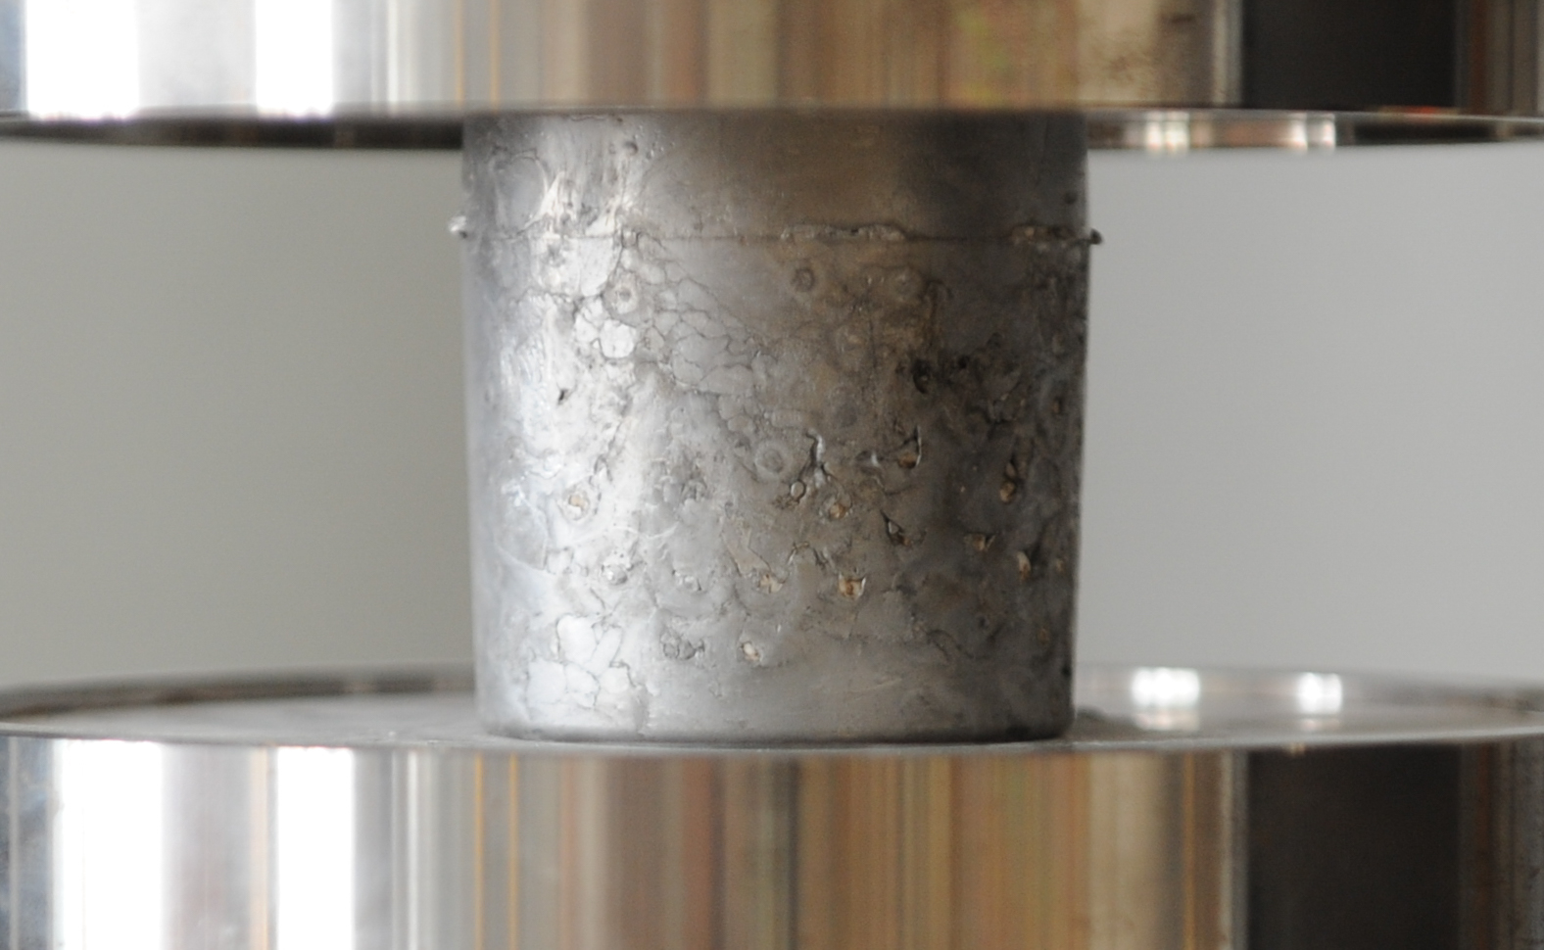
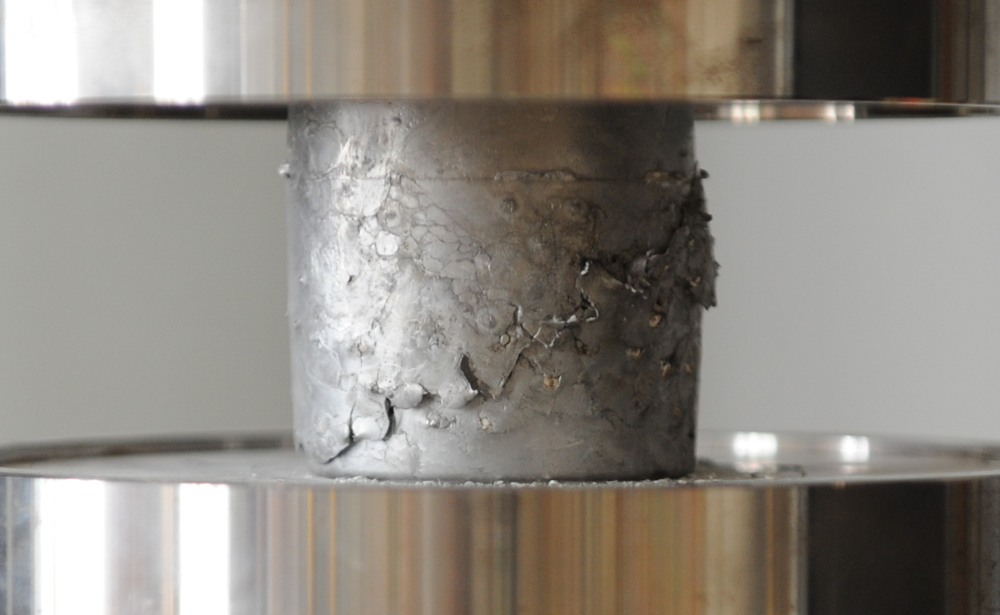
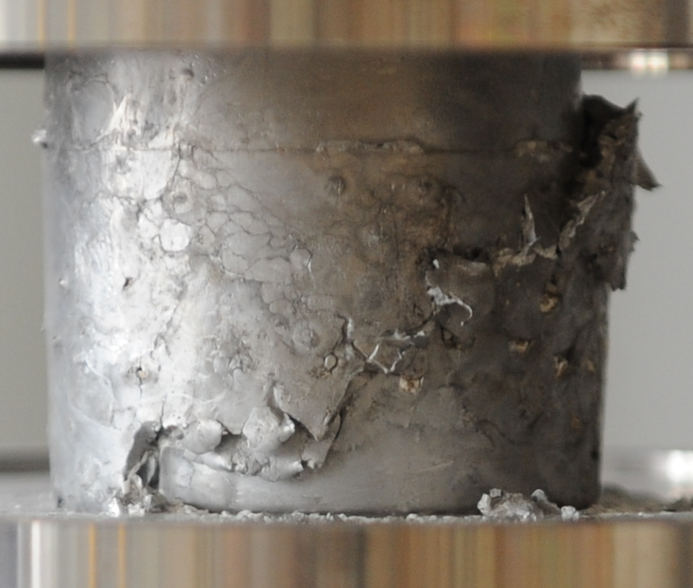
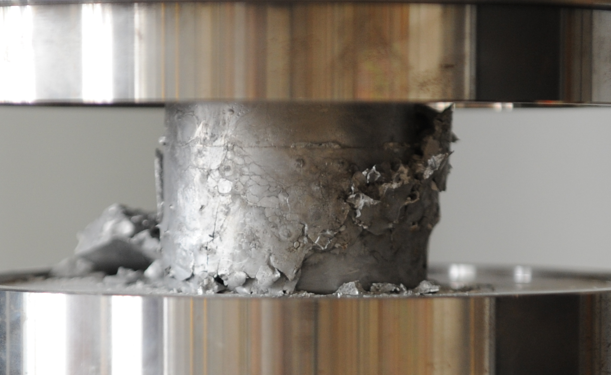
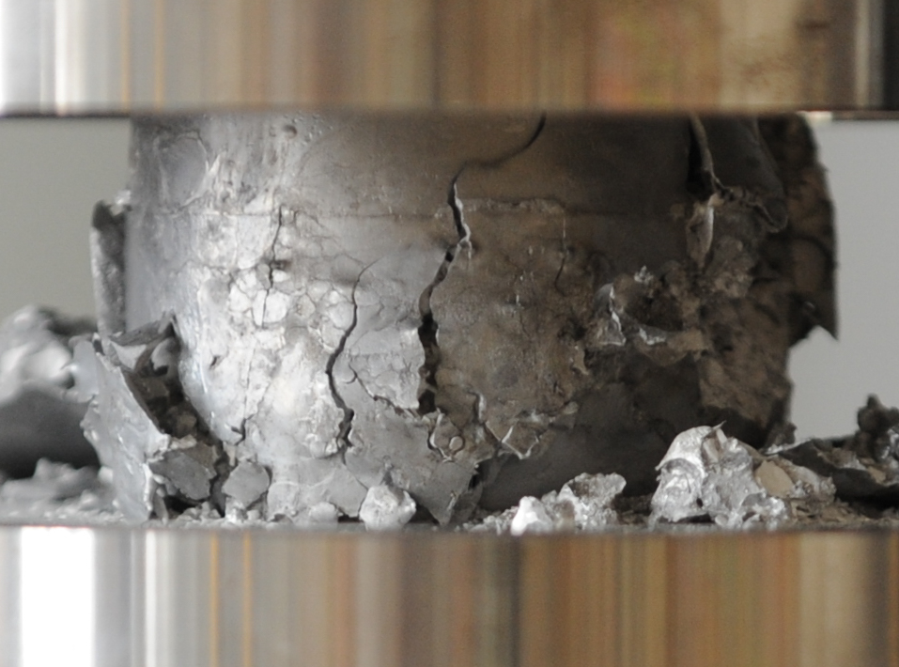
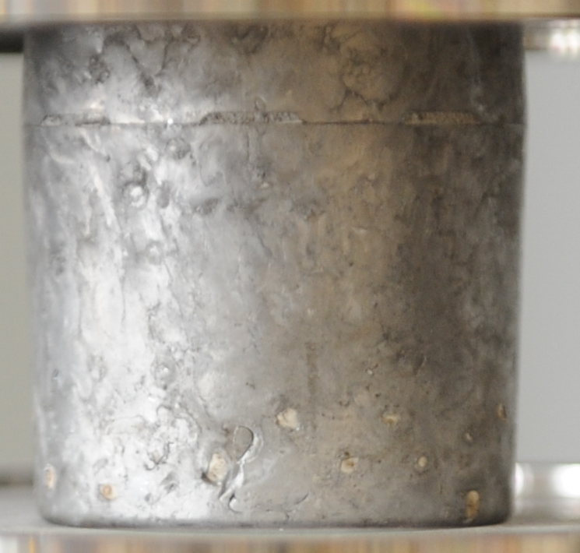
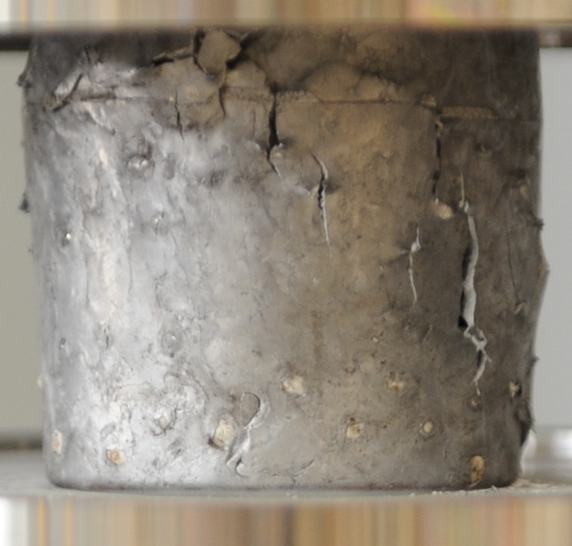
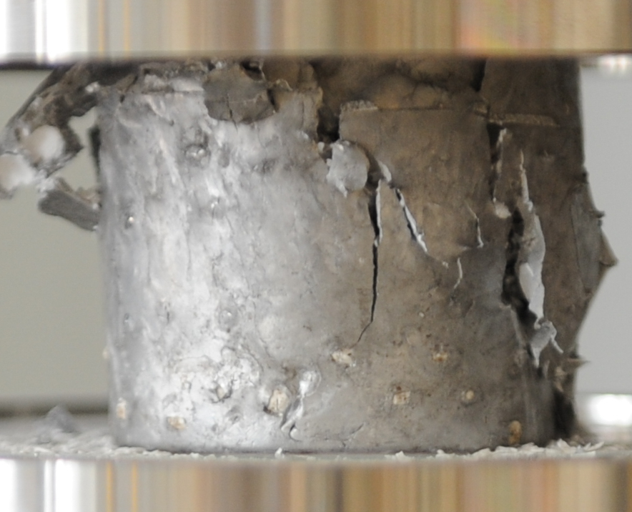
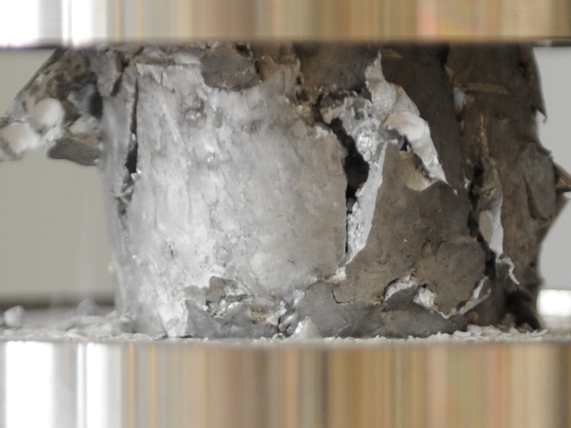
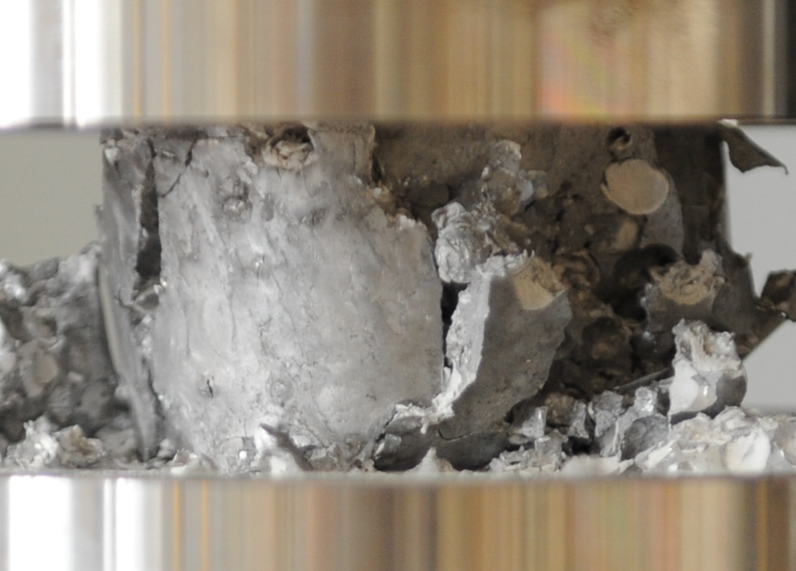
F_260
a)
26 MPa (260 bar)
b)
c)
d)
e)
~45°
ε=0
20 mm
ε=0.12
20 mm
ε=0.24
20 mm
ε=0.36
20 mm
ε=0.5
20 mm
G_280
a)
28 MPa (280 bar)
b)
c)
d)
e)
~45°
ε=0
20 mm
ε=0.12
20 mm
ε=0.24
20 mm
ε=0.36
20 mm
ε=0.5
20 mm

