Slide 1
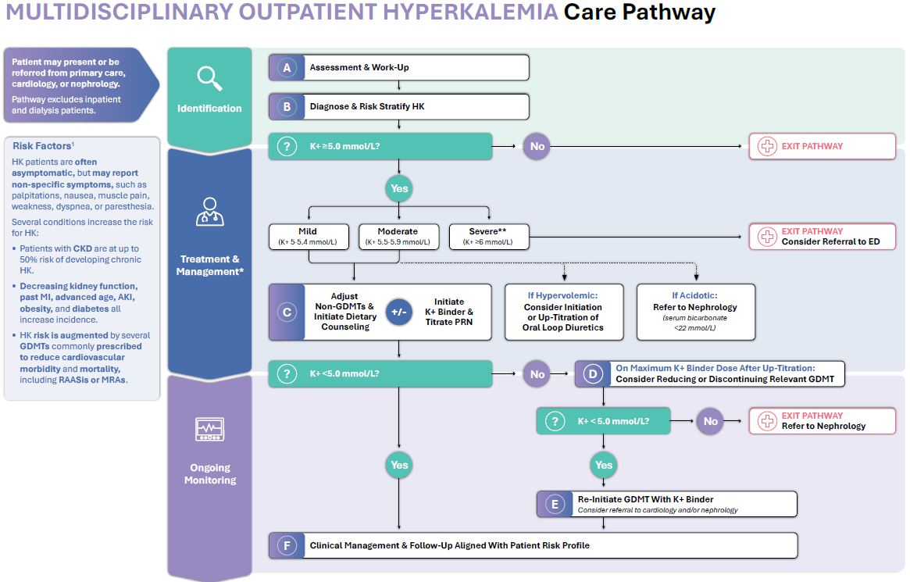
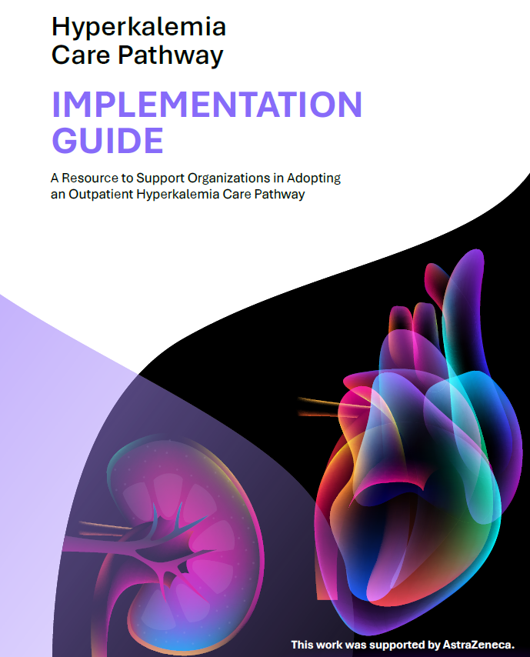
A Multidisciplinary Consensus-Driven Hyperkalemia Care Pathway:
Development, Rationale, and Clinical Recommendations
BACKGROUND
Hyperkalemia is a common and potentially life-threatening electrolyte disorder often associated with CKD and HF. Outpatient approaches remain variable, often resulting in inconsistent treatment and premature discontinuation of GDMTs.
OUTCOME
The consensus Multidisciplinary Outpatient Hyperkalemia Care Pathway provides a pragmatic, specialty-aligned framework that integrates early identification, risk stratification, treatment sequencing, and severity-based monitoring.
METHODOLOGY
A panel of clinician advisors created an outpatient hyperkalemia CP aligned to 4 key principals:
1) prioritize early assessment and risk stratification
2) preserve GDMT when feasible
3) encourage cross-specialty collaboration
4) reduce preventable ED visits
NEXT STEPS
Organizations can use the accompanying Hyperkalemia CP Implementation Guide to support implementation efforts.
Future opportunities should focus on implementing the CP via feasibility pilots and generating real-world evidence.
The Multidisciplinary Outpatient Hyperkalemia Care Pathway provides a structured approach designed to reduce hyperkalemia care variability and support coordinated multidisciplinary care when implemented in clinical practice.
CKD, chronic kidney disease; ED; Emergency Department; HF, heart failure; GDMTs, guideline-directed medical therapies
Bhatt et al.

