Slide 1
Additional File 3: Uncropped blots
GPER in murine astrocytes and mural cells promotes neurovascular coupling and Aβ clearance
Mengjiao Xu, Ke Chen, Meimei Wu, Huashan Gong, Ping Luo, Jing Wang and Weifang Rong
Additional File 3. Uncropped blots corresponding to Figure 2c, 3m, 9e and 9f as labeled. Biorad dual color protein ladder was used in all blots. Dotted lines represent approximate cropped region used as a representative image in corresponding figure.

Slide 2
Figure 2c
6E10
APP/PS1
β-actin
APP/PS1
WT
GPER-KO
GPER-KO
WT
100
50
42
20
HPC
Cx
Figure 3m
6E10
β-actin
APP/PS1; GFAP^{cre}-GPER^{fl/fl}
APP/PS1; GFAP^{cre}-GPER^{fl/fl}
APP/PS1; GPER^{fl/fl}
APP/PS1; GPER^{fl/fl}
GPER^{fl/fl}
GPER^{fl/fl}
100
50
42
20
HPC
Cx

Slide 3
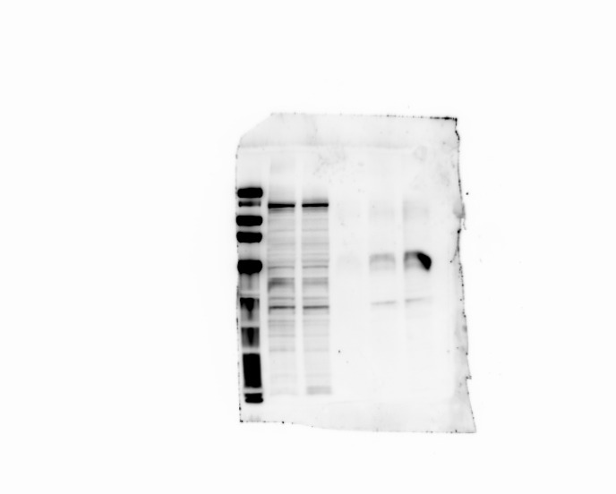
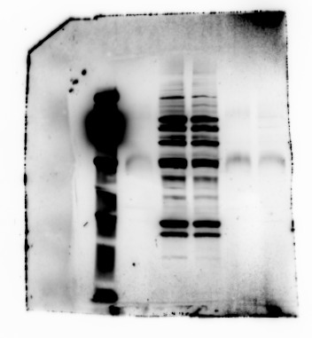
Figure 9e
6E10
APP/PS1-Input
APP/PS1-IP
WT-Input
control IgG
WT-IP
100
50
Figure 9f
GPER
control IgG
APP/PS1-Input
WT-Input
APP/PS1-IP
WT-IP
100
50

