Slide 1
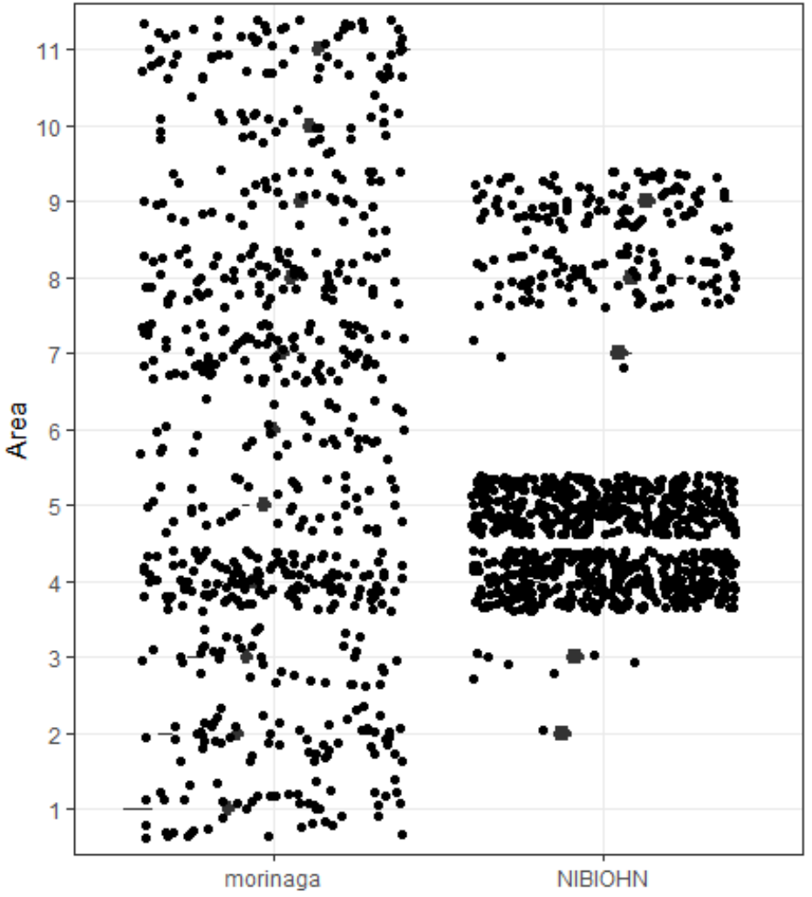
NIBIOHN
MORINAGA
Figure S1. The distribution of area in two cohorts (left: NIBIOHN cohort, right: MORINAGA cohort).
1:Hokkaido; 2: Aomori, Iwate, Miyagi, Akita, Yamagata, Fukushima; 3: Ibaraki, Tochigi, Gunma; 4: Tokyo, Kanagawa, Chiba, Saitama; 5: Niigata, Nagano, Yamanashi; 6: Toyama, Ishikawa, Fukui; 7: Gifu, Shizuoka, Aichi, Mie; 8: Shiga, Kyoto, Osaka, Hyogo, Nara, Wakayama; 9: Tottori, Shimane, Okayama, Hiroshima, Yamaguchi; 10: Tokushima, Kagawa, Ehime, Kochi; 11: Fukuoka, Saga, Nagasaki, Kumamoto, Oita, Miyazaki, Kagoshima, Okinawa; 12:oversea

