Slide 1
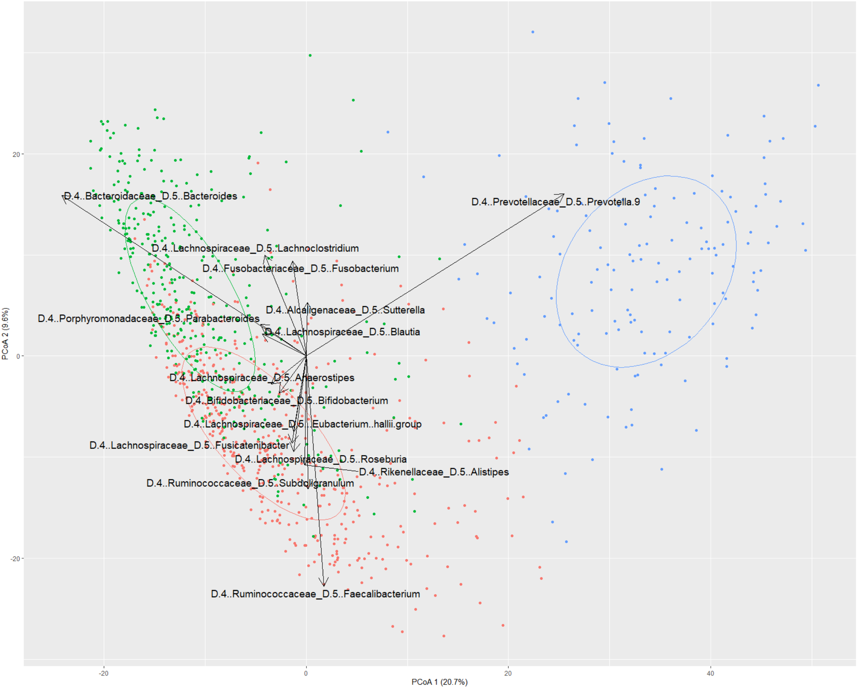
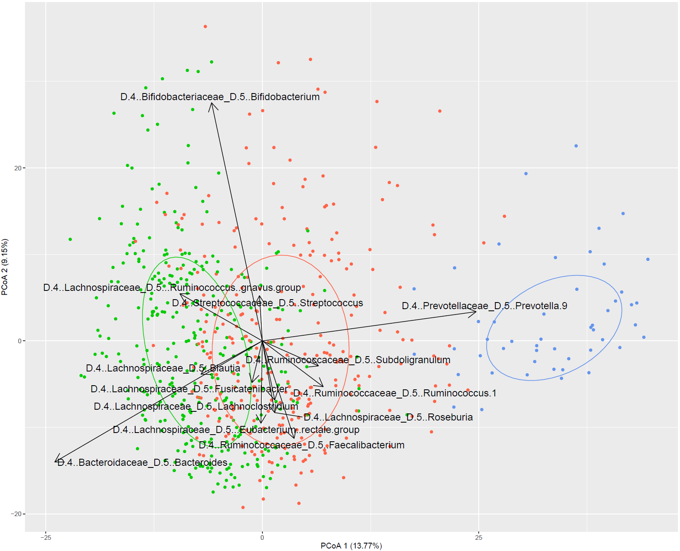
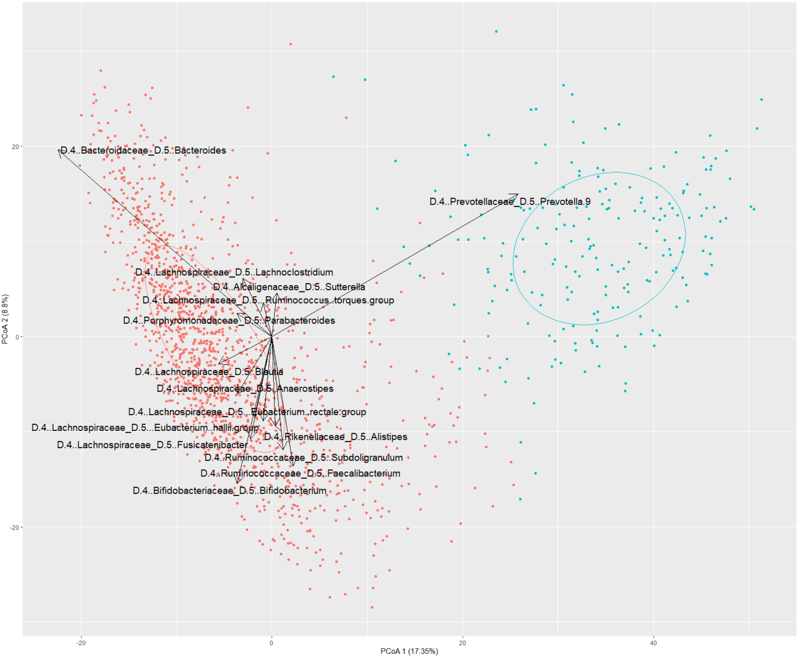
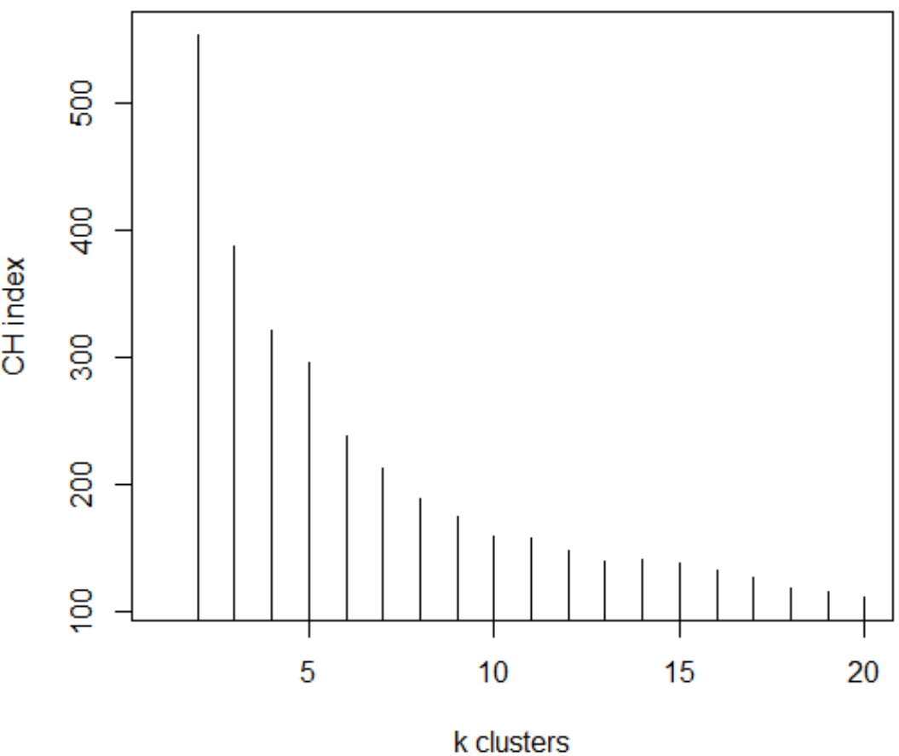
(a)
(b)
NIBIOHN
MORINAGA
(c)
(d)
Merged
Figure S2. Gut microbiota distribution of NIBIOHN cohort (a), MORINAGA cohort (b) and the merged data of the two cohorts (c) by principal coordinates analysis (PCoA, genus-level JSD) and PAM clustering. Arrows indicated the ordination of dominant genus. (d) The estimated result of suitability of cluster number Calinski-Harabasz Index (CH index) on the two cohorts-merged data.

