Slide 1
Appendix A

Slide 2
Video #1
Basic knowledge about hypertension: definition, diagnosis, and blood pressure control.

Slide 3
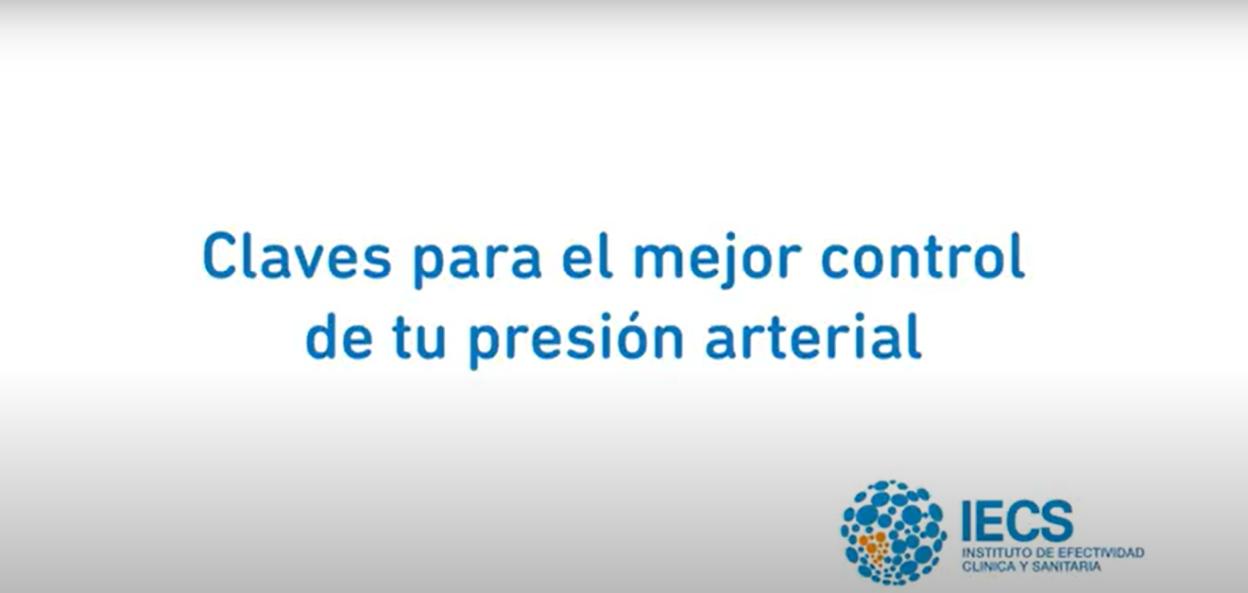
“Keys to better control of your blood pressure”

Slide 4
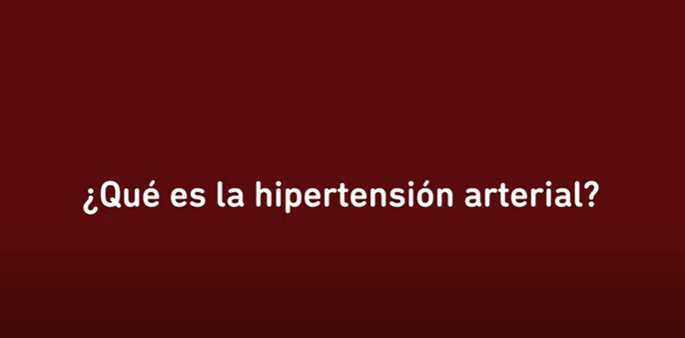
What is high blood pressure?

Slide 5
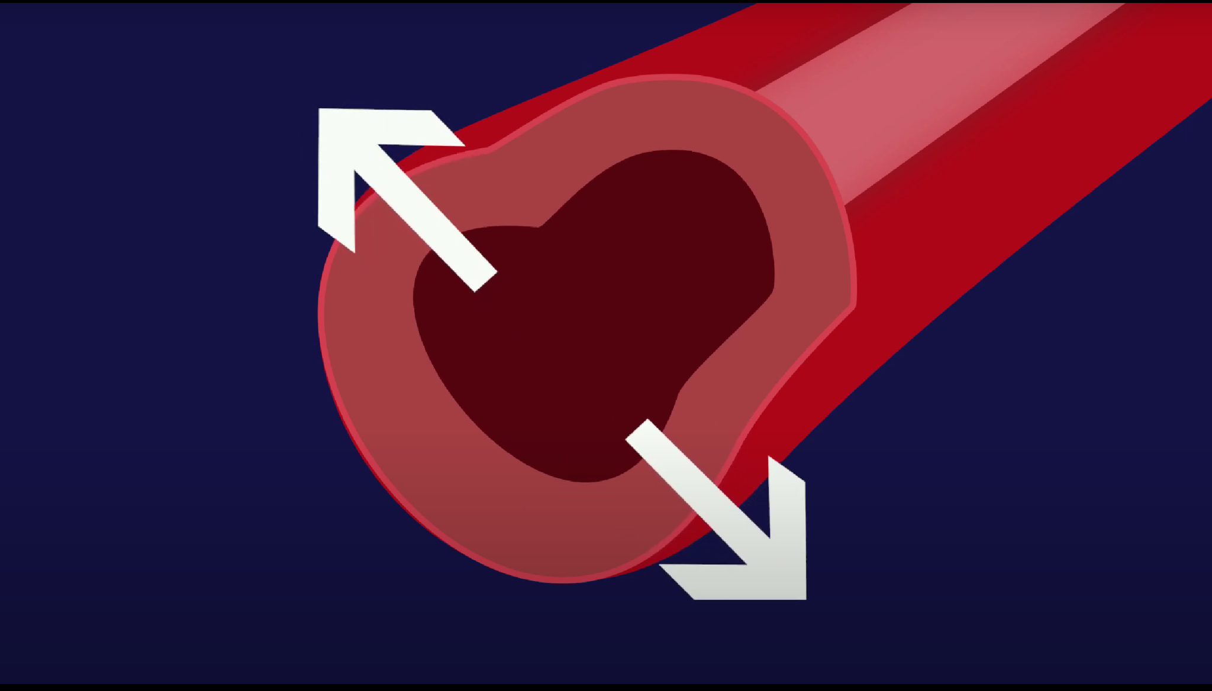
It is an increase in the force that your blood exerts on the walls of your body’s arteries.

Slide 6
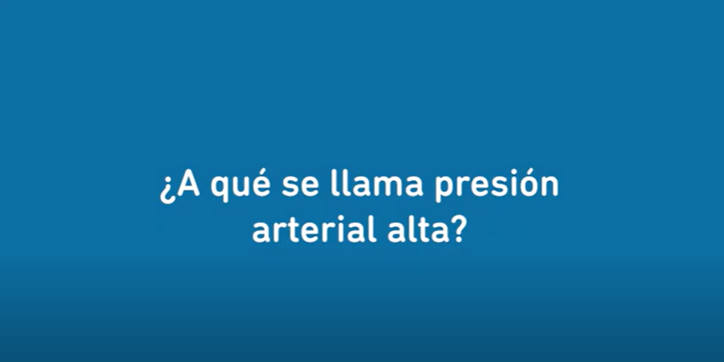
When are you considered to have high blood pressure?

Slide 7
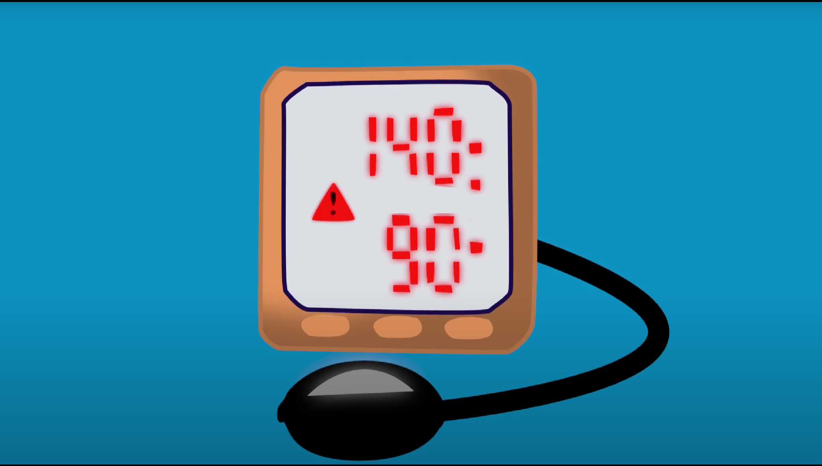
Blood pressure is considered high when your values are equal to or above 140 for the maximum and 90 for the minimum.

Slide 8
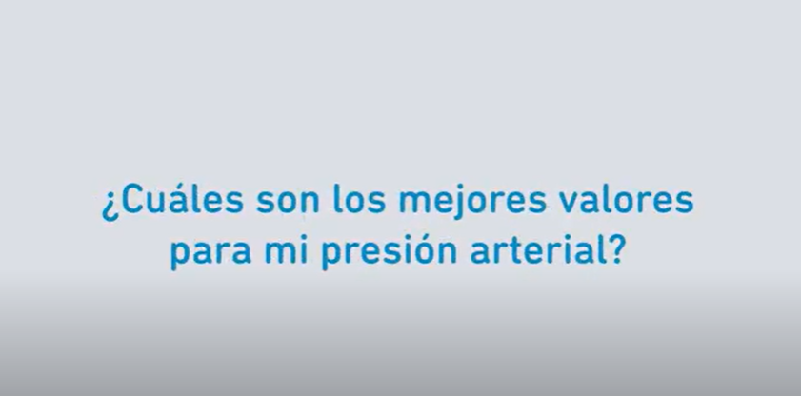
What are the best values for my blood pressure?

Slide 9
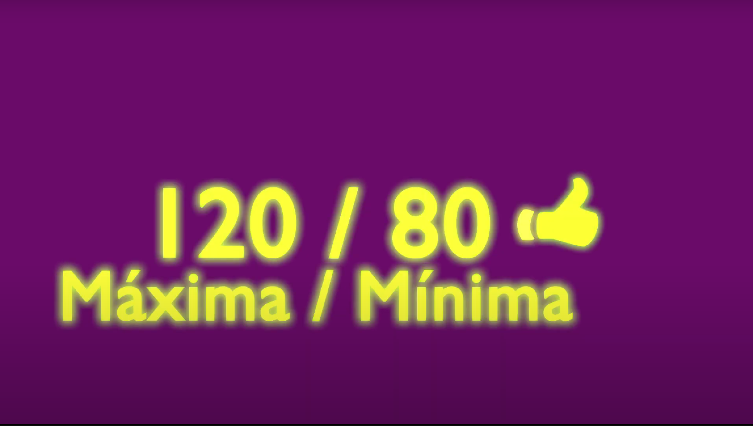
Normal blood pressure is considered to be 120 for the maximum and 80 for the minimum.

Slide 10
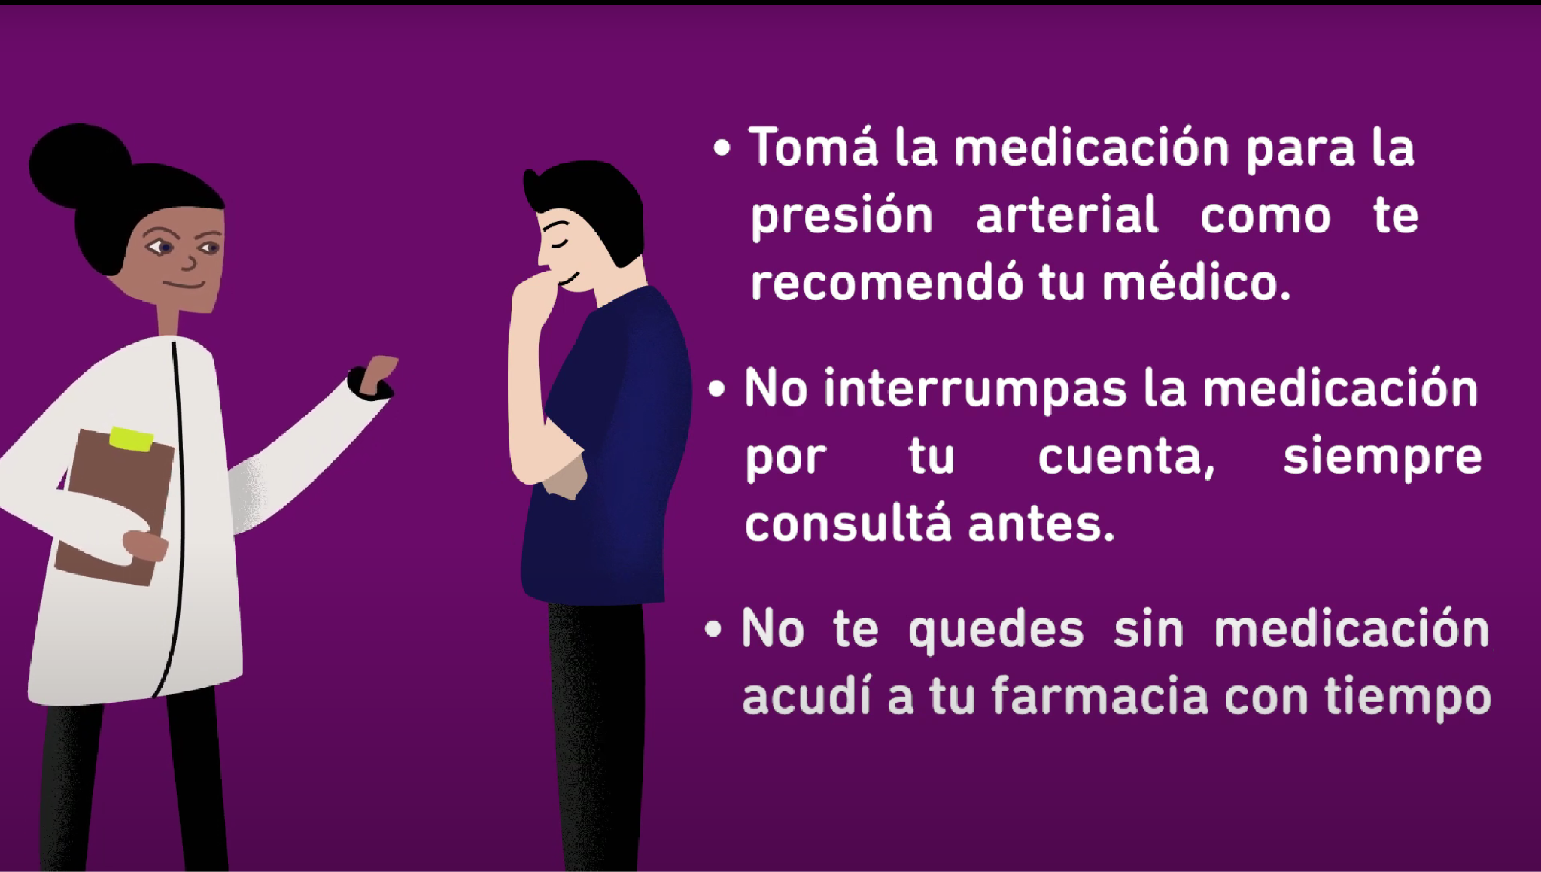
Finally, Remember!
Take your high blood pressure medication per your doctor's recommendations
Do not stop your medication on your own, always ask before.
Don't run out of medication; visit your pharmacy in advance.

Slide 11
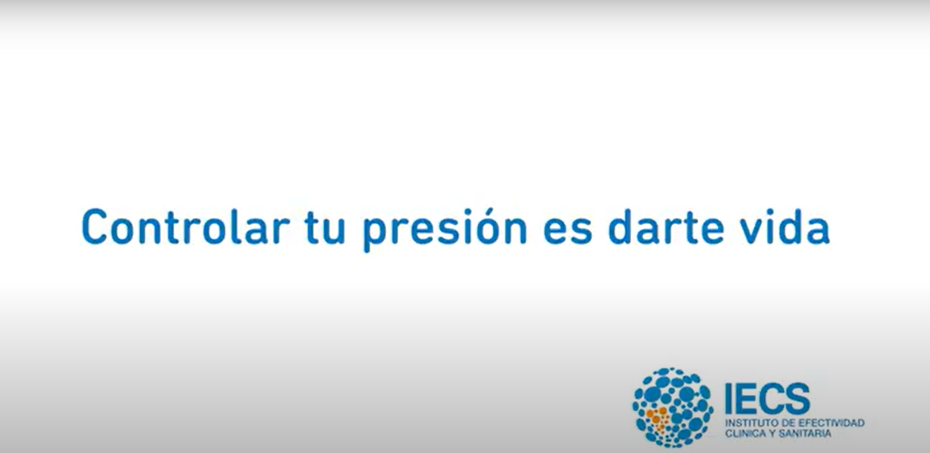
Keeping your blood pressure controlled is giving yourself life.

Slide 12
Video #2
Importance of hypertension control: reinforcement of therapeutic goals and the consequences of uncontrolled BP.

Slide 13
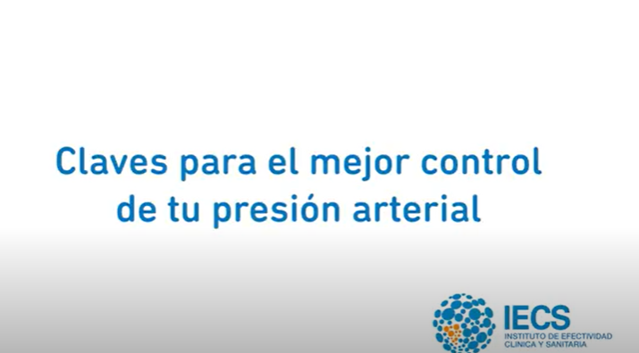
“Keys to better control of your blood pressure”

Slide 14
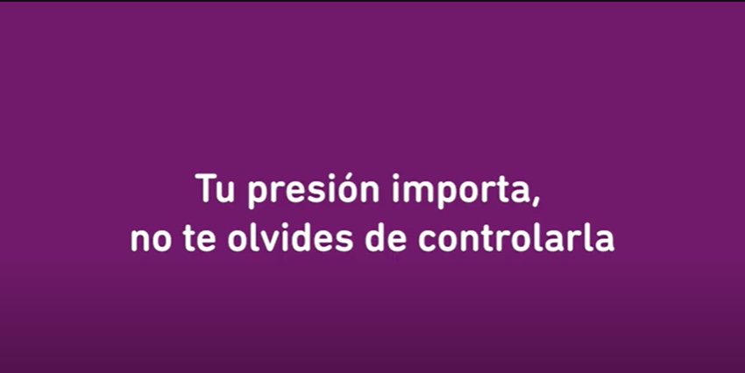
Your pressure matters, don't forget to control it.

Slide 15
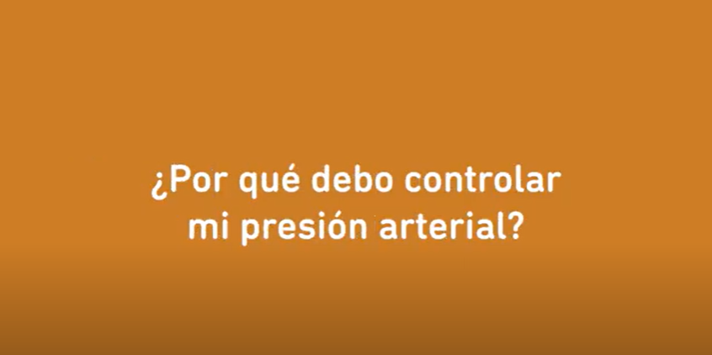
Why should I control my blood pressure?

Slide 16
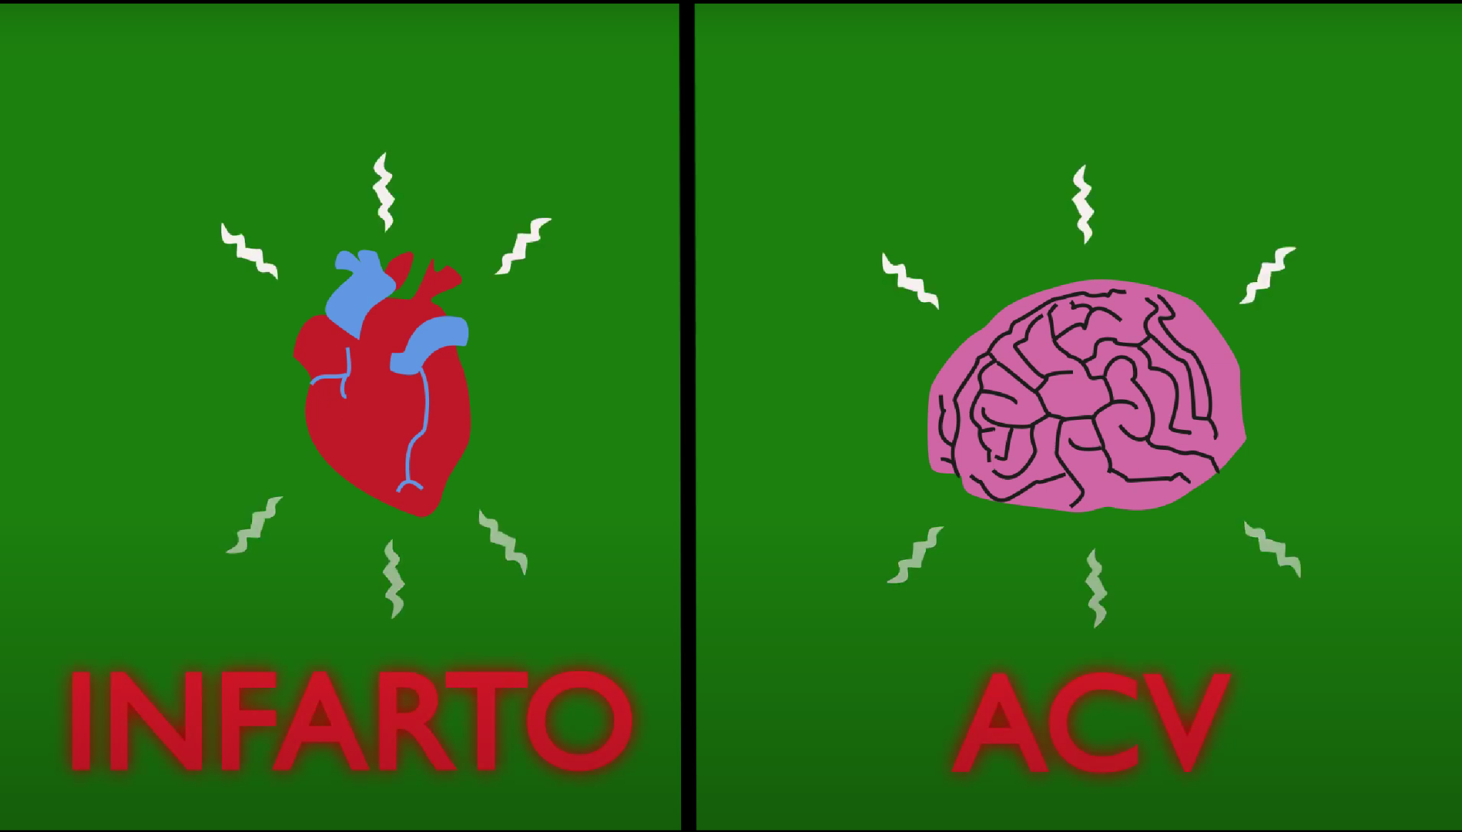
High blood pressure contributes to our arteries becoming unhealthy; which can lead, for example, to a heart attack or a stroke.

Slide 17
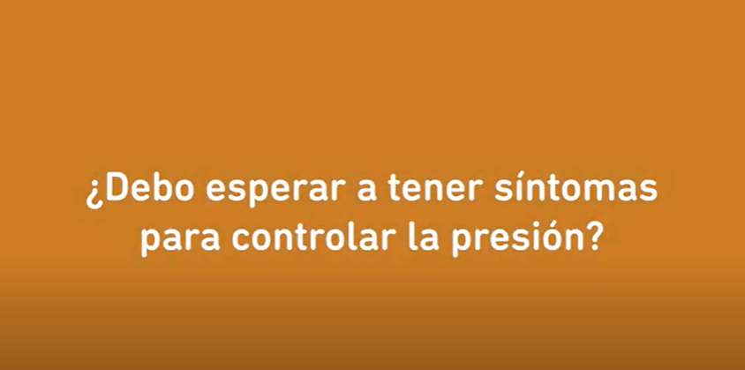
Should I wait until I have symptoms to control my pressure?

Slide 18
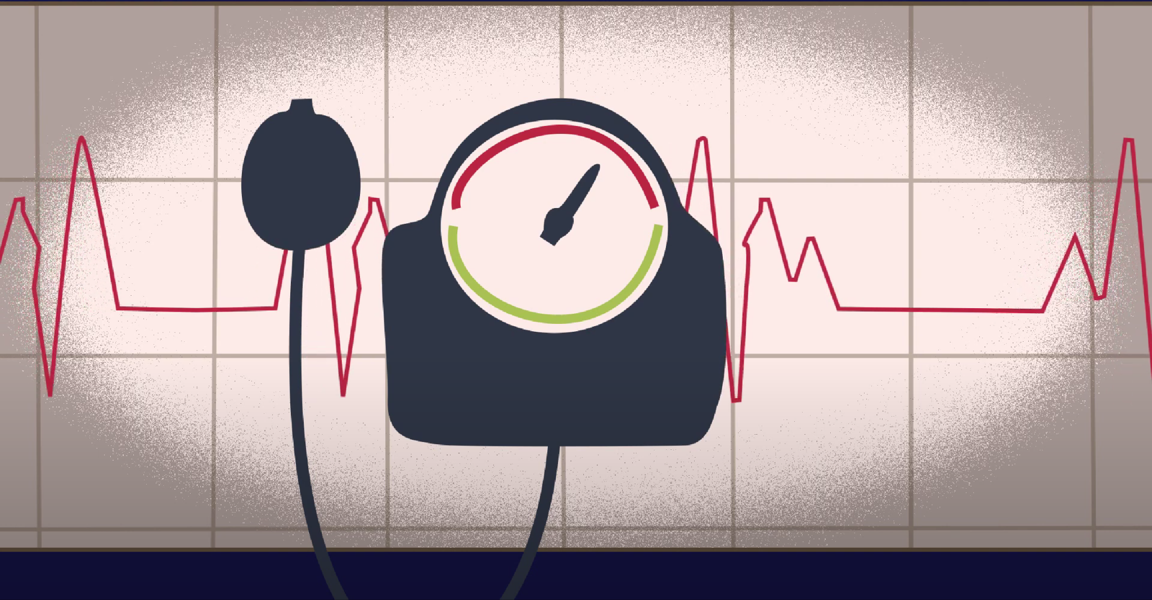
No. High blood pressure usually does not present with symptoms, so it is very important to take your medication daily, even if you don’t experience any symptoms.

Slide 19
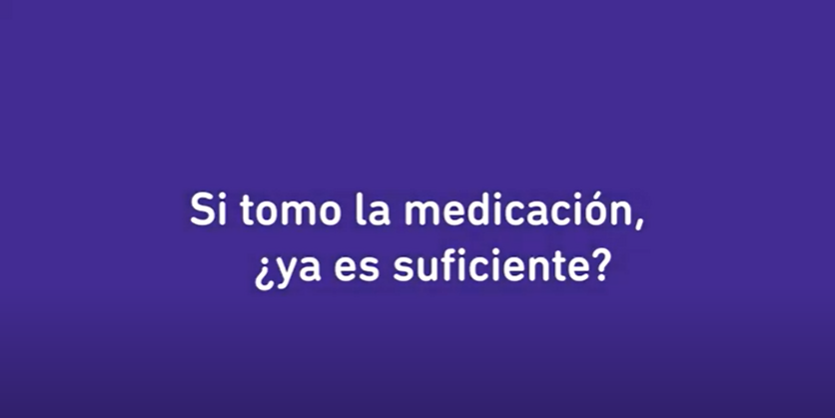
If I take my medication, is it enough?

Slide 20
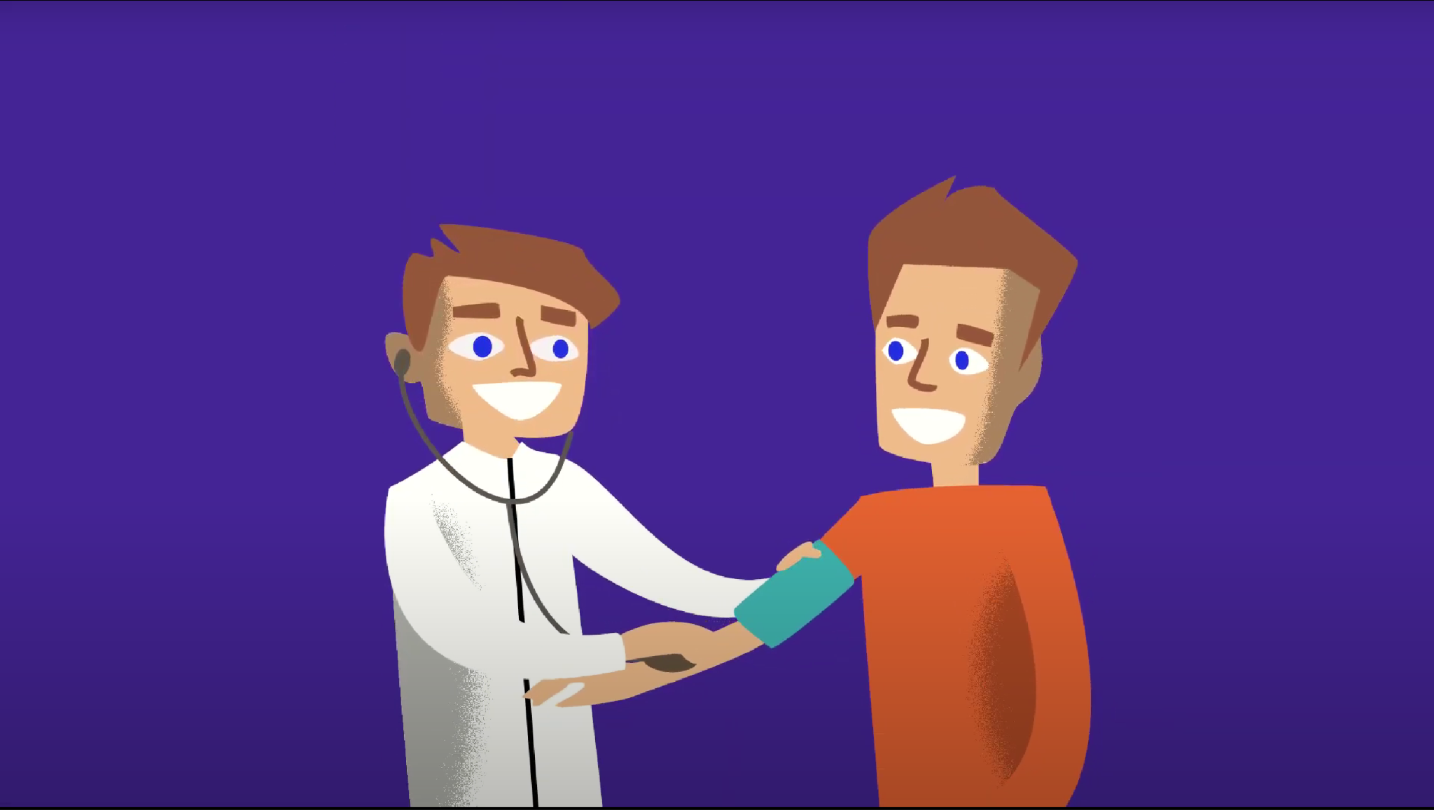
No. It is important to attend your doctor and the health team appointments, as well as follow the instructions of your doctor.

Slide 21
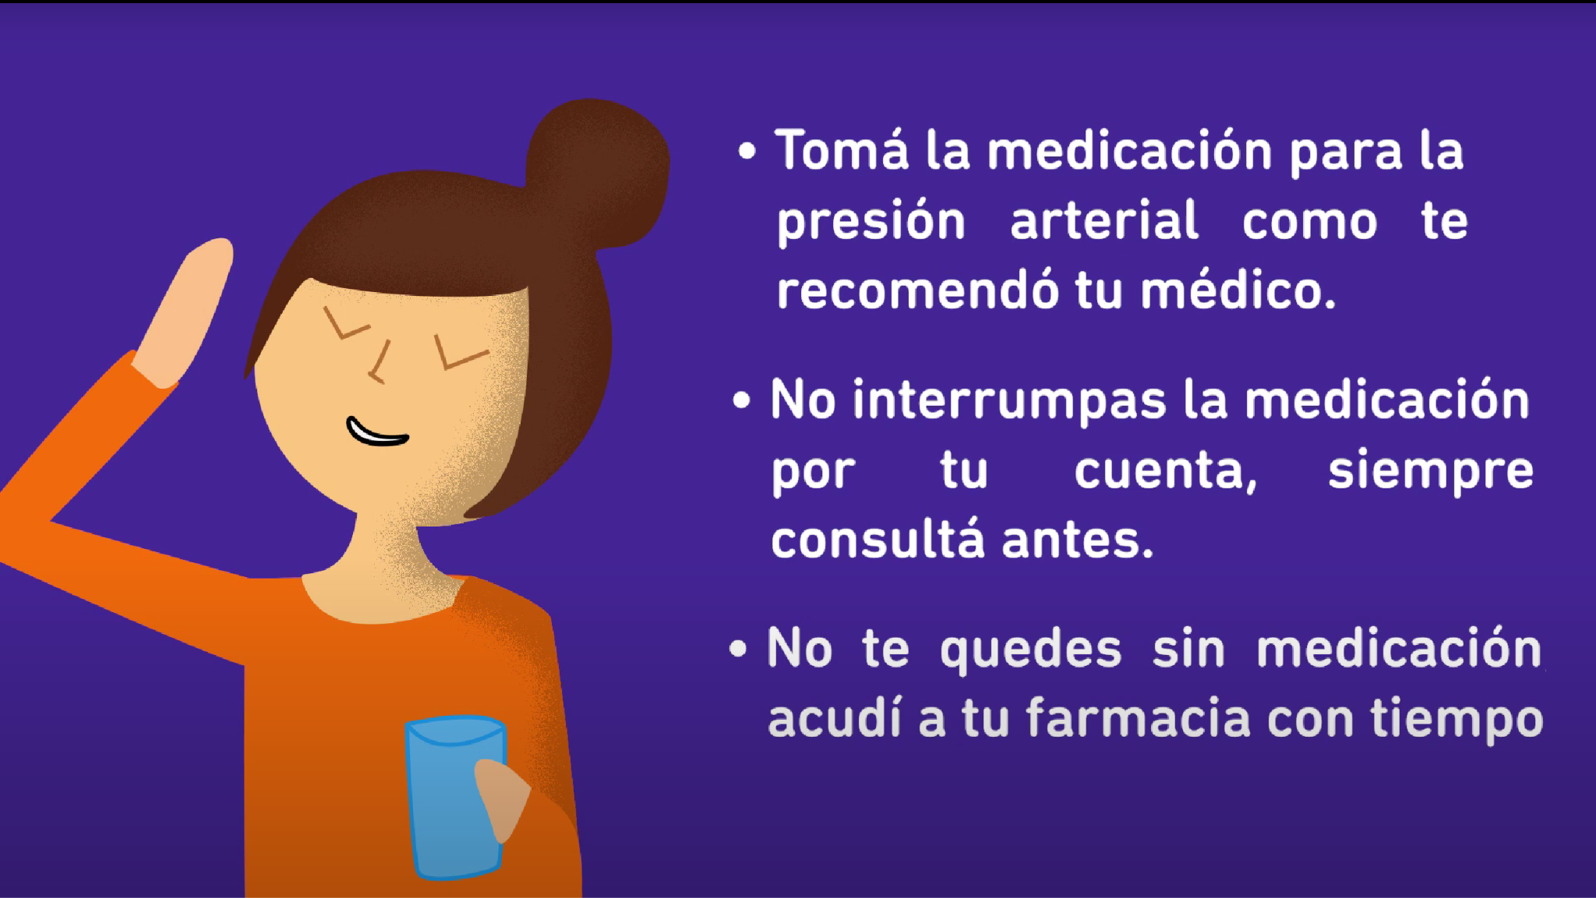
Finally, Remember!
Take your high blood pressure medication per your doctor's recommendations
Do not stop your medication on your own, always ask before.
Don't run out of medication; visit your pharmacy in advance.

Slide 22
Keeping your blood pressure controlled is giving yourself life.

Slide 23
Video #3
Strengthening therapeutic adherence: the role of adequate adherence to medication for BP control. Examples of tools to avoid forgetfulness.

Slide 24
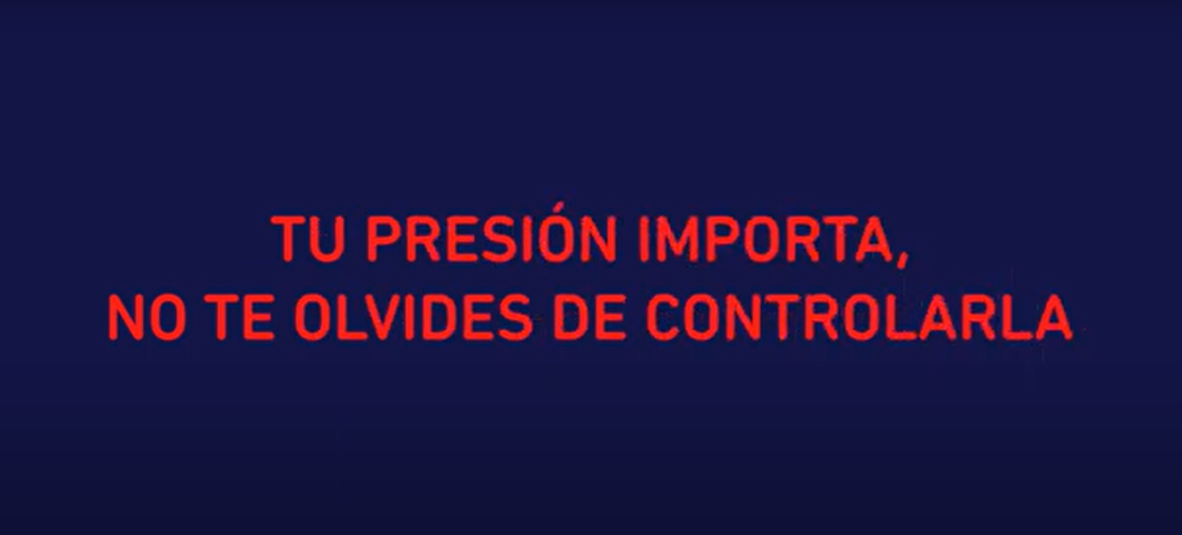
Your blood pressure matters, don’t forget to control it.

Slide 25

Taking your blood pressure medication daily greatly helps mitigate future health problems, especially those related to the heart, arteries, and kidneys.

Slide 26
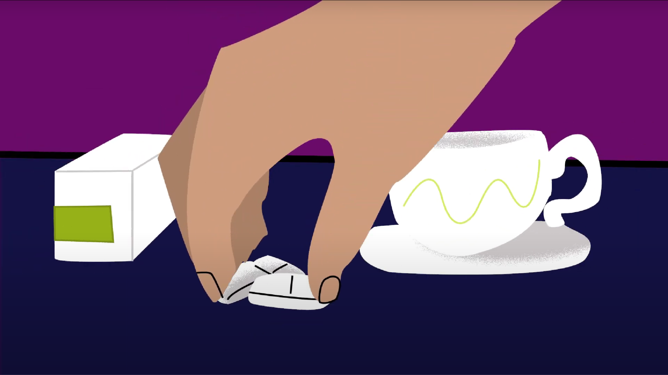
Having a routine to take your medication will help you remember to take them. For example, you can take it along with breakfast or dinner.

Slide 27
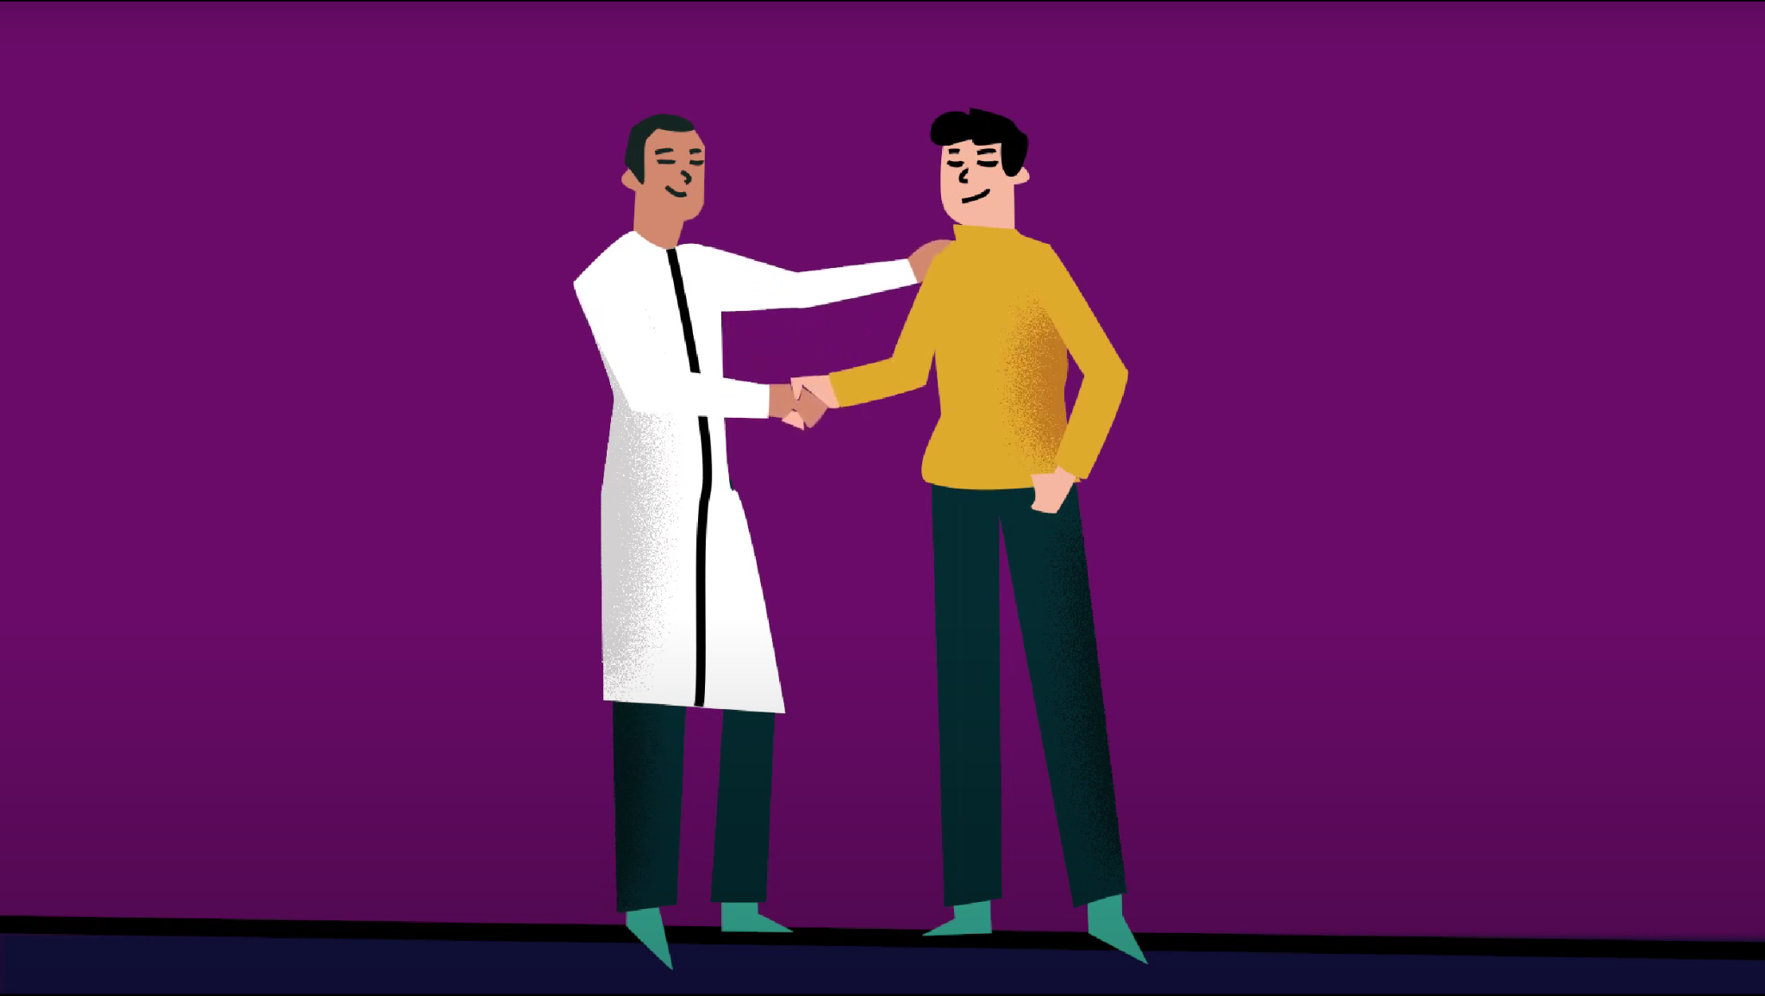
If you have trouble remembering to take your medication, make sure to tell your family and the health team, they can help you.

Slide 28
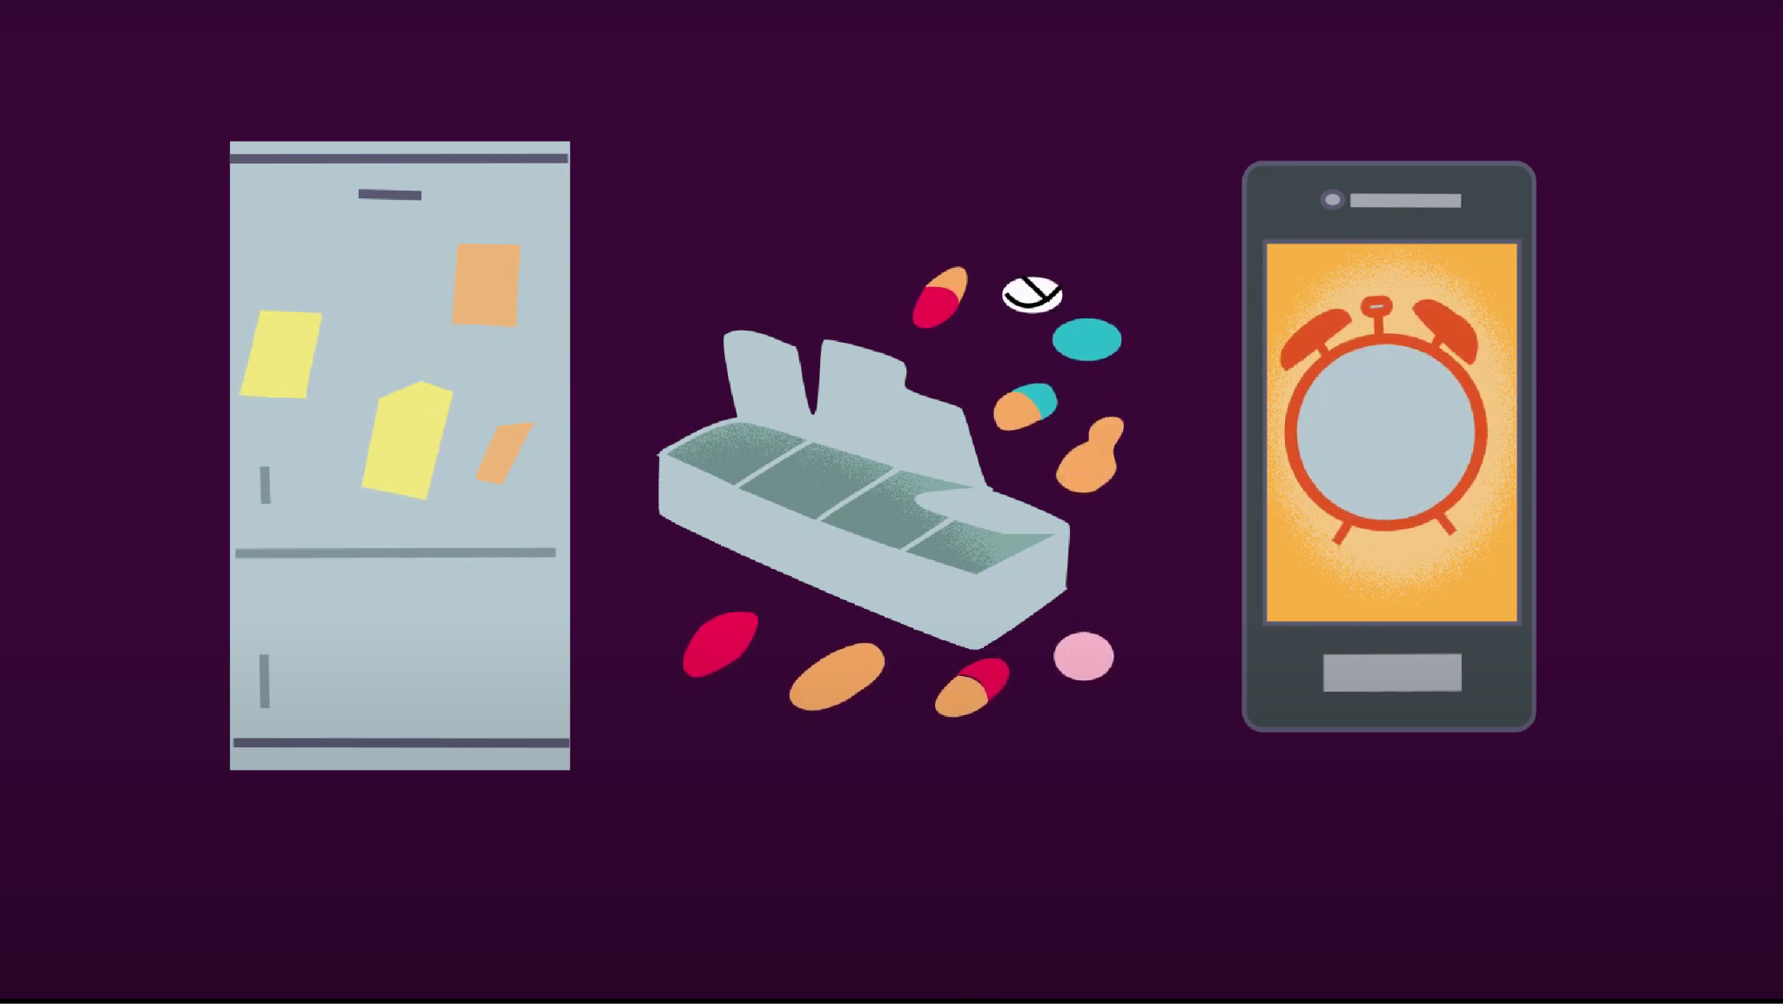
Reminders on your refrigerator, a pillbox, or an alarm on your phone are all ways to help you remember to take your medication every day.

Slide 29
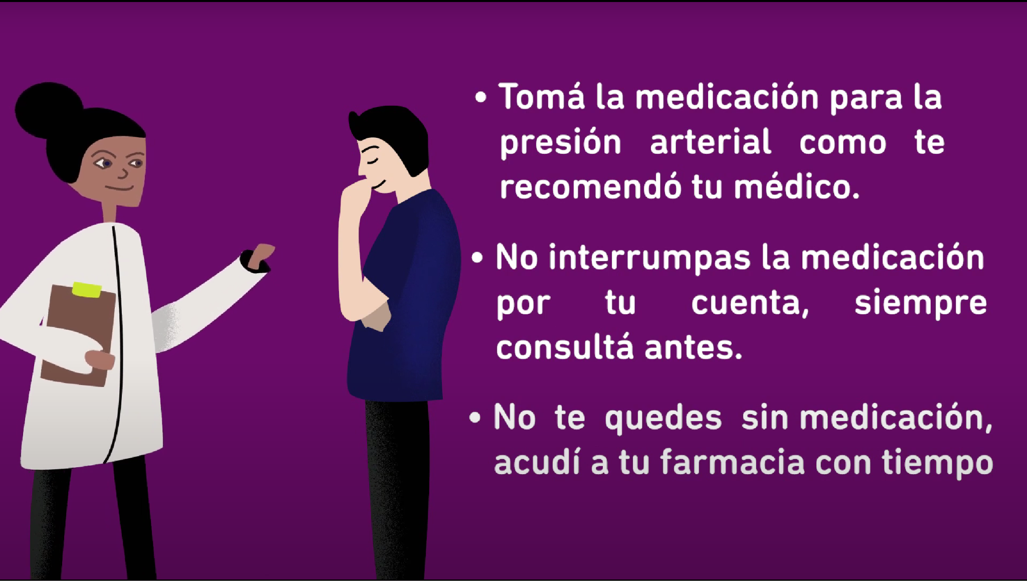
Finally, Remember!
Take your high blood pressure medication per your doctor's recommendations
Do not stop your medication on your own, always ask before.
Don't run out of medication; visit your pharmacy in advance.

Slide 30
Keeping your blood pressure controlled is giving yourself life.

Slide 31
Video #4
Strengthening adherence to non-pharmacological treatment I: recommendations on physical activity and weight control

Slide 32
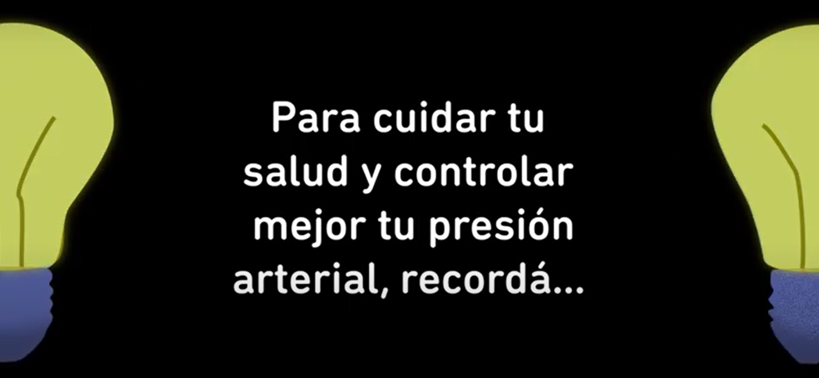
To take a better care of your health and control your blood pressure, remember…

Slide 33
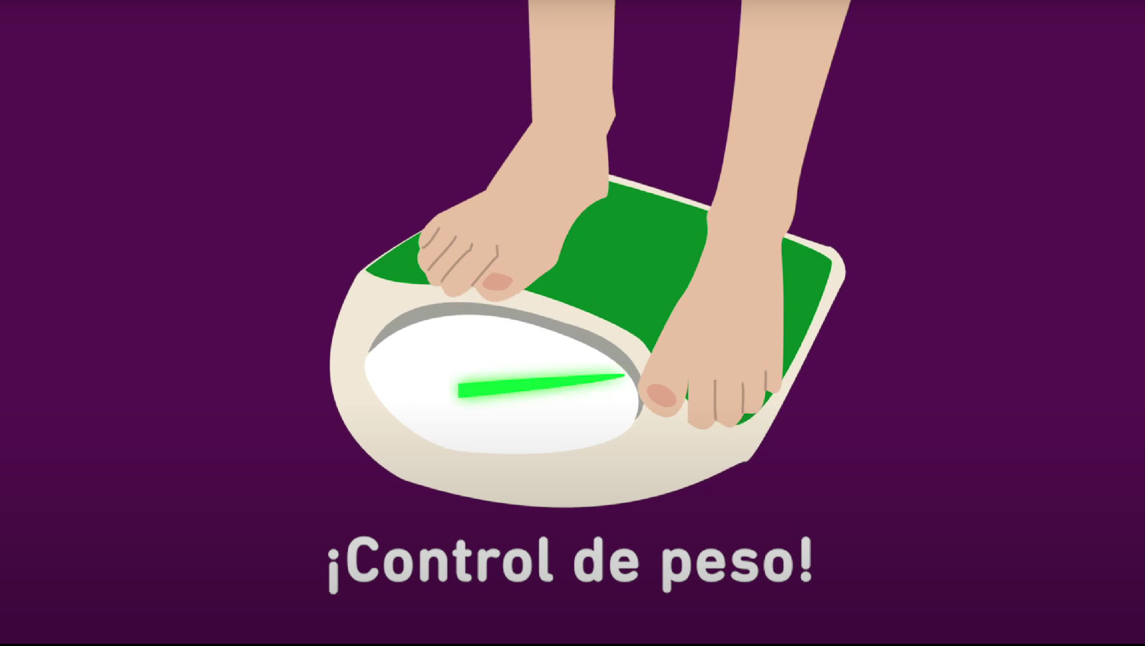
Control your weight, being overweight affects your general health and makes it harder to maintain normal blood pressure.

Slide 34
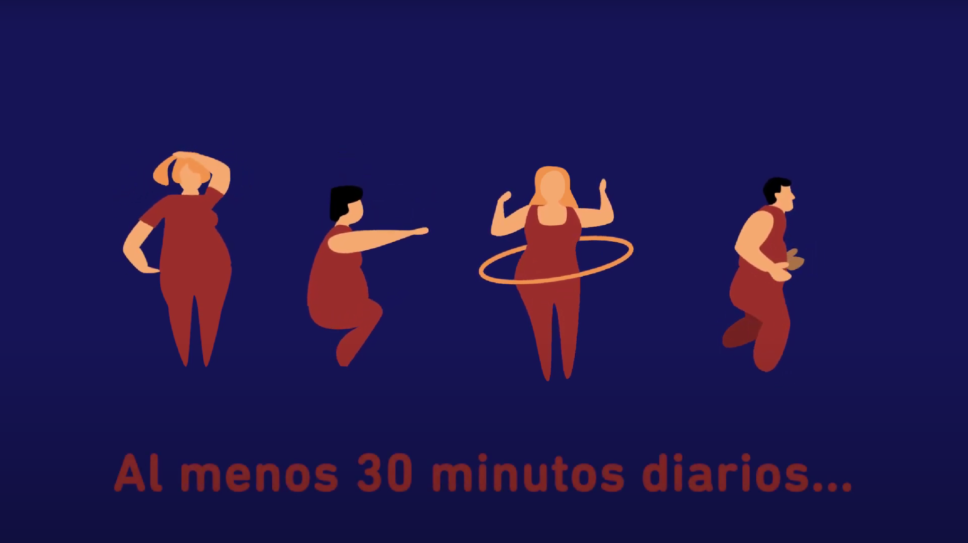
It is important to do exercise. At least 30 minutes of moderate exercise per day, protect your overall health.

Slide 35

Don’t smoke! Remember one cigarette can put your health at risk. If you are thinking of quitting smoking, please reach out for help.

Slide 36
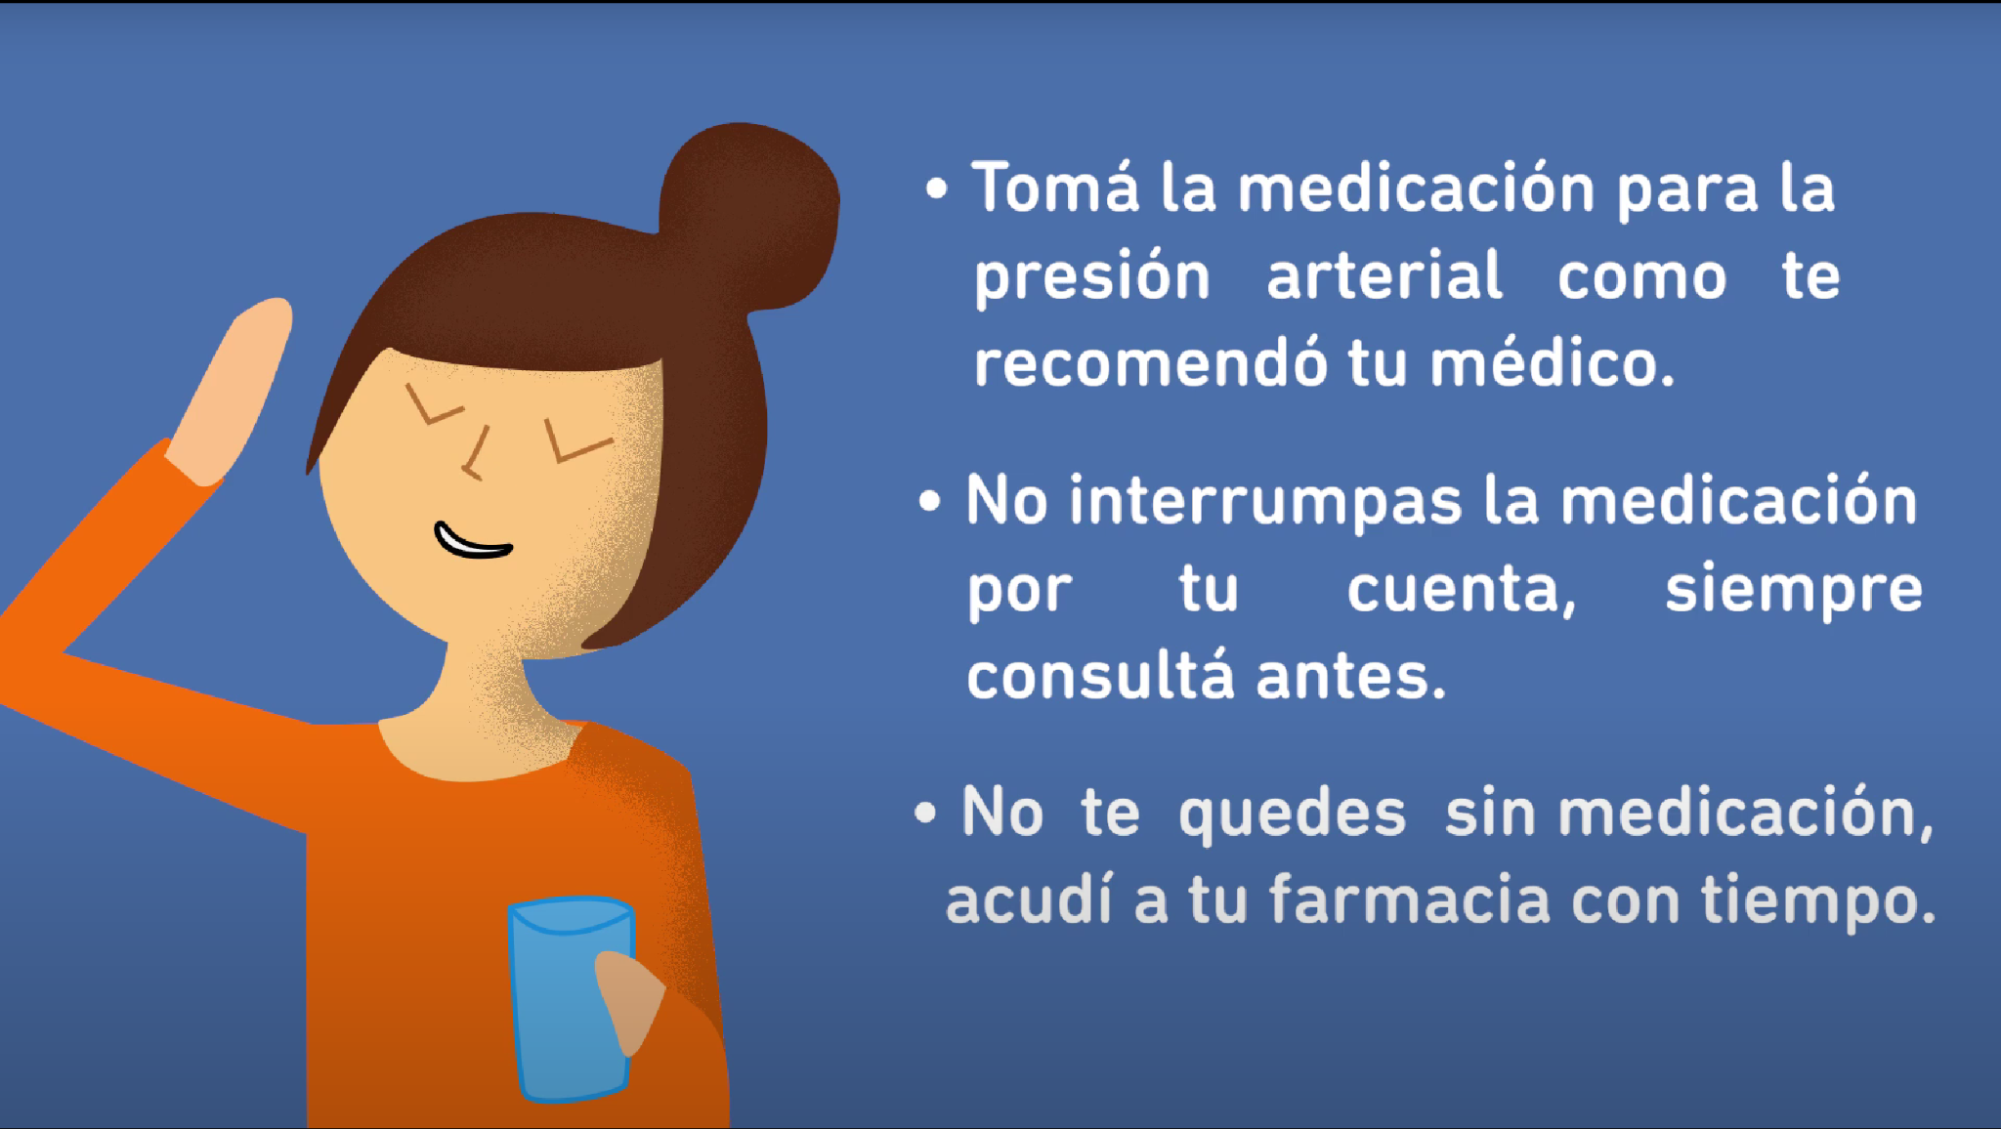
Finally, Remember!
Take your high blood pressure medication per your doctor's recommendations
Do not stop your medication on your own, always ask before.
Don't run out of medication; visit your pharmacy in advance.

Slide 37
Keeping your blood pressure controlled is giving yourself life.

Slide 38
Video #5
Strengthening adherence to non-pharmacological treatment II: recommendations on sodium consumption and diet.

Slide 39
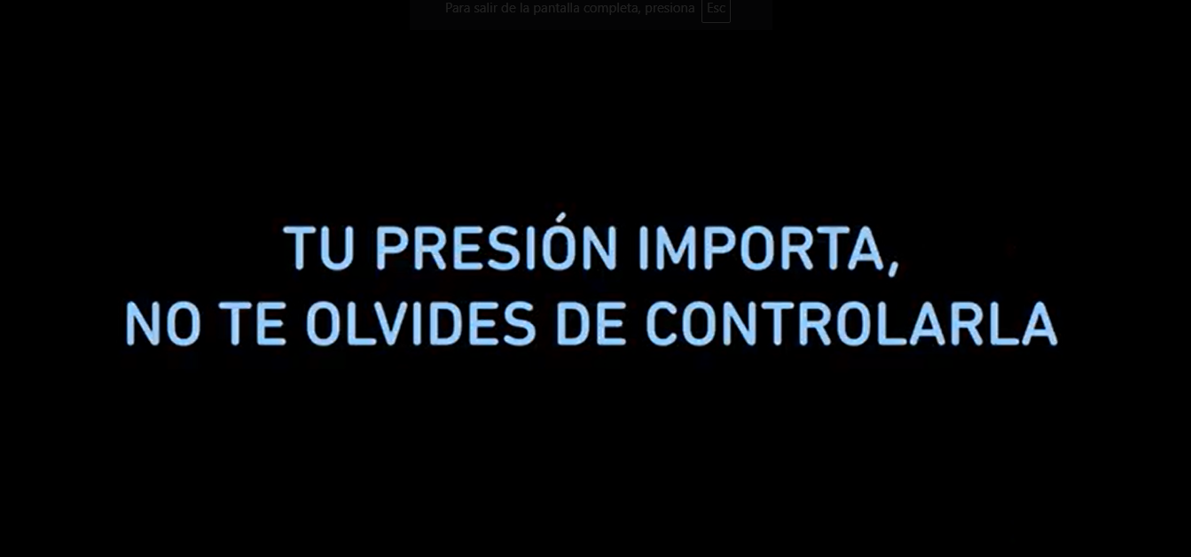
Your blood pressure matters, don’t forget to control it.

Slide 40
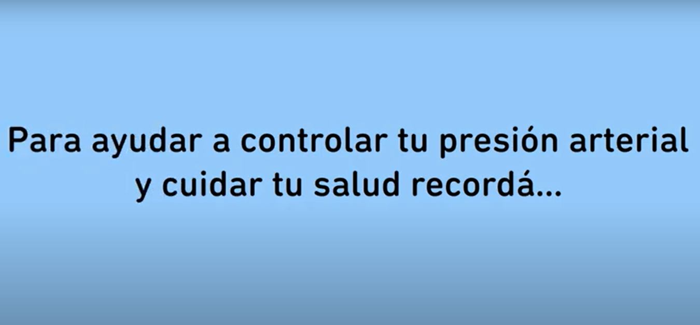
To help control your blood pressure and take care of your health remember…

Slide 41
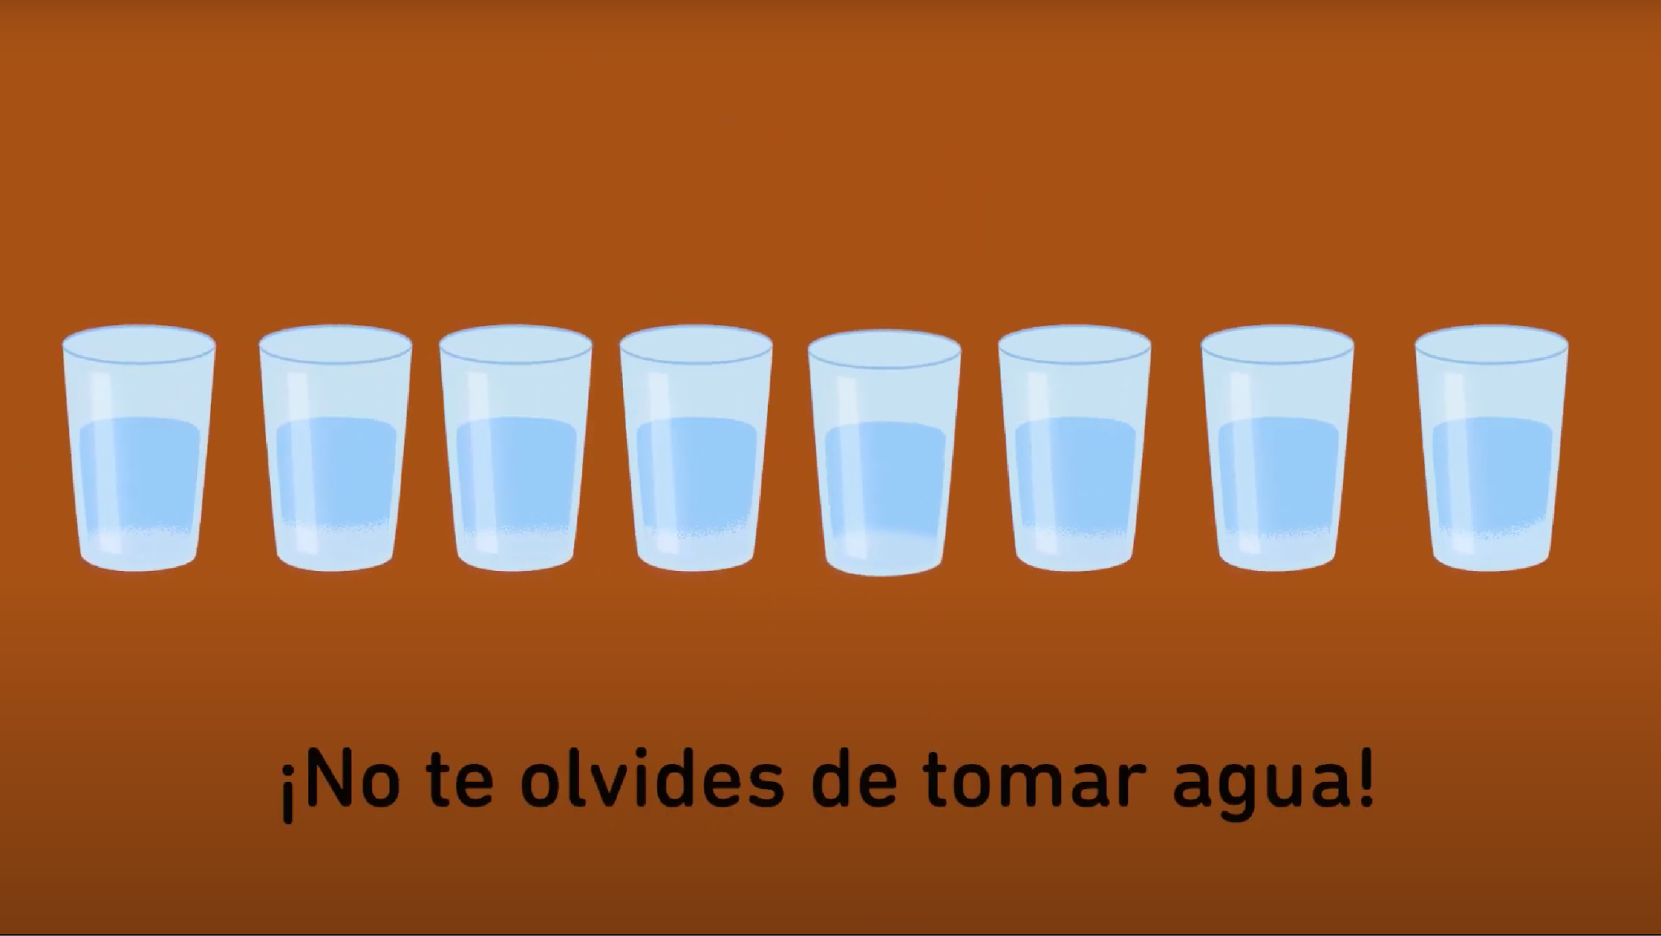
…drink at least 2 liters of water, approximately eight glasses a day

Slide 42
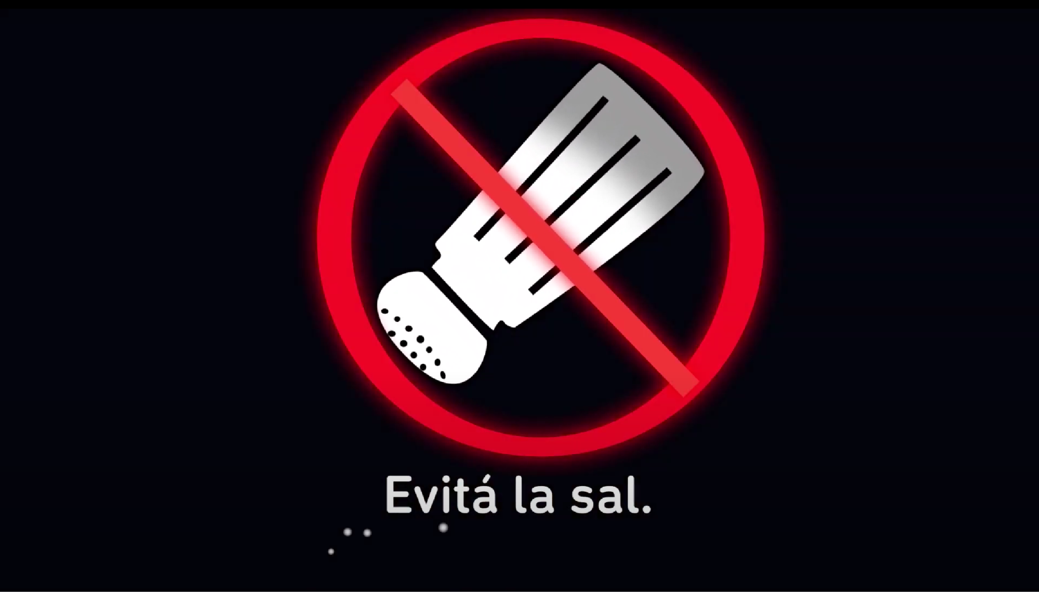
Avoid adding salt to your food.

Slide 43
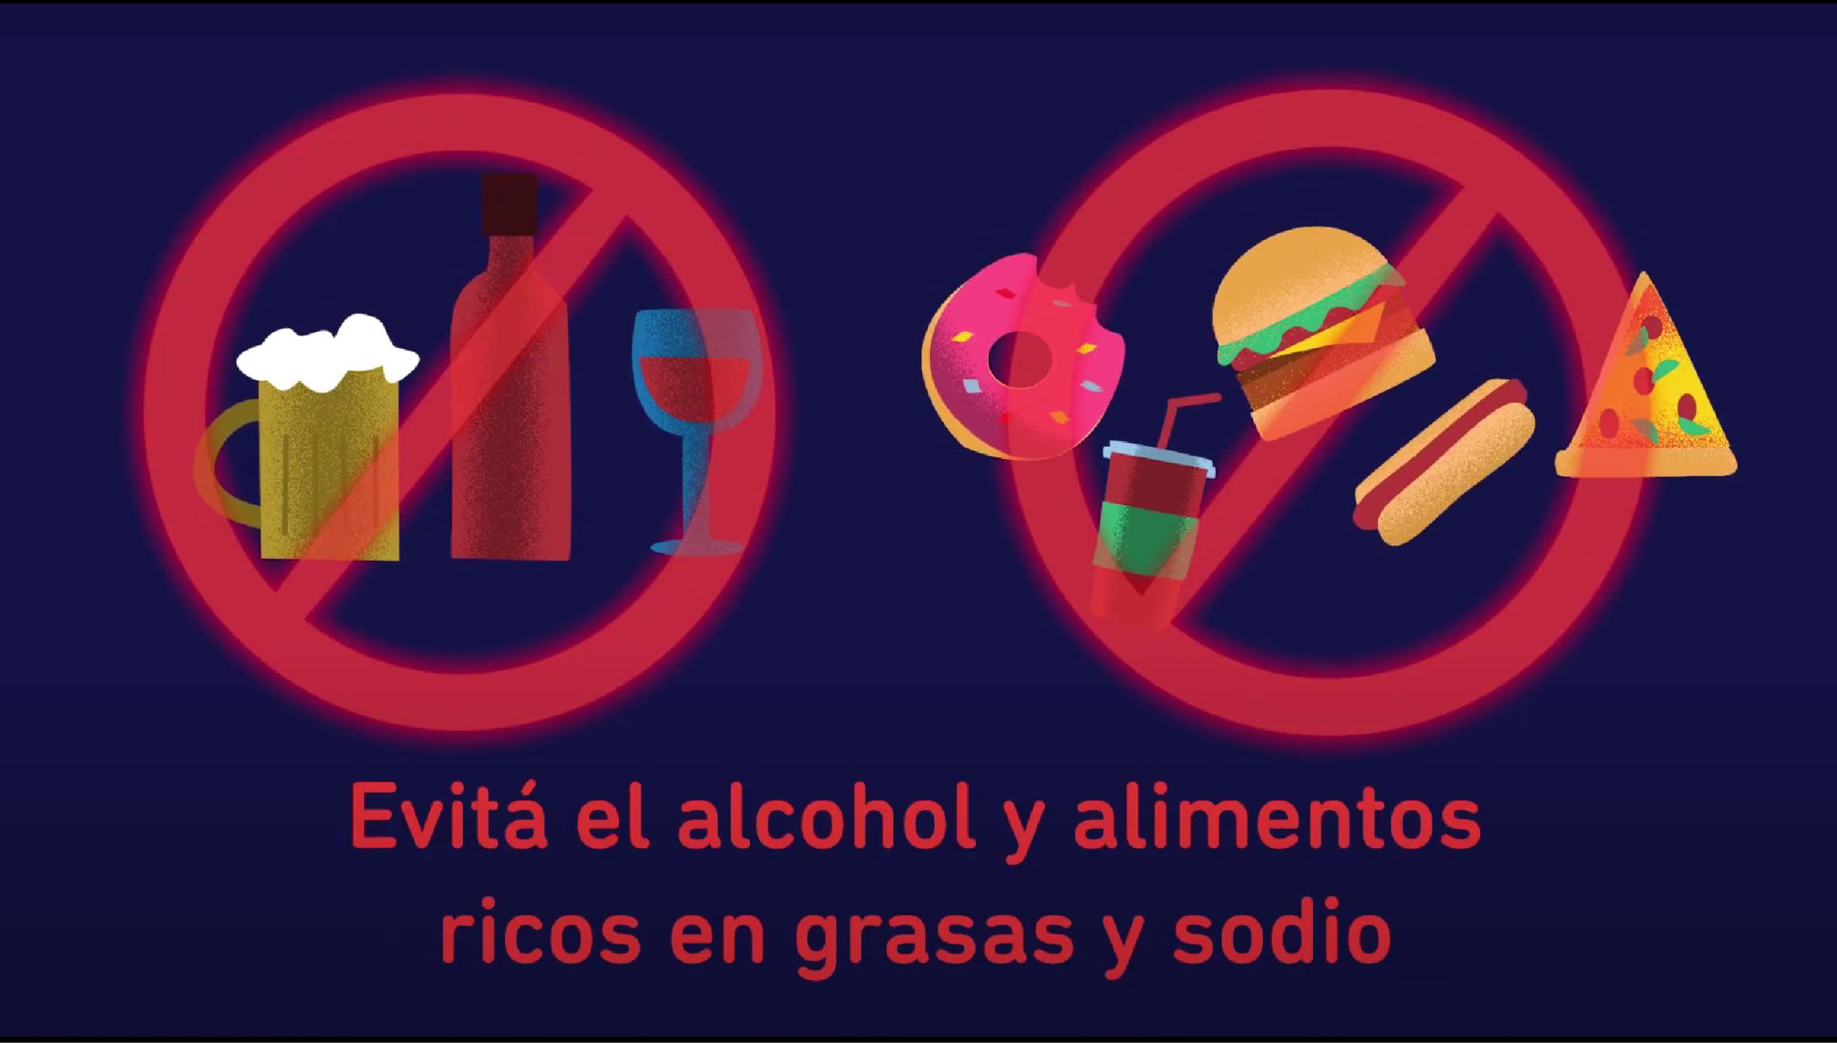
Avoid drinking alcohol and eating foods rich in fats and sodium.

Slide 44
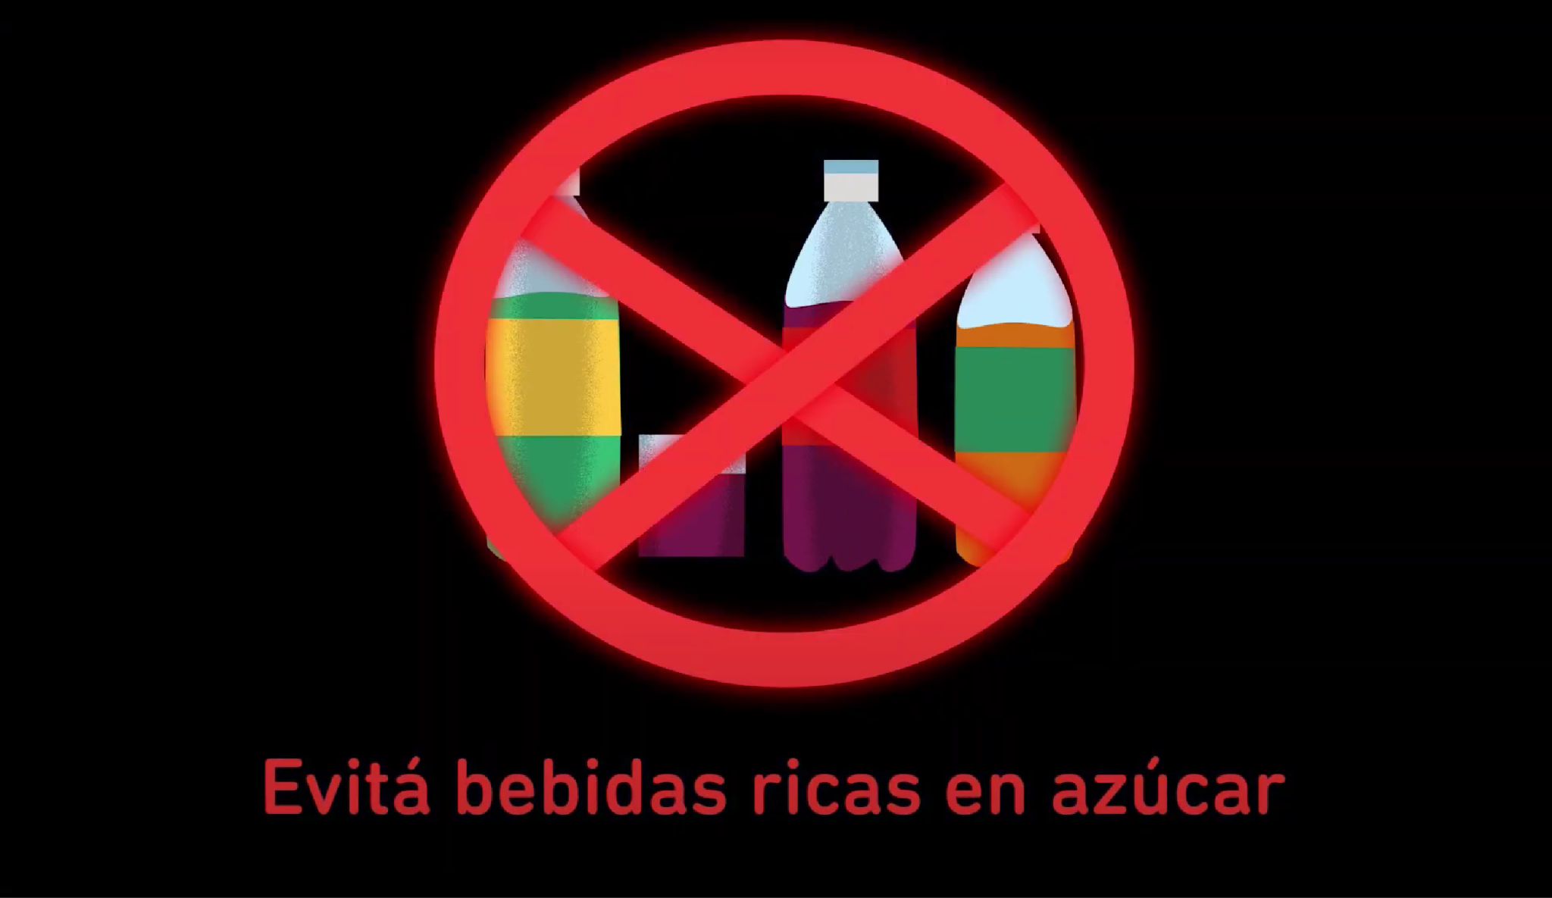
Say “no” to sugary drinks.

Slide 45
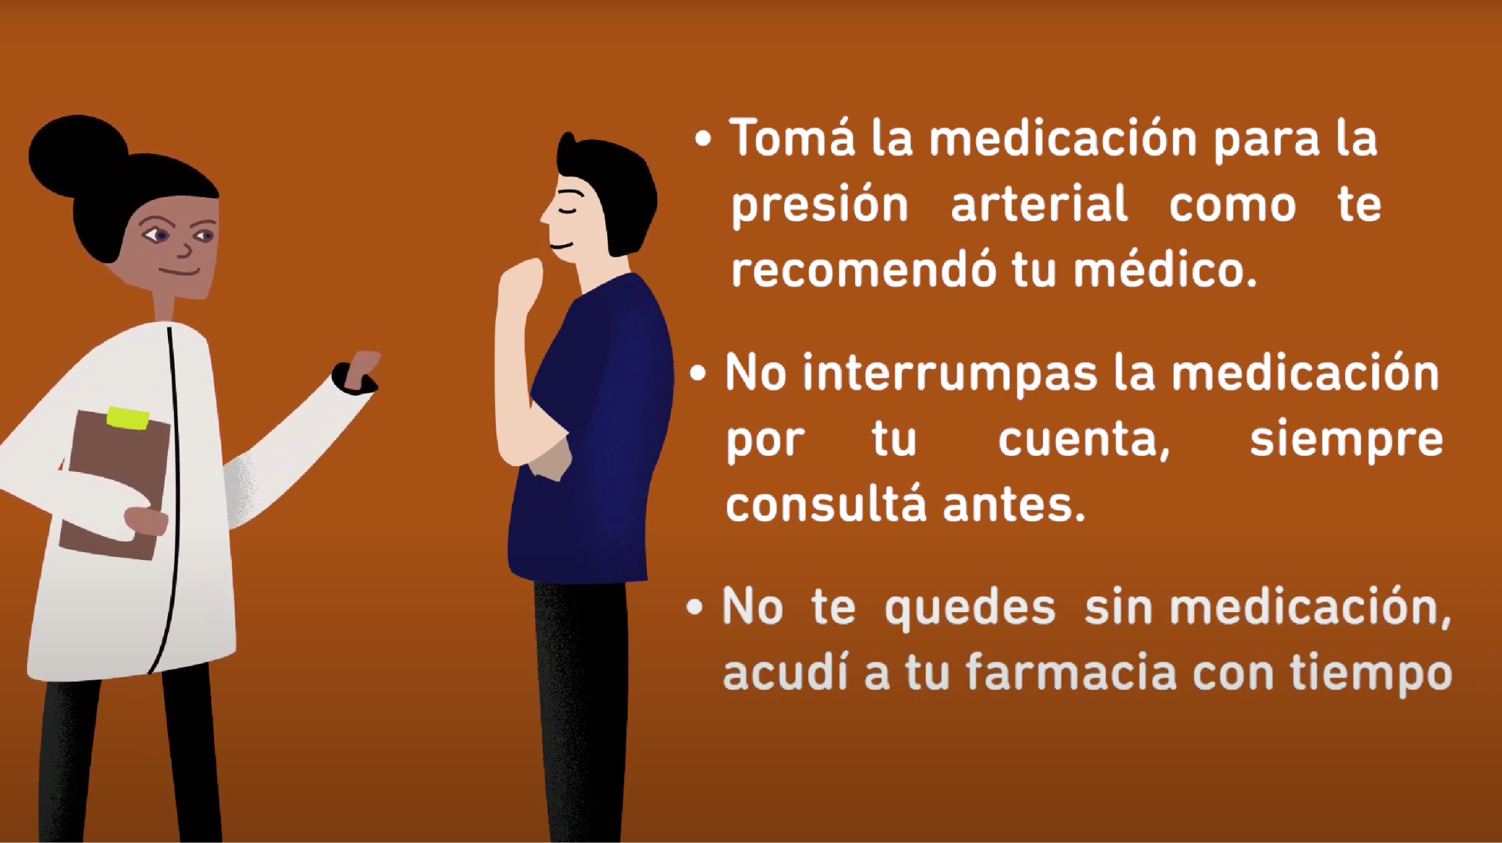
Finally, Remember!
Take your high blood pressure medication per your doctor's recommendations
Do not stop your medication on your own, always ask before.
Don't run out of medication; visit your pharmacy in advance.

Slide 46
Keeping your blood pressure controlled is giving yourself life.

Slide 47
Video #6
Self-monitoring blood pressure: key tips for adequate blood pressure measurement at home.

Slide 48
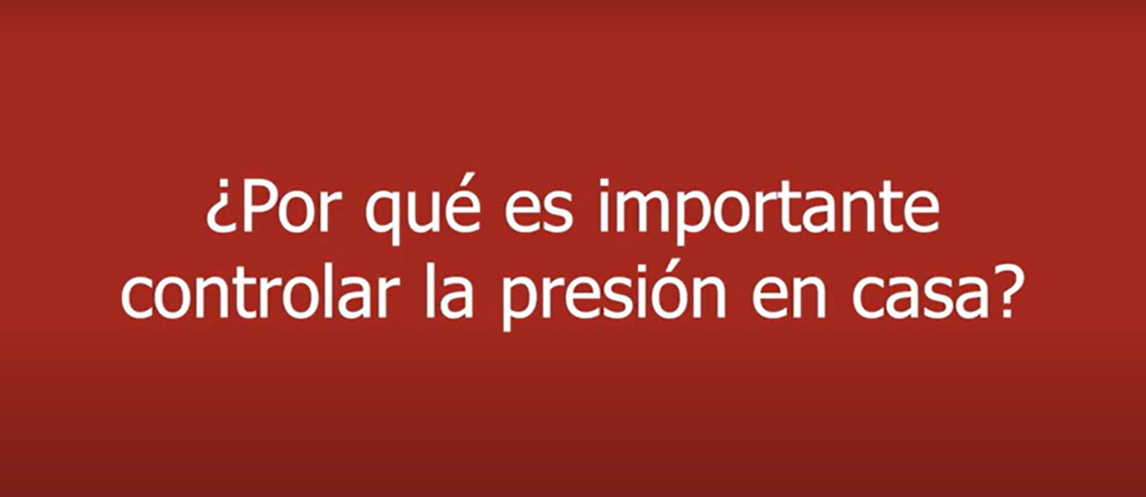
Why is it important to control your blood pressure at home?

Slide 49
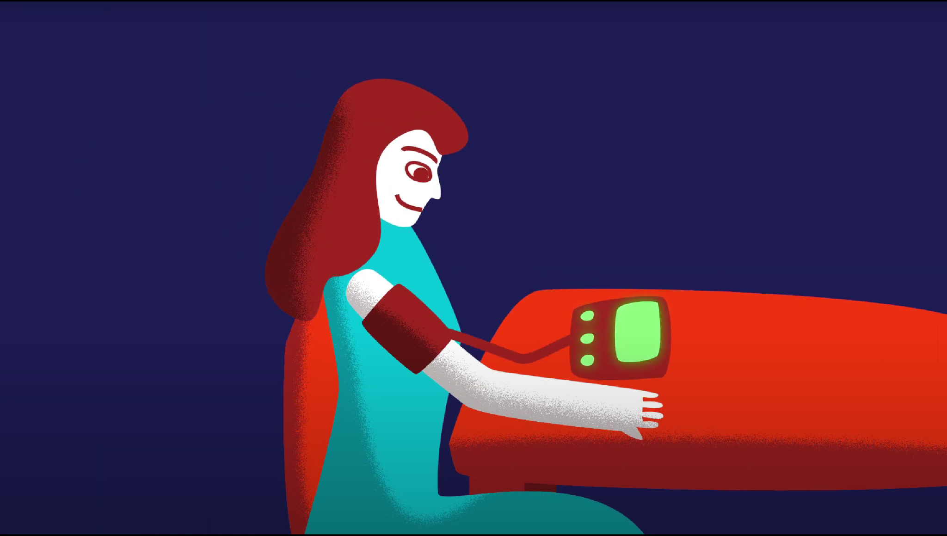
It helps you and your health team to know if your blood pressure is well controlled.

Slide 50
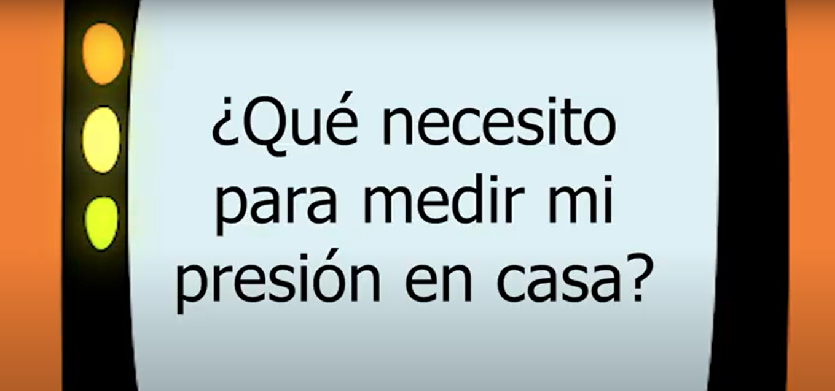
What do I need to monitor my blood pressure at home?

Slide 51
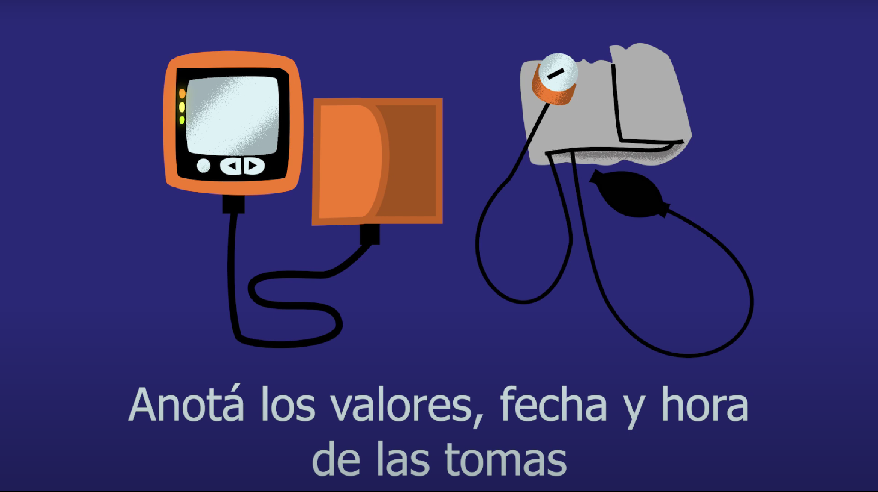
You can use either a validated and automatic blood pressure monitor for your arm or a traditional blood pressure cuff, as long as you have someone who knows how to read it. Record the value, date, and time of your blood pressure measurement to share it with your healthcare team.

Slide 52
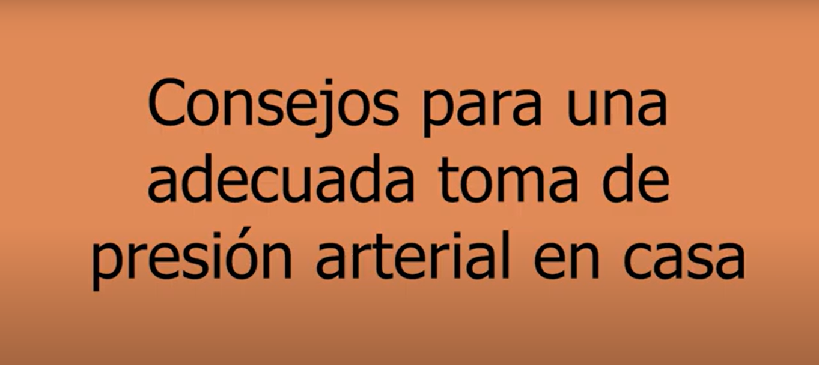
Tips for an adequate blood pressure measurement at home.

Slide 53
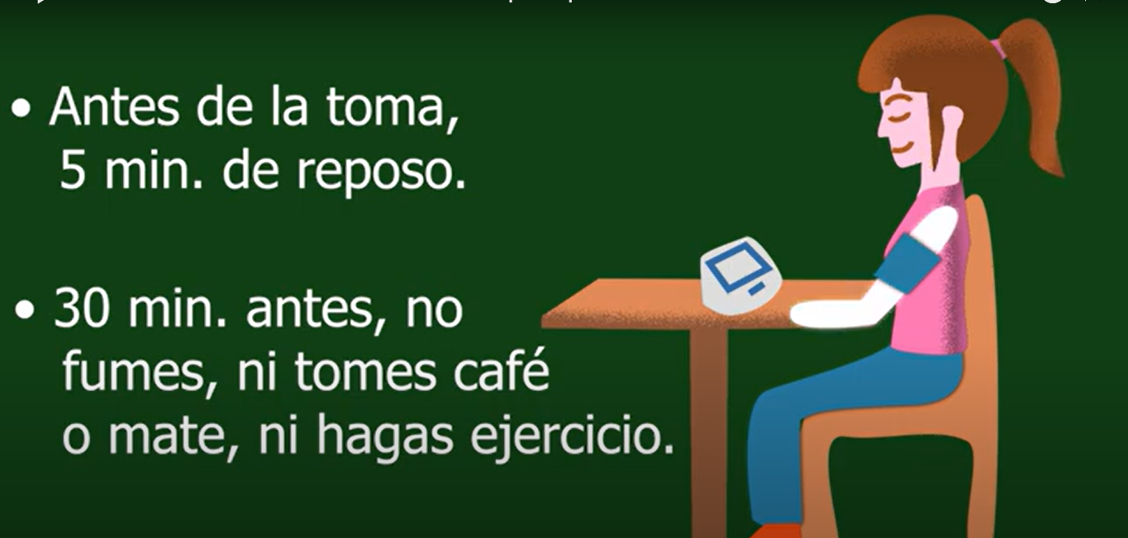
Before conducting the measurement, rest for five minutes.
30 minutes before don’t smoke, drink coffee or mate, or exercise.

Slide 54
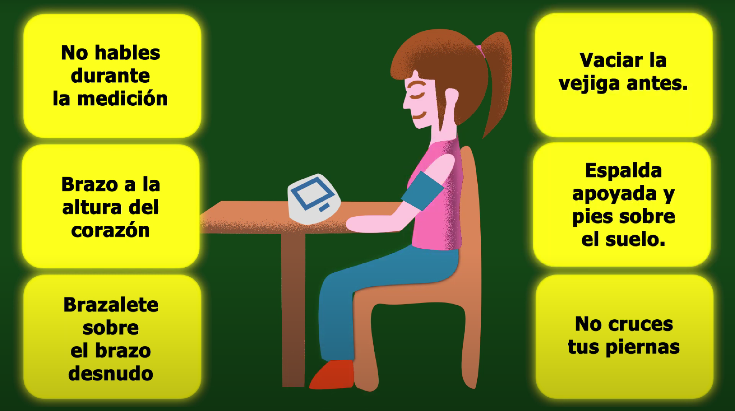
Keep your arm at the height of your heart, the cuff should be placed directly on your skin, do not talk while it is being measured, do not cross your legs, keep your back straight and both legs on the floor. Remember to empty the bladder before taking the measurement.

Slide 55
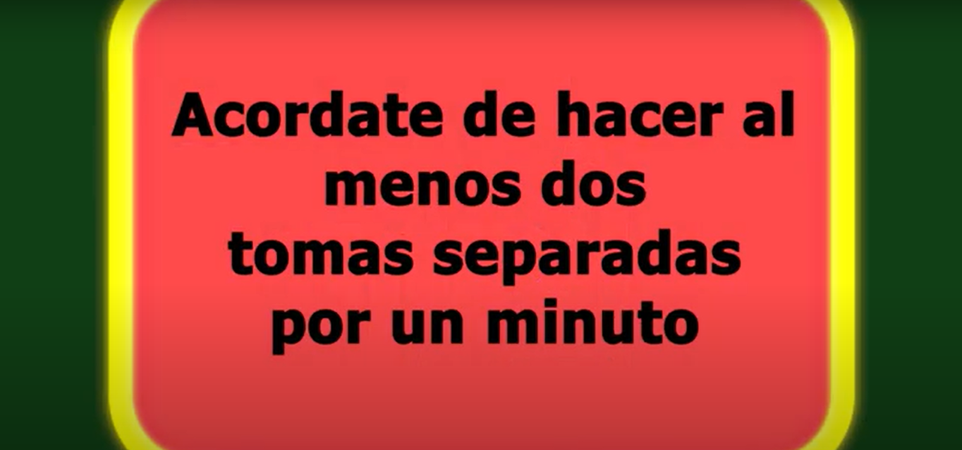
Remember to take at least two readings with a minute in between.

Slide 56
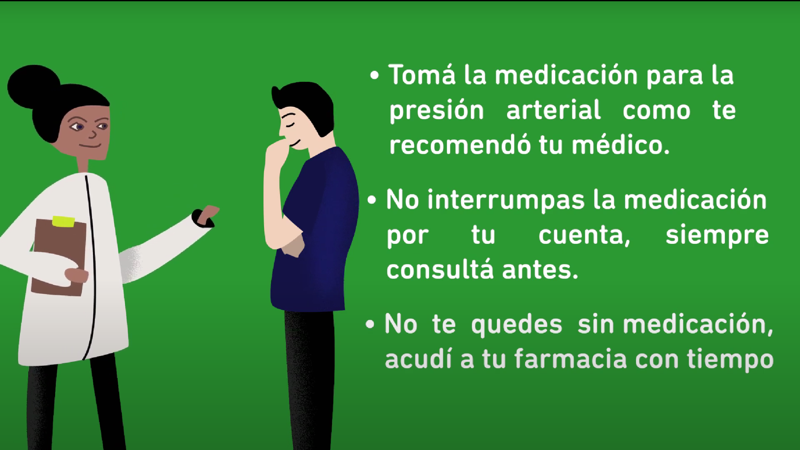
Finally, Remember!
Take your high blood pressure medication per your doctor's recommendations
Do not stop your medication on your own, always ask before.
Don't run out of medication; visit your pharmacy in advance.

Slide 57
Keeping your blood pressure controlled is giving yourself life.

