Slide 1
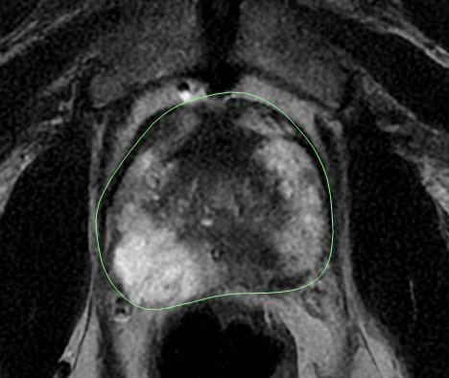
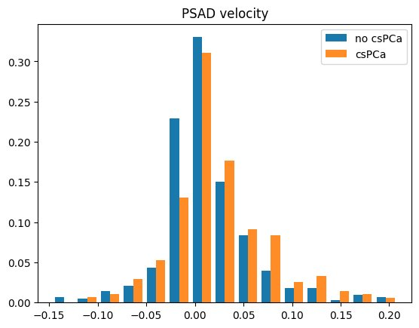
Utility of PSA density velocity in diagnosing prostate cancer on prostate MR ​
​
PSAD-velocity was associated with CsPca on univariate analysis but not on multivariate analysis
Notes:
Figure 1

