Slide 1
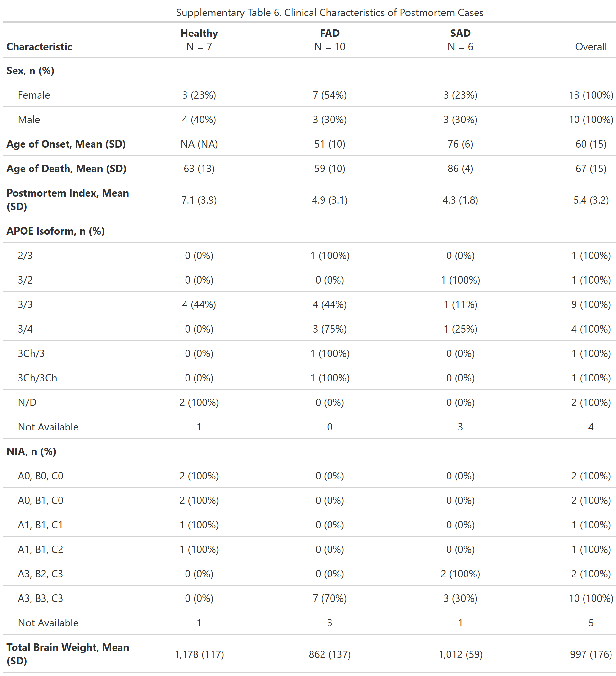
Table 1. Sociodemographic characteristics of post-mortem cases
Table 1.

