Slide 1
Supplemental Table 1
Supplemental Table 1. Identity of constituent proteins within the ~21 kDa band separated from Nagase crude alginate lyse preparation.

Slide 2
Supplemental Table 2
Ligand full name | Ligand short name | FqPBP | HusA
Coproporphyrinogen III | cgen3 | -8.4702 | -7.6545
Protoporphyrinogen IX | pgen9 | -8.9597 | -8.0984
Protoporphyrin IX | ppor9 | -10.4674 | -7.8561
Heme B | hemeb | -10.1500 | -8.1855
Hemin chloride (Heme-Fe3+, Cl-) | hem3 | -9.3278 | -8.5247
Hemin no Cl- (oxidized Heme B) | hem3x | -10.2383 | -8.3944
Zinc Protoporphyrin | porzo | -9.2250 | -8.3916
Zinc Protoporphyrin-H2O | porzn | -10.5126 | -8.5455
Chlorophyll A | chloa | -9.553 | -7.1747
Chlorophyll B | chlob | -9.9153 | -6.6579
Supplemental Table 2. Docking scores (kcal/mol) of FqPBP and HusA against porphyrin related ligands obtained from AutoDock Vina (More negative values indicate higher binding affinity).

Slide 3
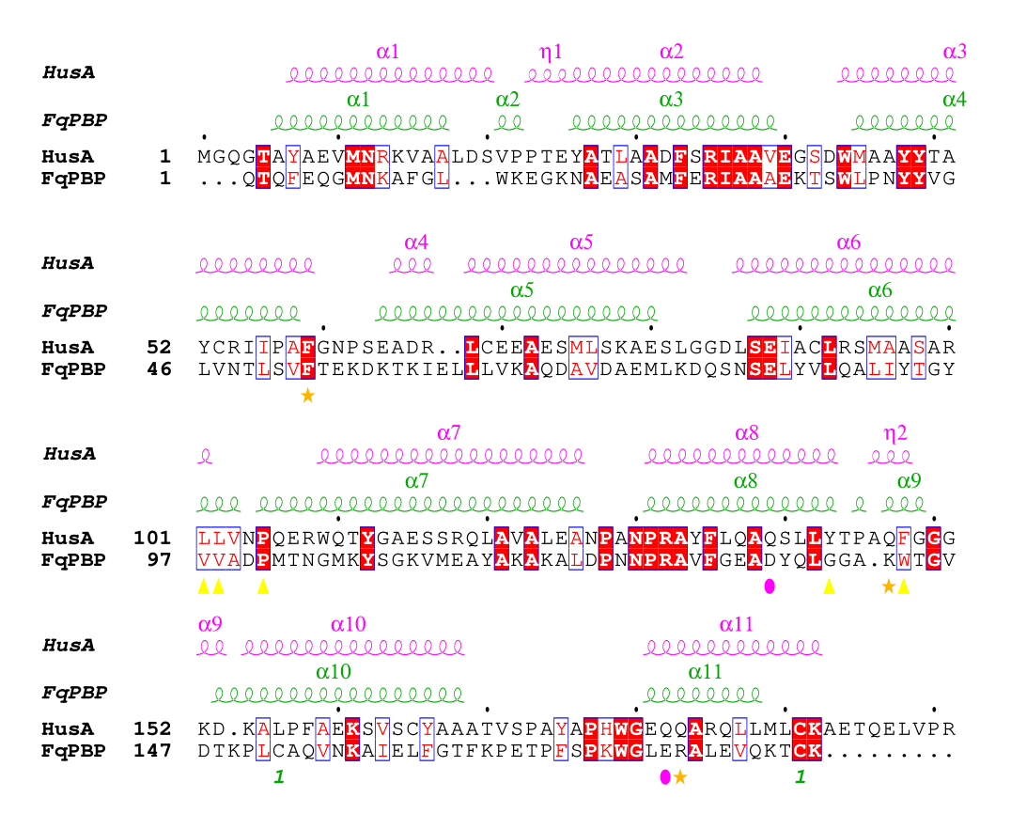
Supplemental Figure 1
Supplemental Figure 1. Sequence alignment of FqPBP and HusA generated with ClustalO including the secondary structures. The major binding contributing residues found by MMPBSA with Protoporphyrin IX on FqPBP are shown below the sequence by the symbols ★,▲ and ●. The marks 1 indicate a cysteine bridge in FqPBP.

