Slide 1
Figure S1 Chromosome-wide counts distribution of SNP and Indels per 100kb between H1 and its two parents.
Note: The subtraction values between the variation number of T44-4x and T45-4x of SNPs (blue color) and Indels (red color) were showed in the vertical axis, positive numbers represent the variation between H1 and T44-4x and negative numbers represent the variations between H1 and T45-4x.

Slide 2
Figure S2 GO analysis of common differentially expressed genes in neo-tetraploid rice comparative its two parents.
Note: Genes were divided into three categories: biological process, cell component, and molecular function. a Significant GO terms of biological process category between up-regulation and down regulation genes. b Significant GO categories of cell component category between up-regulation and down regulation genes. c Significant GO categories of molecular function category between up-regulation and down regulation genes.

Slide 3
Figure S3 Predicted protein-protein interaction network of pollen fertility genes in neo-tetraploid rice compared with its parents

Slide 4
Figure S4 Comparison of the log₂ (FC) of nine selected genes using qRT-PCR analysis.
Note: Both the log₂ transformed values of relative expression of qRT-PCR and fold changes of RNA-seq data were used for linear regression. The Pearson’s correlation coefficient was used to measure the linear correlation of qRT-PCR and RNA-seq analysis.

Slide 5
Figure S5 Mutations of TMS9-1 target sites and its expression level in H1 and nt-tms9-1
Note: a PAM sequence and two target sites of TMS9-1 in neo-tetraploid rice; b Expression level of TMS9-1 in neo-tetraploid rice and its two parents; c Pollen fertility of TMS9-1 knockout lines (nt-tms9-1) and its wild type.

Slide 6
Figure S6 Mutations of TMS5 target sites and its expression level in H1 and nt-tms5
Note: a PAM sequence and two target sites of TMS5 in neo-tetraploid rice; b Sequencing results of two targets in TMS5 knockout lines;
c Expression analysis of TMS5 in its wild type and nt-tms5 mutant.

Slide 7
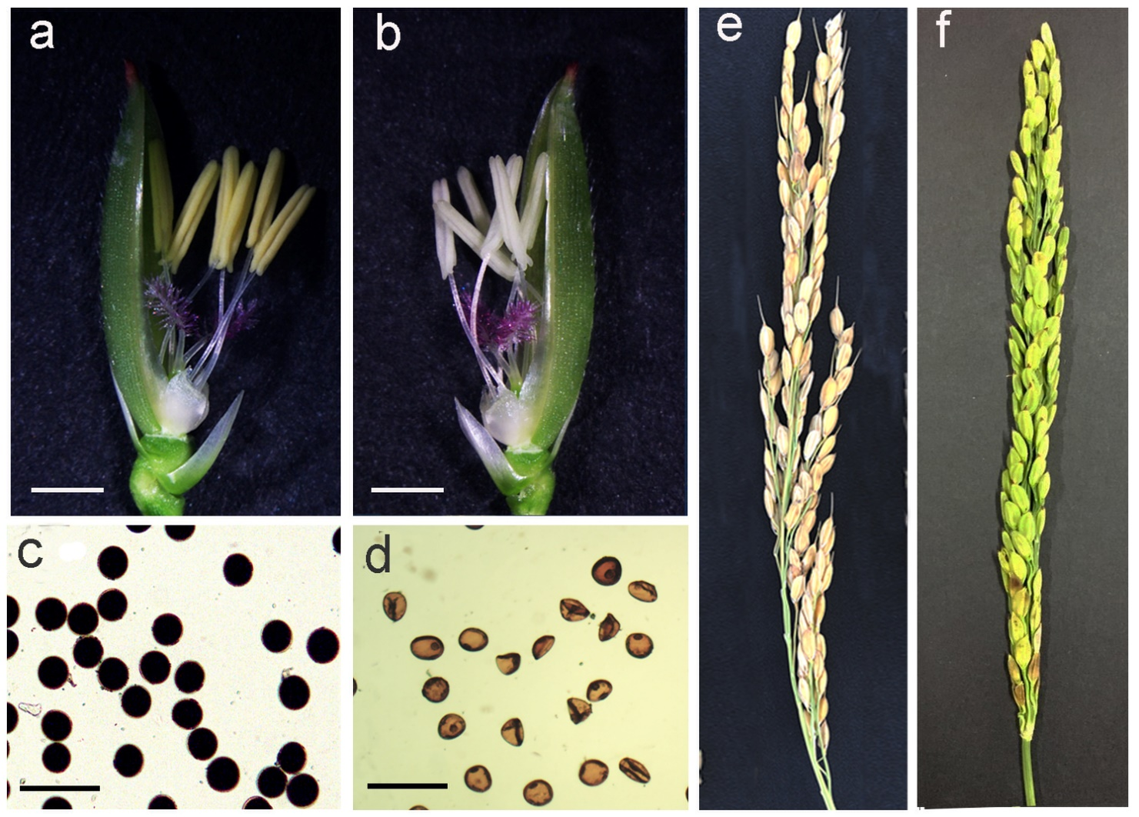
Figure S7 Phenotypic comparison and developing rice anthers between nt-tms5 and its wild type in neo-tetraploid rice.
Note: a and b Floral organs between the wild type and nt-tms5 after removed the lemma. Bars = 1 mm. c and d Pollen grains stained with 1% I₂-KI solution showing mature pollen grains in wild type and typical abortion of mature pollen grains in nt-tms5. Bars = 100 μm. e and f Comparison of the panicle between the wild type and nt-tms5.

