Slide 1
N.S.
N.S.
Figure S 1. RXRα and RXRβ were not related to bexarotene-induced pyroptosis in an ovarian cancer cell line.
After bexarotene treatment, extracellular LDH was measured and compared between the control group and RXRα or RXRβ siRNA-transfected group. Significant differences in LDH activities were not found between each siRNA-transfected group and the control group. Bar graphs represent the mean ± standard deviation of at least three independent experiments. RXR, Retinoid X receptor; NS, not significant.

Slide 2
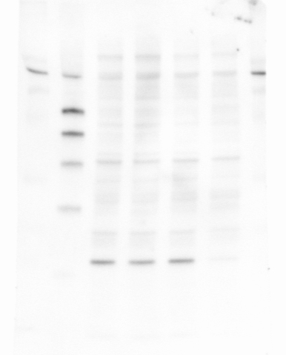
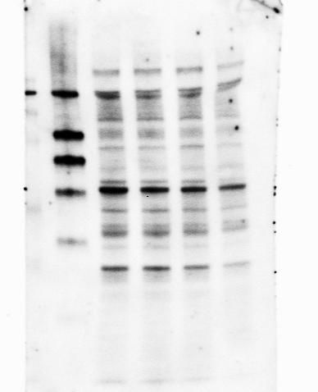
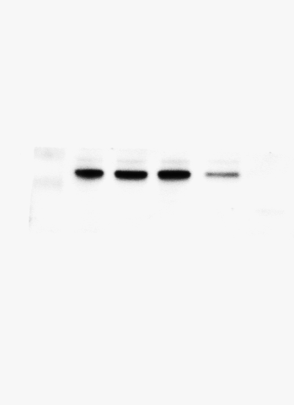
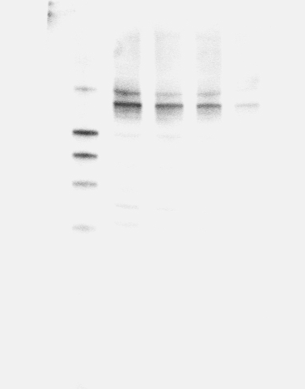
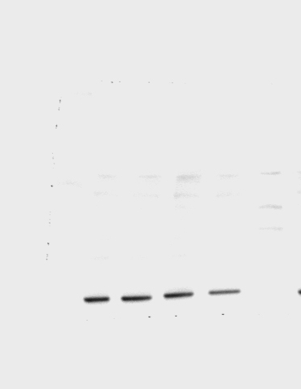
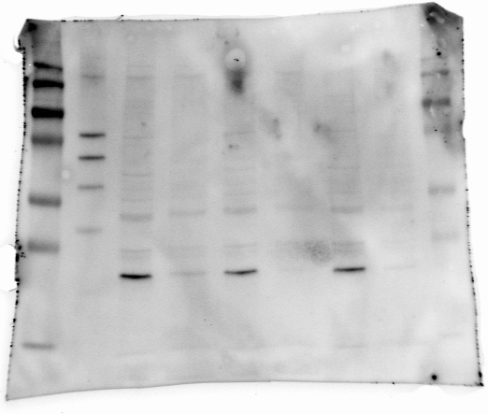
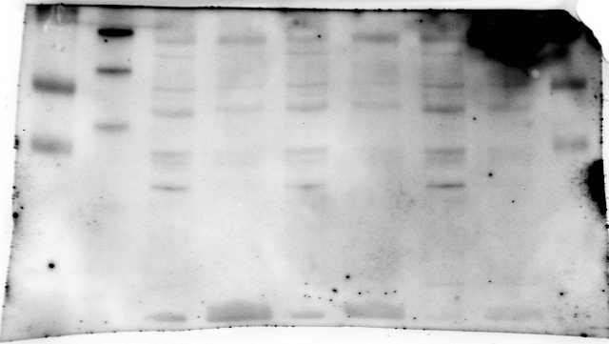
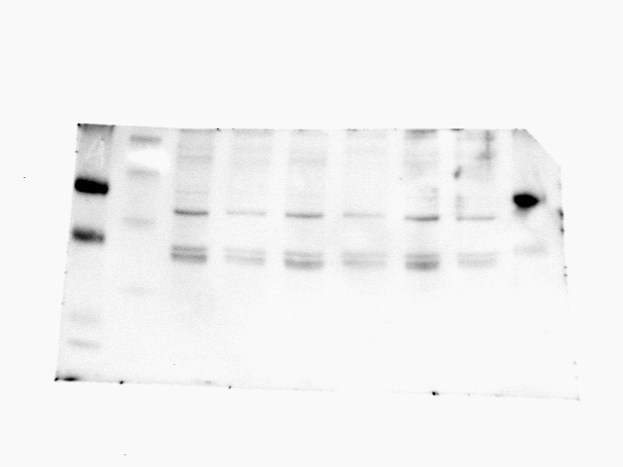
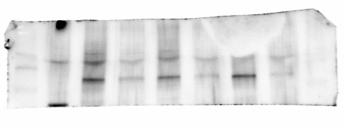
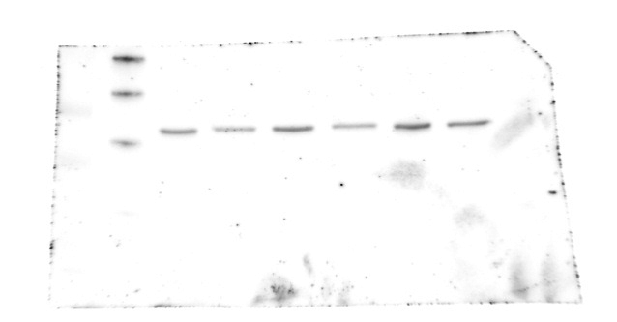
A
Cyclin D1
CDK4
CDK6
-
+
-
+
-
+
10µM BEX
10µM BEX
10µM BEX
Phospho-Rb
ACTB
-
+
10µM BEX
-
+
10µM BEX
B
CDK6
CDK4
-
+
10µM BEX
-
+
10µM BEX
Cyclin D1
Phospho Rb
-
+
10µM BEX
-
+
10µM BEX
-
+
10µM BEX
Figure S 2. Full-length Western blot image for Fig2. (A) full-lemngth image for figure 2c for ES2 cell (B) full-lemngth image for figure 2c for NIH: OVACAR3

Slide 3
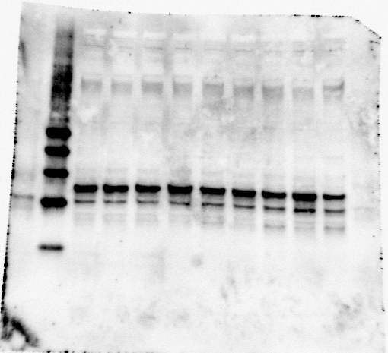
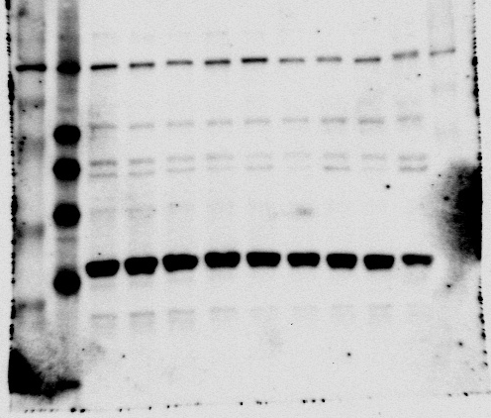
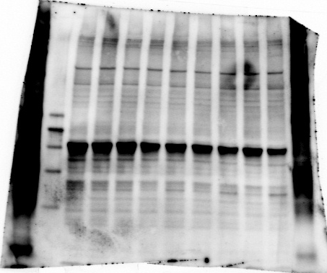
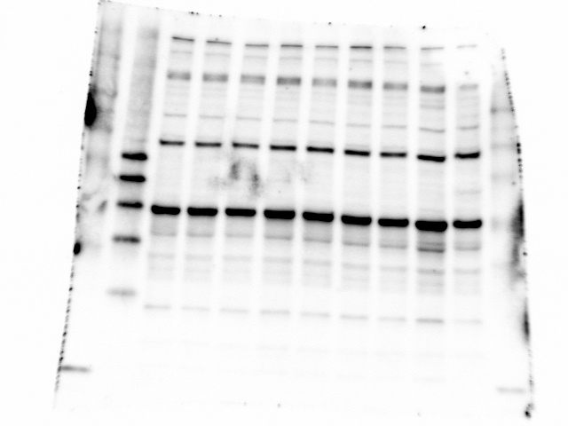
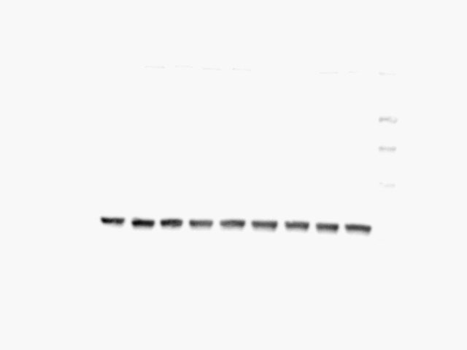
Casp4
Casp3
-
-
+
-
+
-
+
-
+
-
-
+
-
+
-
+
-
+
10µM BEX
10µM BEX
Time (h)
0
2
4
8
24
Time (h)
0
2
4
8
24
GSDME
GSDMD
-
-
+
-
+
-
+
-
+
-
-
+
-
+
-
+
-
+
10µM BEX
10µM BEX
Time (h)
0
2
4
8
24
Time (h)
0
2
4
8
24
-
-
+
-
+
-
+
-
+
10µM BEX
Time (h)
0
2
4
8
24
Figure S 3. Full-length Western blot image for Fig.3

Slide 4
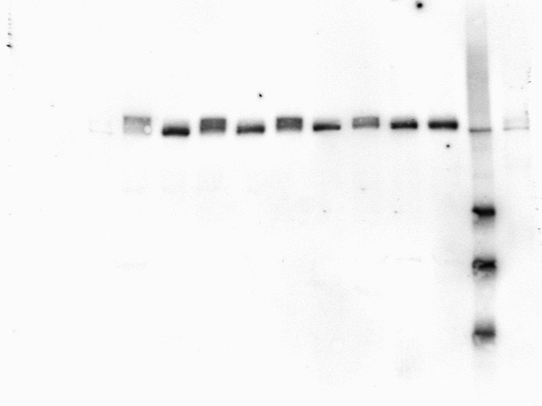
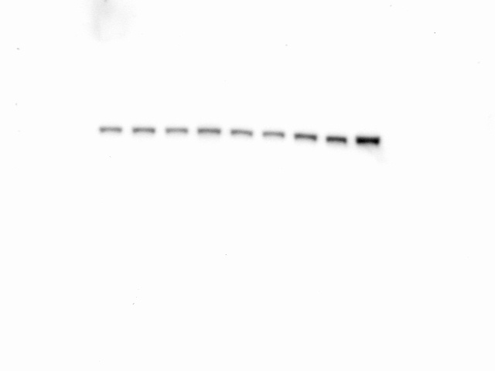
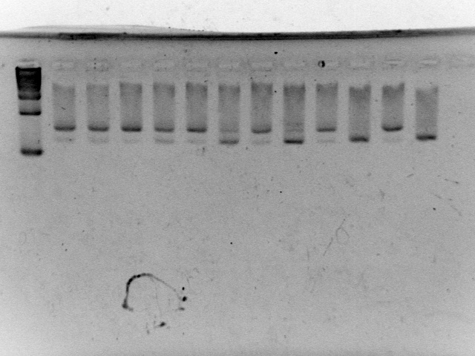
D
Bip
pPERK
PERK
-
-
+
-
+
-
+
-
+
10µM BEX
Time (h)
0
2
4
8
24
-
-
+
-
+
-
+
-
+
Bip
10µM BEX
Time (h)
0
2
4
8
24
-
-
+
-
+
-
+
-
+
10µM BEX
Time (h)
0
2
4
8
24
Figure S 3. Full-length Western blot and agarose gel electrophoresis.

