Slide 1
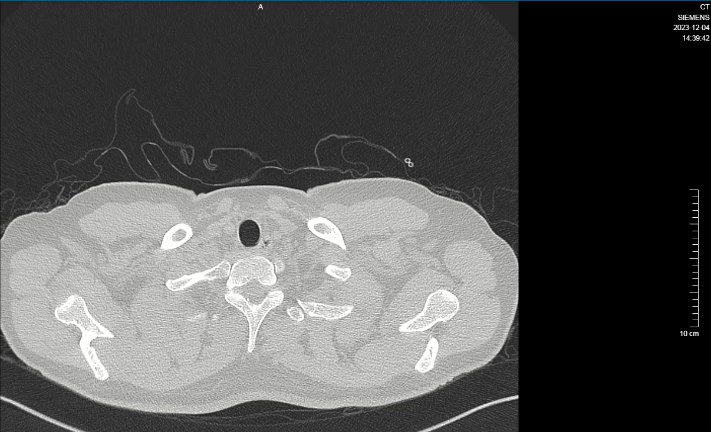
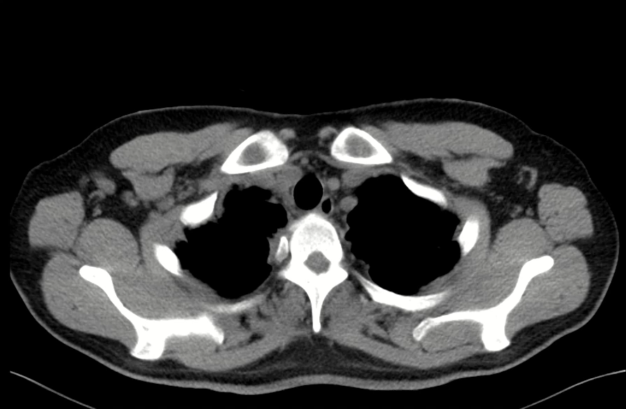
Supplementary Video 2. Chest CT scans for follow-up on 04 Dec 2023

