Slide 1
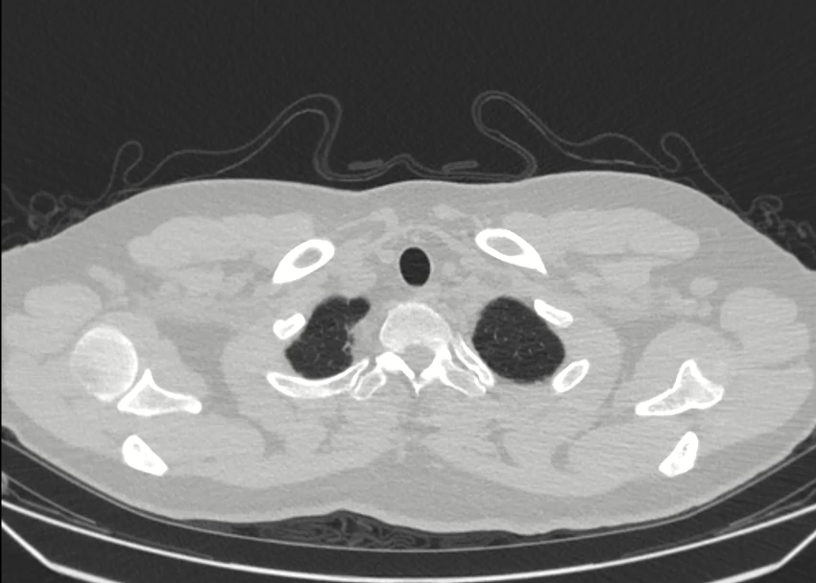
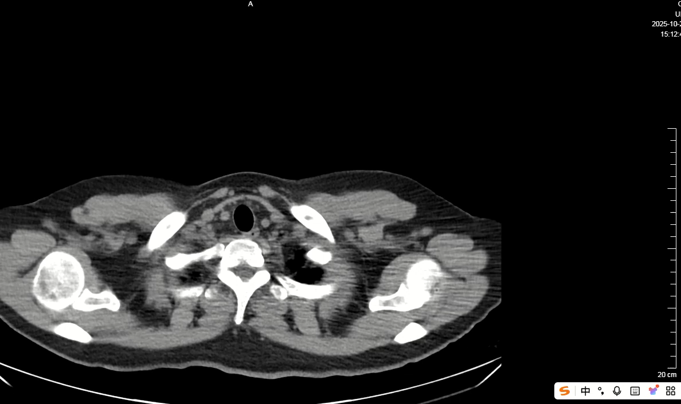
Supplementary Video 5. Chest CT scans for follow-up on 29 OCT 2025

