Slide 1
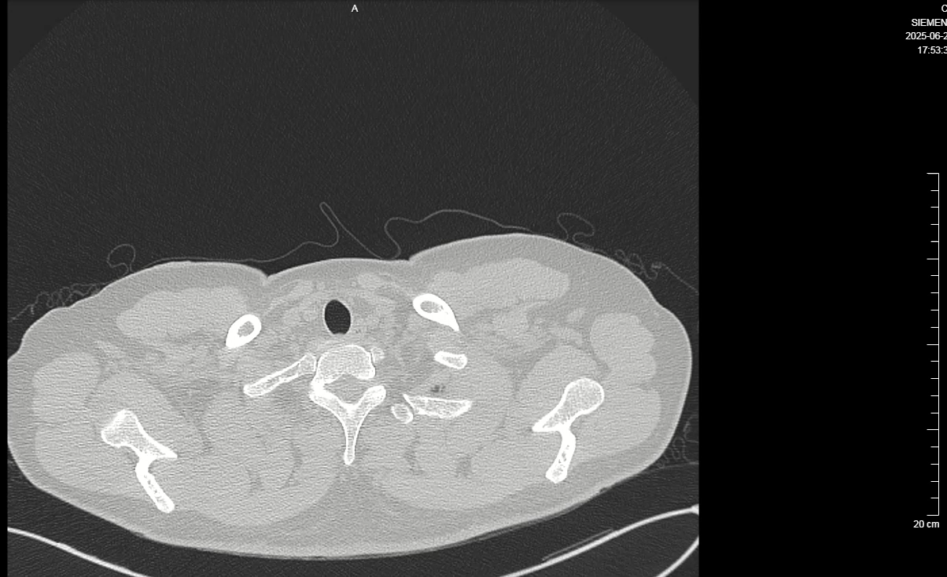
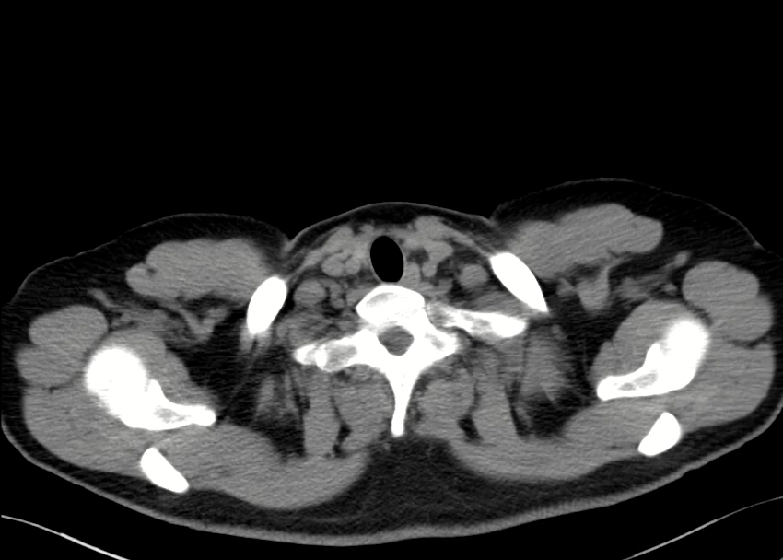
Supplementary Video 4. Chest CT scans for follow-up on 20 June 2025

