Slide 1
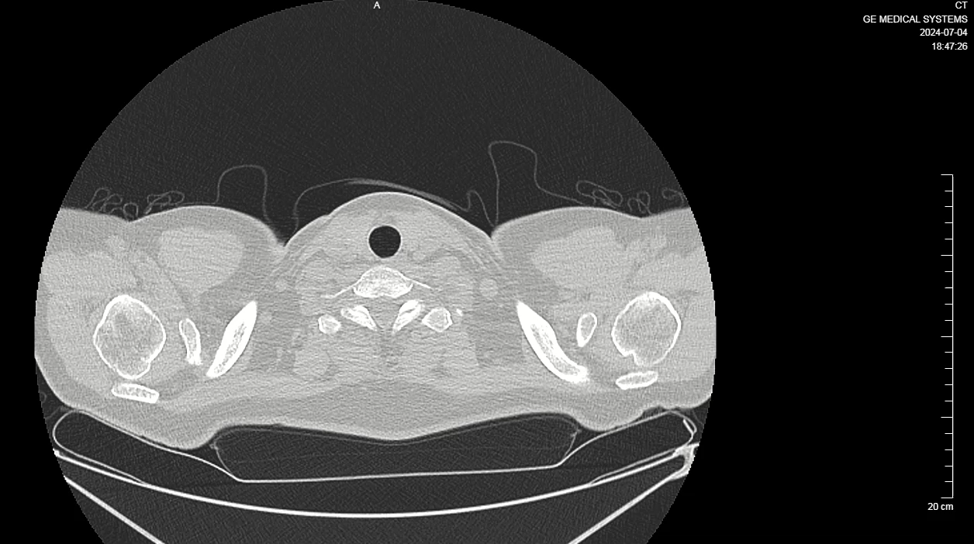
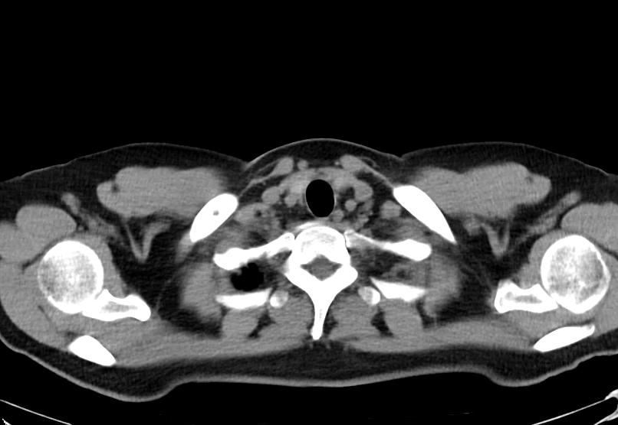
Video 3. Chest CT scans for follow-up on 4 July2024

