Slide 1
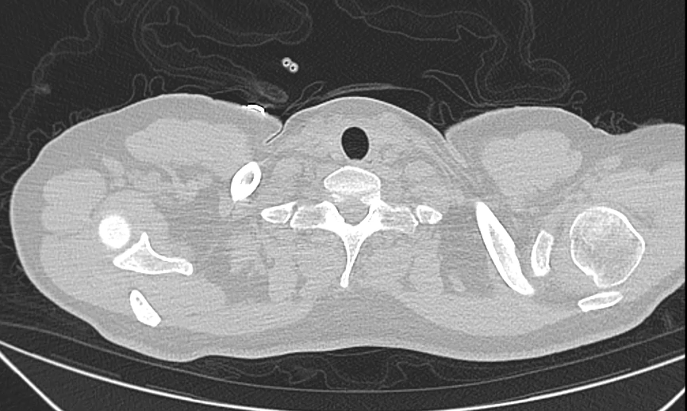
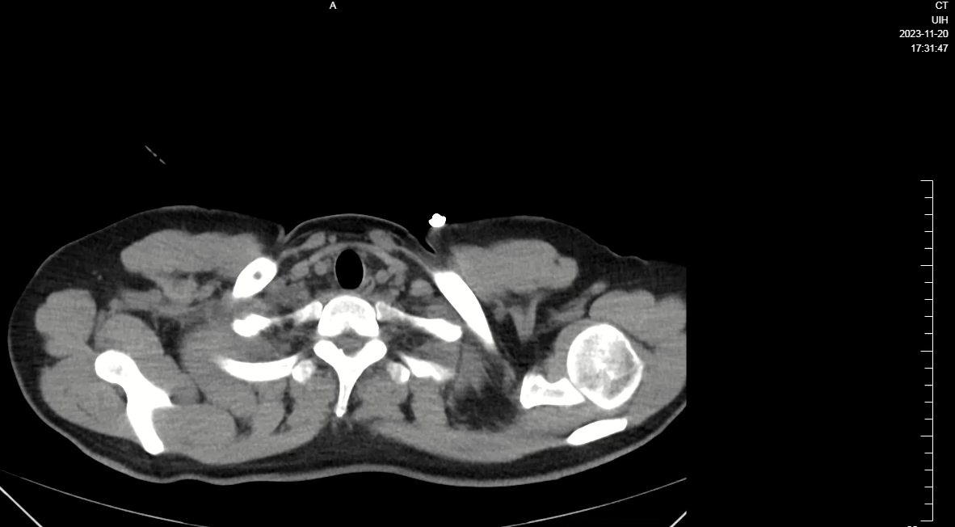
A
B
Supplementary Video 1.Chest CT scan performed after the first admission completed on 20 Nov 2023

