Slide 1
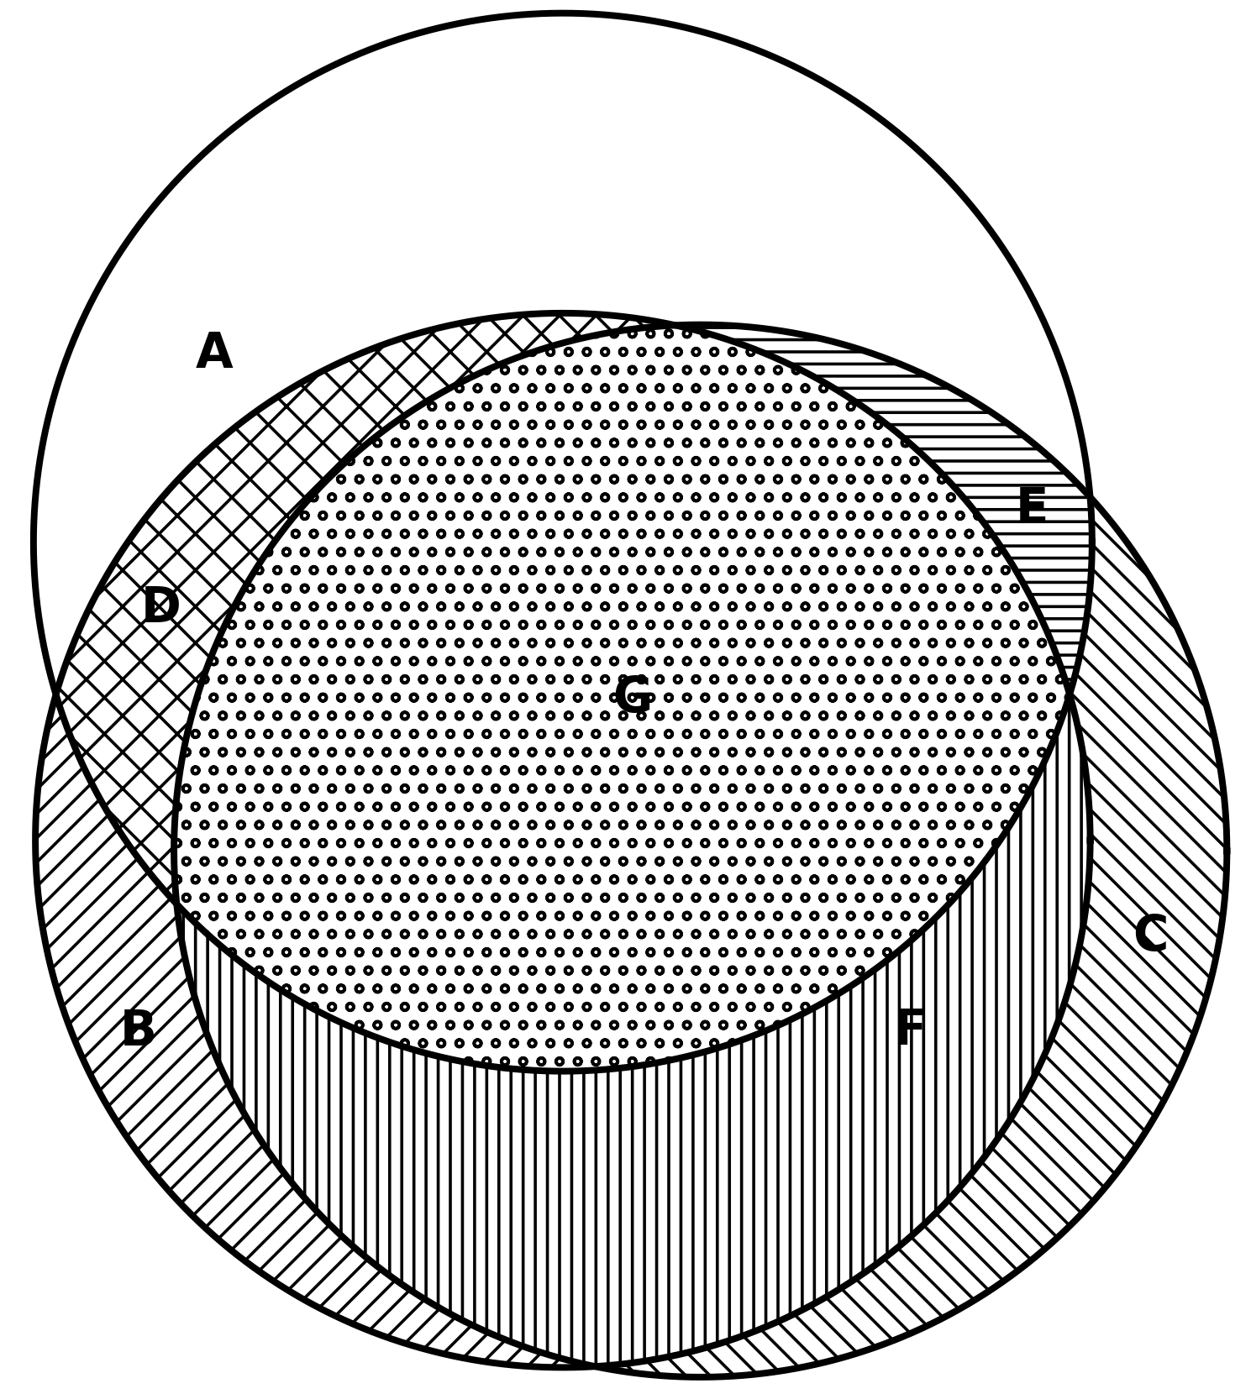
Supplementary Figure 1
ICI
A
E
D
G
C
PTX
B
F
Cmab

