Slide 1
Supplementary Data

Slide 2
S1
Notes:
Table S1. Patients included in epigenetic analyses

Slide 3
S2
CpG | Location | Forward primer (5'-3') | Reverse primer (5'-3') | Sequencing primer (5'-3')
cg19405177 | Cluster 1 | ATGGTTTAGGTTTAGGGAAAGT | [Btn]CCATCACCCAAACCCTACTA | AGGTTTAGGGAAAGTT
cg07427475 | Cluster 2 | TAGGAGTTTAGGGGGATAGTT | [Btn]AAAAAACAACTAAACCAAACC | GTTTAGGGGGATAGTTT
cg02331830 | Cluster 2 | TGGTTTAGTTGTTTTTTATATAGT | [Btn]ACTACAATCTATAACCAAAACTATACC | GATGAGTTGAAGATATTTTAG
cg14598846 | Cluster 2 | ATTTATTTTTAGGGATTGGTAGATGT | [Btn]AACCCAAATTCCCCTCCAACTTC | GGAATTGAGATTATAGGATTTGTTA
cg23299254 | Cluster 2 | [Btn]AGGAATTGAGATTATAGGATTTGTTAG | CCTTTAAAAAACCCAAATTCCCCTCC | AACTTCCAAAAAATTAAAATAAACC
cg21511203 | Between PLEC first exons | TTTAAATTTTTTAGAGGTGGGGAAGT | [Btn]ACCCTAAATCTCATACCAAACTCAAA | GTTAGTTTTTAGGGTTTTGTTATA
S3
CpG | Location | gRNA sequence | Assay Name
cg19405177 | Cluster 1 | AGAAGGTCGAGGAGTGCCAG | NDXK6710.AC
cg07427475 | Cluster 2 | CCAGGGGGACAGCCCCCTCC | NBVW9087.AL
cg02331830 | Cluster 2 | CGAGCTGCAGTCTGTGGCCA | XSMQ2755.AC
cg14598846 | Cluster 2 | GCTCCATCTCCTTAAACTTC | TTVS8373.AH
cg23299254 | Cluster 2 | GAGGCTGTCGGCAACCACGC | JKMT6655.AA
cg21511203 | Between PLEC first exons | AGACCATGCATGGAGACCAA | JDKB1360.AF
NTgRNA | Control | CGTTAATCGCGTATAATACG | NTgRNA1 (custom)
Notes:
Table S2/3 Pyrosequencing and epigenome editing primers
S2. Primer sequences used to amplify and pyrosequence the 6 CpGs taken forward from the initial analyses. [Btn] represents the biotin tag at the 5' end of the primer.
S3. gRNA sequences and assay name for each CpG targeted in TC28a2-dCas9-TET-1 and dCas9-DNMT3a cell line experiments. NTgRNA = non-targeting gRNA, as well a

Slide 4
S4
Gene | Integrated DNA Technologies (IDT) Assays
PLEC | HS.PT.58.3012276
GRINA | HS.PT.58.39790981.g
PARP10 | Hs.PT.58.21152609
 | Custom qPCR assays
 | Forward Primer | Reverse Primer
ACAN | CACTTCTGAGTTCGTGGAGG | ACTGGACTCAAAAAGCTGGG
COL1A1 | TGTTCAGCTTTGTGGACCTC | TTCTGTACGCAGGTGATTGG
COL2A1 | GGCAATAGCAGGTTCACGTA | CTCGATAACAGTCTTGCCCC
COL10A1 | CATAAAAGGCCCACTACCCAAC | ACCTTGCTCTCCTCTTACTGC
SOX9 | CGTCAACGGCTCCAGCAAGAACAA | GCCGCTTCTCGCTCTCGTTCAGAAGT
CCL2 | GATCTCAGTGCAGAGGCTCG | TGCTTGTCCAGGTGGTCCAT
IL6 | TCTCCACAAGCGCCTTCG | CTCAGGGCTGAGATGCCG
ADAMTS5 | GCTGGGAGATGACCATGAGG | GCTGCGCTCTGGAGAACATA
ADAMTS4 | CATCCTACGCCGGAAGAGTC | TCTTGTCATCTGCCACCACC
MMP13 | AGACCTCCAGTTTGCAGAGC | TACGGTTGGGAAGTTCTGGC
PTGS2 | ATCTACGGTTTGCTGTGGGG | TTCTGTACTGCGGGTGGAAC
INHBA | GAAAAGGAGCAGTCGCACAGA | GGCGATGAGGGTGGTCTTC
BMP2 | ATGGATTCGTGGTGGAAGTG | GTGGAGTTCAGATGATCAGC
CXCL8 | TGCCAAGGAGTGCTAAAG | CTCCACAACCCTCTGCAC
NFATC2 | CACGCGGTAGAGAAGACGG | TTCGGCTCTTCTTGGTCCAC
Notes:
Table S4. qPCR primer and assay sequences

Slide 5
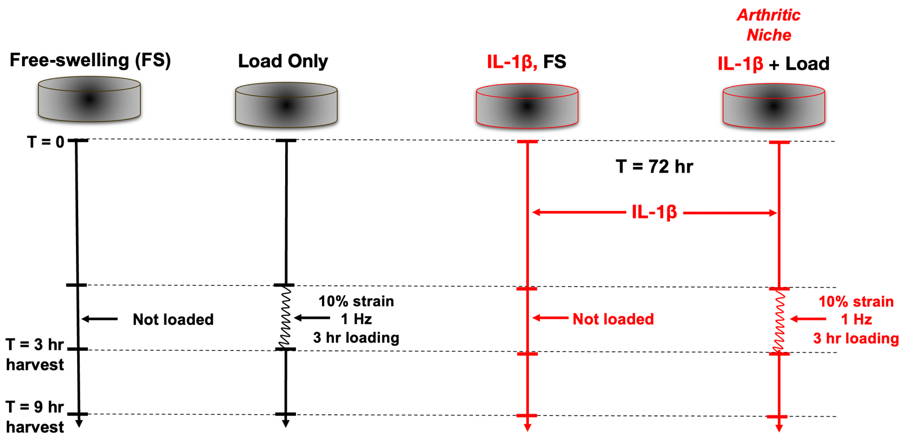
 | FS (1) | Load 3 hr (2) | FS (3) | IL-1β (4) | IL-1β + Load 3 hr (5)
CONTROL | n = 6 | n = 6 | n = 6 | n = 6 | n = 6
PLEC-KO | n = 6 | n = 6 | n = 6 | n = 6 | n = 6
 | Experiment 1 - Physiological load |  | Experiment 2 - Inflammation
 |  |  |  | Experiment 3 - Mechano-inflammation
Notes:
Figure S1. Experimental design for investigating plectin deficiency after mechanical loading, inflammation, and loading in the presence of inflammation.
Top: Graphical depiction of experimental design. Bottom: RNA-Seq design and sample numbers. Each group had its own free swelling (FS 1 and FS 3) control for direct comparison. To prevent batch effects all samples in groups 1-2 and 3-5 were extracted in two separate batches using identical buffers, reagents and kit lots. FS = free-swelling, IL-1β = Interleukin-1 beta, T = time, Hz = hertz, hr = hour.

Slide 6
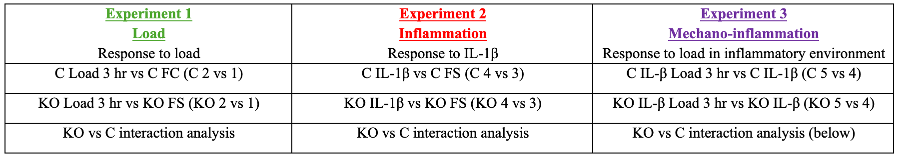
Notes:
Figure S2. description of all groups studied by DEG analyses. Bottom figure, DEG interaction analysis platform for determining effect of pKO using experiment 2 as an example. A, far left to top left, pKO 4 vs 3 DEG (Yes = significant change in response to inflammation in pKO), pC4/pC3 (yes = significant change in response to inflammation in pC), in this case the DEG exists in both pC and pKO, therefore pKO 4 vs 3 adjusted P (pAdj) is divided by pC 4 vs 3 pAdj (Yes = pKO pAdj < pC pAdj), therefore the response of the genes in this group is enhanced by plectin deficiency (KO-dependent-enhanced, KDE, Group A). B, identical to A, all genes are significant DEGs in pKO 4 vs 3, pC 4 vs 3 (significant in both systems), therefore pKO 4 vs 3 pAdj is divided by pC 4 vs 3 pAdj (answer = no therefore pKO pAdj = pC pAdj), these genes are similar in both pC and pKO and independent of the knockout (KO-independent, KOI, group B). C, pKO4 vs 3 DEG (Yes, = significant change in response to inflammation in pKO), pC4 vs 3 (No = no change in response to inflammation in pC), in this case the DEG exists in pKO only (KO-induced-response, KIR, group C). D, pKO 4 vs 3 DEG (No = no change in response to inflammation in pKO), pC5/pC4 (yes = significant change in response to inflammation in pC), in this case pKO is associated with a reduced response than pC (KO-dependent-weakening, KDW, group D). As STAN-HiPSC and iASC-s9c9 experiments were designed and analysed with an identical approach, top table represents the experiment in one line (iASC-s9c9). pC = PLEC control,pKO = PLEC knockdown/out

Slide 7
Notes:
Figure S3. Association between rs11780978 genotype and methylation at additional CpGs captured on pyrosequencing assays in patient cartilage.
P values were calculated using the Kruskal–Wallis test. Horizontal lines and error bars show the mean ± SEM. n = the number of patients providing data per CpG site. Minus (-) and plus (+) denote direction and distance from array CpG.

Slide 8
 | FS (1) | Load 3 hr (2) | IL-1β (4) | IL-1β + Load 3 hr (5)
CONTROL | n = 4 | n = 4 | n = 5 | n = 5
PLEC-KO | n = 4 | n = 4 | n = 6 | n = 5
 | Load only |  | Load in the presence of inflammation
Table S4. N number of RNA samples sequenced for loading analyses
Notes:
Table S5. Number of samples retailed for sequencing

Slide 9
Notes:
Figure S4. cg24891660 (cg1660) mQTL replication
A statistically significant result is observed in a Kruskal–Wallis test, however this was deemed not to be a true mQTL, as the biological mechanism of mQTL function would demonstrate a linear relationship between genotype (copies of the risk allele) and methylation (%).

Slide 10
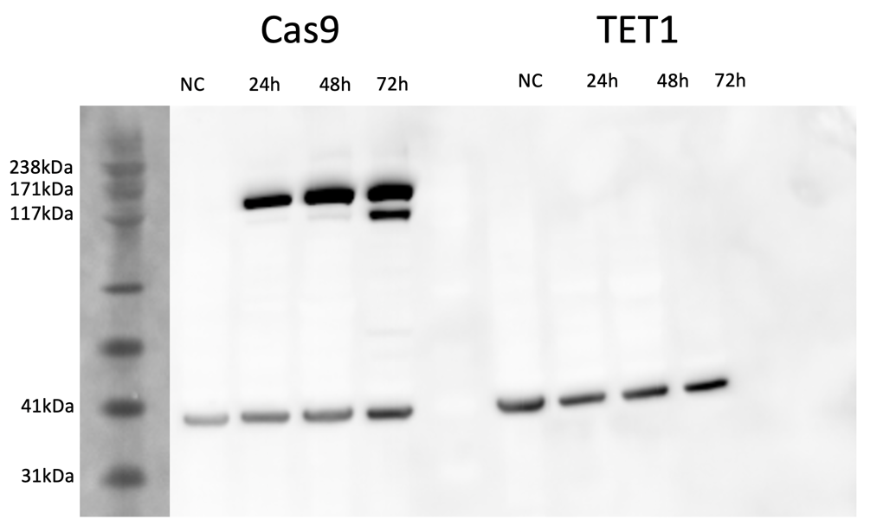
Notes:
Figure S5. Western blot for Cas9 (161 kDa) induction by doxycycline in iASC-s9c9.
Demonstrates induction of Cas9 and failure of induction of dCas9-TET1 (from a separate experiment) 24, 48 and 72 hours after addition of 1µg/ml of doxycycline. kDa = kilodaltons. NC = no doxycycline control, h = hr.

Slide 11
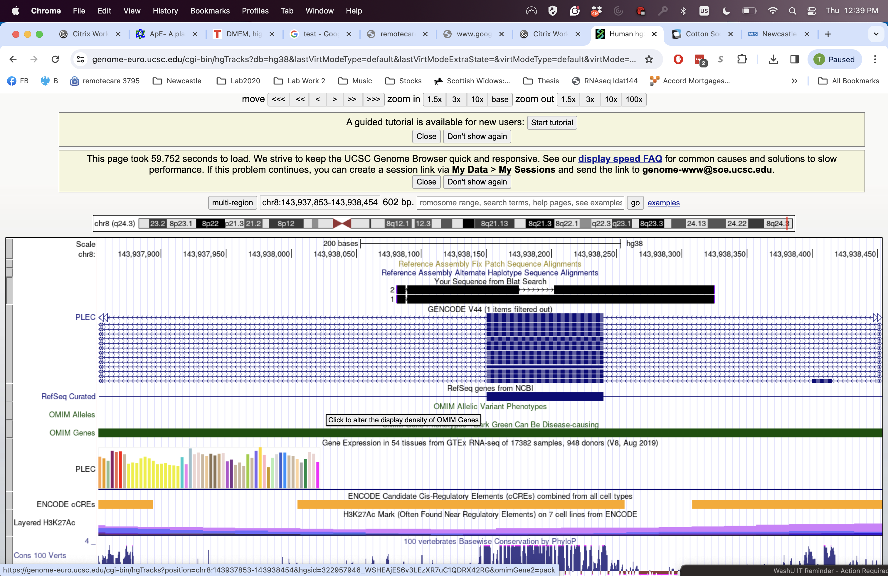
iASC-s9c9-pKO-DNA
iASC-s9c9-pCTRL-DNA
PLEC Exon 3
PLEC Exon 3
Notes:
Figure S6. Representative Sanger sequencing of iASC-s9c9-CTRL and iASC-s9c9-PLEC-KO demonstrating DNA editing
UCSC genome browser view of exon 3 of PLEC on chromosome 8 overlaid with Sanger sequencing results (lower and upper black band labelled respectively). These data demonstrate that in the edited band there was a reproducible 26bp DNA deletion, whereas in the control band and there was no detectable genome editing. The deletion matched the predicted from gRNA design tool. The blue region represents exon 3 of PLEC which was chosen as the most up-stream common exon to all isoforms of PLEC that was amenable to CRISPR design. The genome editing was comparable with the previous deletion undertaken using the same gRNAs in an alternative line which is reported in⁸⁷. Data from n = 3 separate pellets of each line.

Slide 12
Notes:
Figure S7. Western blot image of iASC-s9c9-pC/pKO validation in monolayer and following chondrogenesis.
Left raw images of blots with annotated ladder, note due to size of Plectin (>460 kDa) blots were cut in half between the 117 kDa and 71 kDa and then blotted separately. pC P1 = iASC-s9c9-pC passage 1 after genome editing, pKO P1 = iASC-s9c9-pKO passage 1 after genome editing. P6 = passage 6 after genome editing. pC/pKO d42 protein extracted from 2 separate inductions of chondrogenesis pellets at d42, demonstrating maintenance of plectin knockdown at the end of chondrogenic differentiation.

