Slide 1
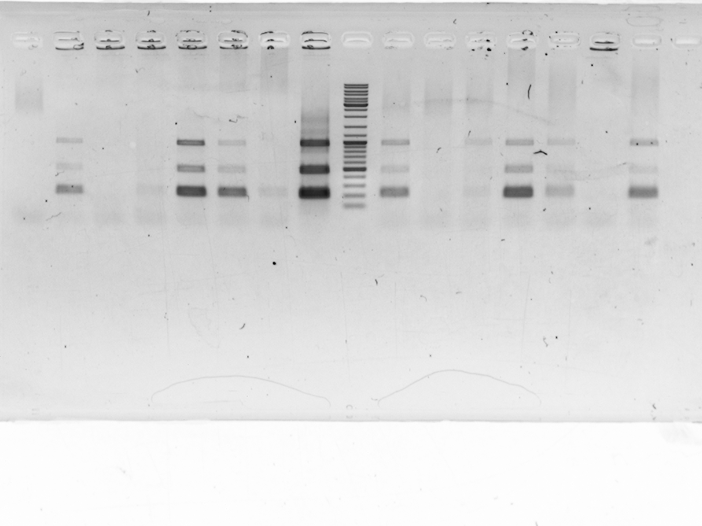
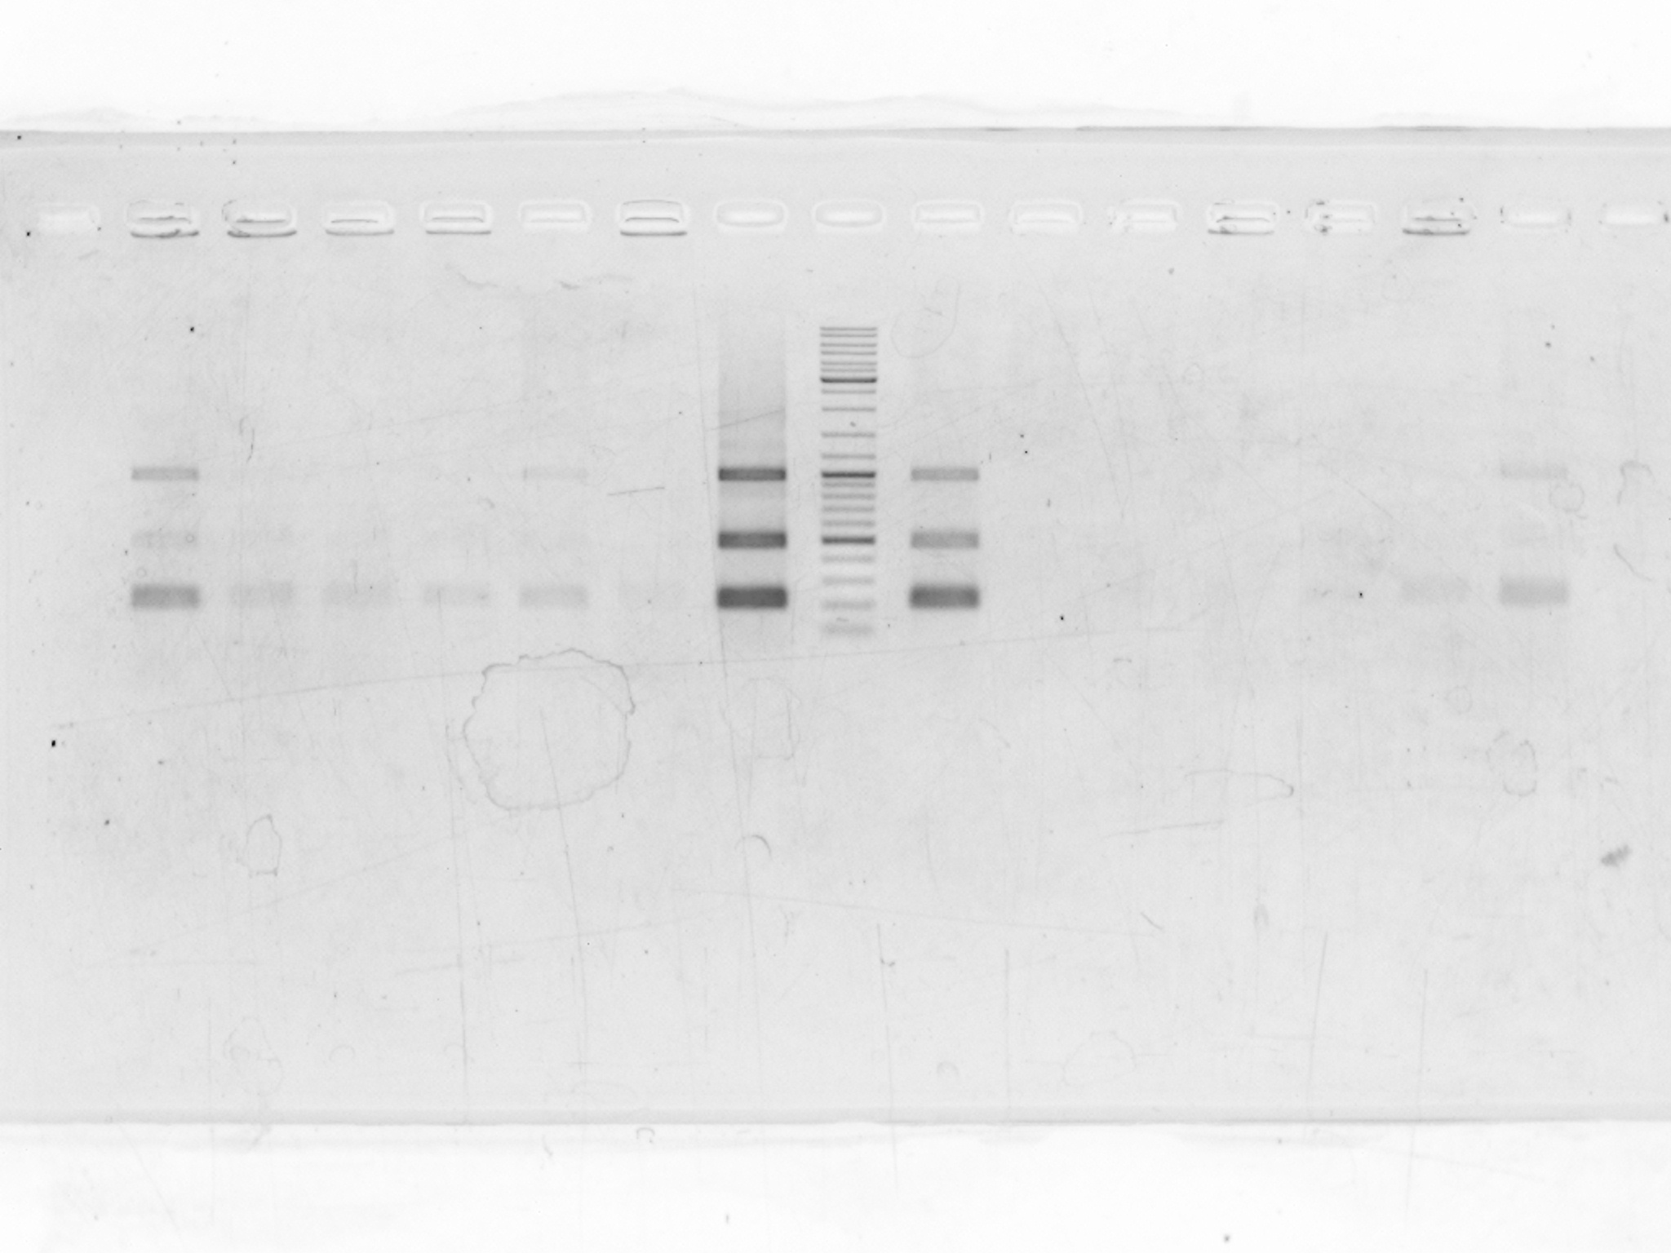
garp-like, replicate 1
garp-like, replicate 2

Slide 2
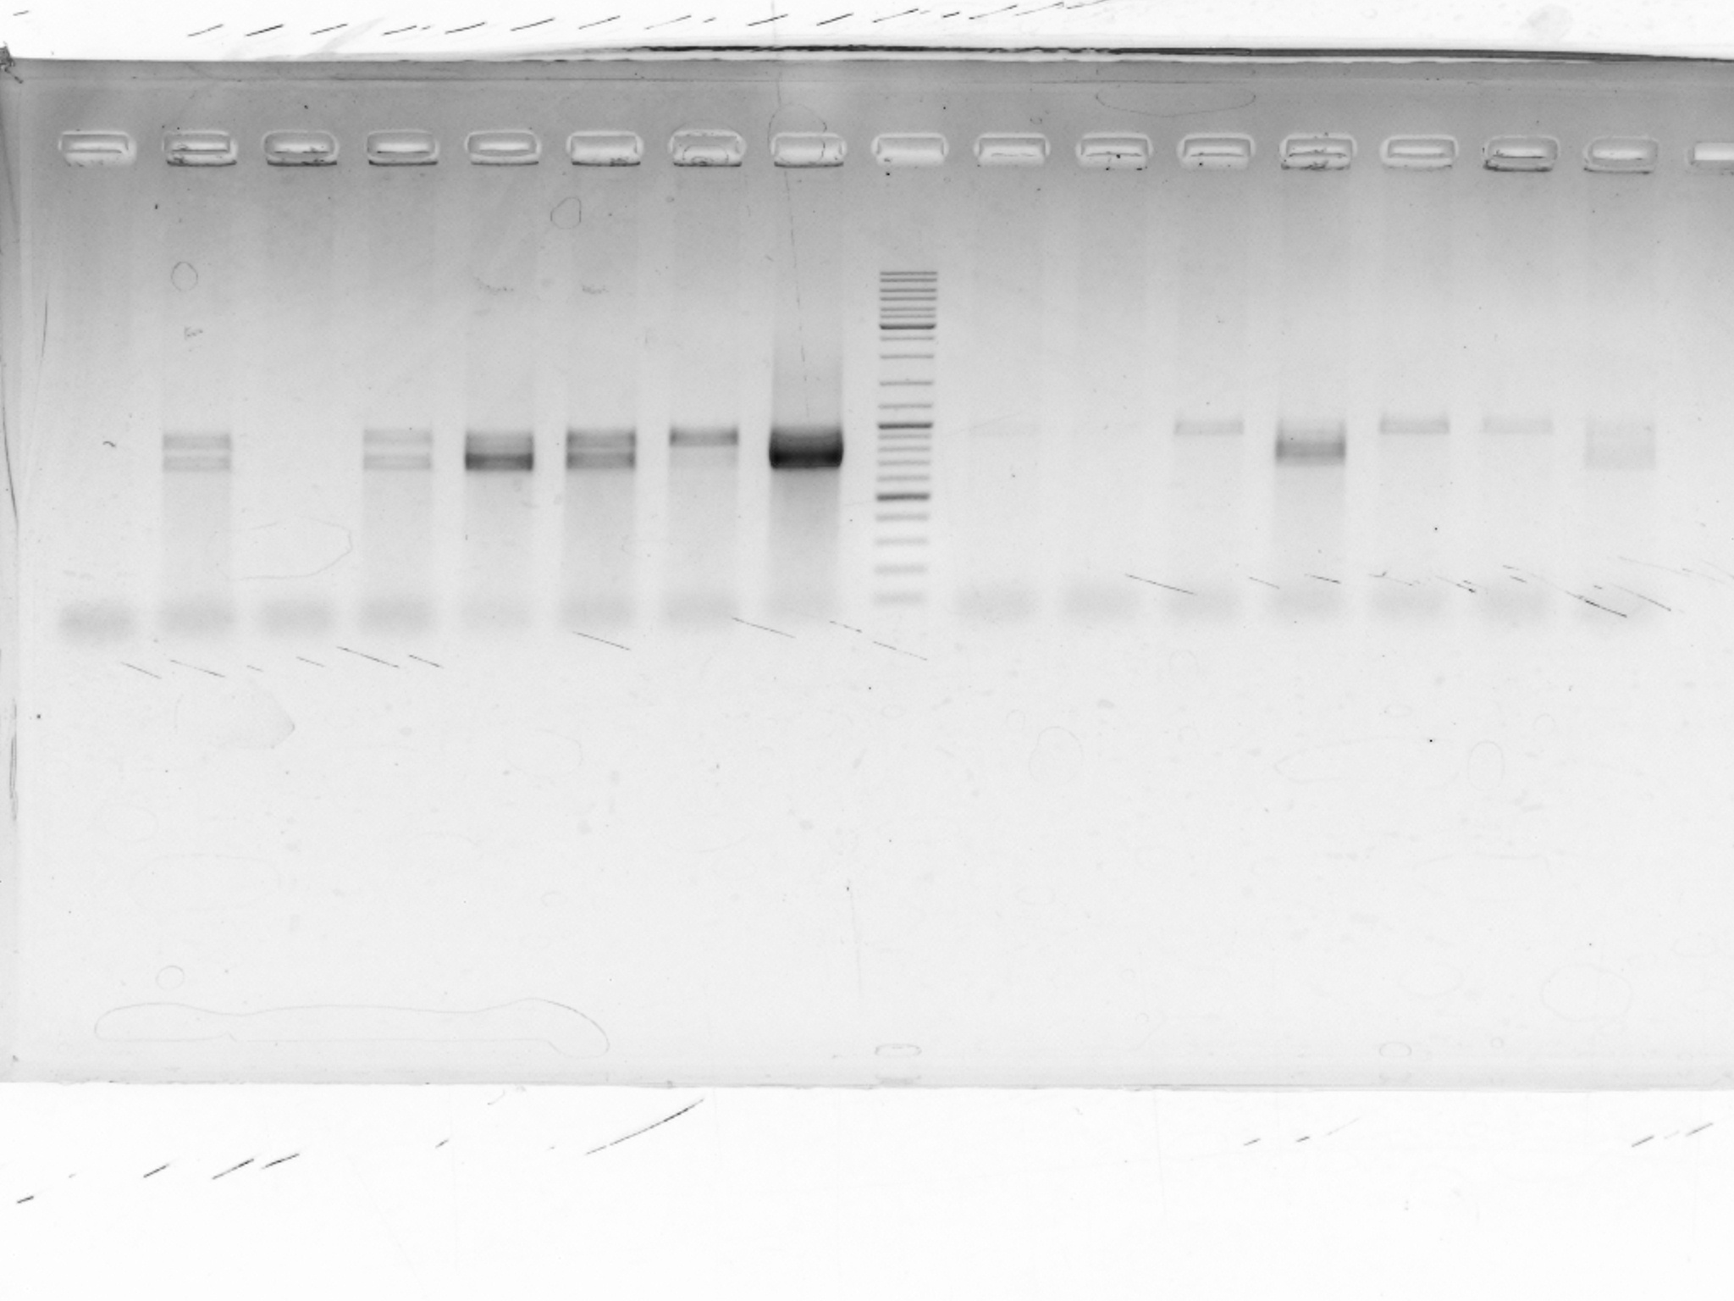
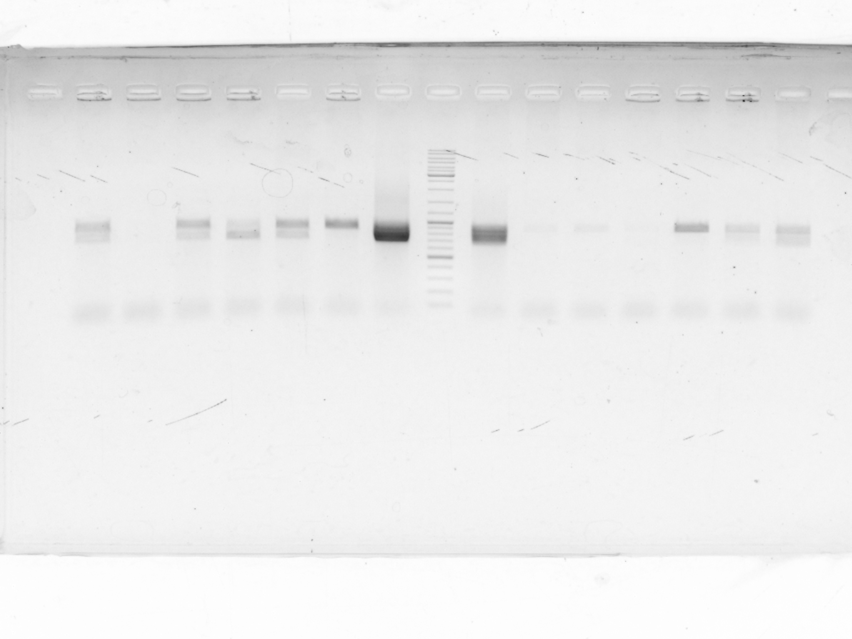
pmfbp1-like, replicate 1
pmfbp1-like, replicate 2

Slide 3
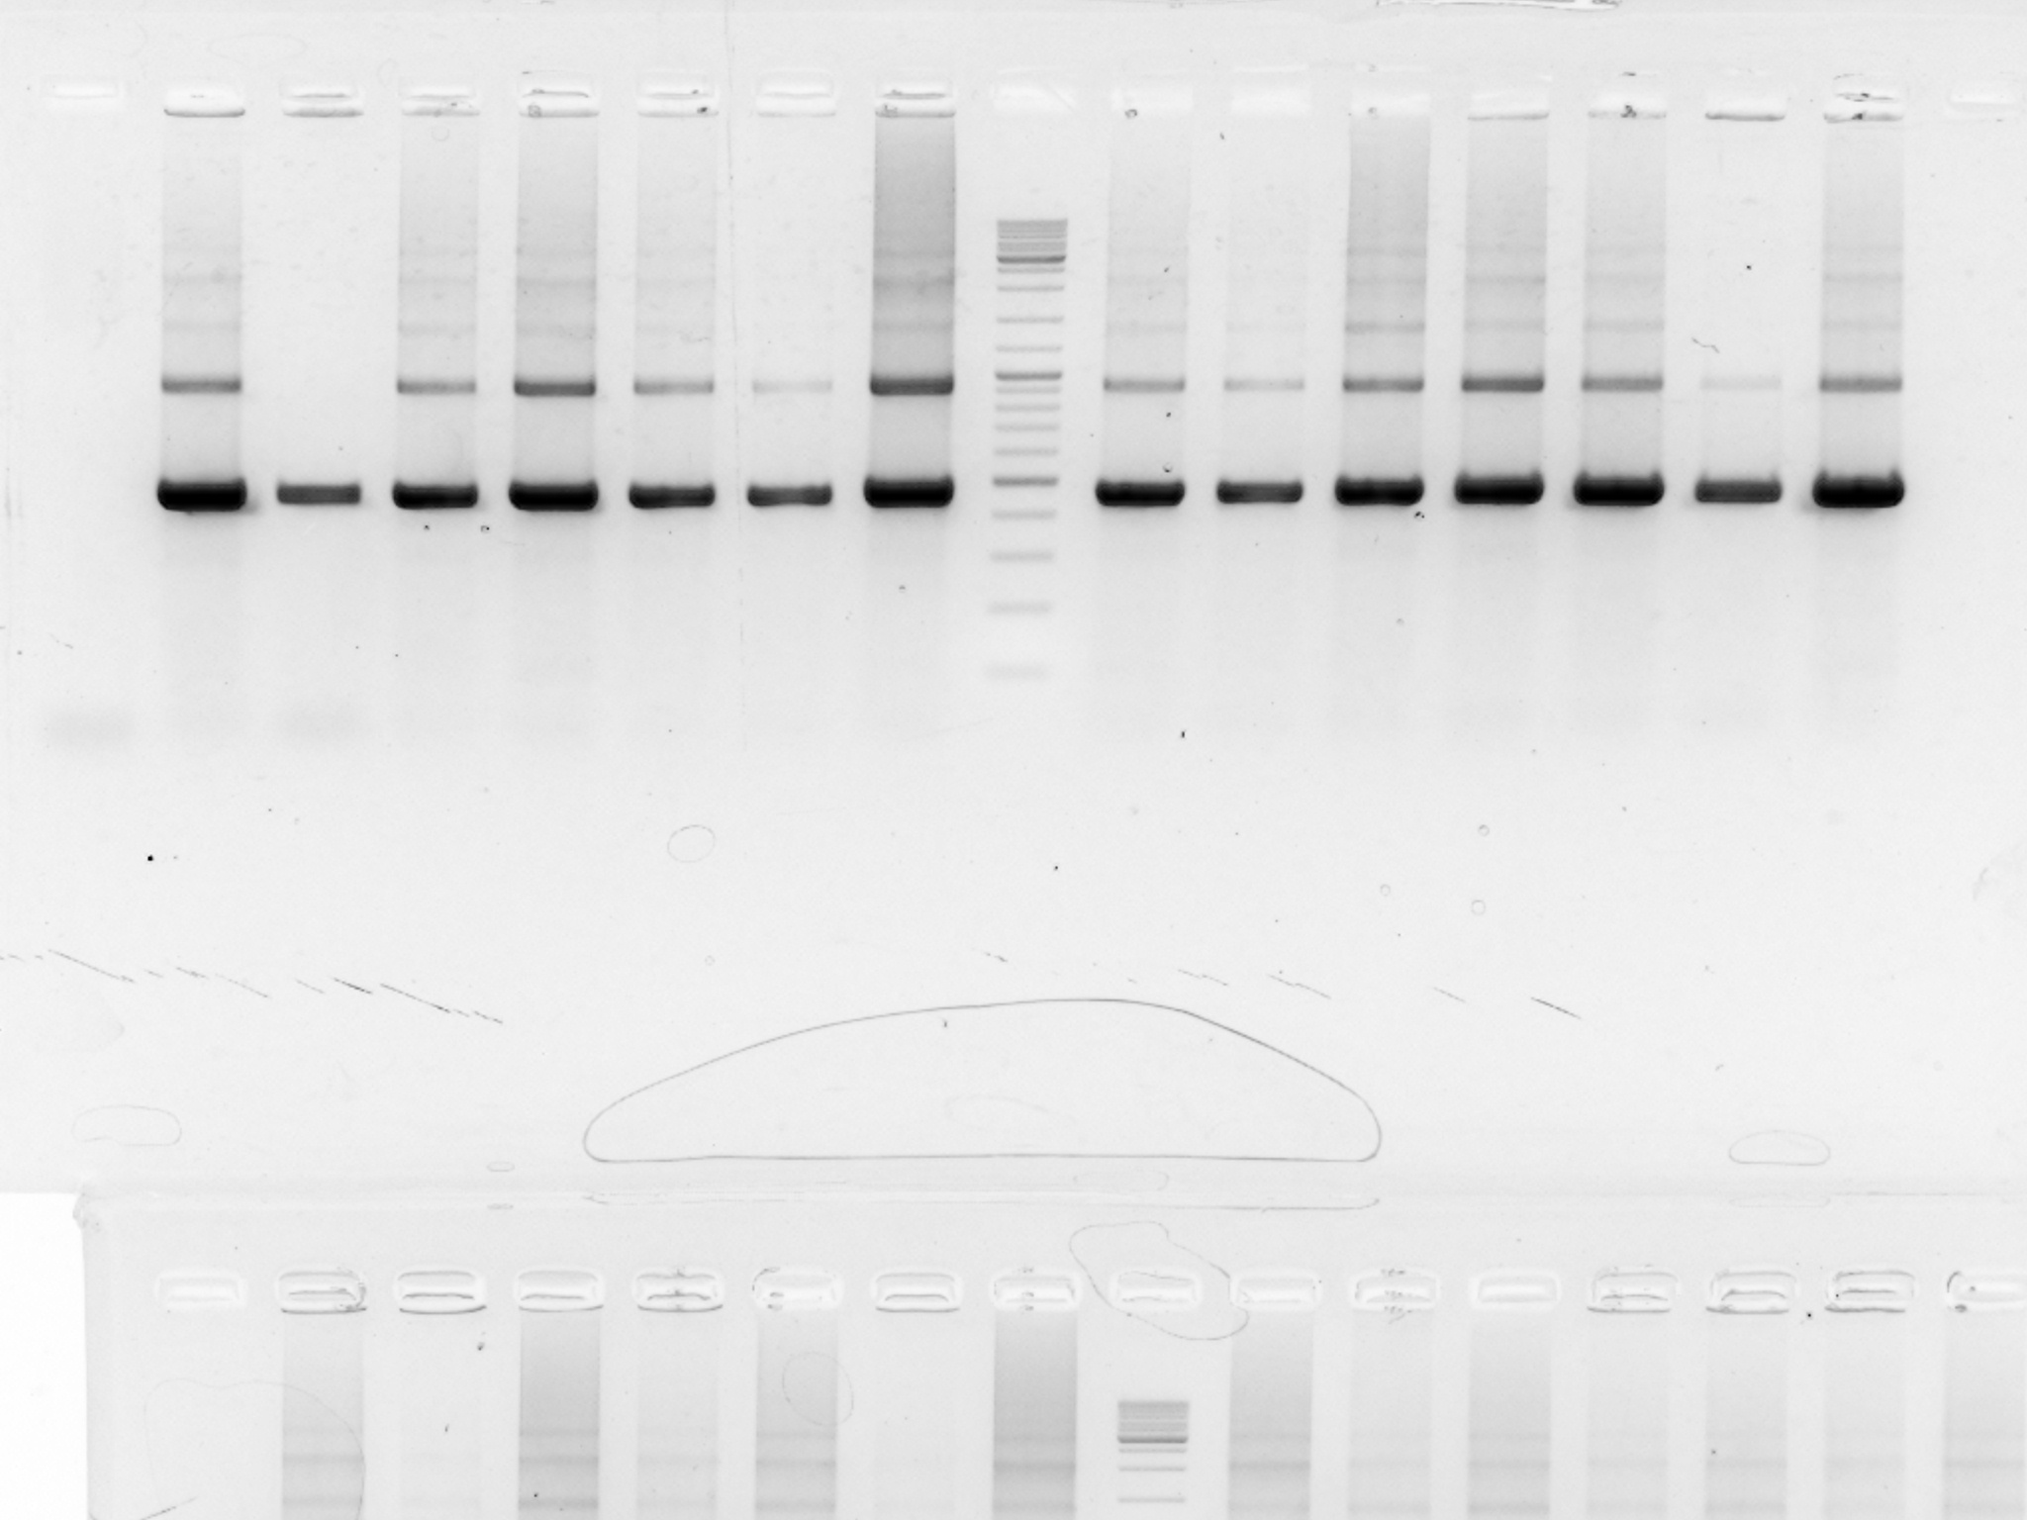
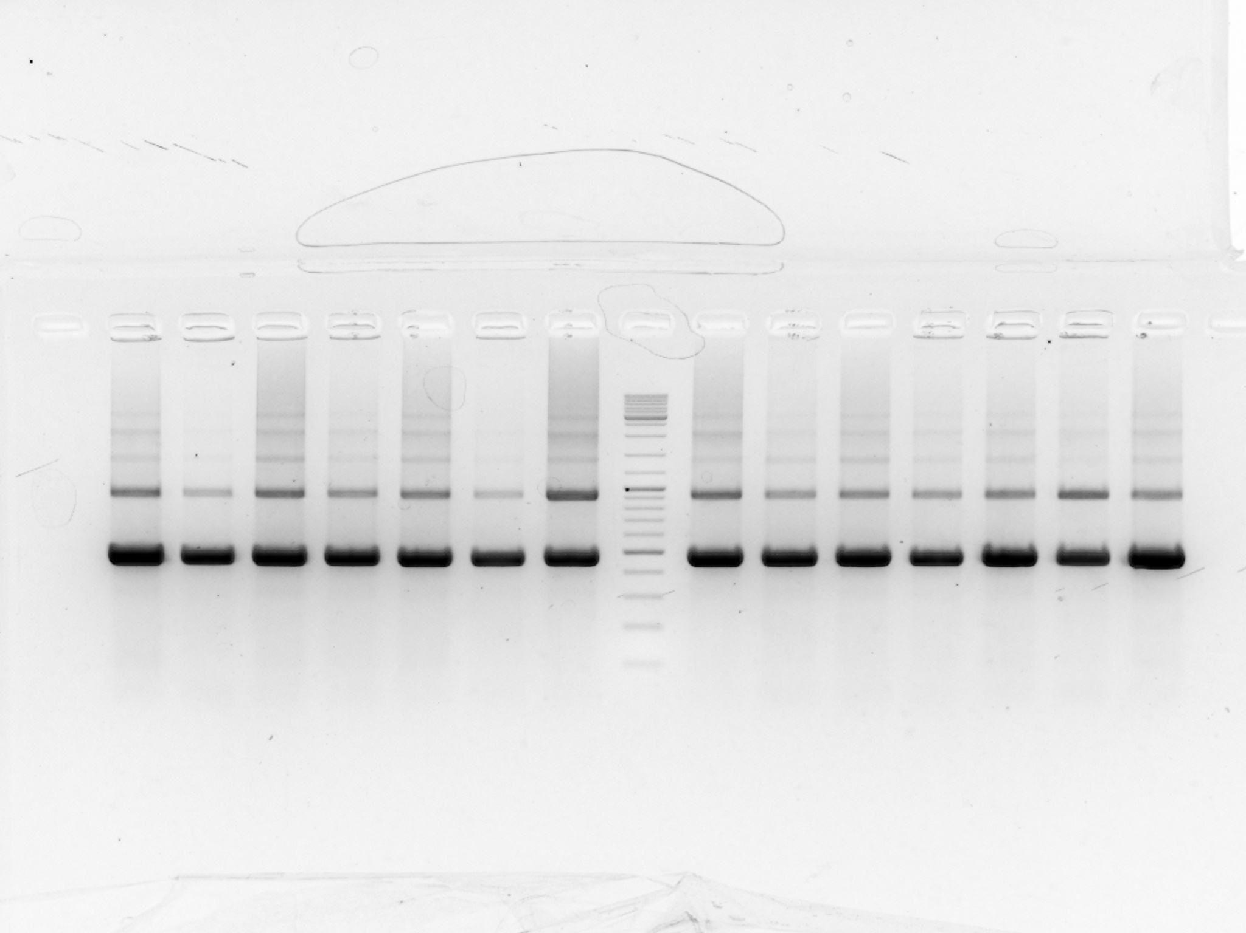
daz1-like, replicate 1
daz1-like, replicate 2

