Slide 1
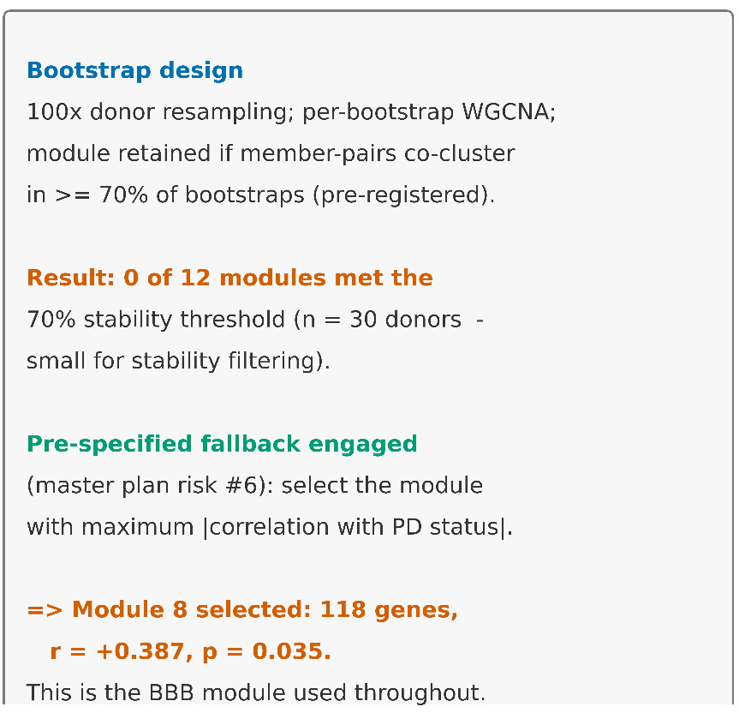
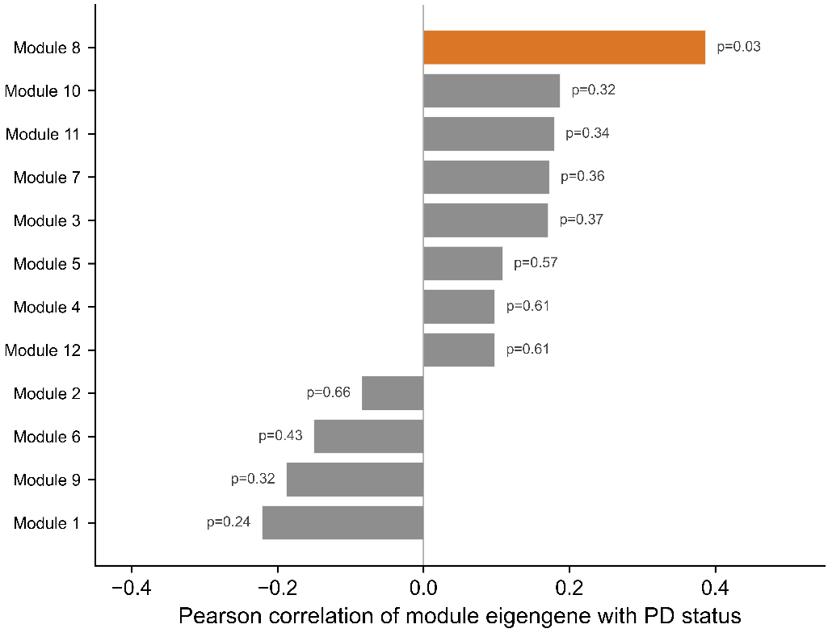
a
b
Supp Fig S1: WGCNA bootstrap module stability and selection.

Slide 2
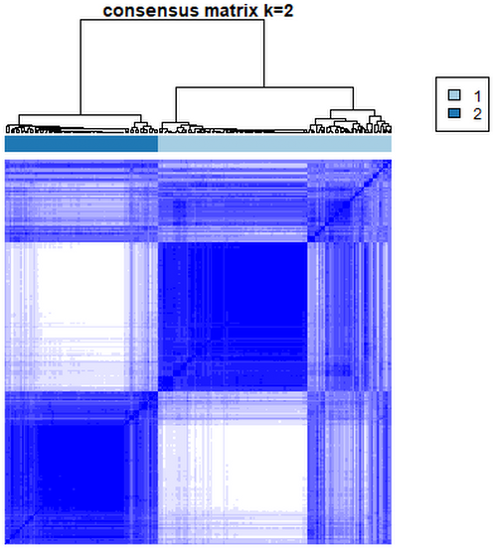
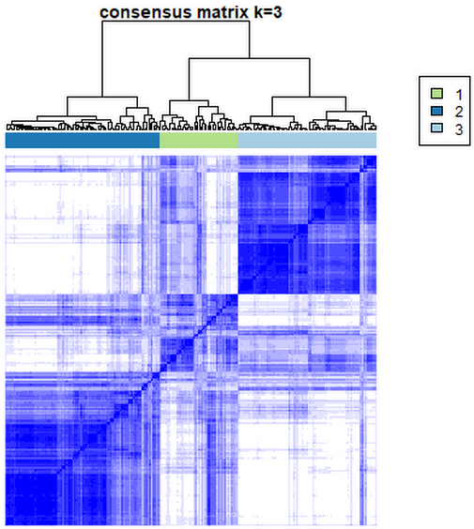
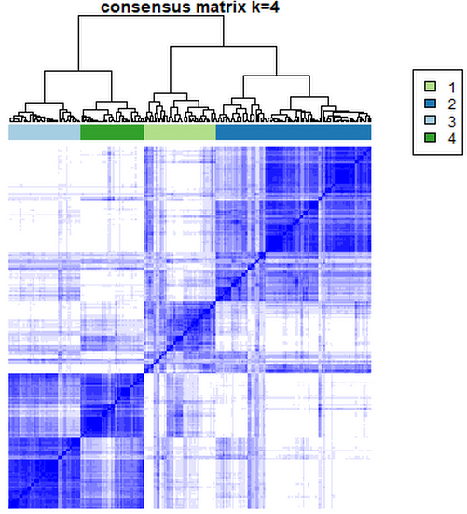
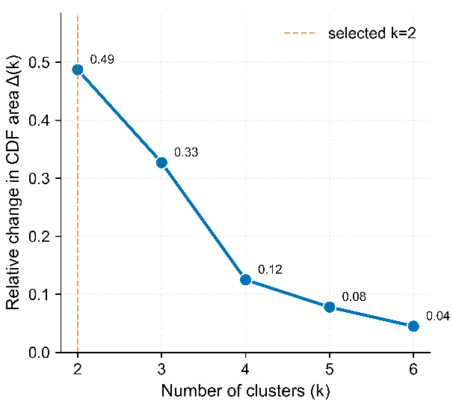
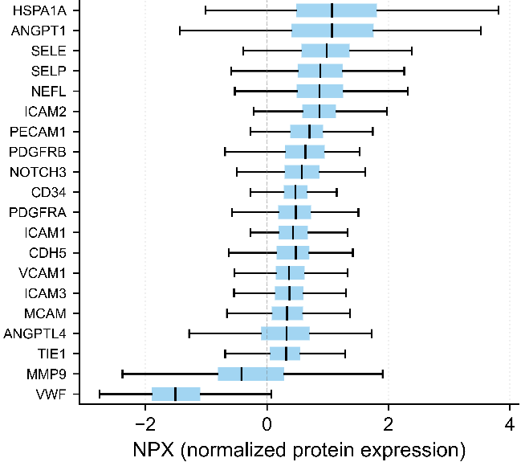
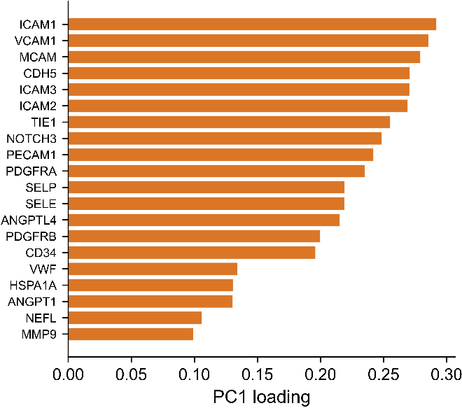
a
b
c
d
e
f
Supp Fig S2: Olink BBB panel QC and ConsensusClusterPlus k=2 justification

Slide 3
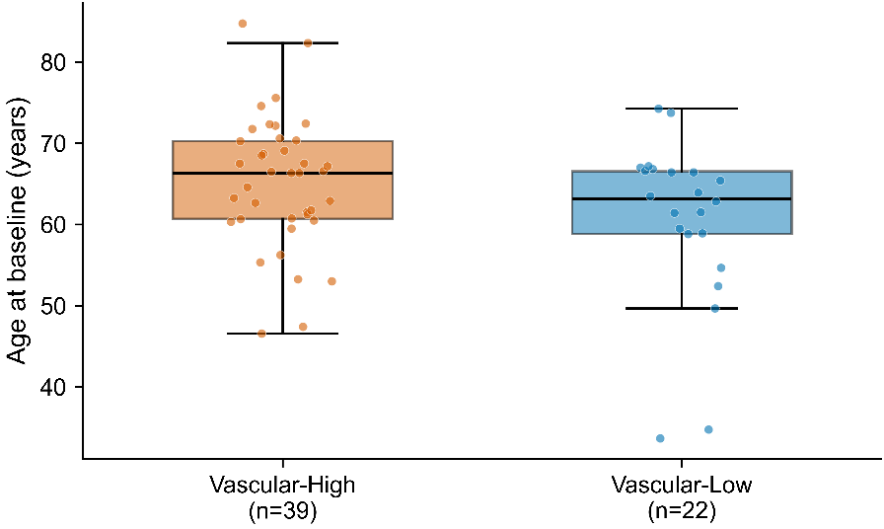
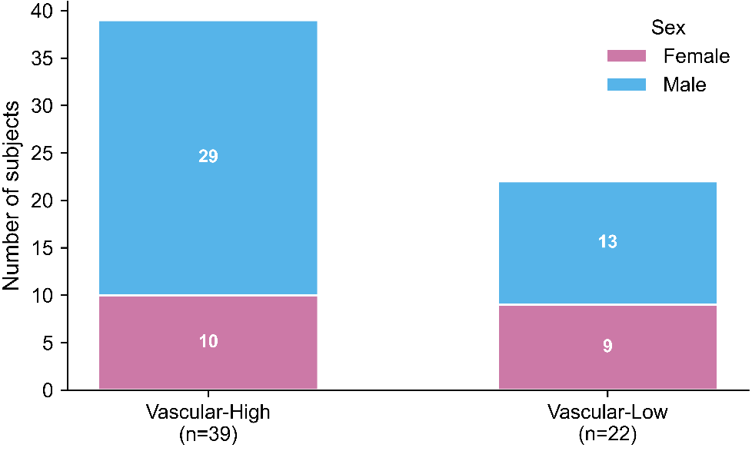
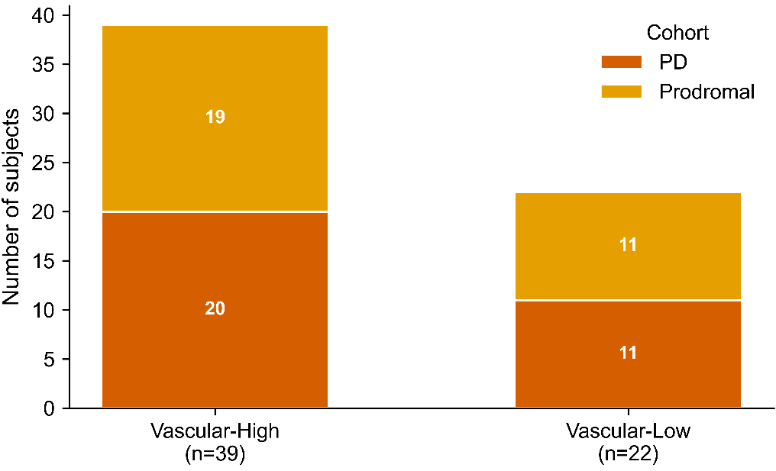
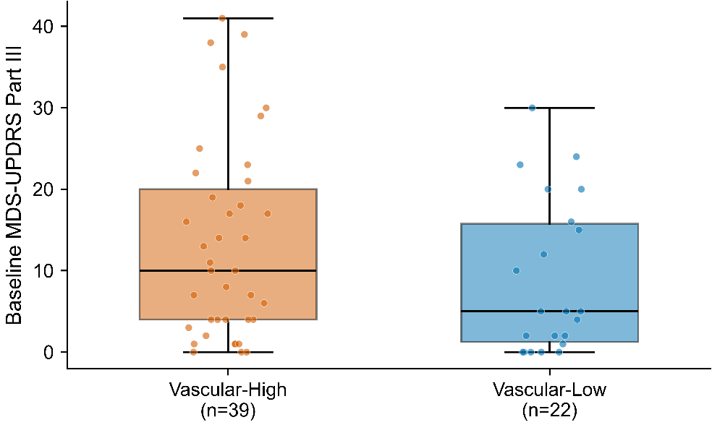
a
b
c
d
Supp Fig S3: Demographic balance per pre-registered subgroup.

Slide 4
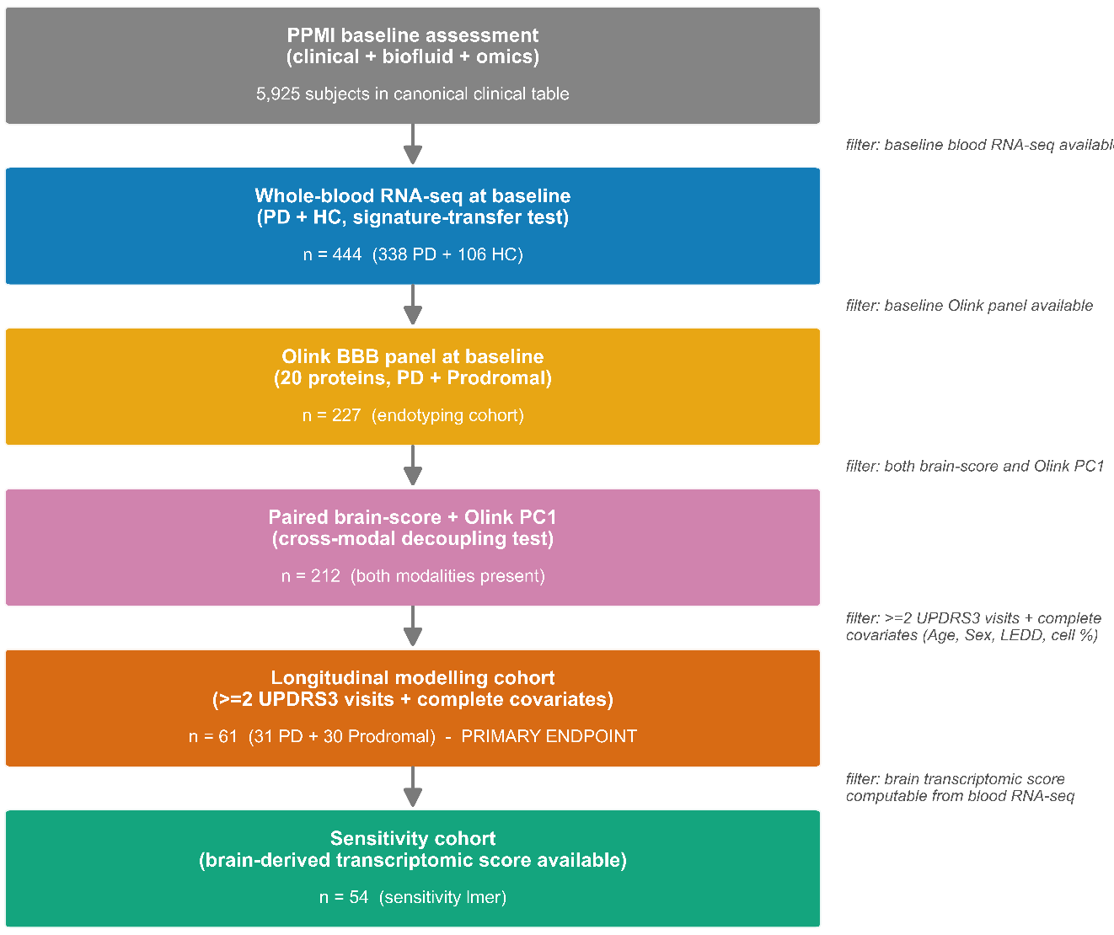
Supp Fig S4: Cohort flow Sankey diagram (442 → 227 → 212 → 61 → 54).

Slide 5
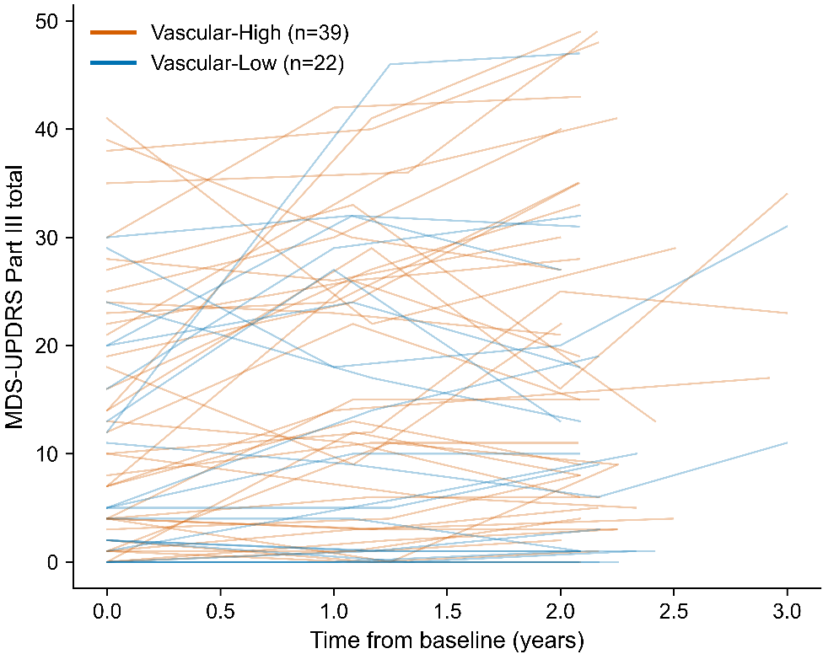
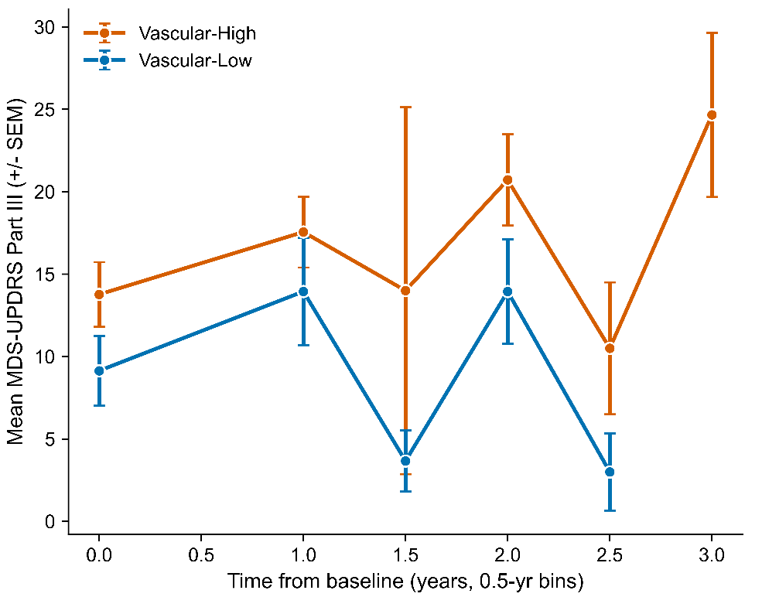
a
b
Supp Fig S5: Individual UPDRS3 trajectories spaghetti plot (n = 61)

Slide 6
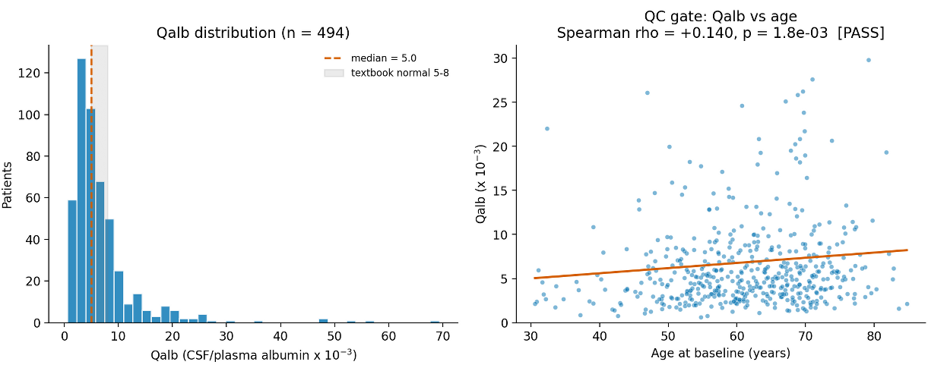
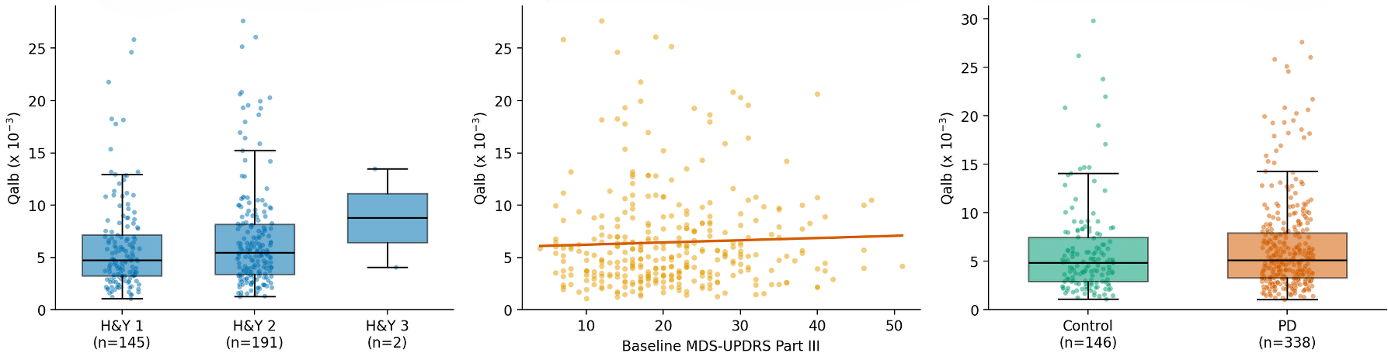
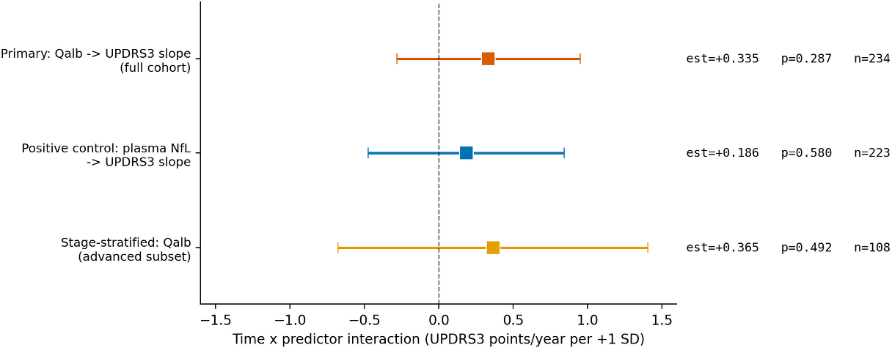
a
b
c
Supp Fig S6: CSF/serum albumin ratio (Qalb) post-hoc exploratory analysis: construction and QC, cross-sectional characterization, and longitudinal models.

Slide 7
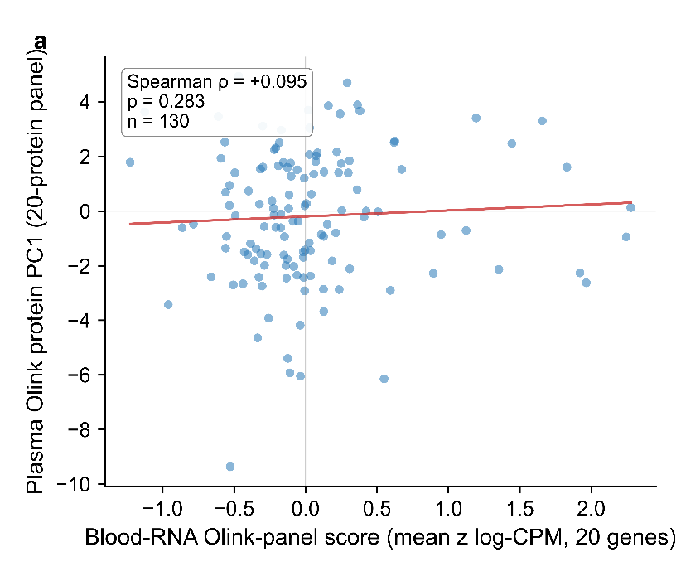
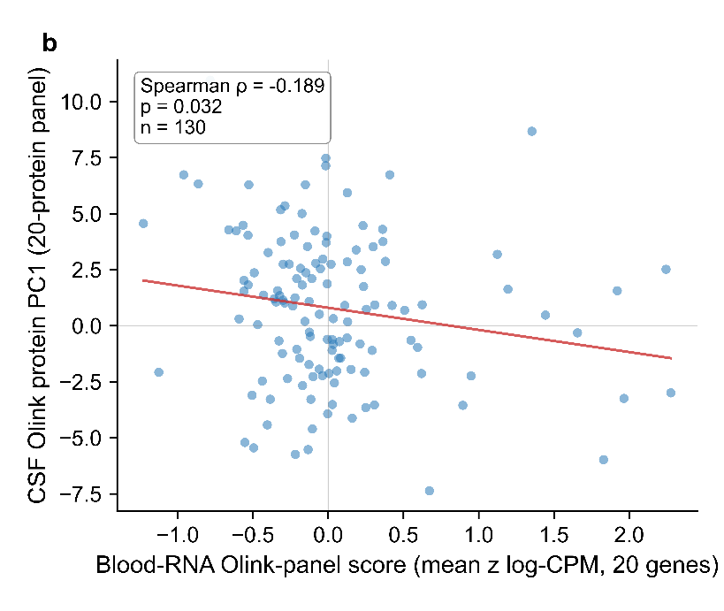
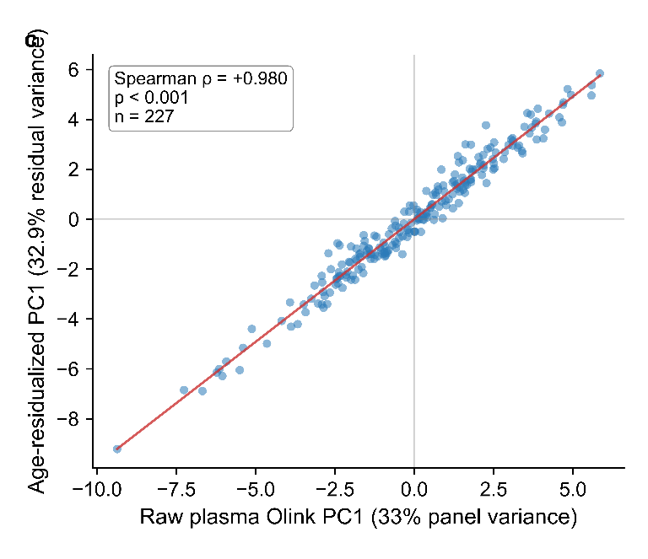
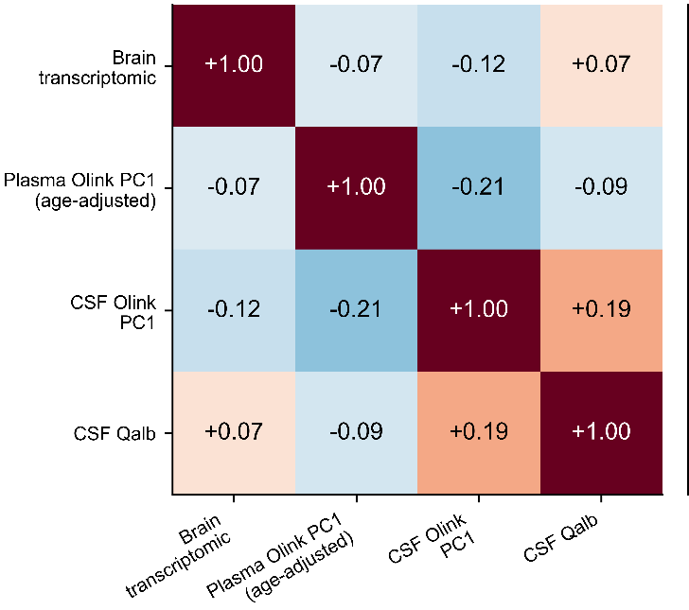
d
Supp Fig S7: Cross-compartment decoupling of BBB biomarkers in PD

