Slide 1
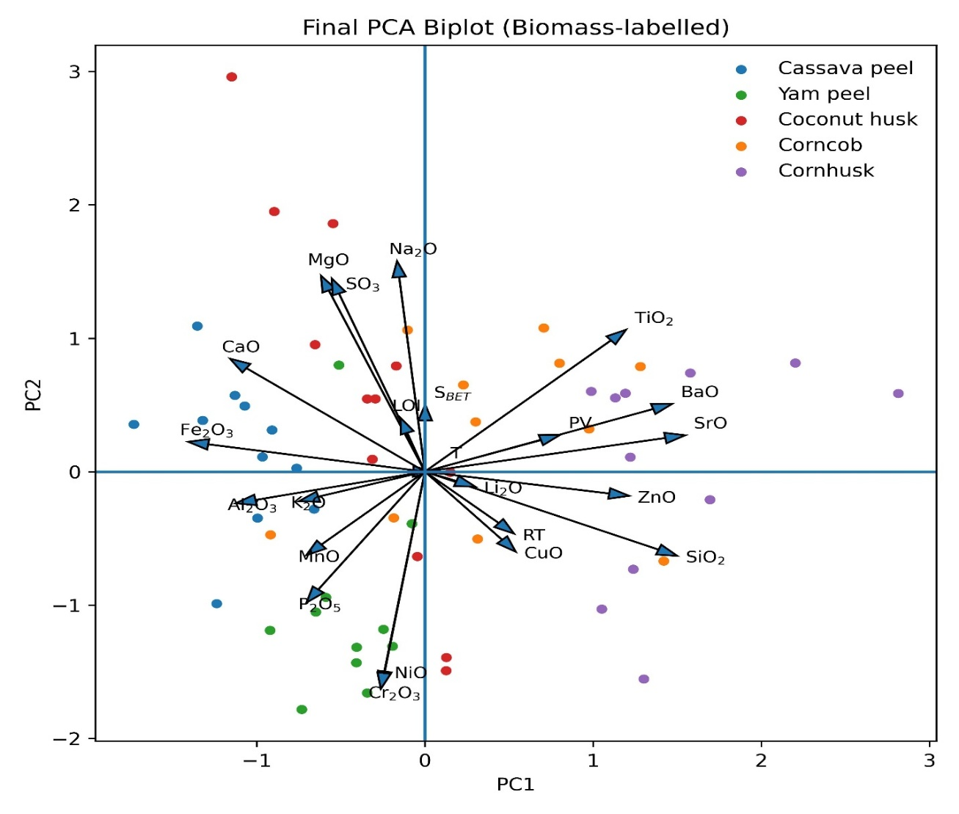


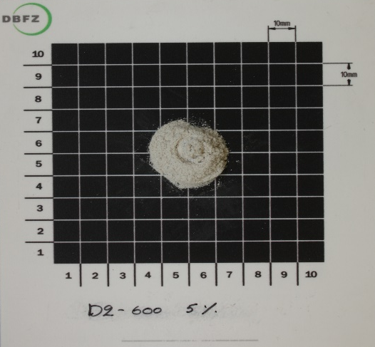



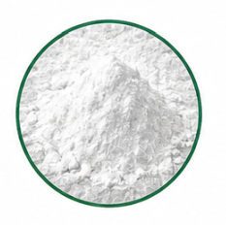

AGRICULTURAL BIOMASS RESIDUES
CITRIC ACID PRETREATMENT
THERMOCHEMICAL CONVERSION
MULTIVARIATE MODELING & THERMODYNAMIC ANALYSIS
PCA
PCA Score Plot
(Cassava, Yam, Coconut,
Corncob, Cornhusk)
Citric acid
(50 °C, 2 h)
Solid-to-liquid ratio: 1:10 (w/v)
Controlled combustion at 400–700 °C
1-4 h
Leached ash
FactSage
Contour plot
KEY FINDINGS
Optimal silica production
Increasing combustion severity reduces surface area (S_{BET}) and pore volume (PV)
K, Na, Ca, and Mg promote alkali–silicate melt formation and silica network depolymerization
Optimal conditions:
550–650 °C, ~2 h
High silica purity, porosity
Citric acid removes AAEMs, suppresses slagging, and enriches SiO₂
Thermodynamic modeling reveals biomass-specific melt evolution with reduced slagging
FEEDSTOCK CHEMISTRY + PROCESS OPTIMIZATION → HIGH-PURITY POROUS BIOGENIC SILICA

