Slide 1
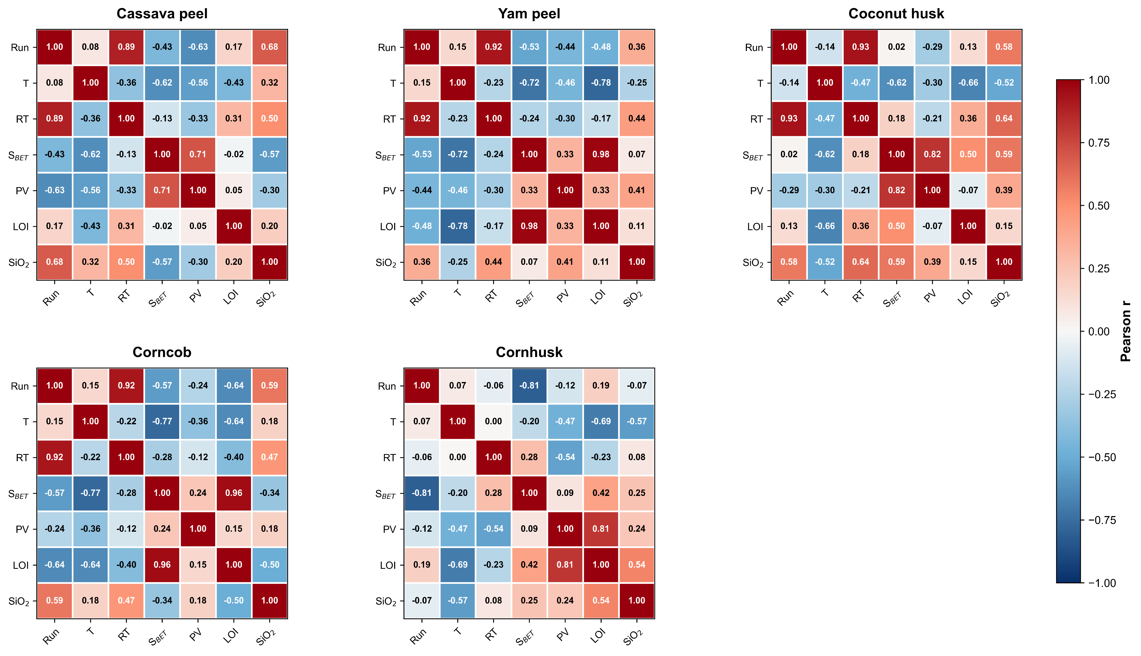
Fig. S1 Pearson correlation heatmaps illustrating the relationships between combustion parameters (T and RT) and silica quality metrics (S_{BET}, pore volume (PV), loss on ignition (LOI), and SiO₂ content) for the investigated biomass fuels. Positive (+) and negative (-) correlations indicate feedstock-specific interactions governing silica preservation, structural densification, and combustion-derived ash transformations

Slide 2
Fig. S2 Oxide composition profiles of untreated and citric-acid-leached biomass ashes showing substantial reductions in AAEM oxides and increased relative SiO₂ content following pretreatment. Modified after Prempeh et al. 2021 with permission from MDPI [13]

Slide 3
(a)
(b)
Fig. S3 (a) Specific surface area (S_{BET}) and (b) pore volume (PV) as a function of combustion temperature (400–700 °C) for all biomass feedstocks (cassava peelings, yam peelings, coconut husk, corncob, and cornhusk). A general decline in S_{BET} with increasing temperature is observed, indicating thermally induced sintering and structural densification. In contrast, PV exhibits a more complex, non-linear behaviour governed by the interaction between temperature and residence time, reflecting competing mechanisms of pore formation and collapse.

