Slide 1
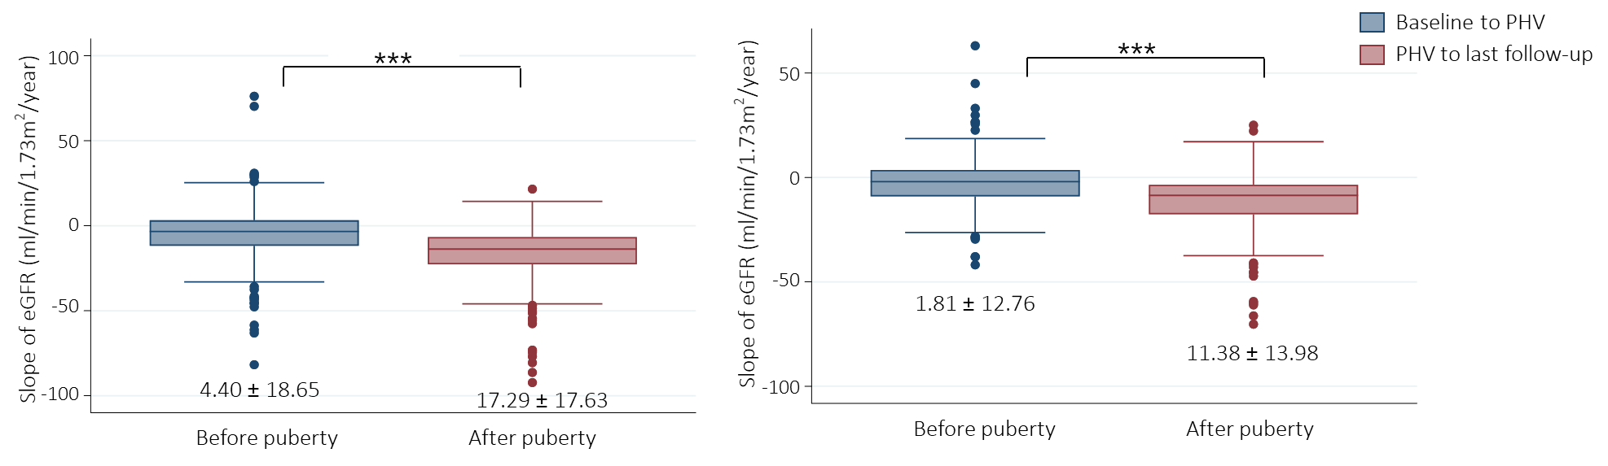


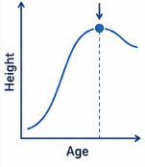
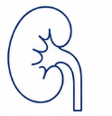
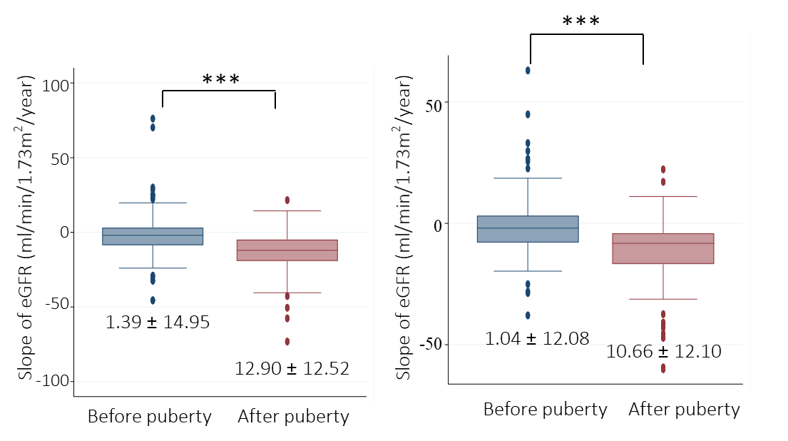
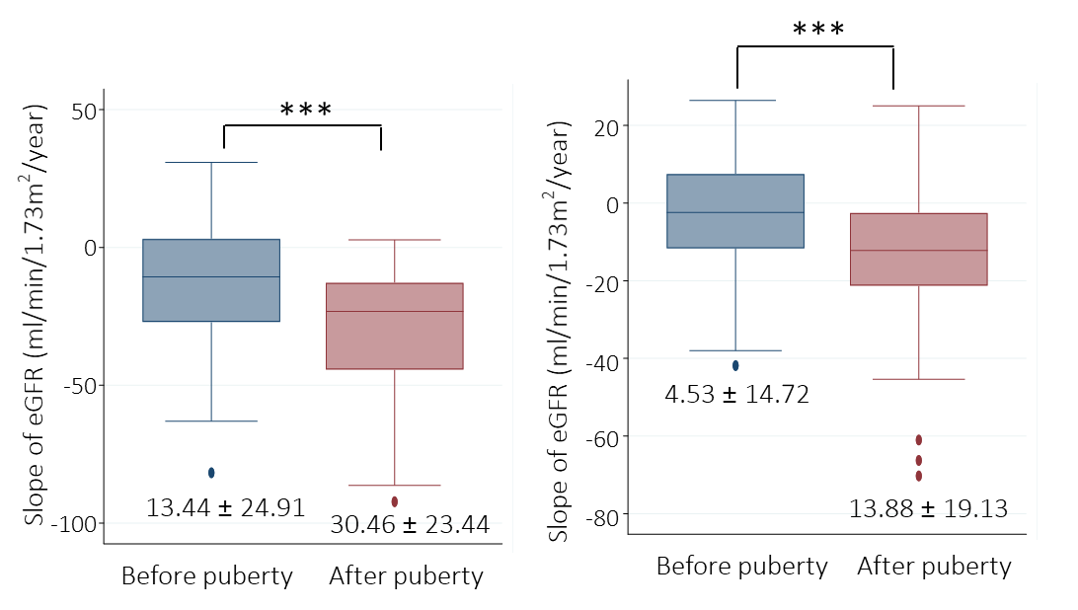
Effect of Puberty on Kidney Function
in children with chronic kidney disease
AIM: aims to evaluate longitudinal changes in kidney function across puberty in children with CKD
DESIGN
Using eGFRcr
Using eGFRcr-cys
KNOW-Ped CKD cohort
Slope of eGFR during puberty
: Nationwide, multi-center, prospective study
212 children with CKD
Mean age 11.9 years
Puberty: using growth velocity
eGFR equation
bedside Schwartz (eGFRcr)
creatinine-cystatin C–based CKiD (eGFRcr-cys)
eGFRcr
Stage 1
eGFRcr-cys
eGFRcr
Stage 2-4
eGFRcr-cys
eGFR slopes during puberty Stratified by CKD Stage
OUTCOMES
Primary outcome: CKD progression during pubertal transition
Annualized eGFR slopes using both eGFRcr and eGFRcr-cys equations
Secondary outcome: Comparison between the two eGFR formulas
CONCLUSION: Puberty is associated with a significant decline in eGFR, even in early-stage pediatric CKD. Decline was greater with eGFRcr than with eGFRcr-cys, suggesting that creatinine-based eGFR estimates may be more influenced by pubertal changes in body composition.
Song et al. 2026

