Slide 1
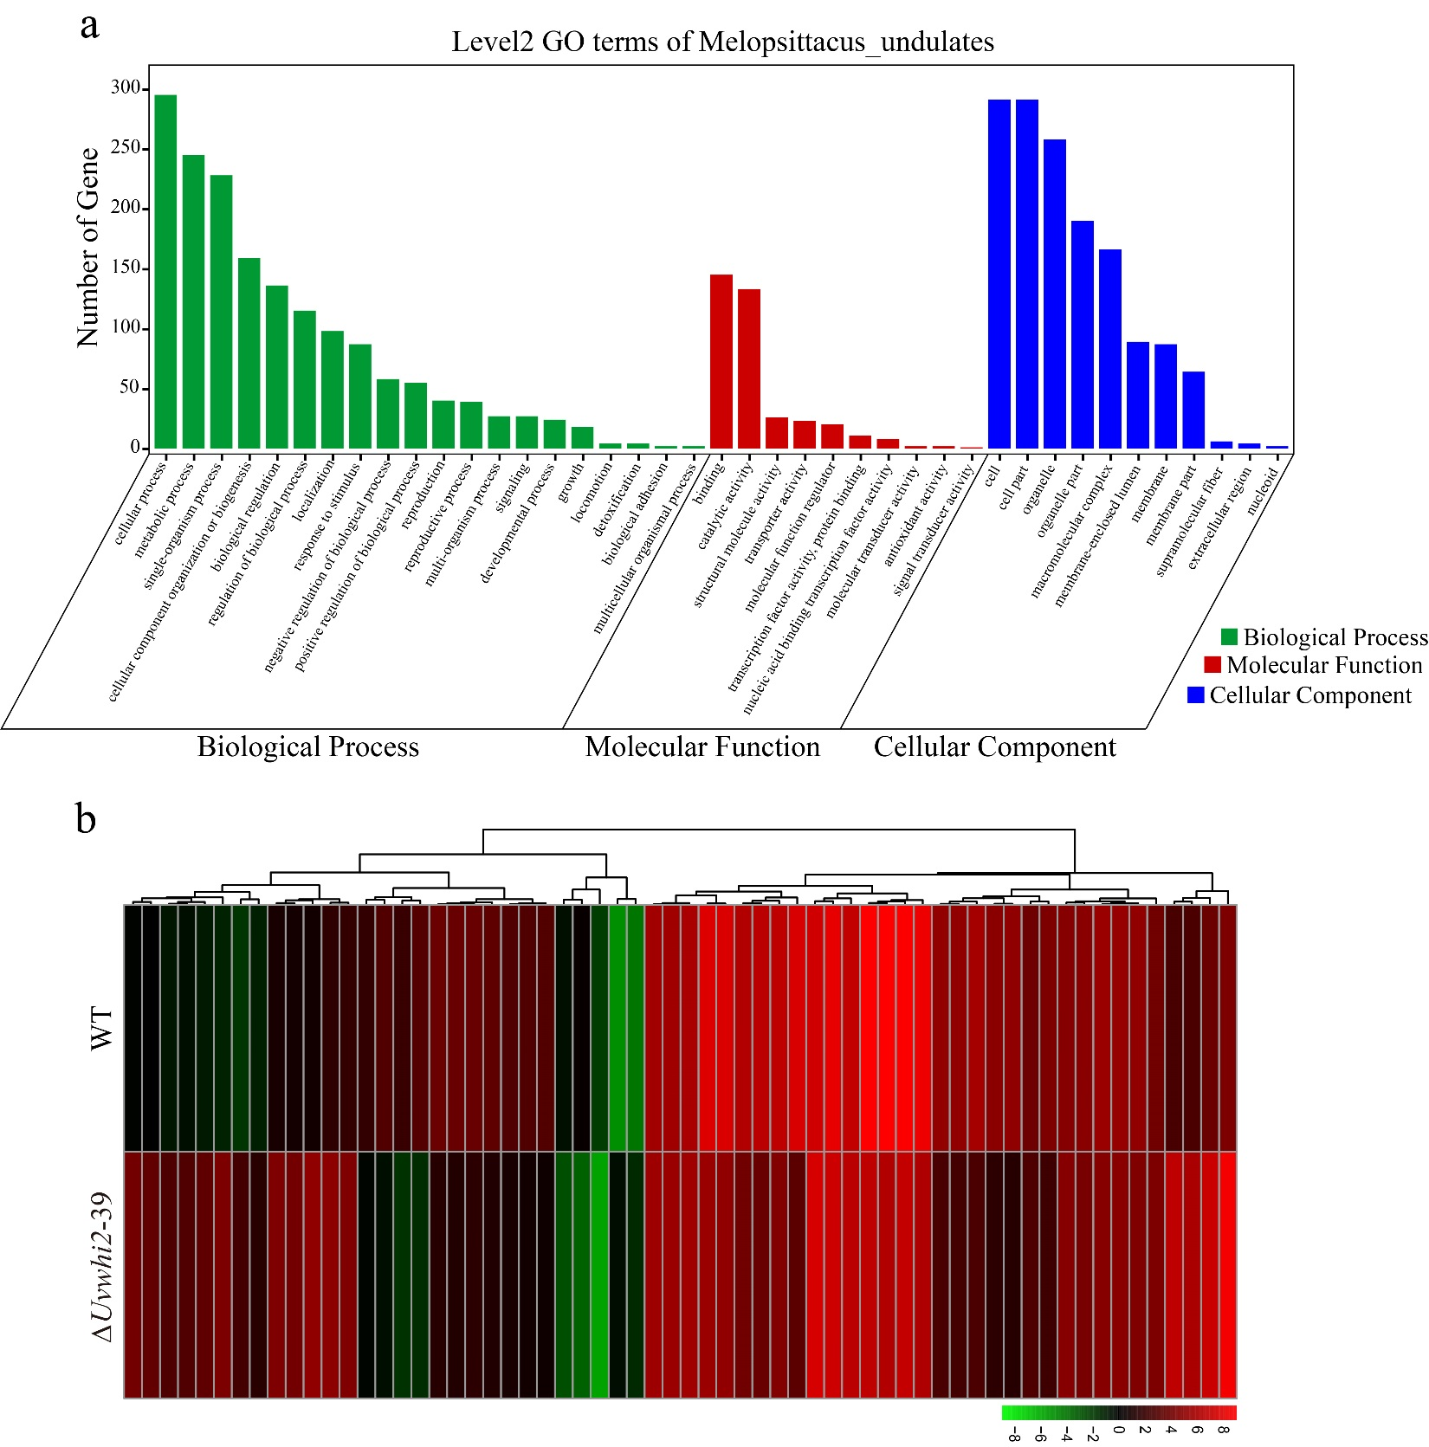
Fig. S1 Comparative transcriptomic analysis of WT and ∆Uvwhi2 strains. a,Gene Ontology (GO) term of differentially expressed genes between the WT and ∆Uvwhi2 strains at mycelia and conidia development stage. b, The heatmap was constructed based on the expression level of each FPKM value of UvWHI2 genes from RNA-Seq data. Blue and red boxes show lower and higher expression levels, respectively.

