Slide 1
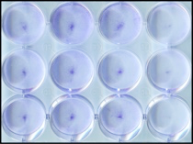
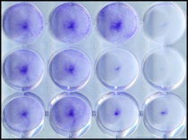
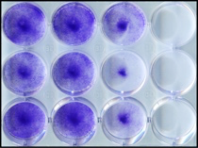
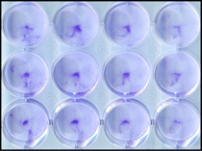
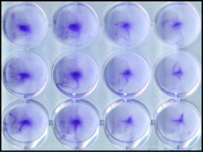
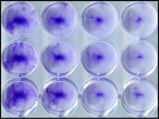
Supplemental Figure 1
A
AUY922 (nM)
0
15
30
45
0
15
30
45
0
15
30
45
DMSO
VE821
WE-68
KU55933
B
24 h
48 h
72 h
AUY922 (nM)
0
15
30
45
0
15
30
45
0
15
30
45
DMSO
VE821
A673
KU55933
24 h
48 h
72 h
C
n3
D
n2
24 h
WE-68
24 h
A673
E
F
48 h
WE-68
n3
48 h
A673
n3
48 h
WE-68
n3
48 h
A673
n3
G
48 h
WE-68
n3
48 h
A673
n3
Figure S1. Analysis of cell proliferation and cell cycle distribution. (A) WE-68 and (B) A673 cells were treated with 15-45 nM AUY922, 2 µM VE821, 5 µM KU55933 and their combinations for up to 72 h. Cell densities were analyzed using crystal violet. Quantifications are shown in Figure 2A-B. (C) WE-68 and (D) A673 cells were treated with 15-45 nM AUY922, 2 µM VE821, 5 µM KU55933 and their combinations for 24 h. (E-G) Cells were treated with the indicated concentrations of AUY922 (E), VE821 (F) or KU55933 (G) for 48 h. Cell cycle distributions were determined by flow-cytometric analysis of PI-stained ethanol-fixed cells. (A-B) are representative for three independent experiments. Mean ± SEM of two (D) or three (C, E-G) independent experiments are shown.

