Slide 1
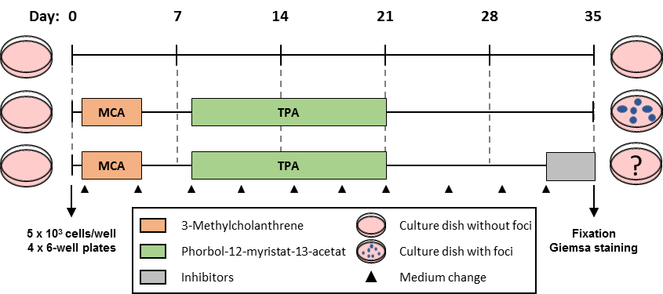





Supplemental Figure 2
A
HCT116 wt
HCT116 p53-/-
B
AUY922
VE821
-
+
-
+
-
+
-
+
ATR
-
-
+
+
-
-
+
+
ATM
Vinculin
BRCA1
PARP1
cl. PARP1
cl. Caspase 3
γH2AX
α-Tubulin
p53
Vinculin
24 h
C
□ WE-68
■ A673
D
□ WE-68
A673 *
**
*
A673 *
*
n3
n3
n3
E
n3
● DMSO
■ VE821
▲ KU55933
n3
Figure S2. Analysis of molecular alterations. (A) Otherwise isogenic p53 wild-type (wt) and p53 null (p53^{-/-}) HCT116 cells were treated with 45 nM AUY922 ± 2 µM VE821 for 24 h. Analysis of indicated proteins was done by Western blotting after 24 h, vinculin was used to control protein loading. Immunoblots are representative for two independent experiments. (B) Schematic workflow of the BALB/c cell transformation assay (BALB-CTA). WE-68 cells were treated with 30 nM AUY922, 1 µM VE821, 7.5 µM KU55933 and their combinations; A673 cells were treated with 15 nM AUY922, 1 µM VE821, 5 µM KU55933 and their combinations. DMSO was used for control. (C-D) The mRNA expression of indicated genes was analyzed after 24 h by qPCR. All graphs show the mean ± SEM of three independent experiments (*p<0.05; **p<0.01; ***p<0.001). (E) WE-68 and A673 cells were treated with 15-45 nM AUY922, 2 µM VE821, 5 µM KU55933 and their combinations for 24 h. Intracellular reactive oxygen species (ROS) level were analyzed by flow cytometry using CM-H₂DCFDA. The graphs show the mean ± SEM of three independent experiments.

