Slide 1
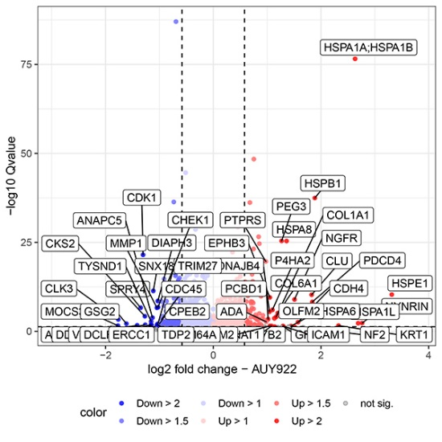
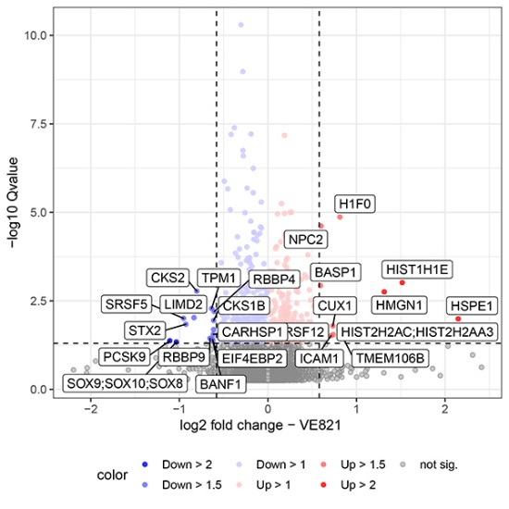
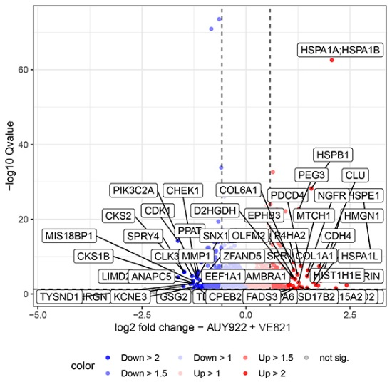
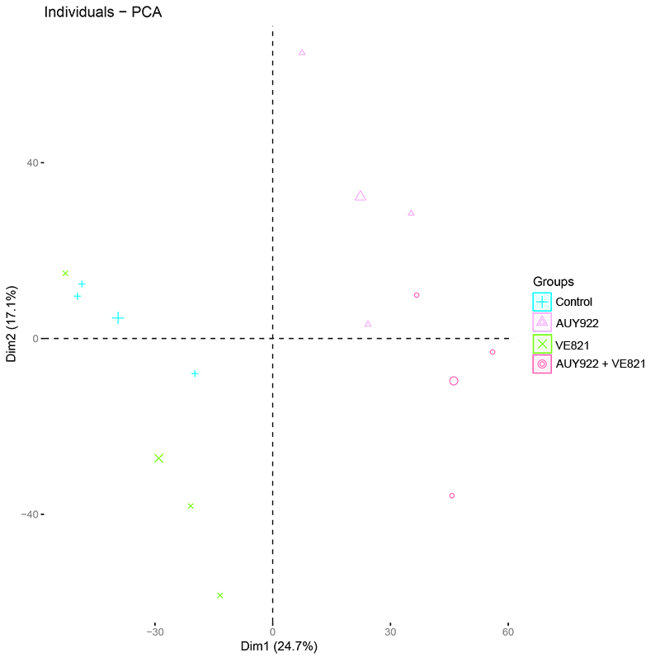
Supplemental Figure 3
A
B
C
D
Figure S3. Proteome analysis in A673 cells. A673 cells were treated with 45 nM AUY922 ± 2 µM VE821 for 24 h, and a quantitative whole proteome analysis was done by mass spectrometry from three individual experiments. Volcano plots show highly altered proteins (cutoff: q<0.05; log2-fold change >0.5) after AUY922 (A), VE821 (B) and their combination (AUY922+VE821) (C). (D) A principal component analysis (PCA) was done on the proteome data set using R studio. The three replicates of each treatment are shown together with their median value (biggest symbol): DMSO (control) in blue, AUY922 in pink, VE821 in green and AUY922+VE821 in magenta. The circles around each group were inserted by hand after PCA for better visual separation.

