Slide 1
Original Western blots Data

Slide 2
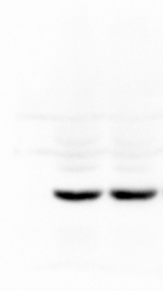
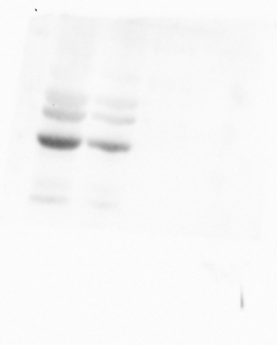
Fig1 c
TPM1
-33 kD
β-actin
-42 kD

Slide 3
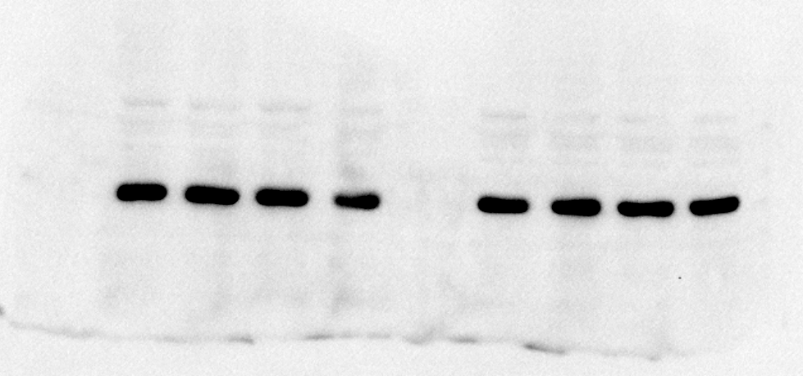
Fig4 b,d
TPM1-OE
-
-
+
+
shTPM1
-
-
+
+
IR
-
+
-
+
IR
-
+
-
+
β-actin
-42 kD

Slide 4
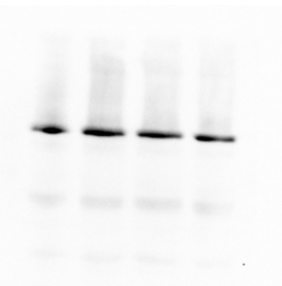
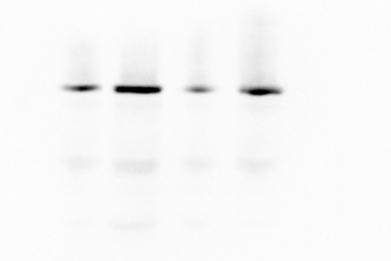
Fig4 b,d
TPM1-OE
-
-
+
+
shTPM1
-
-
+
+
IR
-
+
-
+
IR
-
+
-
+
β-Catenin
-92 kD
β-Catenin
-92 kD

Slide 5
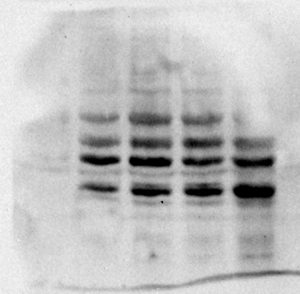
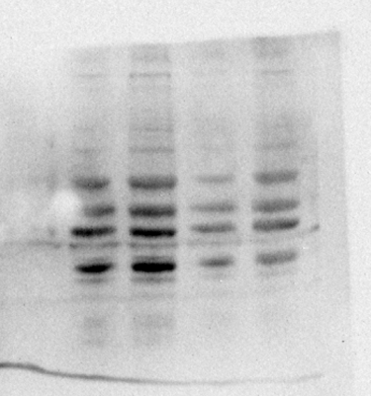
Fig4 b,d
TPM1-OE
-
-
+
+
shTPM1
-
-
+
+
IR
-
+
-
+
IR
-
+
-
+
TPM1
-33 kD
TPM1
-33 kD

Slide 6
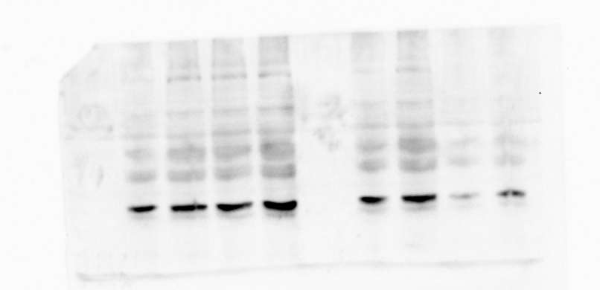
Fig4 b,d
TPM1-OE
-
-
+
+
shTPM1
-
-
+
+
IR
-
+
-
+
IR
-
+
-
+
TCF-4
-71 kD

Slide 7
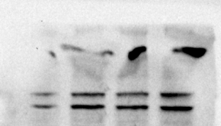
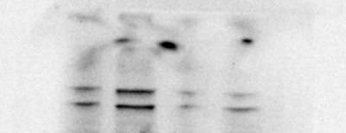
Fig4 b,d
TPM1-OE
-
-
+
+
shTPM1
-
-
+
+
IR
-
+
-
+
IR
-
+
-
+
Wnt-1
-41 kD
Wnt-1
-41 kD

Slide 8
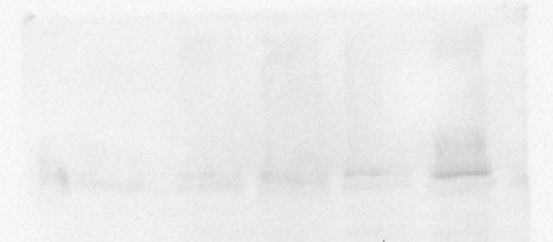
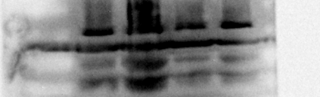
Fig4 b.d
TPM1-OE
-
-
+
+
shTPM1
-
-
+
+
IR
-
+
-
+
IR
-
+
-
+
p-β-Catenin
-86 kD
-86 kD

Slide 9
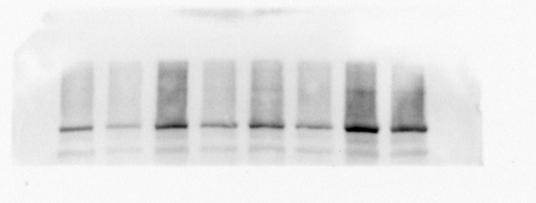
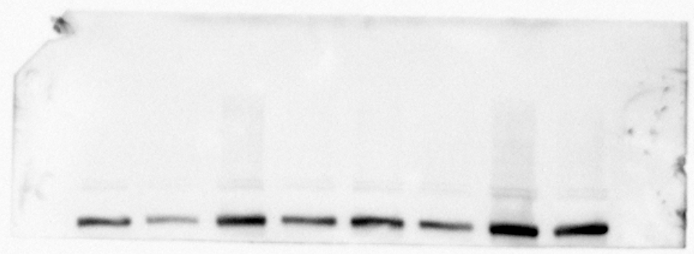
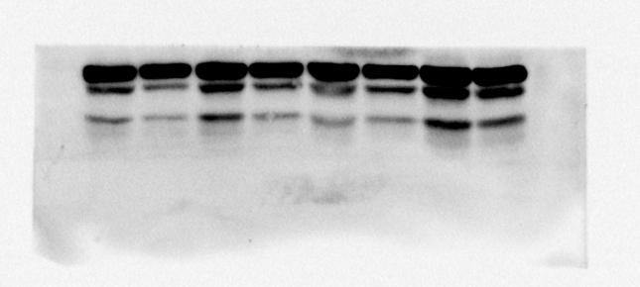
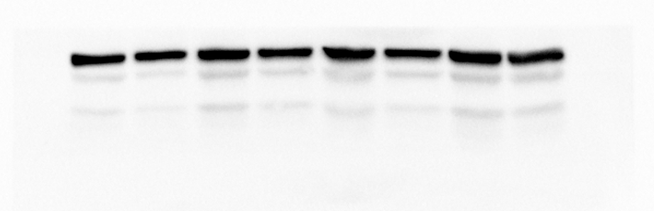
Fig4 f
β-Catenin
-92 kD
p-β-Catenin
-86 kD
TPM1
-33 kD
Wnt-1
-41 kD

Slide 10
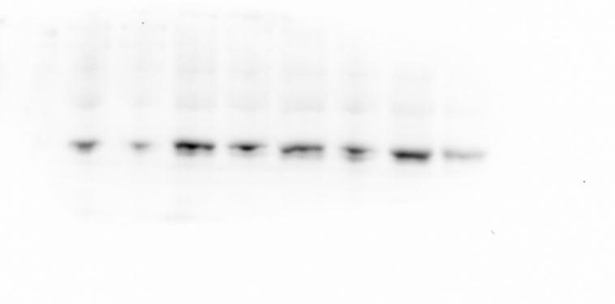
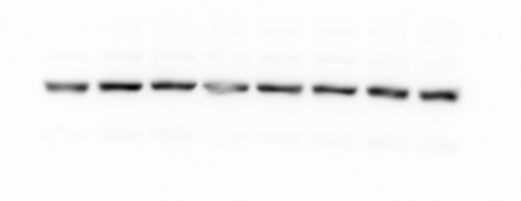
Fig4 f
TCF-4
-71 kD
β-actin
-42 kD

Slide 11
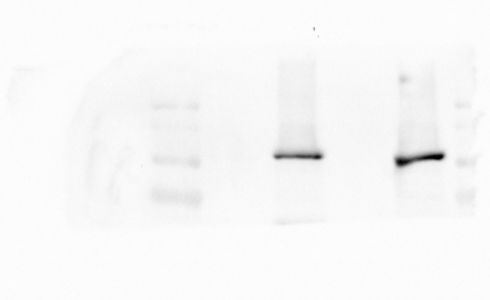
Fig5 b
CON
IR
IgG
TPM1
IgG
TPM1
β-Catenin
-92 kD

Slide 12
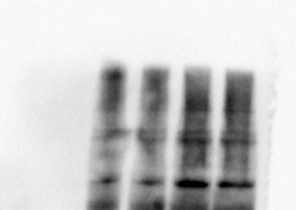
Fig5 b
CON
IR
10% input
β-Catenin
-92 kD

Slide 13
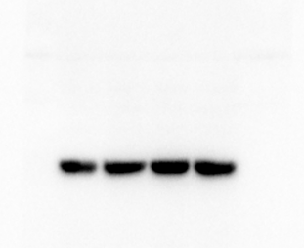
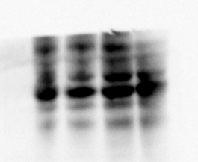
Fig5 b
CON
IR
β-actin
-42 kD
10% input
TPM1
-33 kD

Slide 14

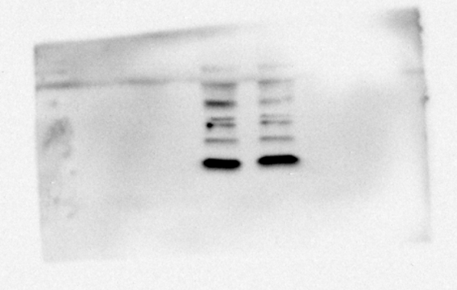
Fig5 g
H3
-17 kD

Slide 15
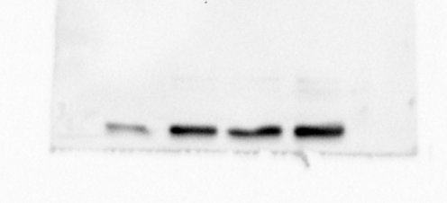
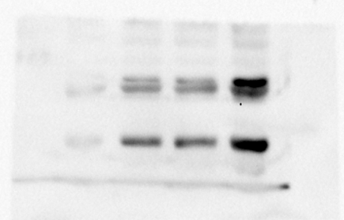
Fig6 e
-
-
TPM1-OE
+
+
IR
-
+
-
+
p-β-Catenin
-86 kD
TCF-4
-71 kD

