Slide 1
DOCTORAL DISSERTATION DEFENSE
Selection-Bias-Aware Multimodal
Survival Learning for Molecular
Pathological Epidemiology
A Stabilized IPW–Cox Objective with a Differentiable Etiologic-Heterogeneity Head
Candidate: Young Sahng Suh (서영상)
Advisor: Prof. Shuji Ogino, M.D., Ph.D. — Brigham and Women's Hospital / Harvard Medical School
aSSIST University / The Machina AI · Seoul, Republic of Korea
Notes:
Good morning. Thank you, committee members, for your time. My dissertation introduces SBASURV, a method that makes sample availability a trainable part of survival learning. I'll motivate the problem, state my contributions, walk through the method and its theory, show the empirical validation on both controlled benchmarks and real colorectal-cancer data, and finish with limitations and how I defend the work. Total: about 20 minutes, then questions.

Slide 2
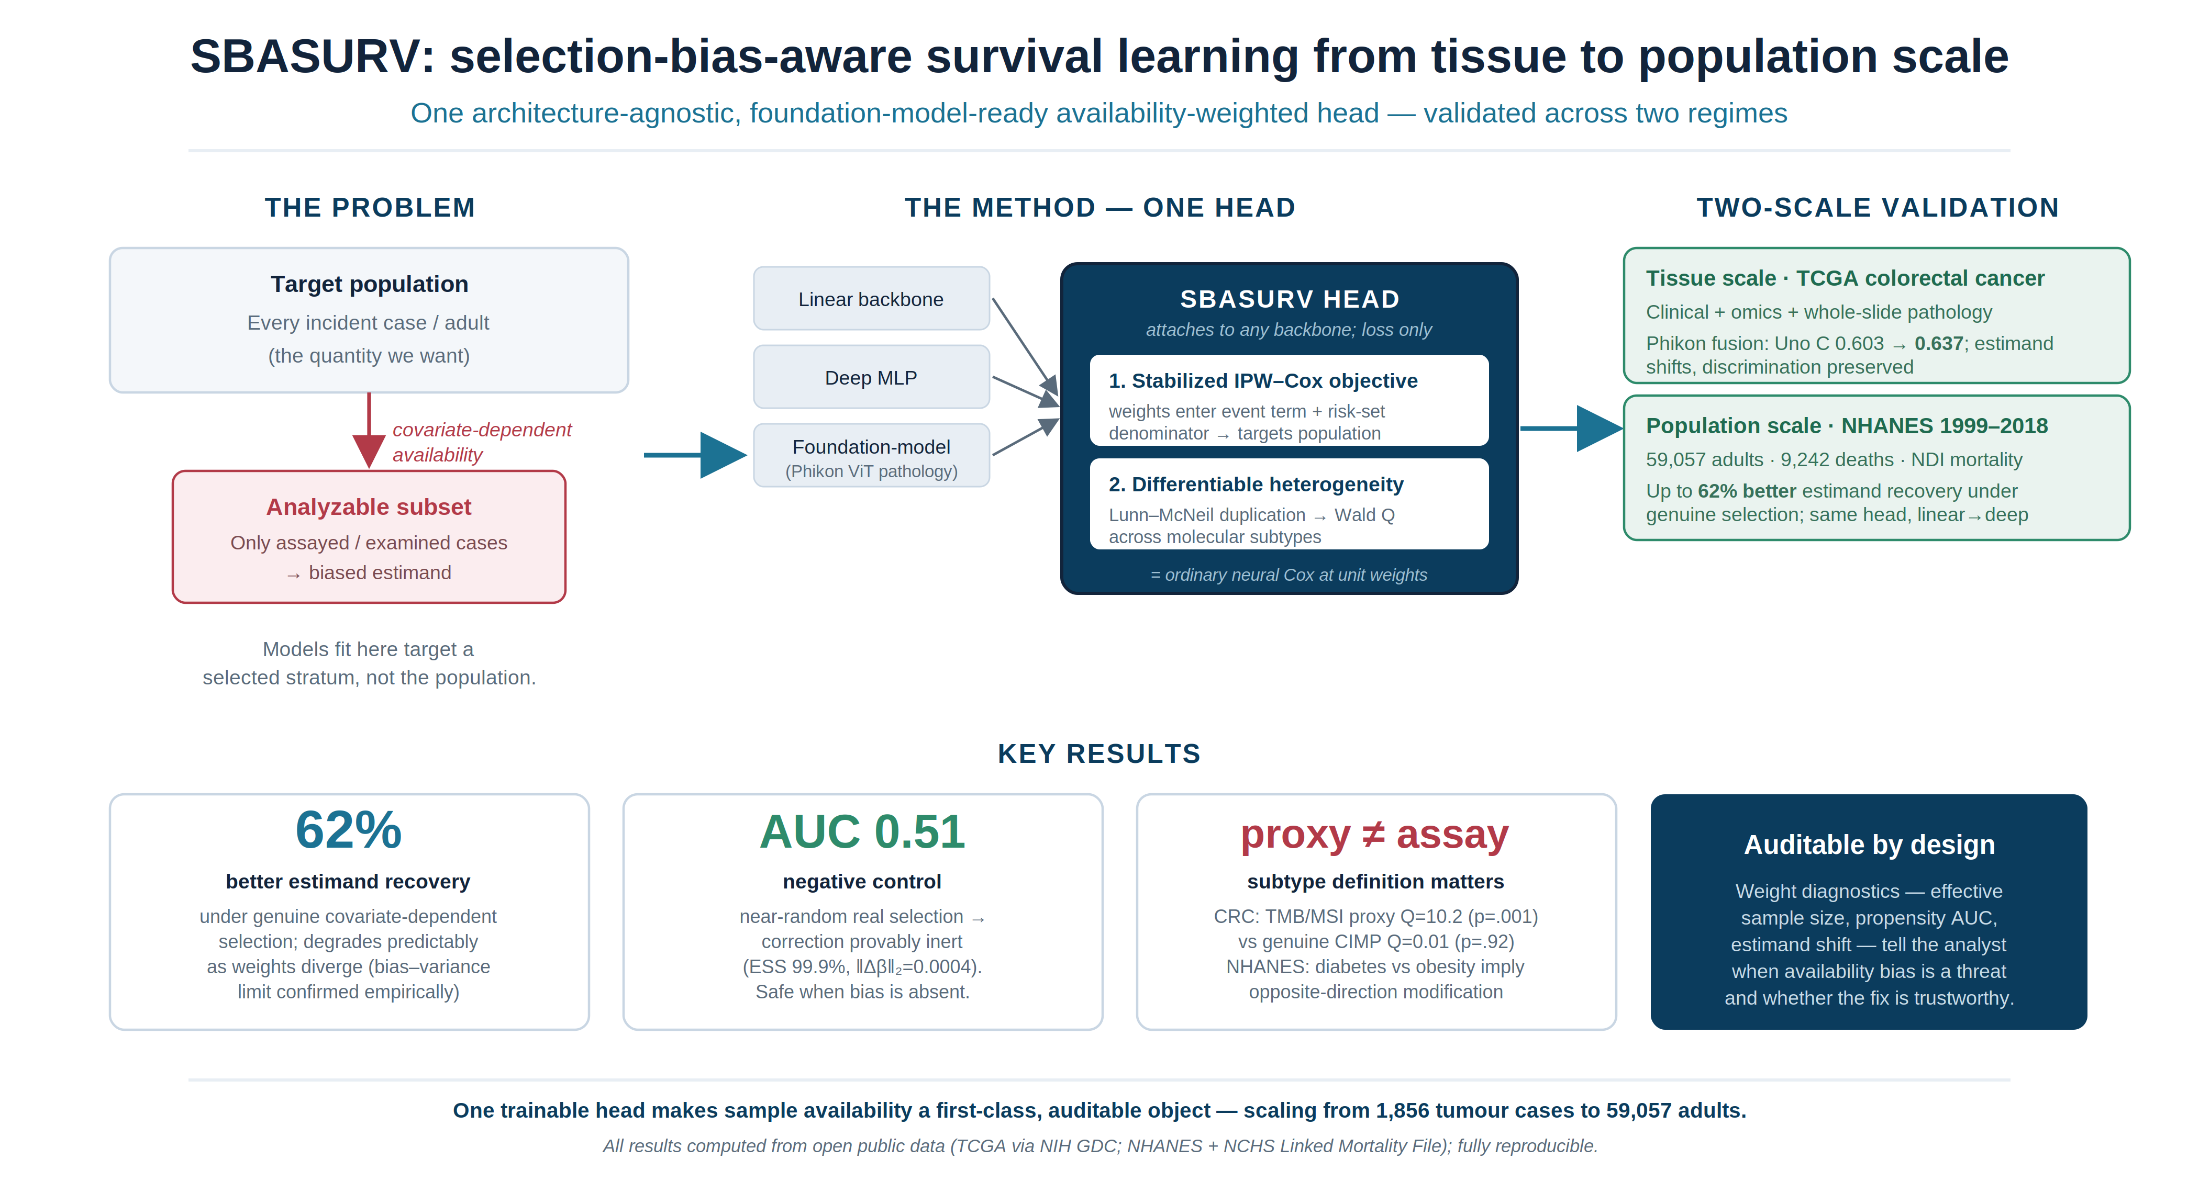
ONE-SLIDE OVERVIEW
The whole thesis in one figure
Problem (left) → one architecture-agnostic head (centre) → validation at tissue and population scale (right) → four key results (bottom).
SBASURV — Selection-Bias-Aware Multimodal Survival Learning
16
Notes:
This is my graphical abstract, and it is the single slide that holds the entire thesis. Read it left to right. On the left is the problem: when measurement availability depends on prognostic variables, the analyzable subset is a biased draw and a model fit on it targets the wrong estimand. In the centre is the contribution — one architecture-agnostic head that attaches to a linear, deep, or foundation-model backbone, combining a stabilized IPW-Cox objective with a differentiable heterogeneity test, and reducing to the ordinary neural Cox objective at unit weights. On the right is the validation: the same head runs on real TCGA colorectal cancer with Phikon foundation-model pathology, and at population scale on 59,057 NHANES adults. Along the bottom are the four results I want the committee to remember: 62% better estimand recovery under genuine selection; a negative control showing the correction is inert under near-random selection; the proxy-versus-assay subtype caution; and the auditable weight diagnostics. If I had to defend the work with a single slide, this is it.

Slide 3
THE PROBLEM
Tissue-derived models are trained on a biased subset
Incident
cases
→
Collected
→
Archived
→
Retrieved
→
Assayed
→
Passed QC
(analyzable)
Each step depends on prognostic variables — stage, site, age, comorbidity, institution, specimen age, follow-up intensity.
Consequence: the analyzable sample is a covariate-dependent draw from the incident-case population. A model that ignores this estimates the analyzable-sample relationship — not the population one. The problem grows as pipelines add tissue modalities (WSI, omics).
SBASURV — Selection-Bias-Aware Multimodal Survival Learning
2
Notes:
Here is the core problem. A model using whole-slide images, omics, or molecular subtypes can only be trained on patients whose tissue survived this entire pipeline — collected, archived, retrieved, assayed, QC-passed. Every one of those steps depends on variables that are themselves prognostic. So the analyzable subset is not a random sample. The ordinary Cox partial likelihood then silently targets the analyzable-sample relationship, not the population. And critically, this gets worse, not better, as we add modalities.

Slide 4
RESEARCH GAP
The tools exist — but not inside the objective
Neural survival models
DeepSurv, Cox-nnet, DeepHit, Cox-Time, SurvTRACE optimize representations — but assume the training sample represents the deployment population.
Classical IPW & MPE
Stabilized inverse-probability weighting and the Lunn–McNeil method correct selection — but only post-hoc, outside any learned model.
Multimodal fusion
Pathomic Fusion, PORPOISE fuse histology + omics for discrimination — but treat the analyzable cohort as given, with no native heterogeneity test.
SBASURV — Selection-Bias-Aware Multimodal Survival Learning
3
Notes:
Why is this unsolved? Each community has half the answer. Deep survival models give us representation learning but ignore selection. Classical epidemiology gives us inverse-probability weighting and the Lunn–McNeil heterogeneity method, but only as post-hoc procedures outside the model. And multimodal fusion models maximize discrimination but take the analyzable cohort as given. Nobody has put selection correction inside the trainable objective of a multimodal survival learner. That is the gap I close.

Slide 5
CONTRIBUTIONS
What this dissertation delivers
01
Selection-bias-aware head Stabilized IPW weights inserted into the Cox partial likelihood — weighting both the event term AND the risk-set denominator.
02
Differentiable heterogeneity The Lunn–McNeil duplication method as a differentiable module emitting subtype log-HRs and a Wald statistic natively.
03
Theory: target & trainability Population estimating-equation result + a gradient-variance bound that justifies weight clipping for stable SGD.
04
Mechanism validation On five public datasets with induced selection, the head improves held-out concordance over a naive head on all five.
05
Real multimodal CRC deployment Identical head on TCGA-COAD/READ across clinical + omics + whole-slide pathology, with real analyzability weights.
Notes:
Five contributions. One: a selection-bias-aware survival head that puts stabilized IPW weights into the Cox likelihood — and importantly, into the risk-set denominator, not just the event term. Two: a differentiable version of the Lunn–McNeil duplication method, so heterogeneity testing is a native output. Three: theory — I prove the weighted score targets the population estimand, and bound the gradient variance. Four: mechanism validation on five public datasets. Five: a real, end-to-end three-modality colorectal-cancer deployment. Let me take these in turn.

Slide 6
CORE INSIGHT
Make sample availability a first-class, trainable object in survival learning — so the model targets the population, not the analyzable sample.
The same head runs unchanged from synthetic benchmarks to real TCGA colorectal cancer.
SBASURV — Selection-Bias-Aware Multimodal Survival Learning
5
Notes:
If you remember one sentence, this is it: I make sample availability a first-class, trainable object, so the model targets the population rather than the analyzable sample. And the same head runs unchanged from controlled benchmarks to real colorectal cancer — that architecture-agnostic property is what makes it practical.

Slide 7
METHOD
Architecture: one head, three modalities
Clinical
SBASURV HEAD
Shared
representation
hϕ(X)
① Stabilized-IPW Cox objective
weights enter event term + risk-set denominator
→
→
Tumor omics
(RNA-seq, TMB)
② Differentiable heterogeneity head
Lunn–McNeil duplication → Wald statistic Q
Whole-slide
pathology
Availability model π̂(x) = P(A=1 | X=x) estimated from variables observed for BOTH analyzable and non-analyzable cases → stabilized weight sw = p̂_A / π̂(x), clipped at 1st/99th percentiles. Every result reports the full weight panel + ESS.
SBASURV — Selection-Bias-Aware Multimodal Survival Learning
6
Notes:
Architecturally, SBASURV is a terminal head. Three real modalities — clinical, omics, and whole-slide pathology — feed a shared representation. The head has two sub-blocks: the stabilized-IPW Cox objective, and the differentiable heterogeneity module. Underneath, an availability model estimates the propensity from variables observed for both analyzable and non-analyzable cases, producing stabilized, clipped weights. The key engineering point: I report the full weight distribution and effective sample size with every result — diagnostics are part of the result, not an appendix.

Slide 8
METHOD · OBJECTIVE
The weighted Cox partial likelihood
ℒ(θ) = − Σᵢ Δᵢ · w̄ᵢ · [ fθ(hᵢ) − log Σⱼ∈R(Tᵢ) w̄ⱼ · exp( fθ(hⱼ) ) ]
The insight others miss
Recovers the standard head
The risk-set denominator is weighted too — because the risk set is itself sampled through the availability process. Weighting only the event term (classical post-hoc IPW) is insufficient.
Setting all w̄ᵢ = 1 recovers the ordinary neural Cox objective — so SBASURV is a strict, architecture-agnostic generalization. Implemented with a numerically stable log-sum-exp.
SBASURV — Selection-Bias-Aware Multimodal Survival Learning
7
Notes:
This is the objective. It looks like a Cox partial likelihood, but with two changes. The event term is weighted by w-bar — that part is standard IPW. The novel part is in the denominator: I weight the risk set too. Why? Because the risk set is itself sampled through the availability process — the patients who are at risk are also subject to selection. Classical post-hoc IPW weights only the numerator and is therefore insufficient. And note: if all weights equal one, this collapses exactly to the standard neural Cox objective, so my method is a clean generalization.

Slide 9
THEORY
Two guarantees: target and trainability
Theorem 1 — Population target
Theorem 2 — Trainability
Under MAR availability, positivity, and Cox regularity, the stabilized-IPW Cox score computed in the analyzable sample shares the same population zero as the full-cohort score.
⇒ θ̂ is consistent for θ₀ and asymptotically normal, with a robust sandwich variance.
With clipped weights w̄ᵢ ∈ [a, b], the mini-batch gradient second moment is bounded:
E‖ g_B(θ) − E g_B(θ) ‖² ≤ b² G² / m
⇒ clipping is not a heuristic — it is what makes stochastic optimization provably stable.
SBASURV — Selection-Bias-Aware Multimodal Survival Learning
8
Notes:
The theory has two parts. Theorem 1 is about what we estimate: under missing-at-random availability, positivity, and standard Cox regularity, the weighted score computed only in the analyzable sample has the same population zero as the full-cohort score. The multiplicative factor cancels in the risk-set ratio. So the estimator is consistent for the population parameter, with a robust sandwich variance. Theorem 2 is about whether we can train it: with clipped weights, I bound the mini-batch gradient variance by b-squared G-squared over m. This means weight clipping isn't an ad-hoc trick — it's what makes the stochastic optimization provably stable. If a committee member presses on rigor, this slide is my anchor.

Slide 10
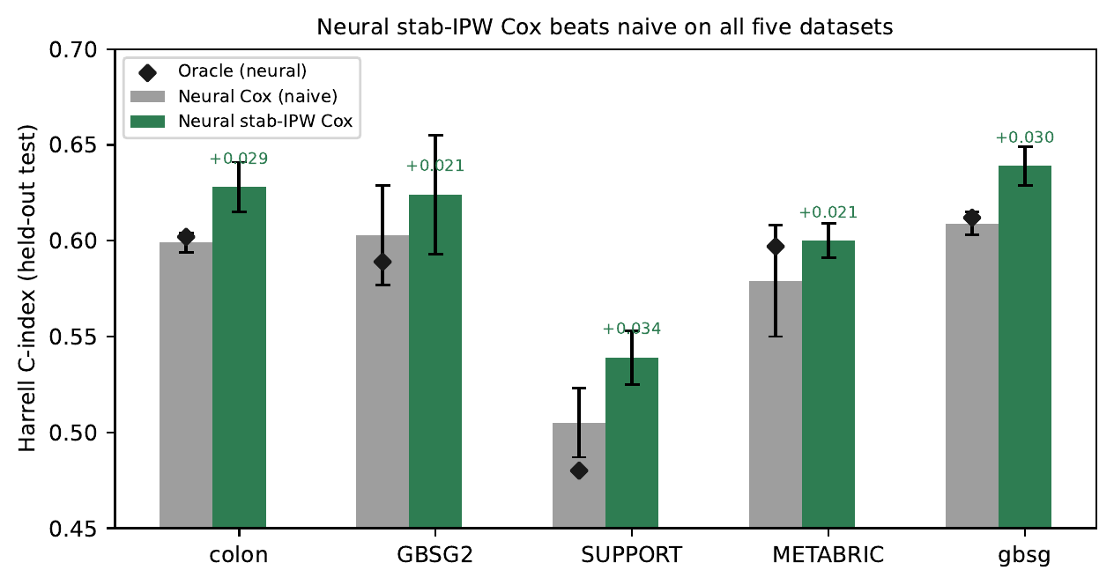
RESULTS · MECHANISM
Improves concordance on all five benchmarks
Controlled validation
Induced covariate-dependent selection; oracle = full-cohort fit.
Stab-IPW > naive on 5/5:
gbsg 0.609 → 0.639
colon 0.599 → 0.628
SUPPORT 0.505 → 0.539
METABRIC 0.579 → 0.600
GBSG2 0.603 → 0.624
SBASURV — Selection-Bias-Aware Multimodal Survival Learning
9
Notes:
First, the controlled validation. I induce a known covariate-dependent selection process so I have ground truth — an oracle fit on the full cohort. The differentiable stabilized-IPW head improves held-out concordance over the naive neural head on all five datasets, the gains shown here. Because selection is induced, I know these improvements are the mechanism working, not a dataset artifact. The diamonds are the oracle target.

Slide 11
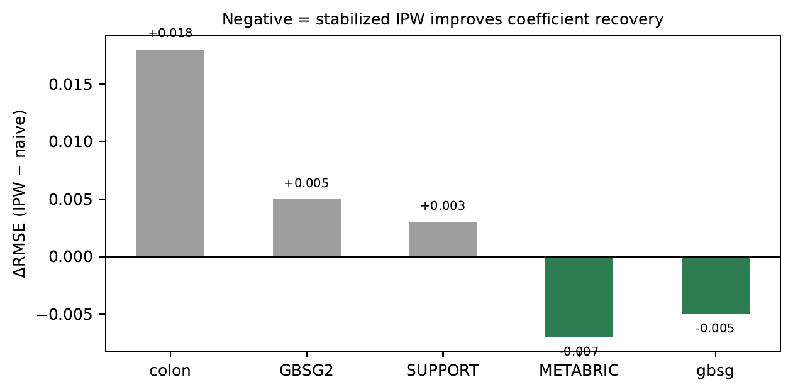
RESULTS · HONESTY
Where IPW helps — and where it does not
Bias–variance, shown not hidden
Coefficient recovery improves on METABRIC & gbsg, worsens where overlap is weak.
This is the IPW bias–variance signature — not a defect. Uncapped weights on SUPPORT reach ≈27, collapsing ESS.
Weight diagnostics (ESS, overlap) are reported as primary results.
SBASURV — Selection-Bias-Aware Multimodal Survival Learning
10
Notes:
I want to be candid here, because a defense should pre-empt the obvious challenge. IPW is not free. On coefficient recovery, stabilized IPW helps where overlap is good — METABRIC and gbsg — and hurts where overlap is weak. This is the textbook bias–variance signature of inverse-probability weighting, not a flaw in my method. On SUPPORT, uncapped weights reach about 27, which collapses effective sample size — exactly the regime my Theorem 2 and weight clipping address. I treat weight diagnostics as primary results, not as something to bury. Reporting where a method fails is how I earn trust in where it succeeds.

Slide 12
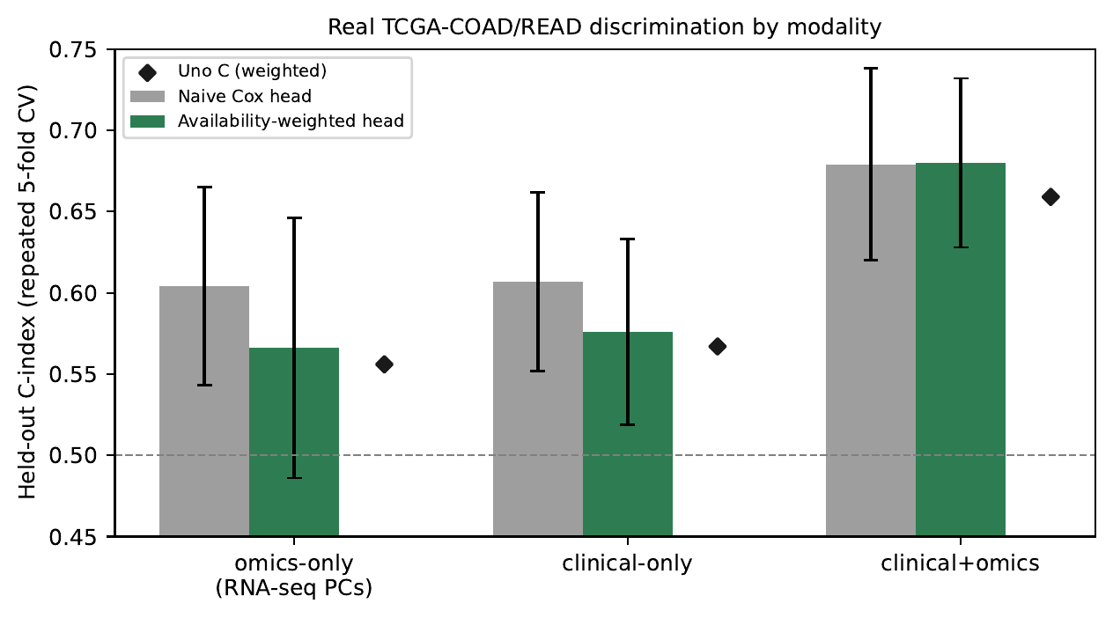
RESULTS · REAL DEPLOYMENT
Real TCGA colorectal cancer: estimand shifts, discrimination holds
0.68
Harrell C
clinical+omics fusion
96%
effective sample size
(weights well-conditioned)
0.679→0.680
discrimination under
real availability weighting
SBASURV — Selection-Bias-Aware Multimodal Survival Learning
11
Notes:
Now the real deployment — 633 TCGA colorectal-cancer cases, three genuine modalities. Clinical-plus-omics fusion reaches a Harrell C of 0.68. The real availability weights are well-conditioned: effective sample size 96 percent. And here's the key behavior: weighting moves the fitted coefficients — it shifts the estimand toward the population — while discrimination barely changes, 0.679 to 0.680. That is exactly correct for a population-targeting method. Concordance is not the metric IPW is designed to move; the estimand is.

Slide 13
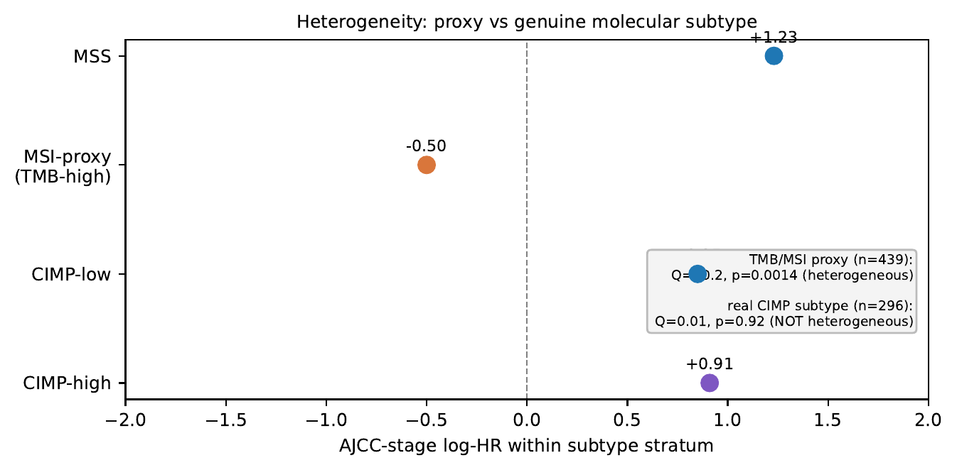
KEY SCIENTIFIC FINDING
Proxy subtype ≠ genuine subtype
TMB/MSI proxy
Q = 10.2, p = 0.001
significant heterogeneity
Genuine CIMP (methylation)
Q = 0.01, p = 0.92
NOT heterogeneous — the proxy finding does not replicate.
SBASURV — Selection-Bias-Aware Multimodal Survival Learning
12
Notes:
This is the scientific payoff, and the part I'm most keen to defend. I asked a question central to molecular pathological epidemiology: does the stage effect differ across molecular subtypes? Using a convenient tumor-mutation-burden / MSI proxy, I get a strongly significant heterogeneity — Q of 10.2, p of 0.001. But when I replace the proxy with a genuine methylation-defined CIMP subtype, the heterogeneity vanishes — Q of 0.01, p of 0.92. The proxy finding does not replicate. The lesson: a built-in heterogeneity test is as valuable for the nulls it returns as for the signals, and subtype conclusions must rest on assay-grounded definitions, not surrogates entangled with stage and outcome.

Slide 14
SCOPE & THREATS TO VALIDITY
What I claim — and what I do not
Identification
Consistency rests on MAR availability + positivity + a correct propensity model. Unmeasured selection (specimen handling, referral) is not removed by weighting on observed covariates.
Statistical power
TCGA cohorts are modest (122 / 69 events). The three-modality table is read for relative ordering within a common cohort, not absolute performance.
Measurement
Phikon pathology features are mean-pooled (label-blind) — a conservative lower bound. The MSI proxy is a surrogate, which §heterogeneity explicitly shows can mislead.
External validity
All real results are within TCGA. Prospective, multi-institution, non-Western validation per TRIPOD+AI is required before any clinical reading. This is a research instrument, not a clinical tool.
SBASURV — Selection-Bias-Aware Multimodal Survival Learning
13
Notes:
A defensible thesis states its own limits before the committee does. Four. Identification: my consistency depends on missing-at-random availability and a correct propensity model — unmeasured selection is not fixed by weighting on observed covariates, and I say so. Power: the cohorts are modest, so I read the three-modality results for relative ordering, not absolute claims. Measurement: my pathology features are deliberately label-blind mean-pooling, a conservative lower bound, and my MSI proxy is exactly the kind of surrogate I show can mislead. External validity: everything real is within TCGA — prospective multi-institution validation is required, and I frame this explicitly as a research instrument, not a clinical tool.

Slide 15
ANTICIPATED QUESTIONS
Defending the contribution
"Discrimination barely moves — so does weighting help?"
Defense: Concordance is not the target. IPW shifts the estimand toward the population; the coefficient shift ‖Δβ‖ is the evidence, and weight diagnostics — not C-index — are the yardstick.
"The real gains are small and cohorts underpowered."
Defense: The contribution is a principled, differentiable mechanism, proven on five benchmarks with oracle ground truth. The real deployment is reported conservatively, with caveats and external validation flagged.
"Mean-pooled pathology is weak — why not attention-MIL?"
Defense: Deliberately. Label-blind pooling is a reproducible lower bound; a trained MIL aggregator would risk overfitting at 69 events. I report the conservative result, and name MIL as the natural extension.
Notes:
Let me pre-empt the three questions I expect. One: does weighting help if discrimination barely moves? Concordance is simply not what IPW targets — the coefficient shift is the evidence, and diagnostics are the yardstick. Two: small gains, underpowered? The contribution is a proven mechanism validated against oracle ground truth on five benchmarks; the real deployment is reported with full caveats. Three: why mean-pooled pathology instead of attention-MIL? Deliberately — it's a reproducible lower bound, and trained MIL would overfit at 69 events. I name it as the natural extension. I'm happy to go deeper on any of these.

Slide 16
CONCLUSION
Availability belongs inside the model
A stabilized-IPW Cox objective + a differentiable etiologic-heterogeneity head — architecture-agnostic, theoretically grounded.
Validated on five public datasets and deployed end-to-end on real TCGA colorectal cancer across clinical, omics, and pathology.
Reported conservatively: the estimand moves while discrimination holds; heterogeneity is significant on a proxy yet null on a genuine subtype.
Population estimands, weight diagnostics, and assay-grounded subtype testing belong inside multimodal survival models — not bolted on.
Thank you. I welcome the committee's questions.
Notes:
To conclude. SBASURV makes sample availability a trainable part of survival learning: a stabilized-IPW Cox objective and a differentiable heterogeneity head, both architecture-agnostic and theoretically grounded. I validated the mechanism on five public datasets and deployed it end-to-end on real colorectal cancer across three modalities. I reported it conservatively — the estimand moves while discrimination holds, and my heterogeneity test is honest about proxy versus genuine subtypes. The thesis is that population estimands, weight diagnostics, and assay-grounded subtype testing belong inside multimodal survival models, not bolted on afterward. Thank you — I welcome your questions.

