Slide 1
Additional information
Enhanced extracellular invertase production in Bacillus subtilis by boosting synthesis and secretion in a suitable chassis cell
Dongbang Yao^{1,2,3}, Yuanyuan Chen^{1,2,3}, Longwei Que^{1,2,3}, Jiaru Qi¹, Fangmin Gu¹, Wei Fang^{1,2,3}, Zemin Fang^{1,2,3}, Juanjuan Liu^{1,2,3*}, Yazhong Xiao^{1,2,3*}
*Correspondence: Juanjuan Liu (liu_juan825@ahu.edu.cn); Yazhong Xiao (yzxiao@ahu.edu.cn)
¹ School of Life Sciences and Medical Engineering, Anhui University, Hefei, 230601, China.
² Anhui Key Laboratory of Biocatalysis and Modern Biomanufacturing, Hefei, 230601, China.
³ Anhui Provincial Engineering Technology Research Center of Microorganisms and Biocatalysis, Hefei, 230601, China.

Slide 2
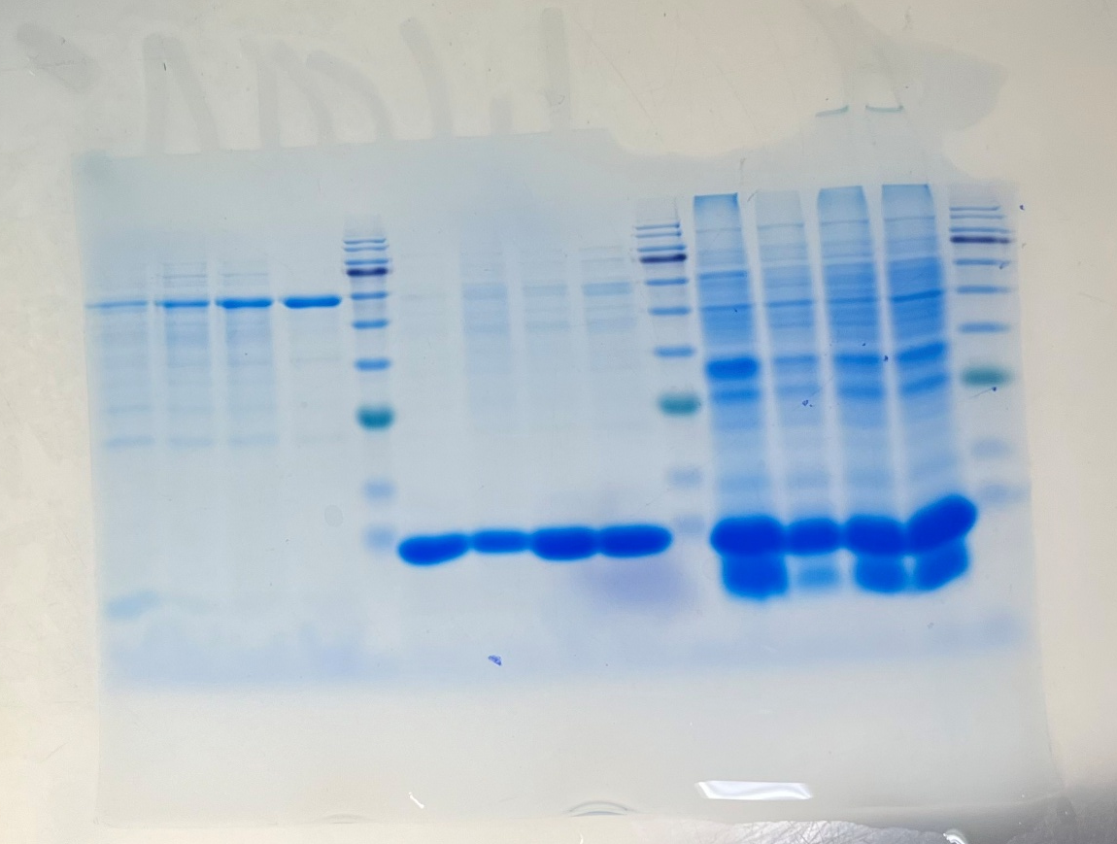
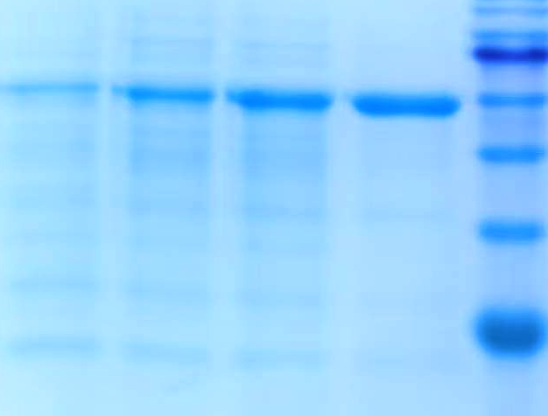
1 2 3 4 M
kDa
1 2 3 4 M
140
100
75
60
45
35
25
Fig. 6D SDS-PAGE analysis of fermentation supernatant from various strains
The red arrow indicates the theoretical band position of the recombinant InvDz13 (~58.2 kDa).
Fig. S1 The original gel image of Fig. 6D

Slide 3
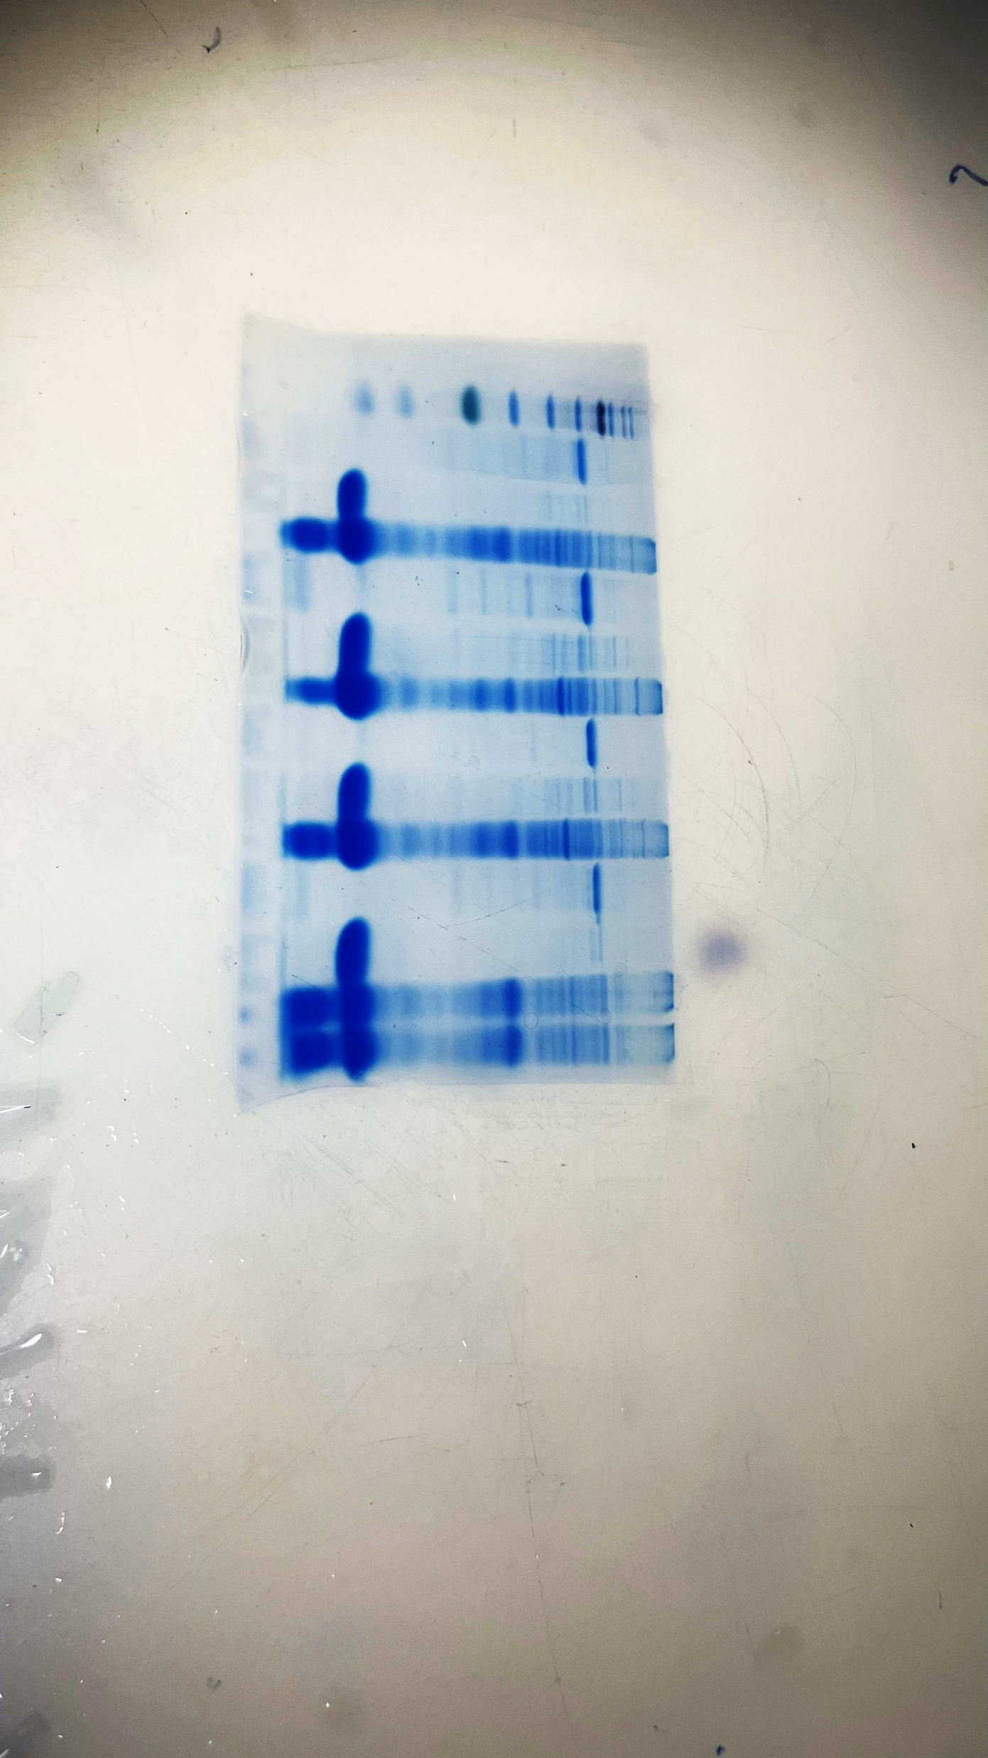
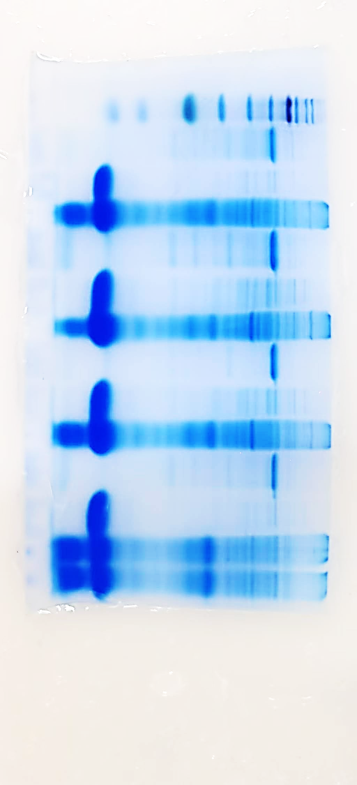
kDa M 1 2 3 4 5 6 7 8 9 10 11 12
140
100
M 1 2 3 4 5 6 7 8 9 10 11 12
75
60
45
35
25
Fig. 7C SDS-PAGE analysis of shake-flask culture of strains producing InvDz13
Lanes 1, 4, 7, and 10: the fermentation supernatants of WBSS142I4, WBSS142I4PA, WBSS142I4ST, and WBSS142I4TA, respectively; Lanes 2, 5, 8, and 11: the cell disruption supernatants of WBSS142I4, WBSS142I4PA, WBSS142I4ST, and WBSS142I4TA, respectively; Lanes 3, 6, 9, and 12: the cell disruption precipitates of WBSS142I4, WBSS142I4PA, WBSS142I4ST, and WBSS142I4TA, respectively. The red arrow indicates the theoretical band position of the recombinant InvDz13 (~58.2 kDa).
Fig. S2 The original gel image of Fig. 7C

Slide 4
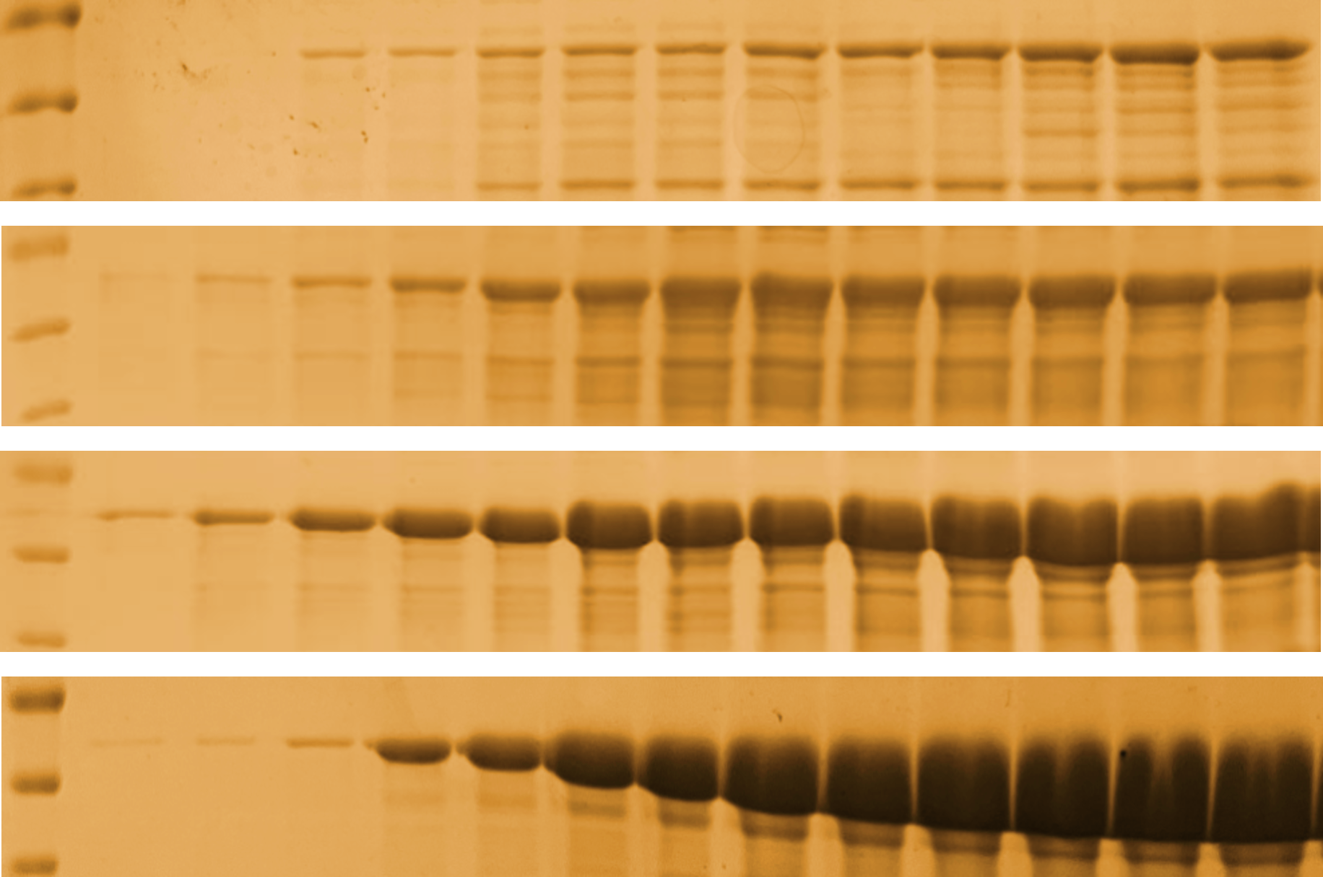
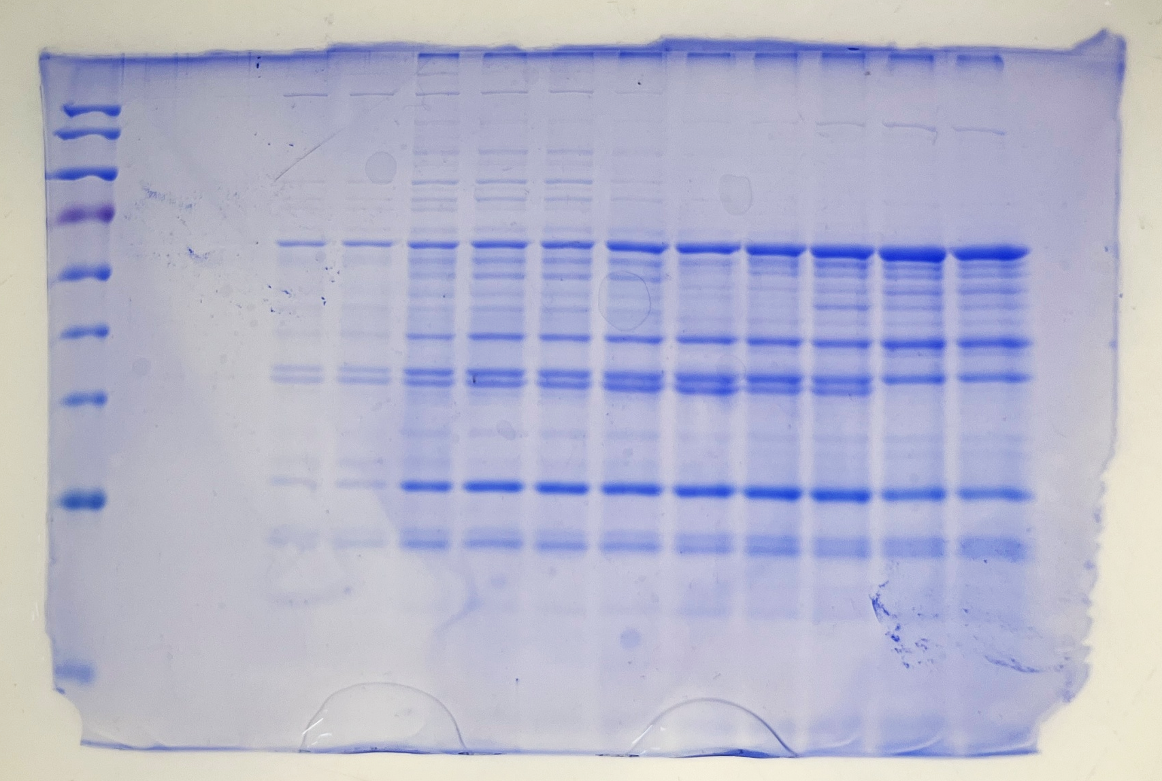
kDa M 1 2 3 4 5 6 7 8 9 10 11 12 13
75
M 1 2 3 4 5 6 7 8 9 10 11 12 13
WBVYI
55
A
43
75
WBSS142I
55
43
75
WBSS142I4
55
43
75
WBSS142I4PA
55
43
Fig. S3 The original gel image of WBVYI in Fig. 8B
Fig. 8B SDS-PAGE analysis of fermentation supernatant from various strains
The red arrow indicates the theoretical band position of the recombinant InvDz13 (~58.2 kDa).

Slide 5
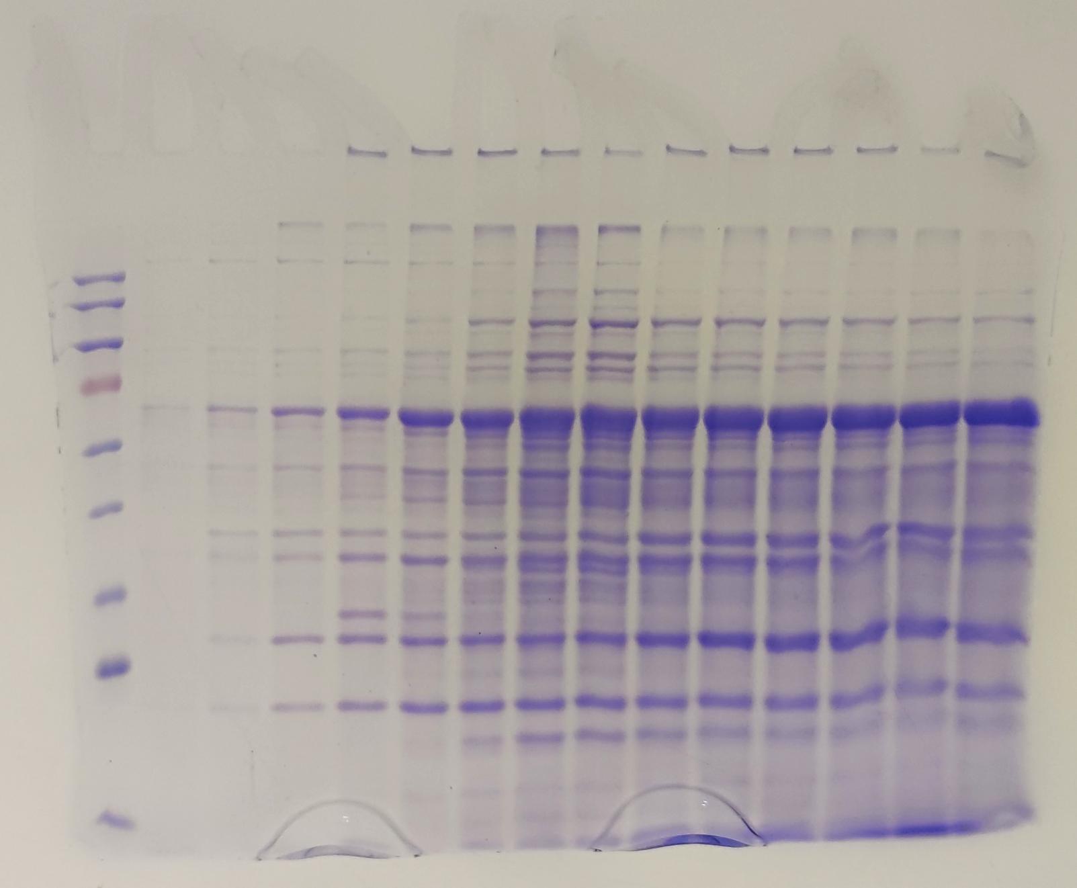
kDa M 1 2 3 4 5 6 7 8 9 10 11 12 13
75
WBVYI
55
M 1 2 3 4 5 6 7 8 9 10 11 12 13
A
43
75
WBSS142I
55
43
75
WBSS142I4
55
43
75
WBSS142I4PA
55
43
Fig. S4 The original gel image of WBSS142I in Fig. 8B
Fig. 8B SDS-PAGE analysis of fermentation supernatant from various strains
The red arrow indicates the theoretical band position of the recombinant InvDz13 (~58.2 kDa).

Slide 6
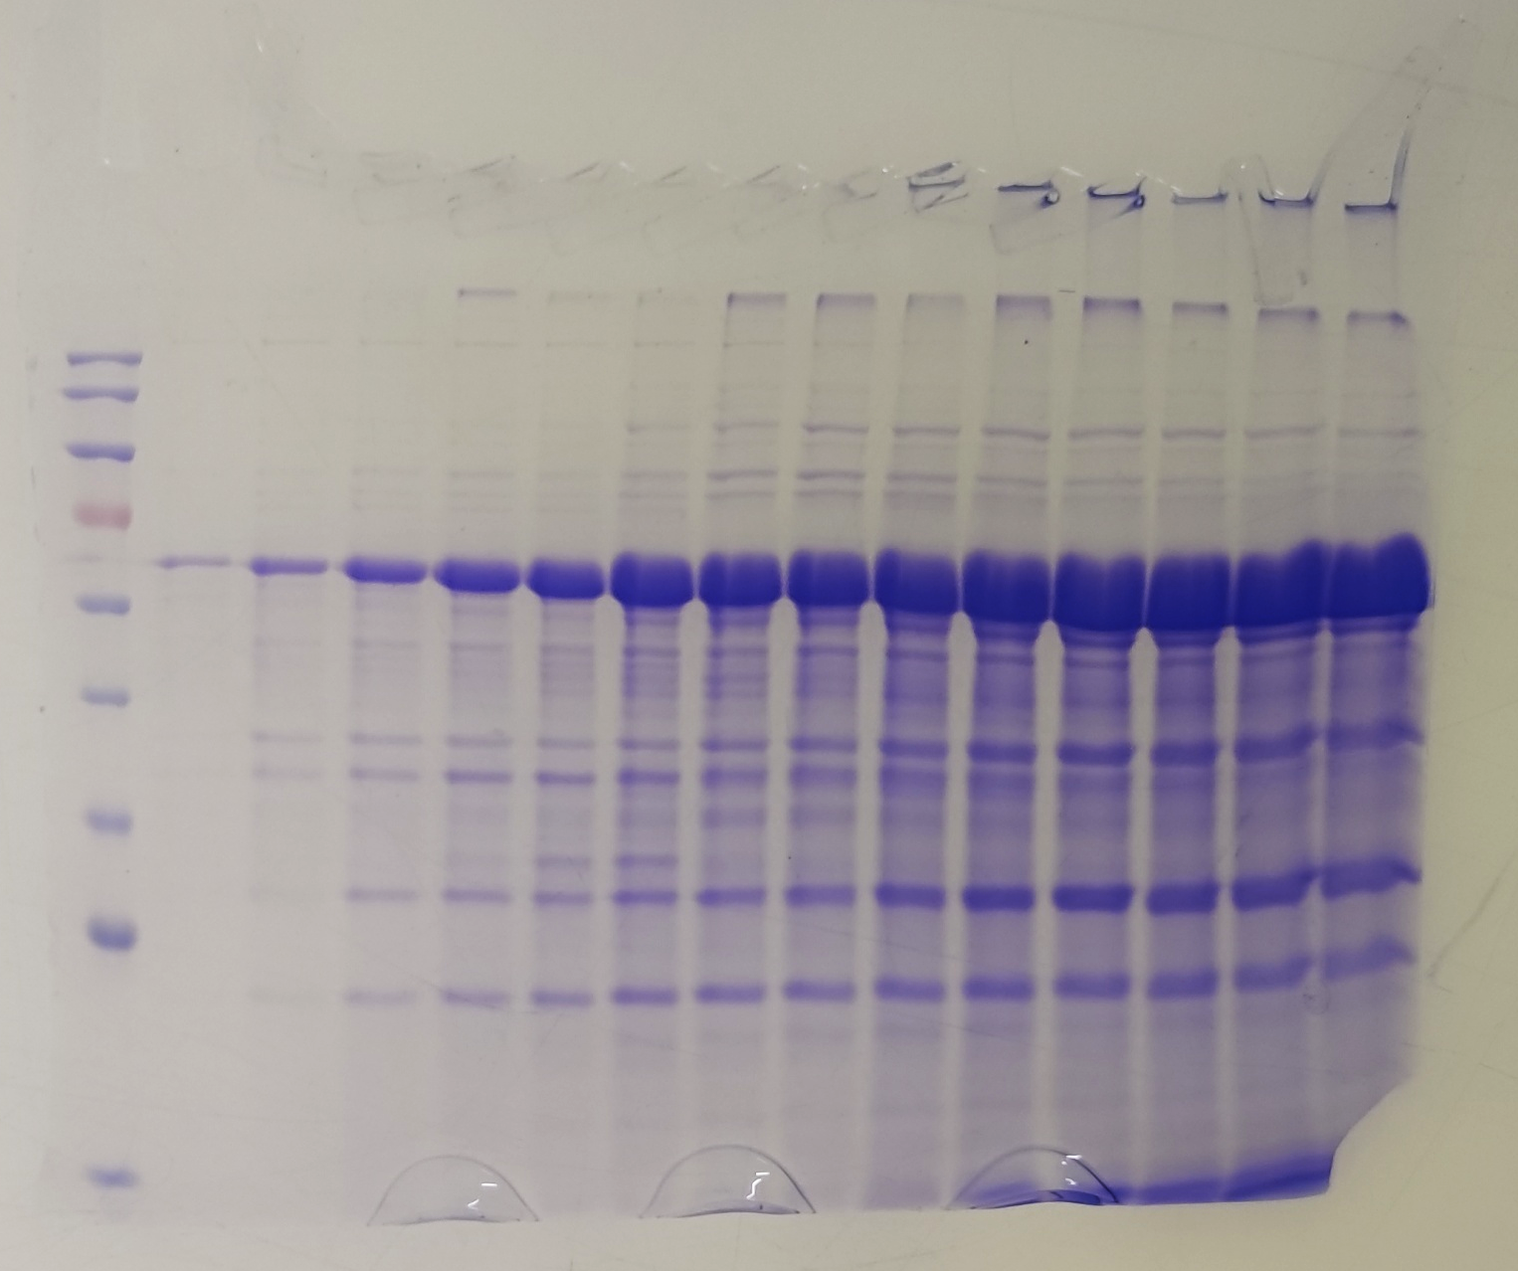
kDa M 1 2 3 4 5 6 7 8 9 10 11 12 13
75
WBVYI
55
M 1 2 3 4 5 6 7 8 9 10 11 12 13
A
43
75
WBSS142I
55
43
75
WBSS142I4
55
43
75
WBSS142I4PA
55
43
Fig. S5 The original gel image of WBSS142I4 in Fig. 8B
Fig. 8B SDS-PAGE analysis of fermentation supernatant from various strains
The red arrow indicates the theoretical band position of the recombinant InvDz13 (~58.2 kDa).

Slide 7
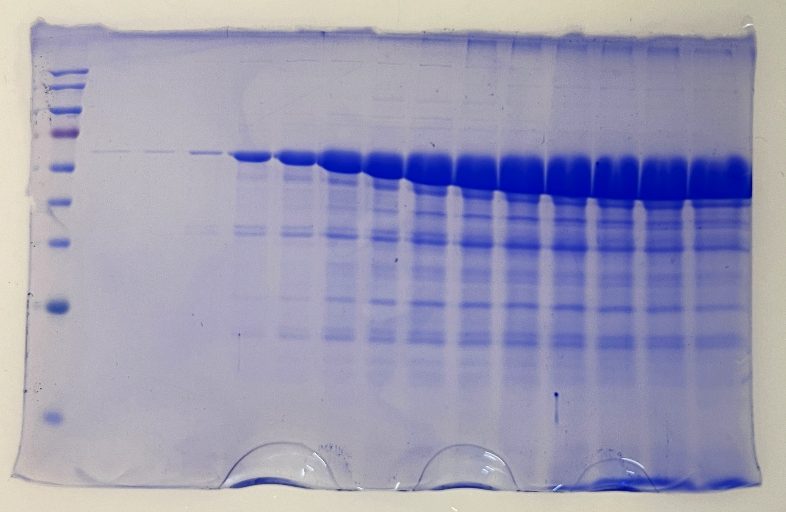
kDa M 1 2 3 4 5 6 7 8 9 10 11 12 13
75
M 1 2 3 4 5 6 7 8 9 10 11 12 13
WBVYI
55
A
43
75
WBSS142I
55
43
75
WBSS142I4
55
43
75
WBSS142I4PA
55
43
Fig. S6 The original gel image of WBSS142I4PA in Fig. 8B
Fig. 8B SDS-PAGE analysis of fermentation supernatant from various strains
The red arrow indicates the theoretical band position of the recombinant InvDz13 (~58.2 kDa).

